Slide 1
PROJECT-AJAJ
AN SIMPLE OS

Slide 2
Ajaj-os
Operating system

Slide 3
MADE BY
AADISANKAR NS
AIDEN S PRASHANTH
JOVAN SAJAN
JOHANN JINTO

Slide 4
COMMANDS:
COMMAND | MEANING
clr | Clear the screen
abt | About makers
greenmode | Change color to green
redmode | Change color to red
whitemode | Change color to white
sd | shutdown
rs | retsart
intext | Print the input

Slide 5
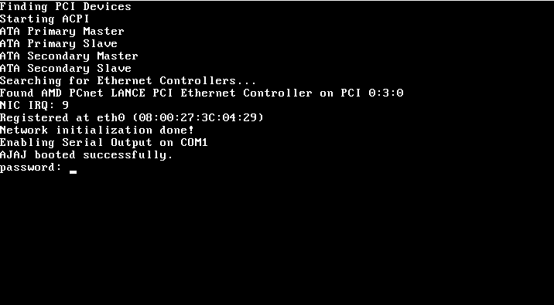
interface

