Slide 1

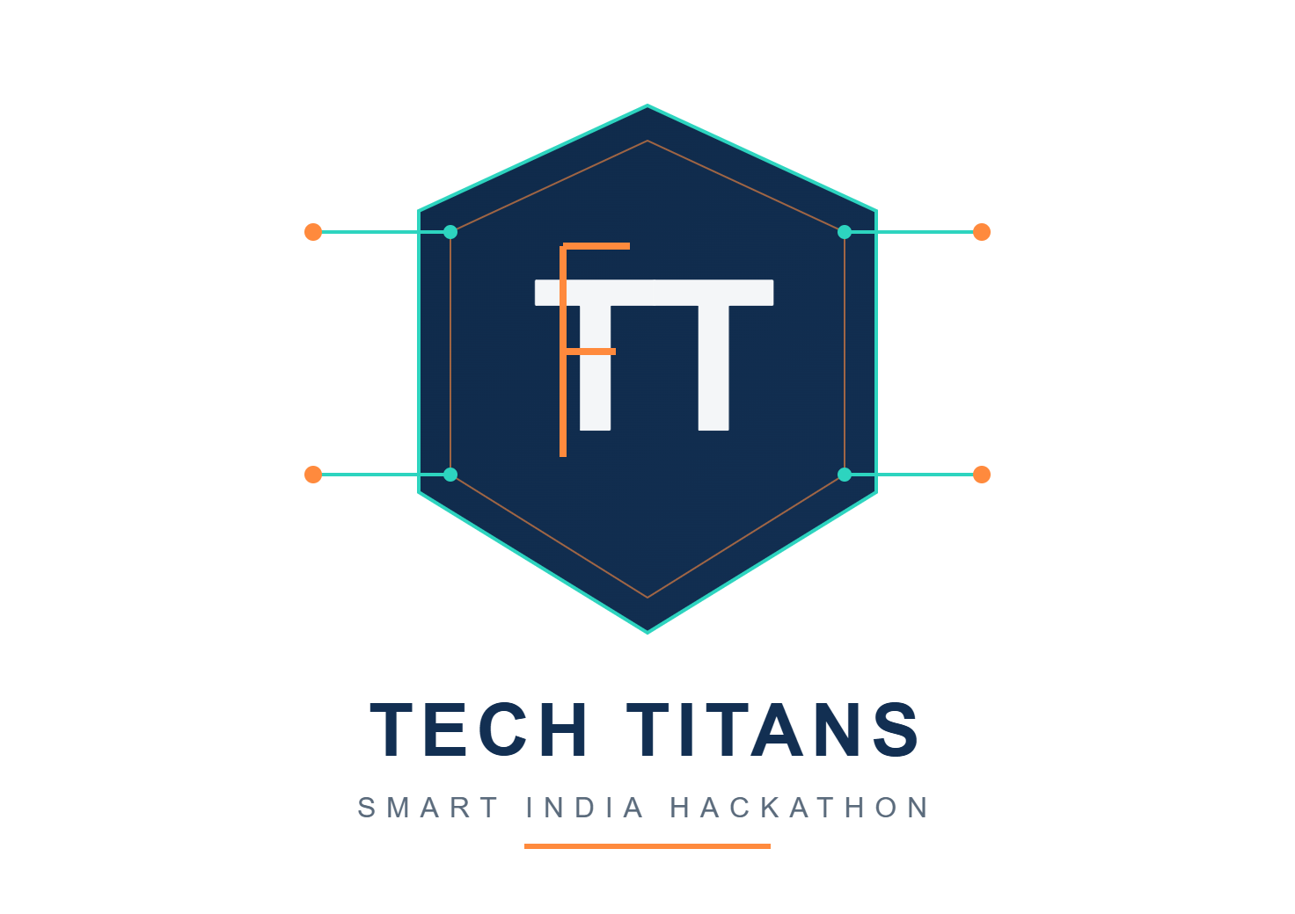

SMART INDIA HACKATHON 2026
DRIFT- Don’t wander, Arrive!
Problem Statement ID - 26044
Problem Statement Title - Portal for Academia : Industry Collaboration
Theme - Smart education
Team ID: SIH26-A0H-T135
PS Category - Software
Team Name - Tech Titans

Slide 2
Drift - "One platform. Every student's next step."
PROPOSED SOLUTION
Problem at hand
Key Features
•Information Overload: Students struggle to find the right resources, courses and opportunities.
•Lack of Guidance: No personalized roadmap for learning and skill development.
• Disconnected Opportunities: Internships, hackathons and collaborations are scattered.
• Untracked Progress: Students can't easily track their learning.
Track and Grow
Built for students
Drift - The ultimate solution!!!
•Personalized Roadmaps: AI-based learning paths customized to goals.
•Curated Resources: Courses, articles, videos and practice sets.
• Opportunities Hub: Internships, hackathons and events in one place.
• Progress Tracking: Track skills, achievements and certificates.
• Community Connect: Connect with peers, mentors and experts.
All in one
Stay ahead
Smart and personalized
Location enabled chances

Slide 3
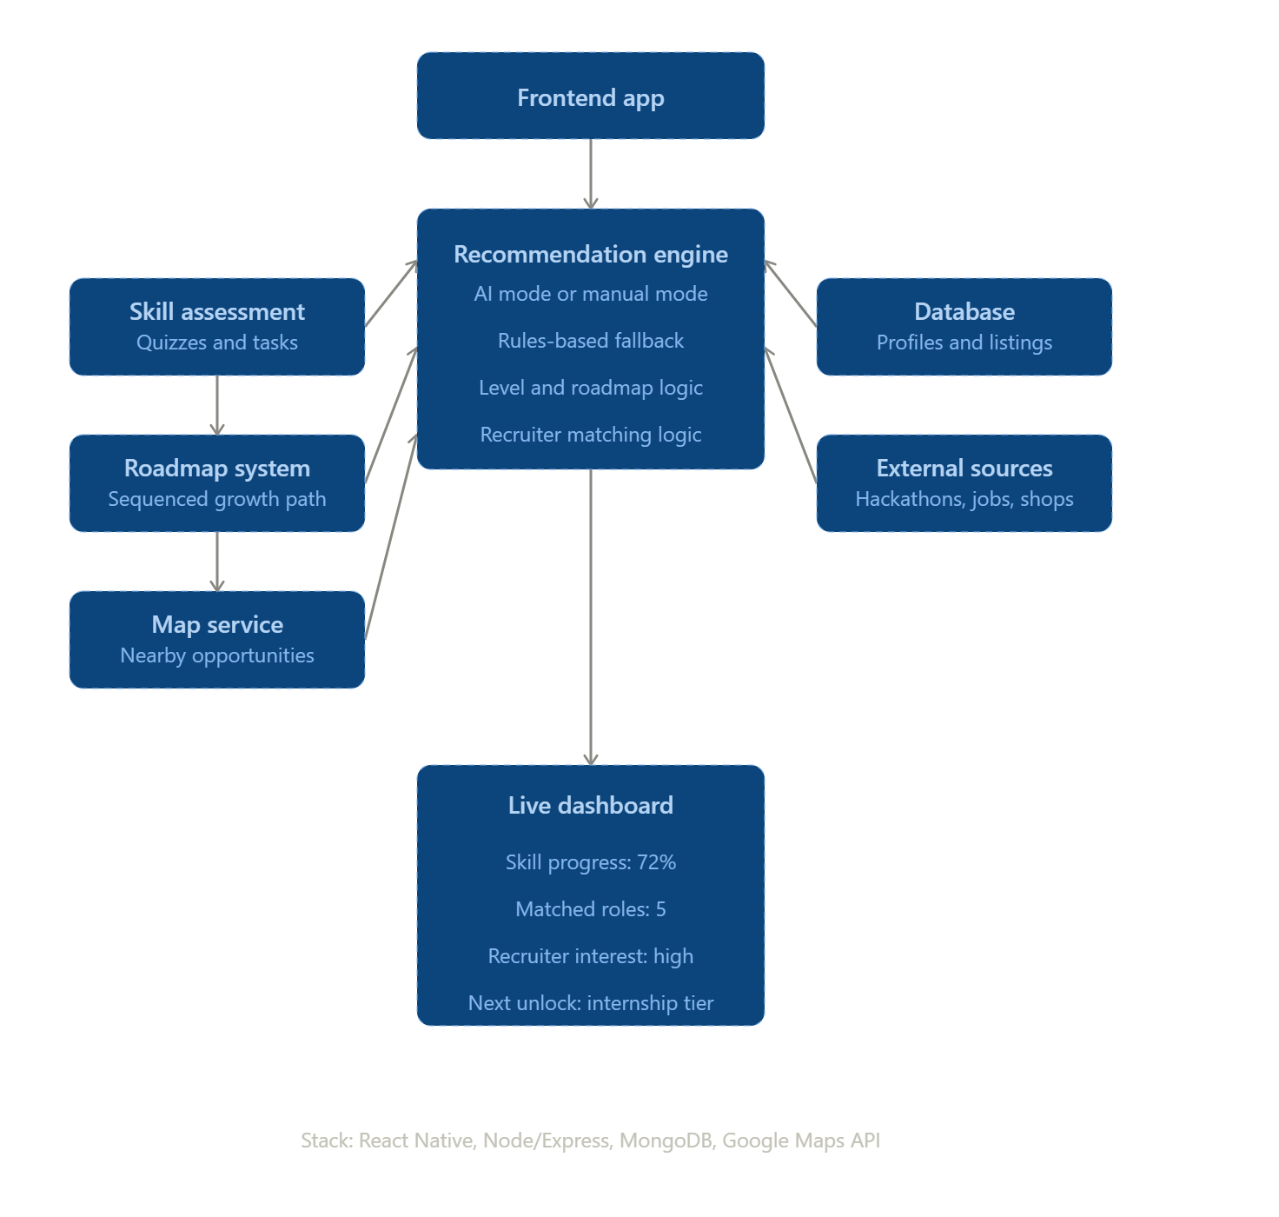
TECHNICAL APPROACH

Slide 4
FEASIBILITY AND VIABILITY
Feasibility
Viability
Challenges
Frontend: HTML, CSS, JavaScript / React
Backend: Python + Flask/Fast API
Database: MySQL / PostgreSQL
AI/ML: Skill-gap analysis & student–opportunity matching
Maps: Google Maps / OpenStreetMap API for location-based opportunities
Students: Find relevant internships, training and placement opportunities in one platform.
Recruiters: Discover candidates based on skills, interests and location .
Institutions: Track student skills, internships and placement progress.
Academicians: Connect students with industry projects, mentors and training.
Scalable: Can expand from individual institutions to universities and industries across India.
High Impact: Bridges the gap between education, skills, internships and employment.
Skill–Opportunity Mismatch
Data Accuracy
User verification
Matching Accuracy
Privacy & Security
Location Integration
User Adoption

Slide 5
IMPACT AND BENEFITS
IMPACT
BENEFITS
Social — skill matters more than who you know
Economic — local shops get help, students get real experience
Educational — career prep feels like a game, not homework
Efficiency — recruiters stop wasting time on mismatched resumes
Students get a roadmap instead of random list
Easier for both students and recruiters
Combines multiple needs in one
Helps in focusing on growth of skills than the search for ”perfect” opportunity.

Slide 6

RESEARCH AND REFERENCES
https://www.ayush.gov.in/
https://www.linkedin.com/jobs/
https://internship.aicte-india.org/
https://internshala.com/
https://maps.google.com/
https://devfolio.co/

