Slide 1
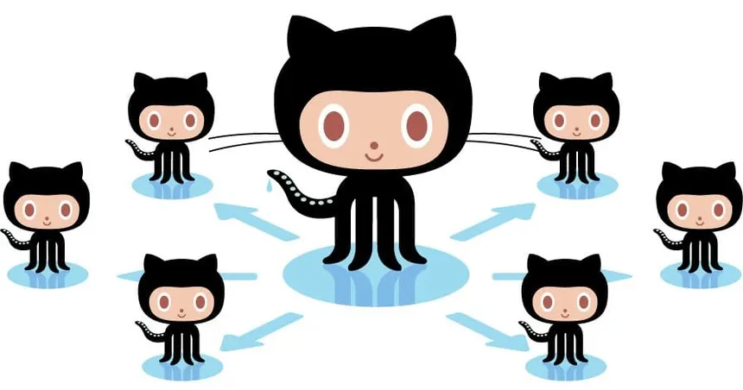
GitHub & Rstudio workshop
Jaclyn Aubin
March 19, 2026

Slide 2
Pre-workshop assignments
Update RStudio
Create a GitHub account
Send me your GitHub username and email
Download Git to your computer

Slide 3
Goals of this workshop
Gain familiarity with GitHub and its R Studio interface
Get comfortable using GitHub for version control
Set yourself up for success by updating your R code to GitHub often

Slide 4
Definitions
Git: version control software
GitHub: a website that hosts Git repositories
Repository: a folder on Github that stores all files and code for a project, along with the complete history of all changes
Committing: saving your (annotated) edits locally
Pushing: saving your edits to GitHub
Pulling: downloading the latest version of a repo from GitHub

Slide 5
Why use GitHub?
Keeps your code safely backed up
Allows for version control (a time machine for your code)
Allows for simultaneous collaborative coding
The gold standard for sharing and publishing code
Git is open source and GitHub is free for most applications

Slide 6
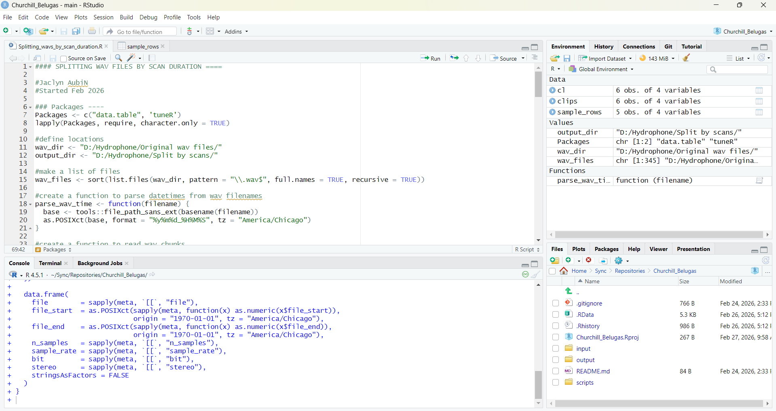
Intro/Refresher to R Studio
Project
Source
Console

Slide 11
Step 1: Link Git to RStudio

Slide 12
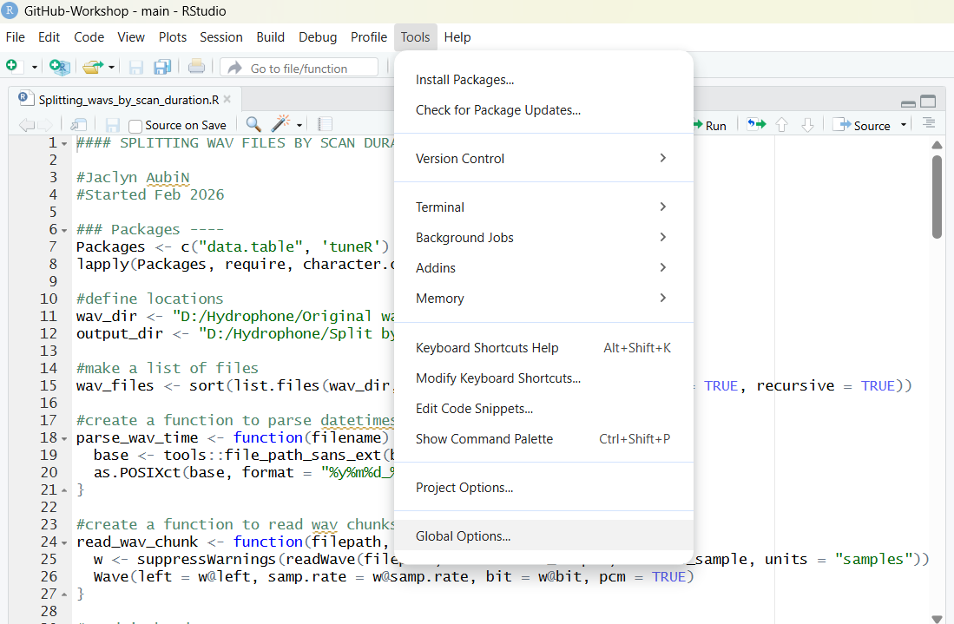

Slide 13
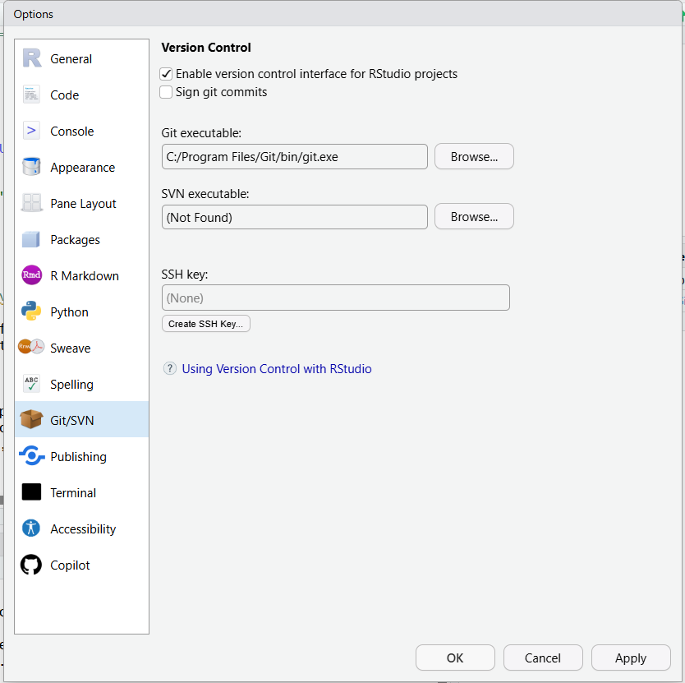
Windows
C:/Program Files/Git/bin/git.exe
Mac
/usr/bin/git

Slide 14
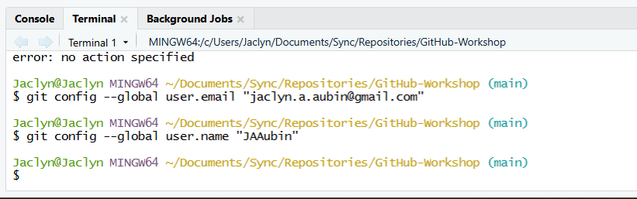
Step 2
Load your credentials into the terminal
git config --global user.email "you@example.com"
git config --global user.name "Your Name"

Slide 15
Step 2: Install gitcreds package in R Studio

Slide 16
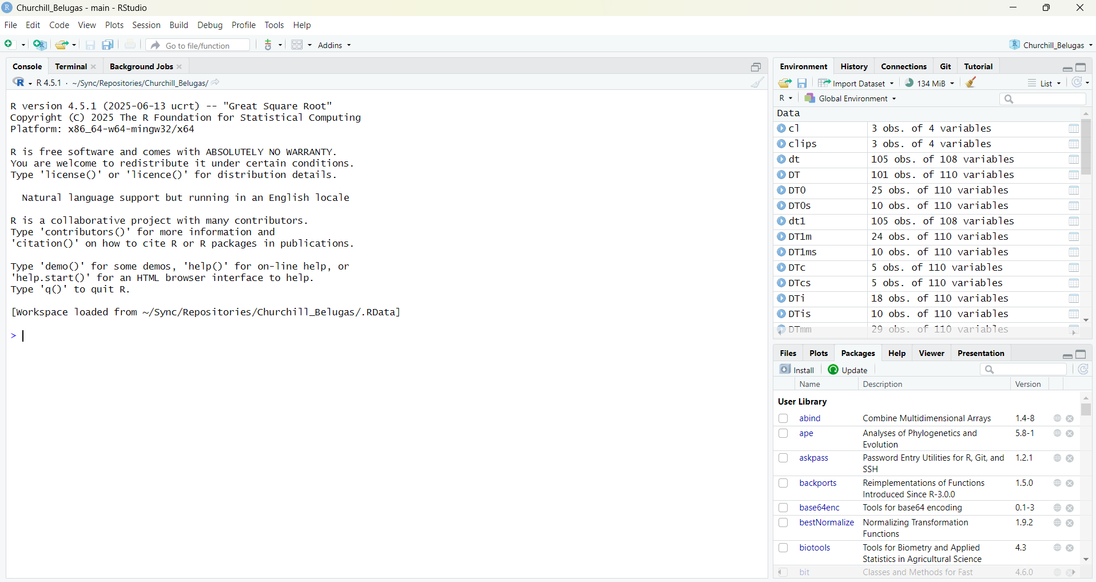

Slide 17
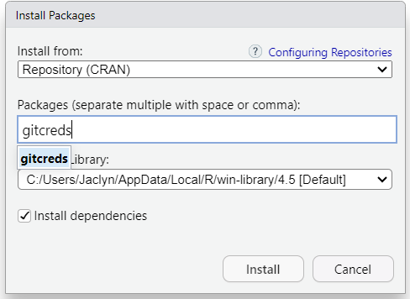

Slide 18
Step 3: Generate a GitHub Personal Access Token

Slide 19
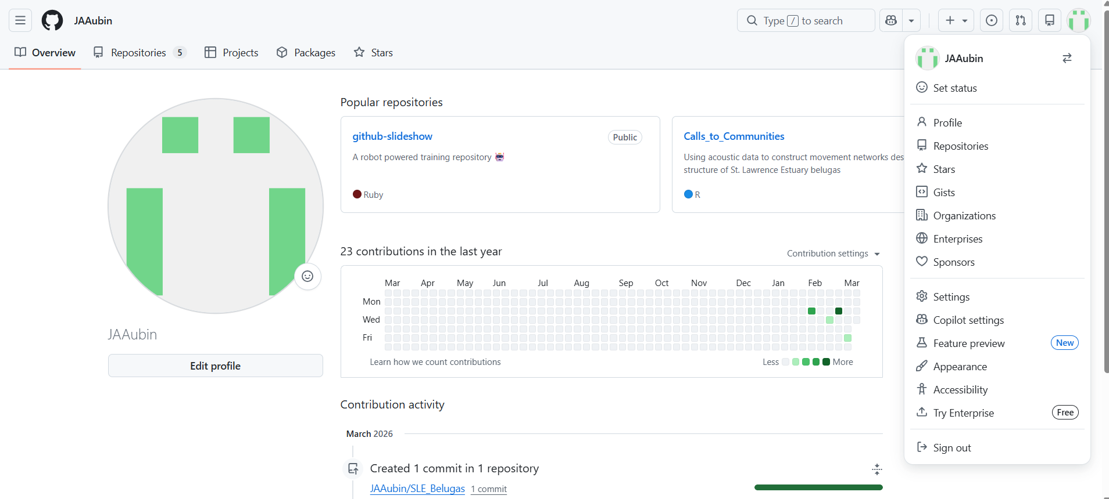

Slide 20
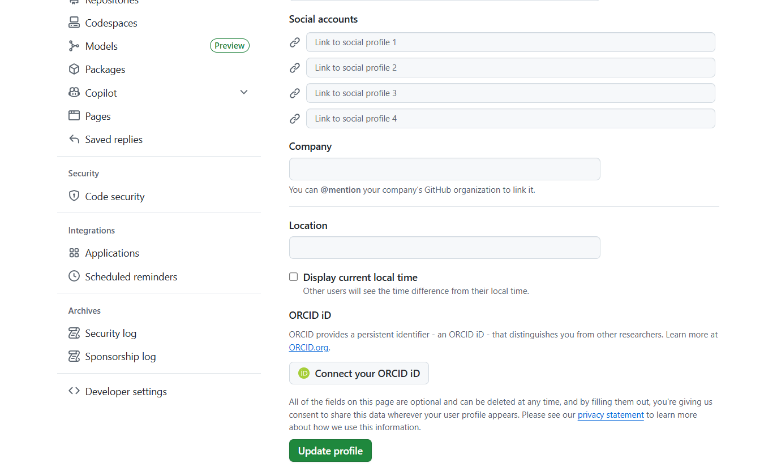
Scroll down

Slide 21
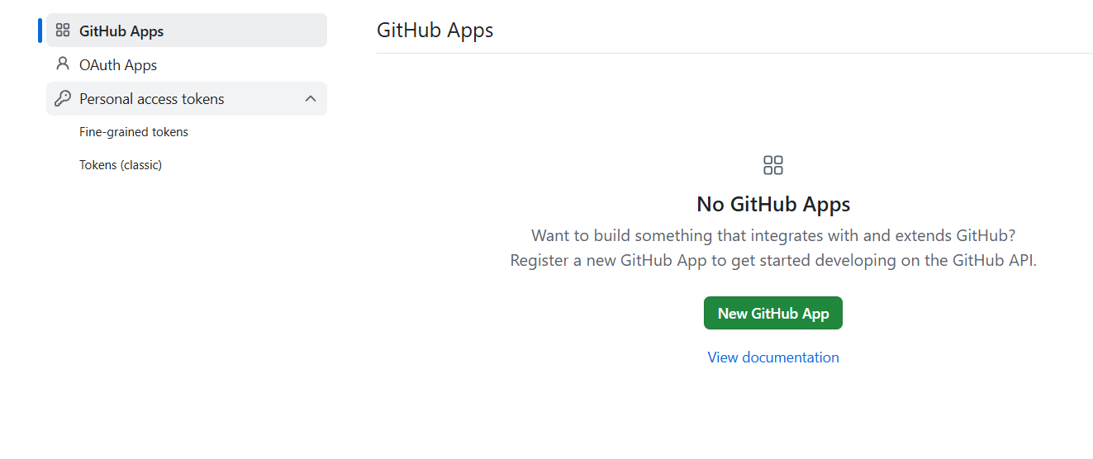

Slide 22
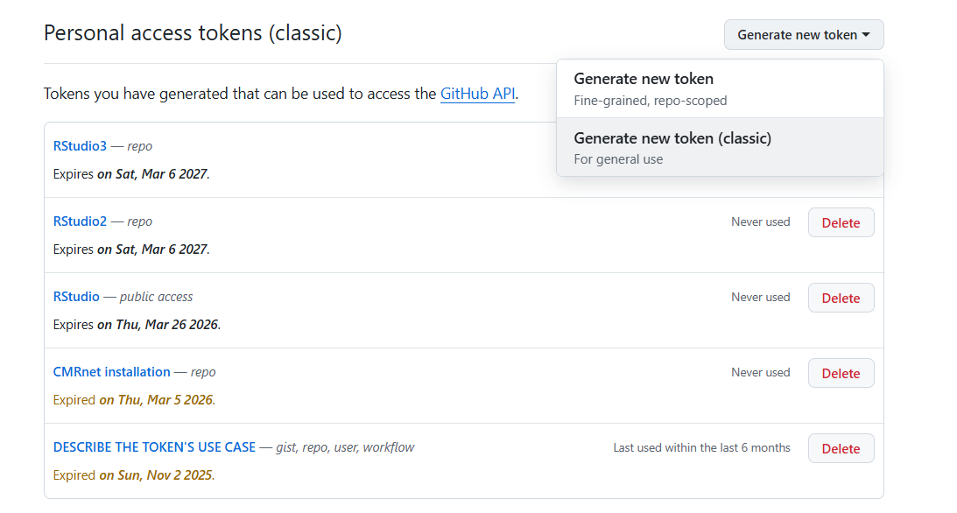

Slide 23
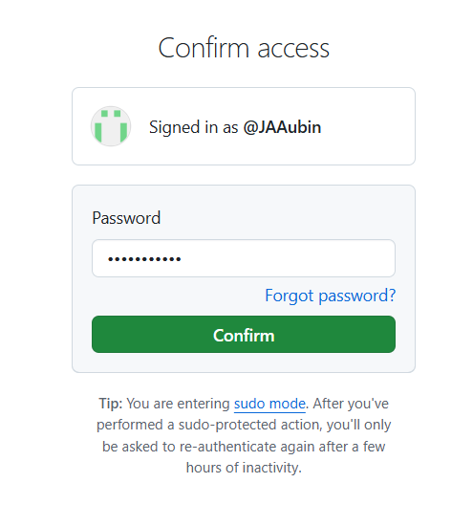

Slide 24
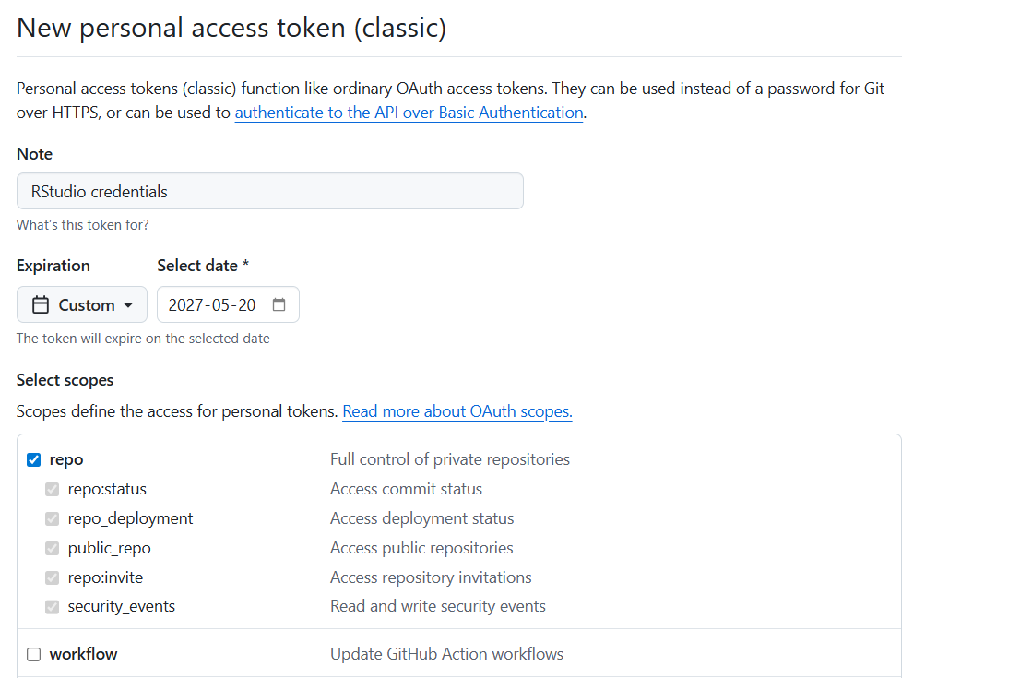

Slide 25
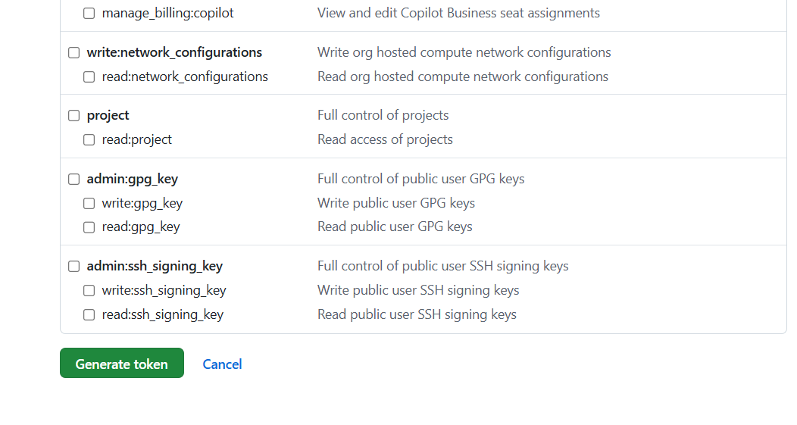
Scroll to bottom

Slide 26
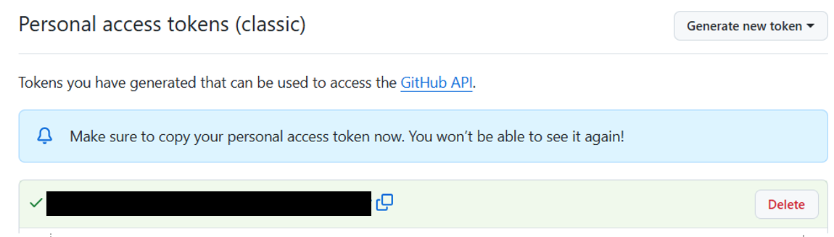

Slide 27
Step 4: Load your token into R Studio using gitcreds_set()

Slide 28
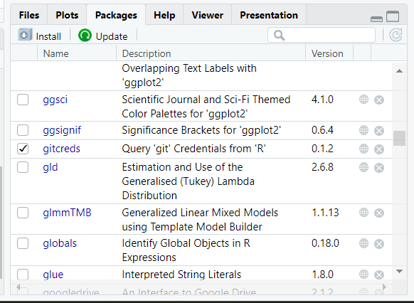

Slide 29
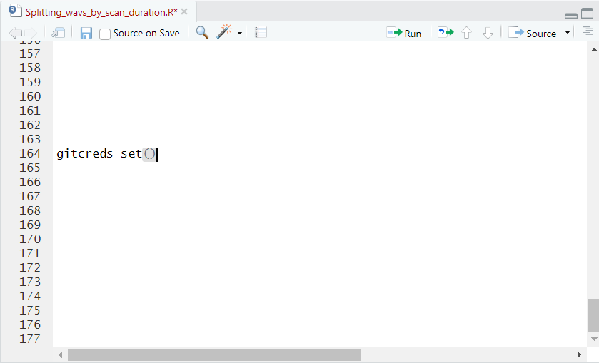

Slide 30
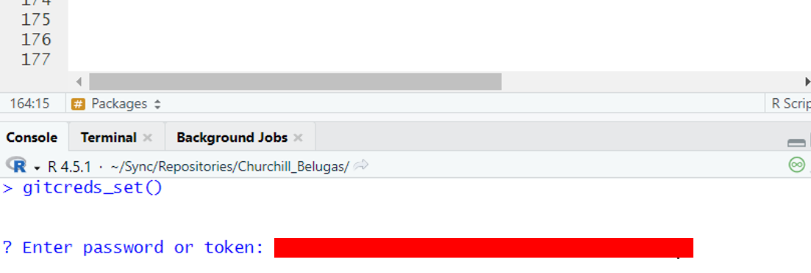

Slide 31
Step 5: Connect to the repo for this workshop

Slide 32
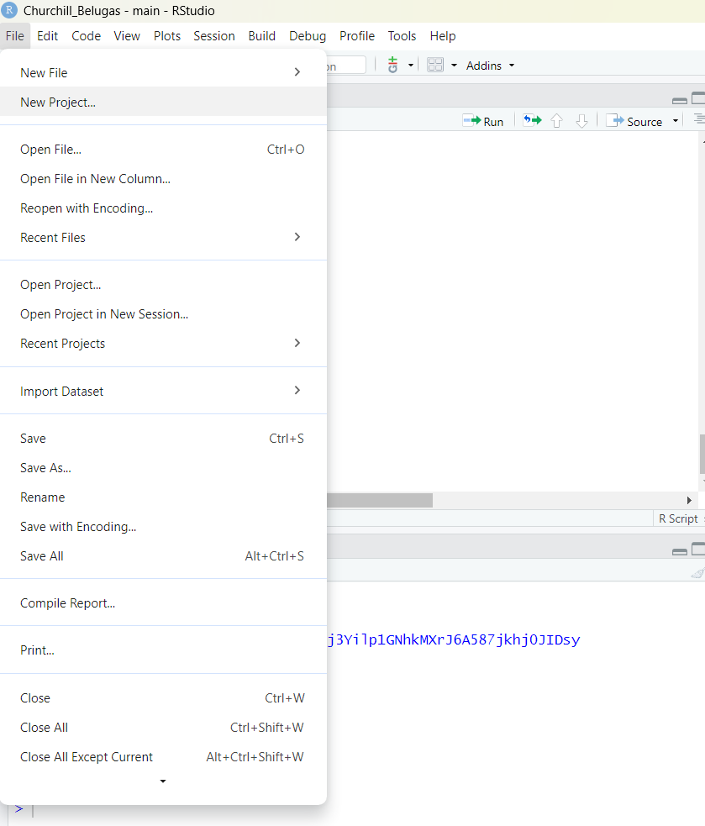

Slide 33
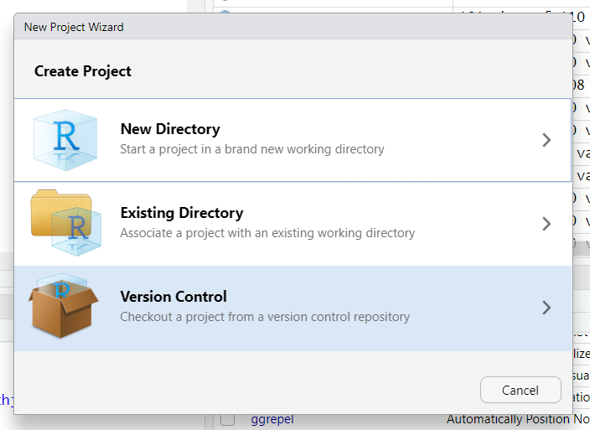

Slide 34
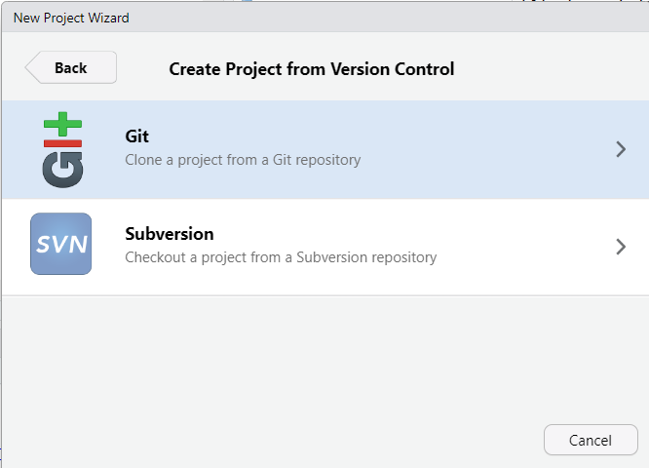

Slide 35
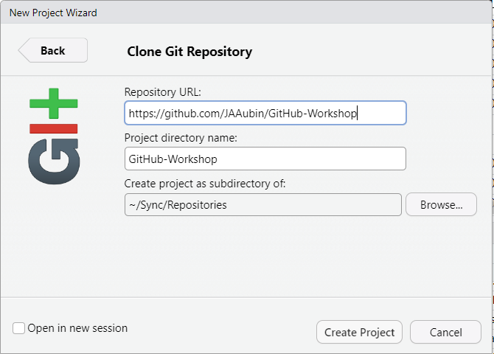
Notes:
https://github.com/JAAubin/GitHub-Workshop

Slide 36
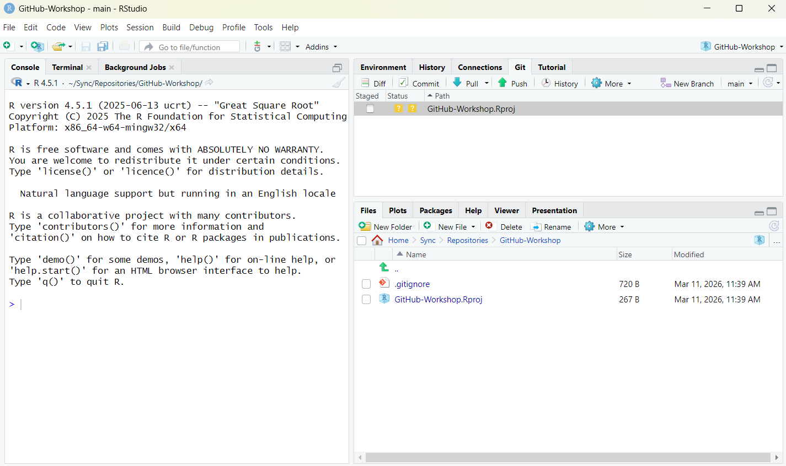

Slide 37
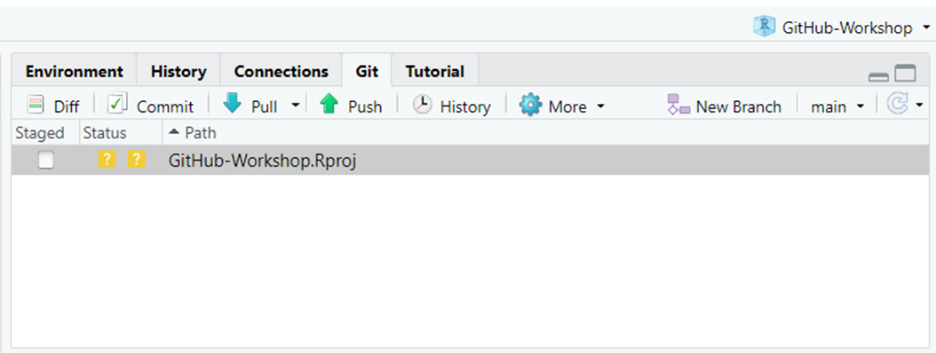
Check out your fancy new git pane!
Notes:
This gives Rstudio permission to directly access your Repositories

Slide 38
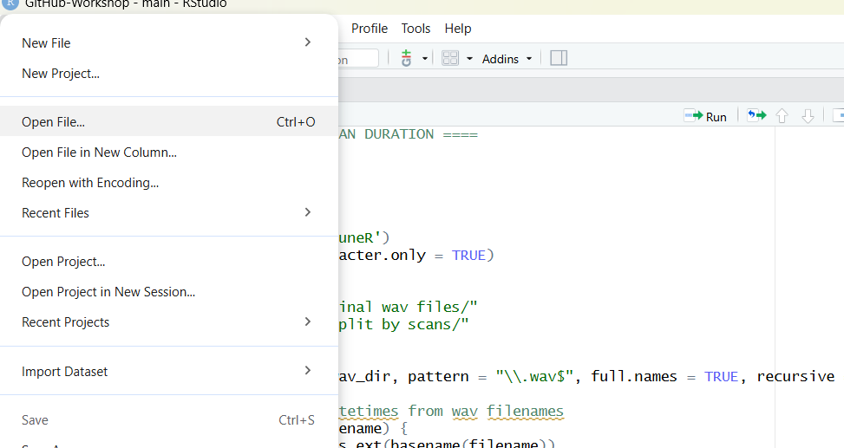

Slide 39
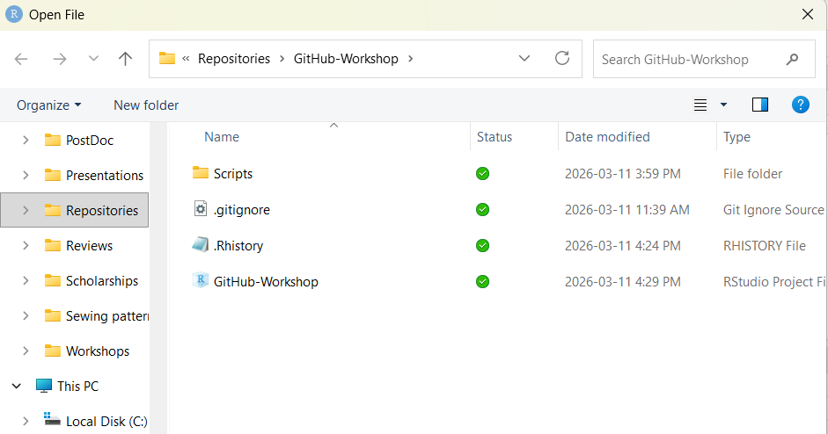

Slide 40
Exquisite Corpse
time for an

