Slide 1



The Art of
Sport Activity Classification
Presenter
Matarmaa Jarno Olavi
Master of Artificial Intelligence

Slide 2

Literature overview
Human Activity Recognition (HAR) is well studied area in recent years, achieving average accuracies of 92 % (Demrozi et al., 2020).
Traditional HAR studies are conducted using inertial sensor data (basically, a set of 3-dimensional (x,y,z) accelerometer sensors)
Amount of activity types varies from 5 to 20, containing sitting down, standing up, laying down, etc., among most common sports.
Classification tasks have been conducted using wide variety of CML and Neural Network models

Slide 3
Study objectives
Providing alternative method for SAC
Classifying sport activities from the extracted sensor features when original sensor data is not available
Investigating the effect on accuracy when using different data structure and data types
Reach a competitive level of accuracy with previous HAR studies
Notes:
Wrong sport labeling is problematic for a several reasons:
Misleading training guidance based on the training history
Distortion in general personal data statistics
Segment leaderboards loses their validity if one can use a bike to get a better place in a running segment

Slide 4
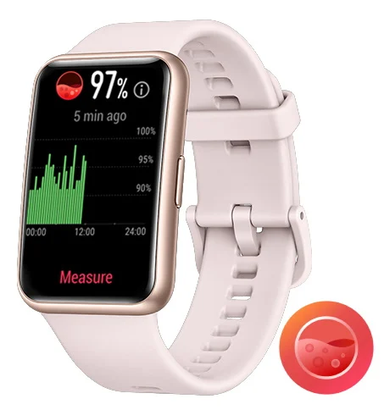
The relevance of the study
The daily usage of activity trackers, sport watches, and other devices to record daily and sport activities has increased tremendously in past ten years
The main reasons are the development of battery technology and small size hardware with a low energy consumption such as LED displays
Human activity recognition has become a common function and is enabled by several device manufacturers

Slide 5
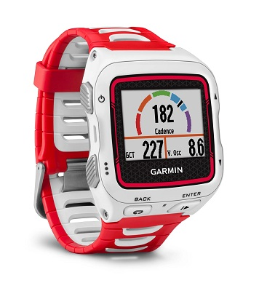
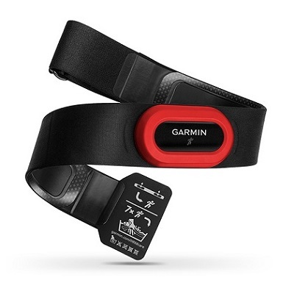
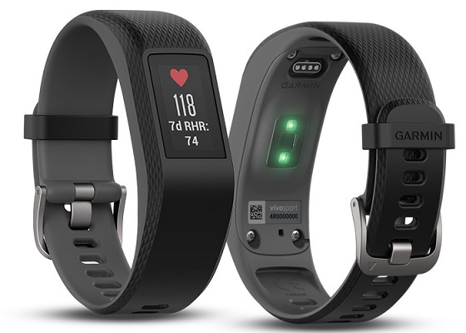
Materials and methods
Two type of datasets from a single athlete
Training history dataset for S-CML with extracted features (21)
3-dimensional pure time series signal dataset for TSC
Original dataset has 297 activities in 5 diverging sport categories
Basically, the very same data in two different structure
Classes/categories are {biking, running, walking, skiing, roller-skiing}
Adopted classifiers
9 Standard CML classifiers from Scikit-learn (sklearn)
11 Time Series Classifiers from Sktime API
Evaluation metrics
Accuracy (Mean), Model training time
Precision, Recall, F1-score
ROC-AUC, Stability (accuracy variance)

Slide 6
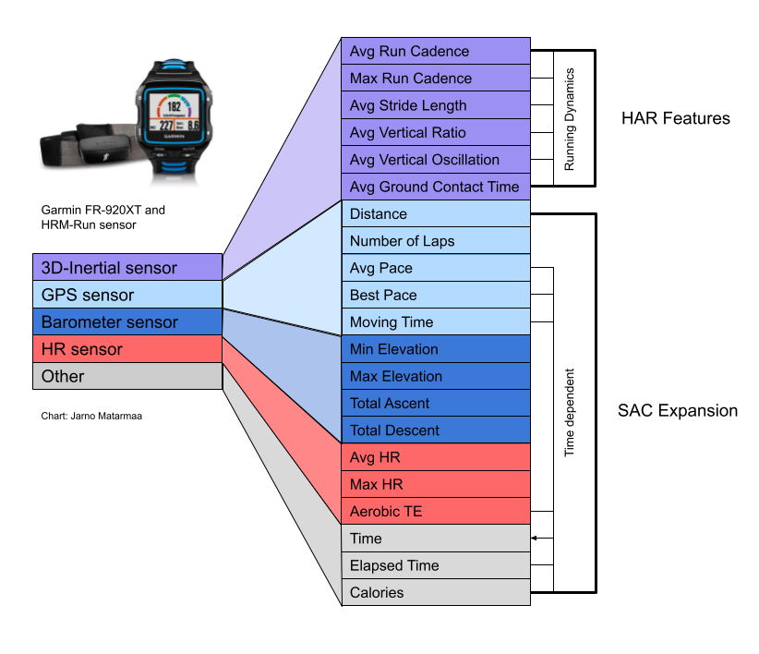
S-CML Dataset
Features
21 features

Slide 7
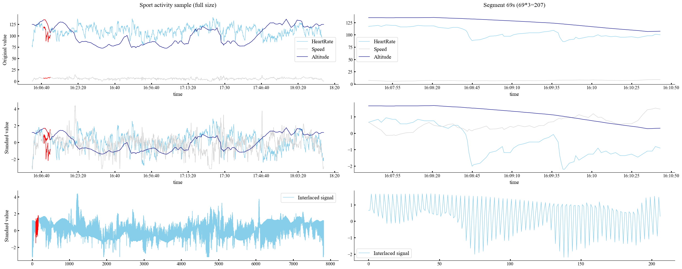
Interlacing method of multivariate signals (TSC)
Notes:
Wrong sport labeling is problematic for a several reasons:
Misleading training guidance based on the training history
Distortion in general personal data statistics
Segment leaderboards loses their validity if one can use a bike to get a better place in a running segment

Slide 8
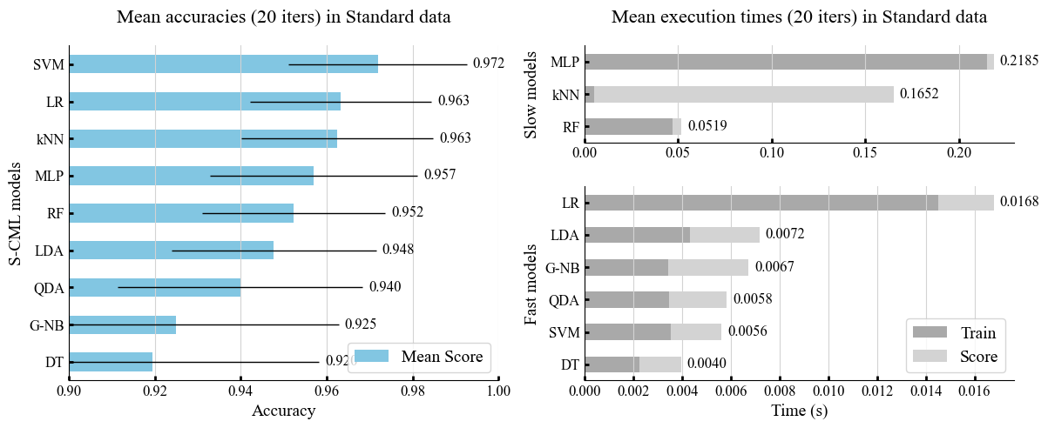
Results: S-CML

Slide 9
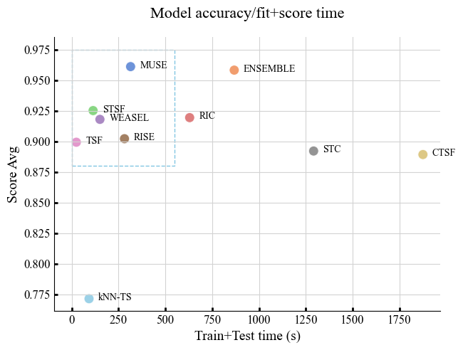
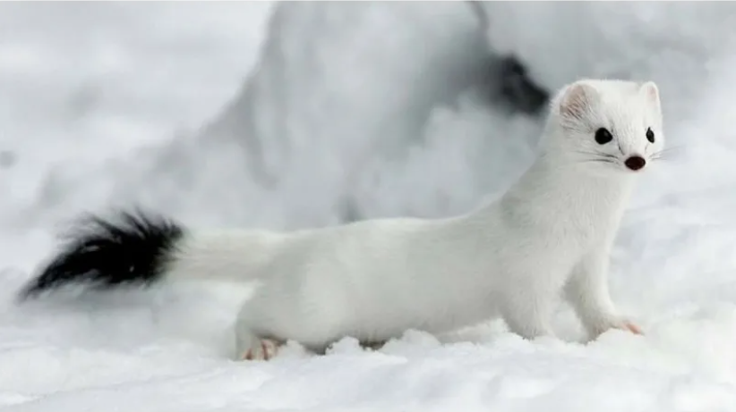
Results: TSC
Performance map Accuracy-Time

Slide 10
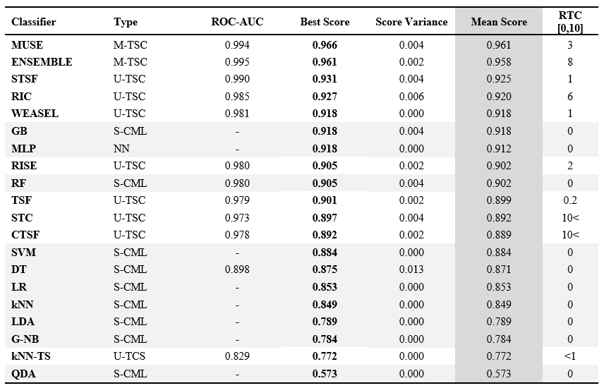
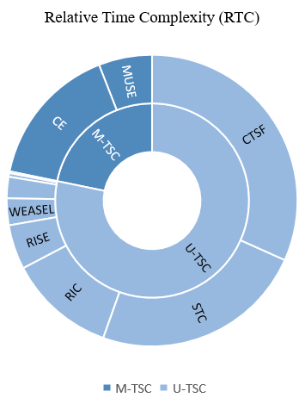
Results: Compilation table

Slide 11
Conclusions
Three diverging methods (S-CML, U-TSC, and M-TSC) were successfully applied for a retrospective personalized supervised sport activity classification of a single athlete
The observed results are mainly good, up to 96,6%. HAR average (92%) (Demrozi et al., 2020)
Model selection depends on the available data and application objectives
MUSE (96,6%) can be gently recommended for the multivariate time series data
In certain circumstances, TSF as a fast model could be more preferable than MUSE, and then solving this problem in univariate space can take place
S-CML as a very fast and effective method with low computation requirement could be suggested always when the appropriate dataset is available, but it might be prone to interpersonal differences, and therefore results not generalizable

Slide 12
Right Questions
What’s the significance of constructing interlaced signals instead of using simple column concatenation method?
In which cases pure time series signals could be especially useful compared to extracted features?
Why we should classify sports from heart rate, speed, and altitude features instead of using inertial sensor data which have produced a great results in previous studies?
Are the results generalizable and can we expect the same accuracy level among athletes with different physical and personal characteristics such as gender, age, weight, length, etc.?
Why we should have a specialized classification method for outdoor sports?
Why we should classify sports at all?
What makes it preferable to conduct a personalized sport classification?

Slide 13
Discussion...

Slide 14
Appendices

Slide 15
Why personalized SAC with a dataset recorder in uncontrolled non-laboratory environment
Foerster et al. (1999) demonstrated accuracy drop for ambulation activities from 95.6% of a controlled data collection experiment to 66% of uncontrolled non-laboratory natural environment.
Berchtold et al. (2010) identified an open debate on the design of any activity recognition model. Since according to some authors, people perform activities in a different manner as they differ on age, gender, weight, and so on, a specific recognition model should be built for each individual.

Slide 16
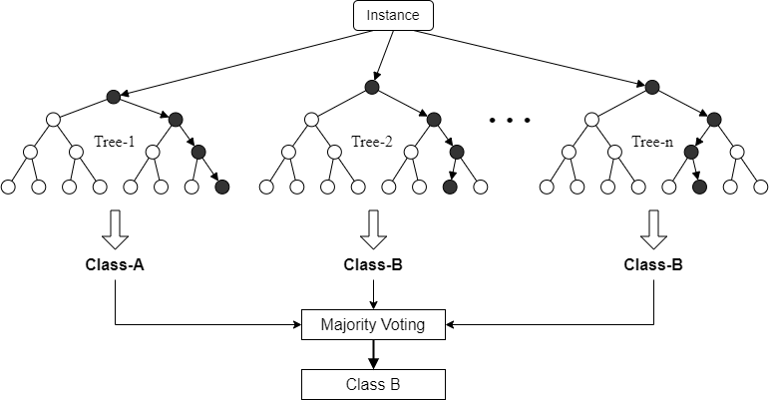
TSC - Random Forest

Slide 17
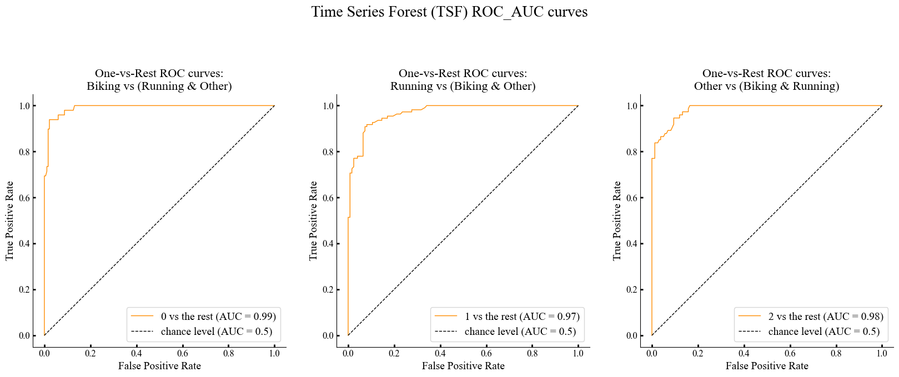
TSC - Classification quality metric ROC-AUC

Slide 18
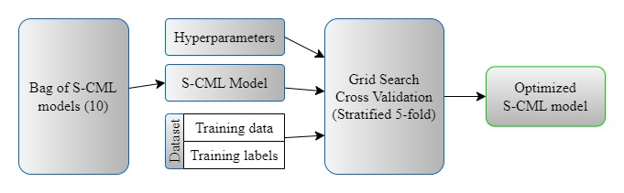
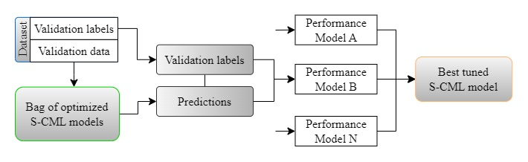
S-CML Pipeline
Step 1: Hyperparameter optimization
Step 2: Model selection

Slide 19
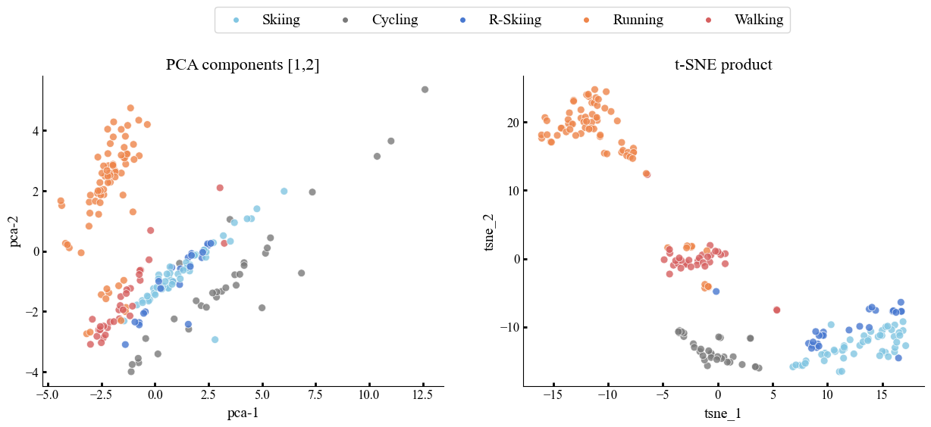
Category divergency in S-CML data

