Slide 1



The Art of
Sport Activity Classification
Докладчик
Matarmaa Jarno Olavi
Master of Artificial Intelligence

Slide 2

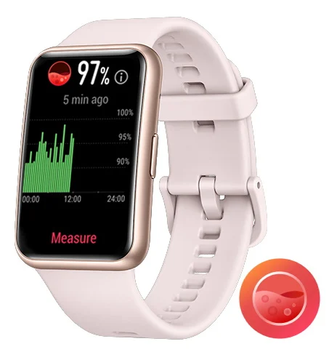
The relevance of the study
The daily usage of activity trackers, sport watches, and other devices to record daily and sport activities has increased tremendously in past ten years
The main reasons are the development of battery technology and small size hardware with a low energy consumption such as LED displays
Human activity recognition has become a common function and enabled by several device manufacturers

Slide 3
Current level and methods of problem solving
Human Activity Recognition (HAR) is well studied area in recent years, achieving average accuracies of 92 % (Demrozi et al., 2020).
Traditional HAR studies are conducted using inertial sensor data (basically, a set of 3-dimensional (x,y,z) accelerometer sensors)
Studies have been conducted in a controlled laboratory conditions
Amount of activity types varies from 5 to 20, containing sitting, standing up, standing down, laying down, etc., among most common sports.
Classification task have been conducted using wide variety of signal classification methods including Classical Machine Learning and Neural Networks

Slide 4
Purpose and problem description of the study
Alternative ways to classify sport activities might be reasonable, for example, all the devices do not have inertial sensors, or such a data is not available for external analysis of third parties.
The purpose of the study is to tackle false human sport activity labeling problem when inertial sensor data is not available
Wrong sport labeling is problematic for a several reasons:
Misleading training guidance based on the training history
Distortion in general personal data statistics
Segment leaderboards loses their validity if one can use a bike to get a better place in a running segment

Slide 5
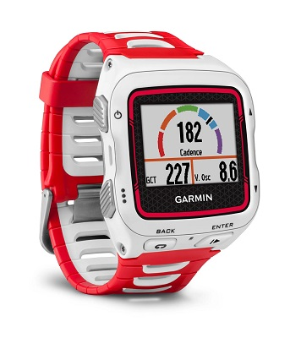
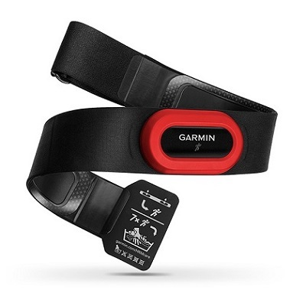
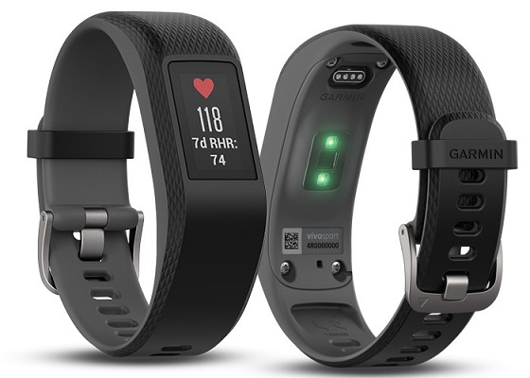
Materials and methods
Two type of datasets from a single athlete
Training history dataset for S-CML with extracted features
3-dimensional pure time series signal dataset for TSC
Original dataset has 297 activities in 5 diverging sport categories
Basically, the very same data in two different structure
Adopted classifiers
9 Standard CML classifiers from Scikit-learn (sklearn)
11 Time Series Classifiers from Sktime API
Evaluation metrics
Accuracy (Mean), Model training time
Precision, Recall, F1-score
ROC-AUC, Stability (accuracy variance)

Slide 6
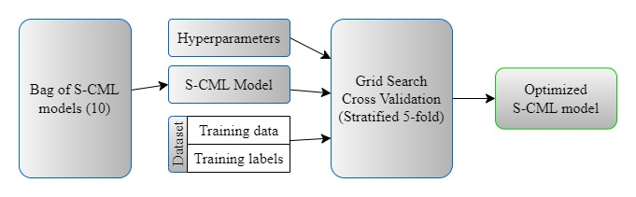
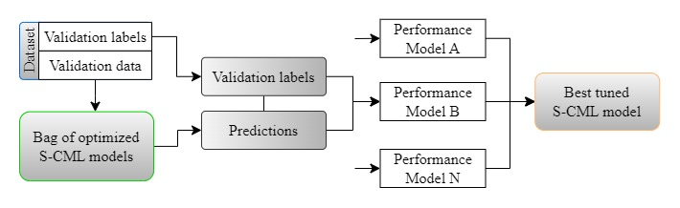
Materials and Methods: S-CML
Step 1: Hyperparameter optimization
Step 2: Model selection

Slide 7
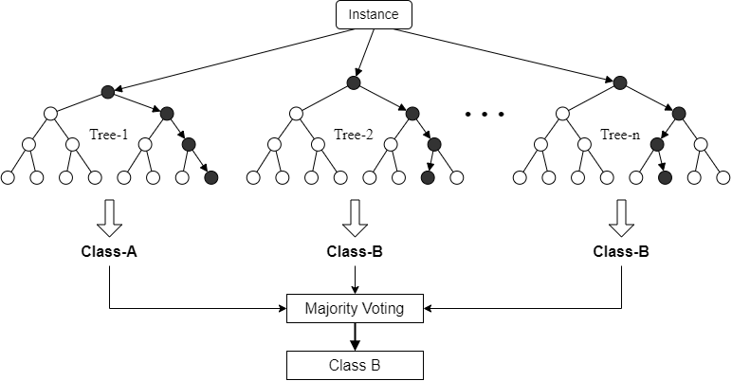
Materials and Methods: TSC - Random Forest

Slide 8
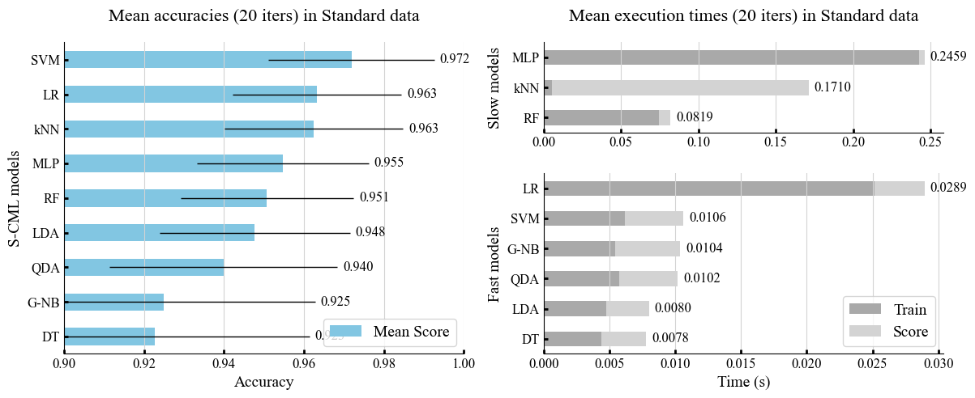
Results: S-CML

Slide 9
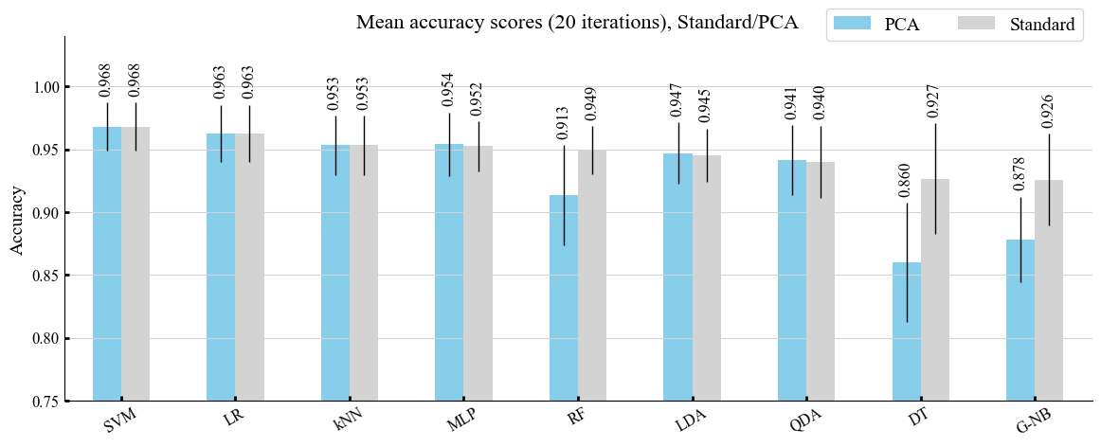
Results: S-CML

Slide 10
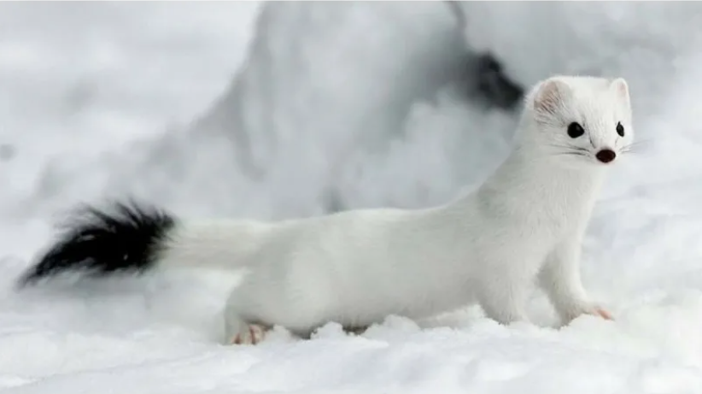
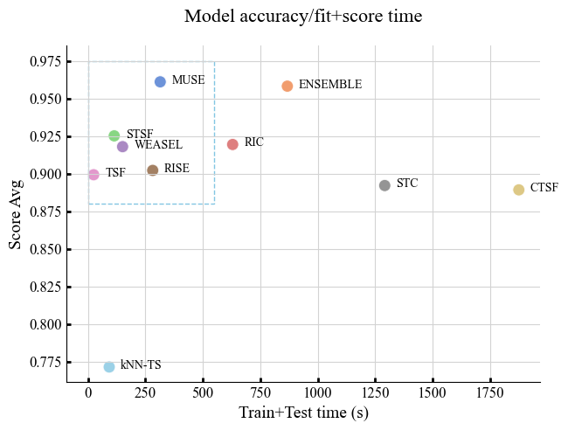
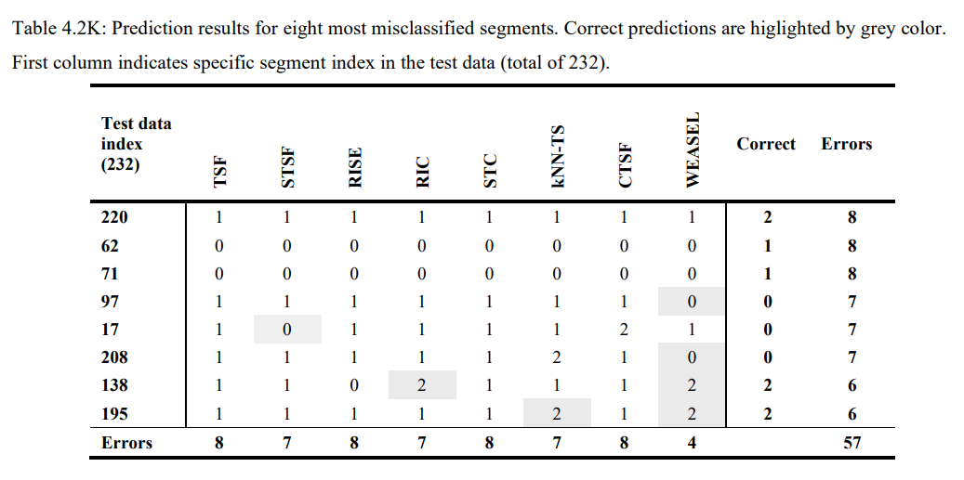
Results: TSC
Performance map
Mis-classification table

Slide 11
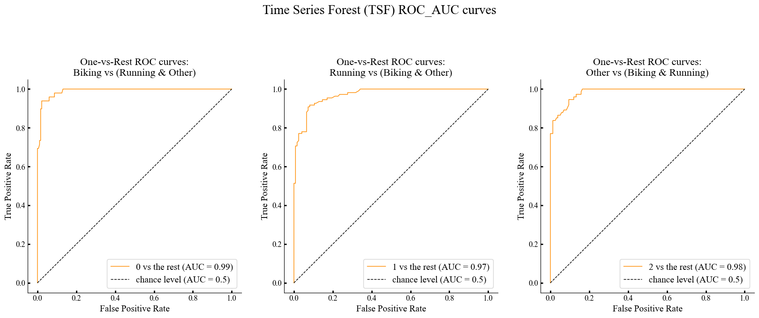
Results: Classification quality metric ROC-AUC

Slide 12
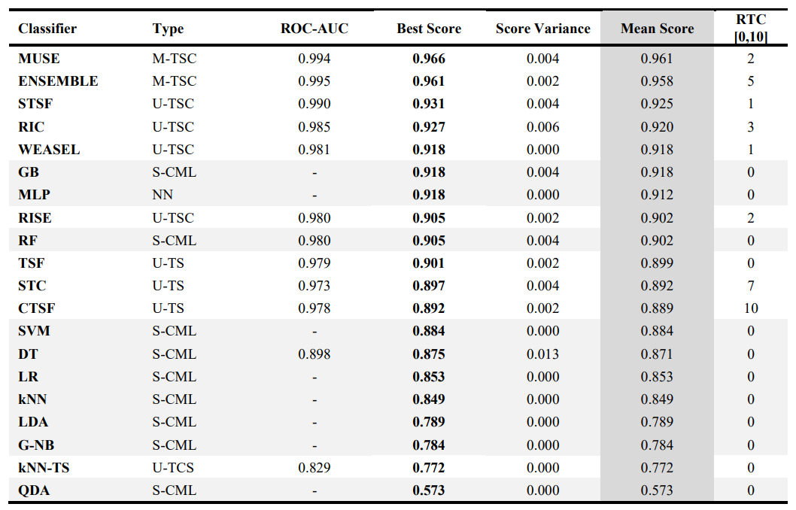


Results: Compilation table

Slide 13
Conclusions
Three diverging methods (S-CML, U-TSC, and M-TSC) were proposed and investigated to conduct a retrospective personalized supervised sport activity classification of a single person
A total of twenty different machine learning models from sklearn and sktime were adopted, which makes the study quite extent application of CML models into a specific type of sport data.
The observed results are mainly good (up to 96,6%), and even better than the average results (92%) in recent HAR studies (Demrozi et al., 2020)
The selection of the classification method for sport activities depends on the available data, and therefore one model cannot be preferred over others in all the cases
MUSE (96,6%) can be gently proposed as the best choice for sport activity classification when using multivariate time series data
However, in certain circumstances, for example TSF as a fast model could be more preferable than MUSE, and then solving this problem in interlaced univariate data can take place
S-CML as a very fast and effective method with low computation requirement could be suggested always when the appropriate dataset is available, but it might be prone to interpersonal differences, and therefore results not generalizable

Slide 14
Discussion...

Slide 15
Right Questions
What’s the significance of constructing interlaced signals instead of using simple column concatenation method?
In which cases pure time series signals could be especially useful compared to extracted features?
Why we should classify sports from heart rate, speed, and altitude features instead of using inertial sensor data which have produced a great results in previous studies?
Are the results generalizable and can we expect the same accuracy level among athletes with different physical and personal characteristics such as gender, age, weight, length, etc.?
Why we should have a specialized classification method for outdoor sports?
Why we should classify sports at all?
What makes it preferable to conduct a personalized sport classification?

