Slide 1



















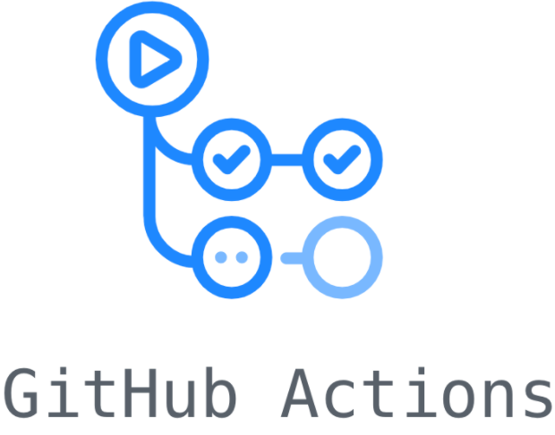
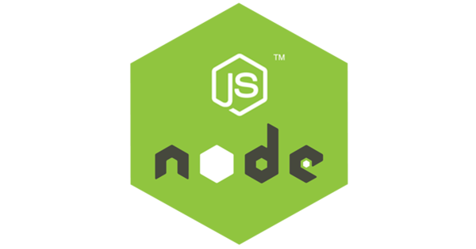
AWS Cloud
AWS Certificate Manager (ACM)
Route 53
SSL
Users
VPC
Amazon GuardDuty
Public subnet
Public subnet
Availability Zone
Availability Zone
IAM
aws-iam-authenticator-server
IAM Identity
ConfigMap aw-auth
Bucket S3
Verify IAM Identity
Access Logs
Kubernetes User
Application Load Balancer
Authentication
Cloudwatch Logs
Private subnet
Private subnet
Private subnet
Private subnet
Availability Zone
Availability Zone
Availability Zone
Availability Zone
EKS
RDS -MySQL
ECR
KubernetesNode
ASG
KubernetesNode
Multi-AZ
GitHub

