Slide 1
Version Control (I)
Git
Luís Ferreira

Slide 2
Git
Git is a powerful, sophisticated system for distributed version control.
Version control means keeping all the changes during the developing processes.
Interest to:
  Developers
  Scientists during papers writing
  Students during writing reports
  Musicians
  Anyone who wants to!

Slide 3
Git
Git Installation
Install Git Bash (https://git-scm.com/downloads)
Options:
  Use Git from Git Bash only
  Checkout Windows-style, commit Unix-style line endings
  Use MinTTY
  Uncheck Enable Git Credential Manager

Slide 4
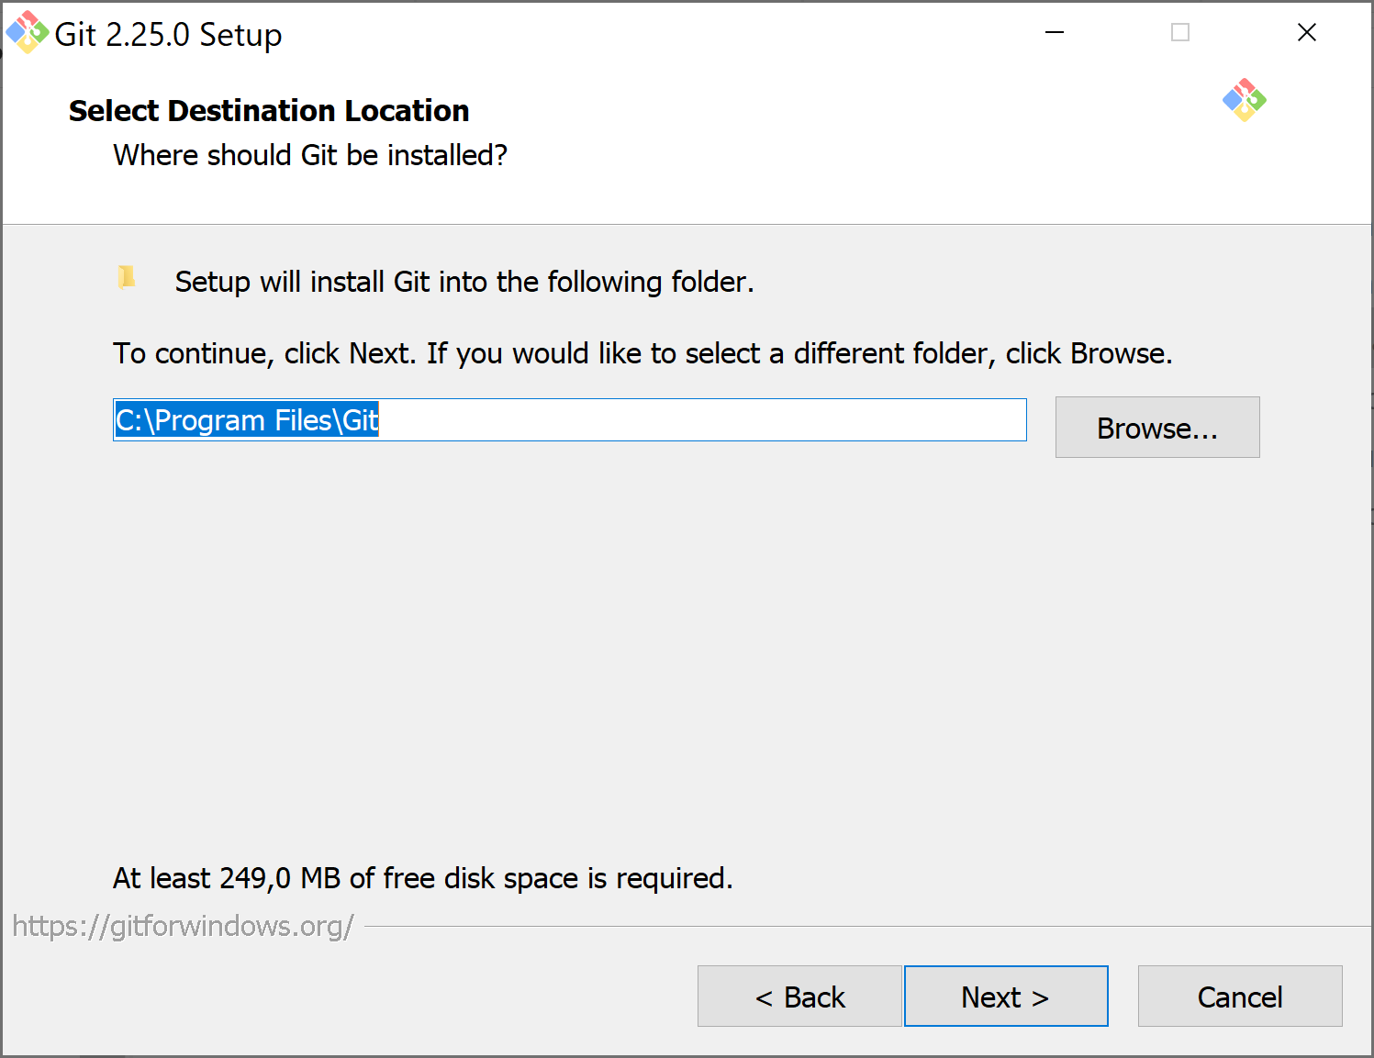
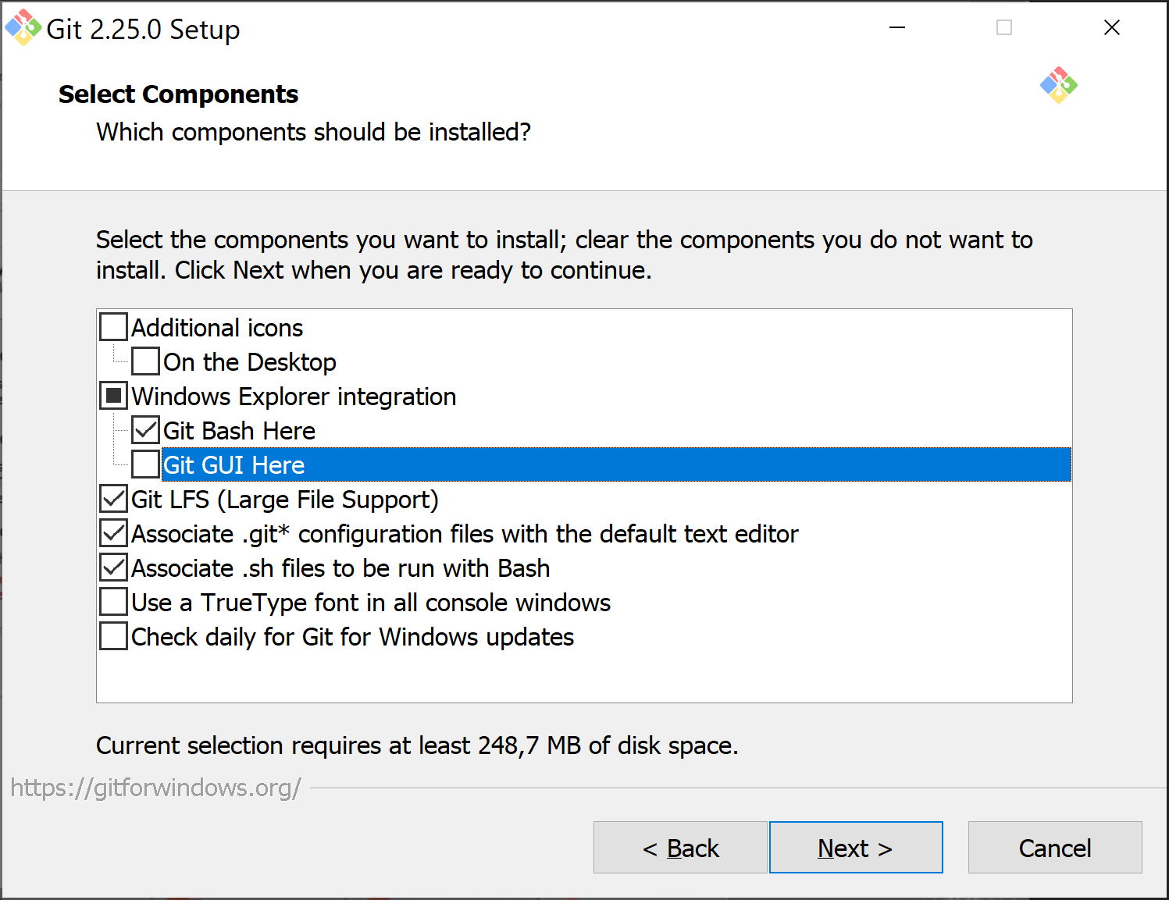
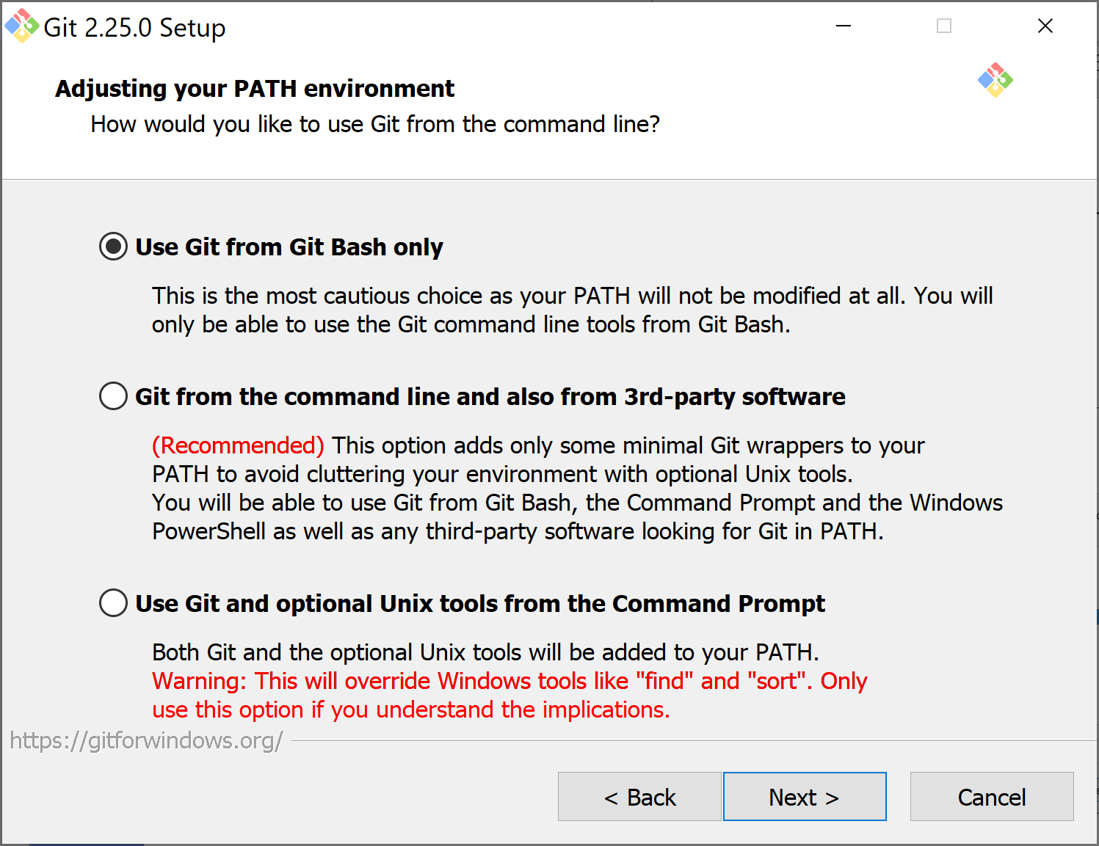
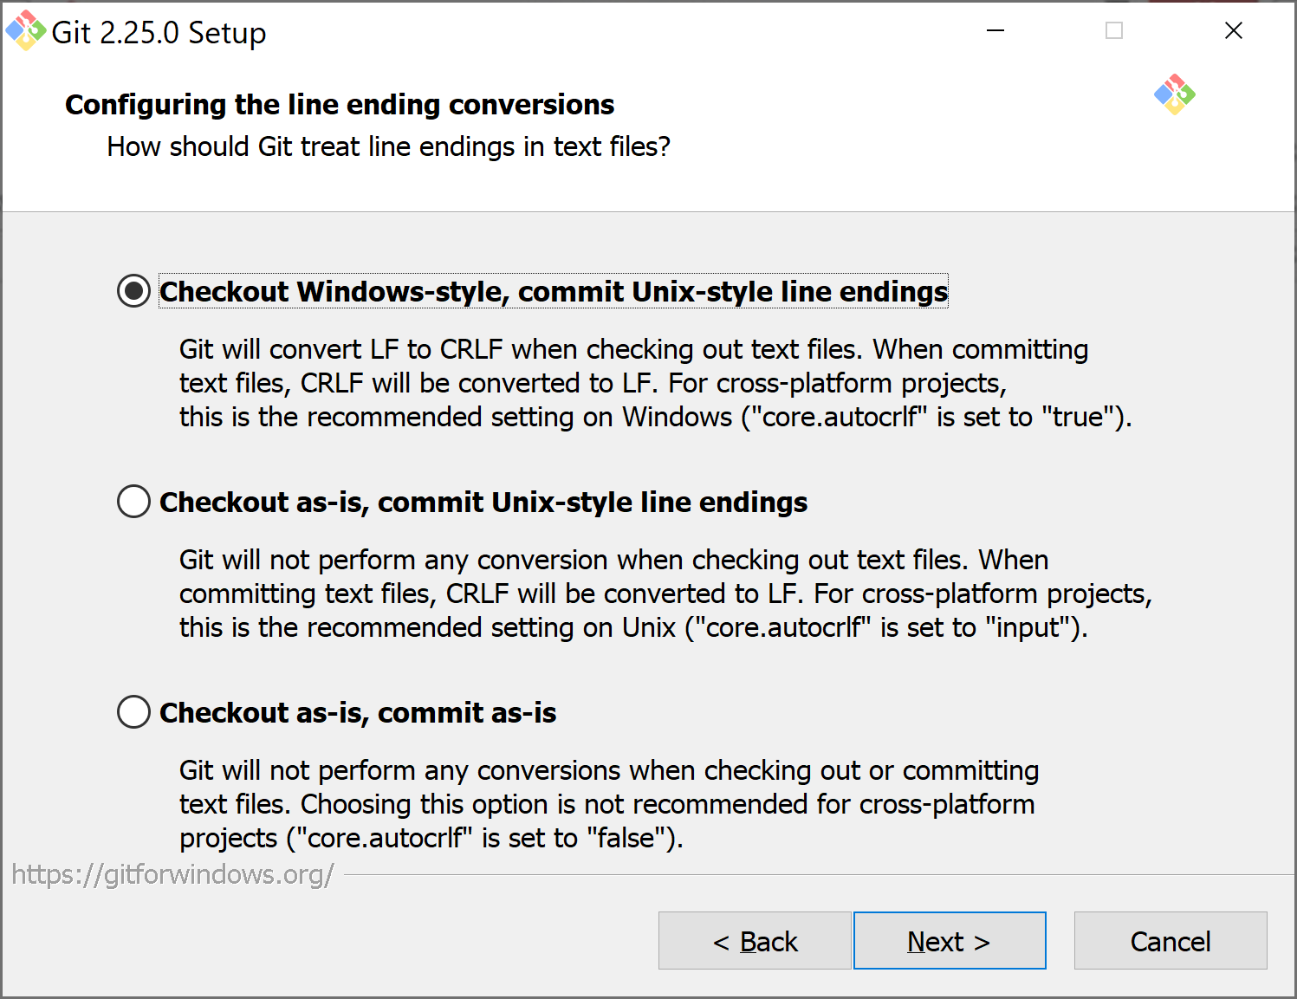
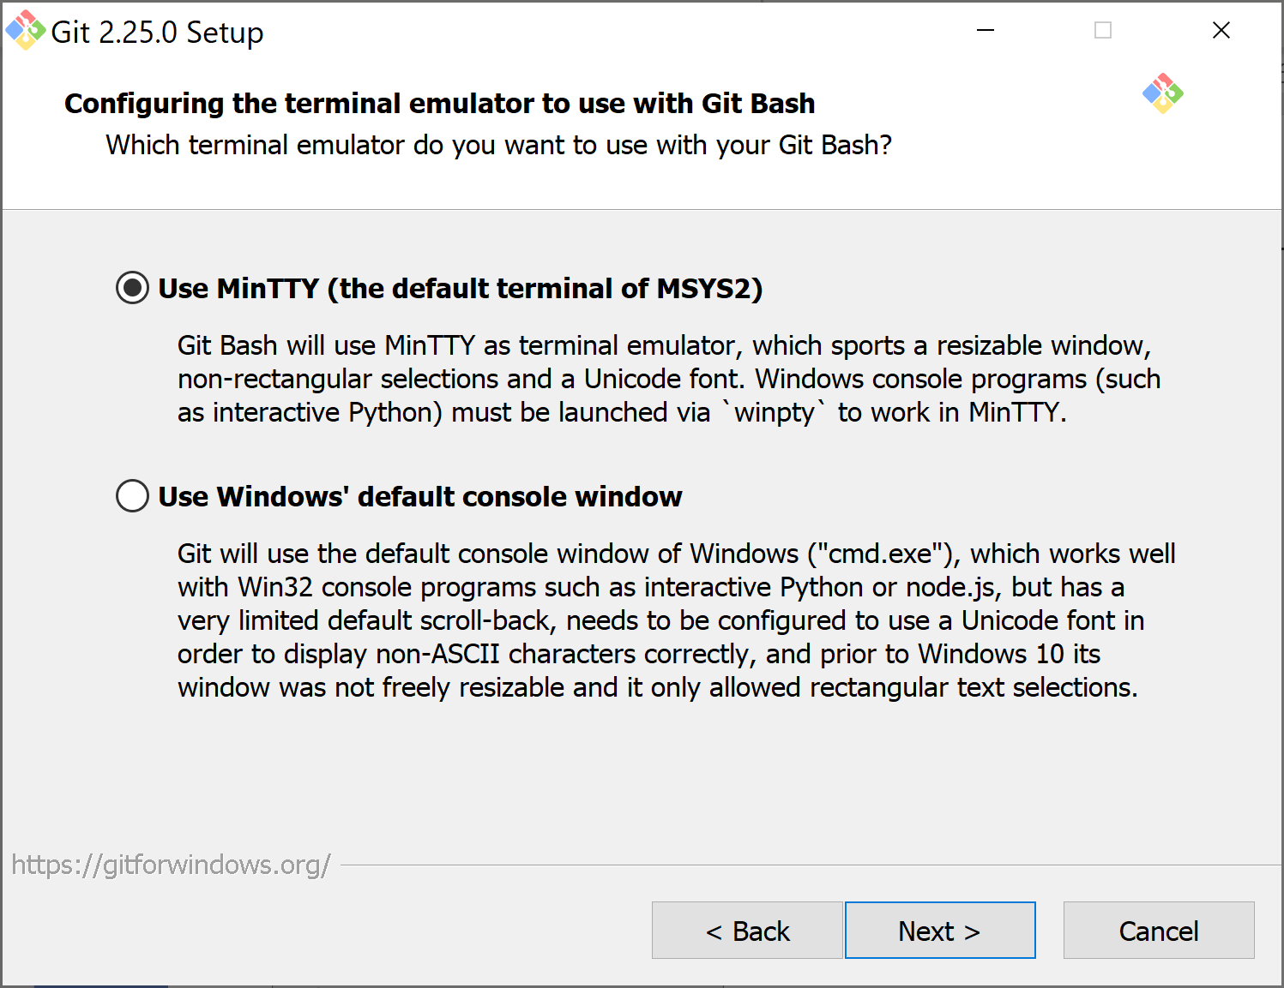
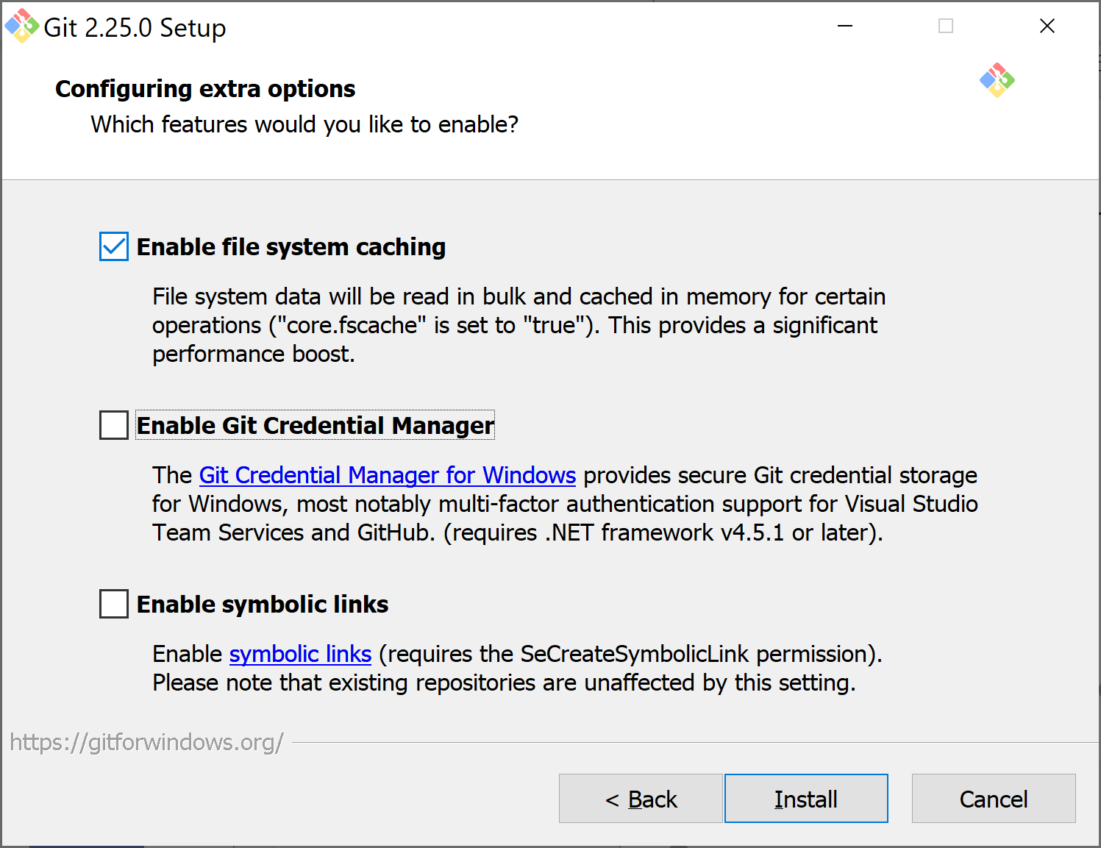
Git
Git Installation

Slide 5
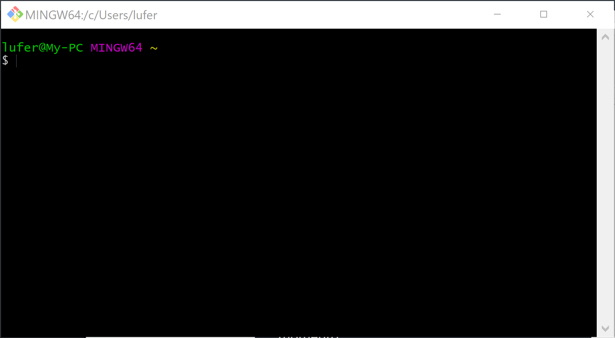
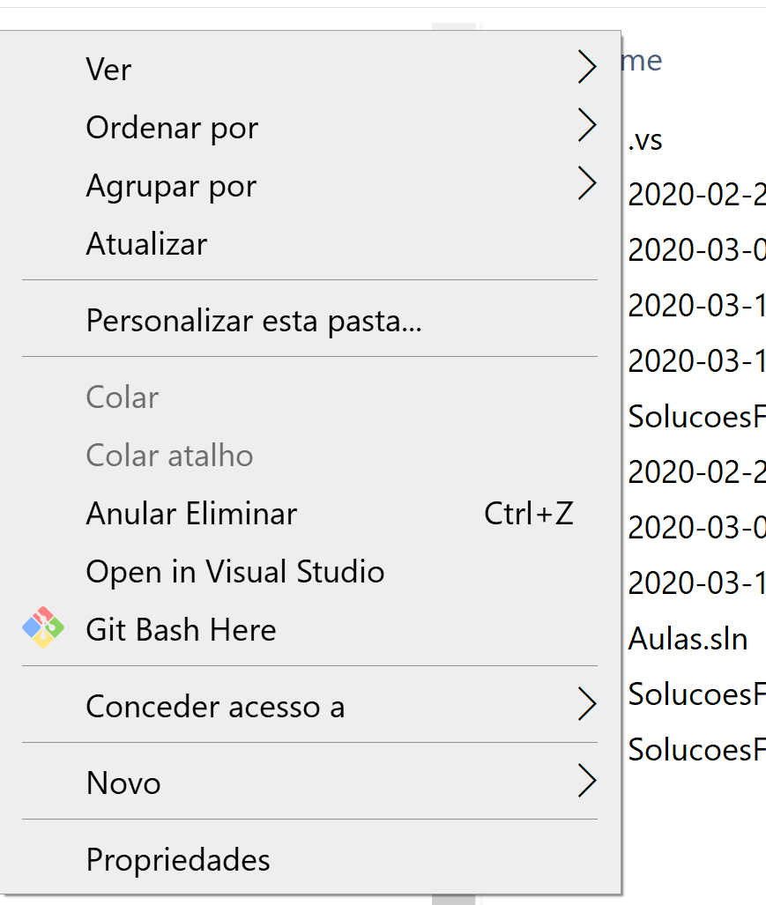
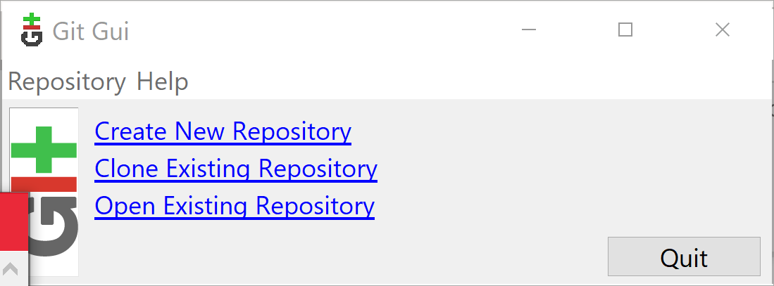
Git
Git Instalation
Git Bash
Git GUI

Slide 6
Git
Creating a Git repository
Git repository: place (folder) where you want to manage version of existing files!
Set Windows Folder View to show Hidden Files
Create a text file .gitignore on the repository (folder)
  (c:>ren t.txt .gitignore)
  https://github.com/github/gitignore/blob/master/VisualStudio.gitignore
Open Git Bash on the repository folder
  git init

Slide 7
Git
User identification
“Who did what” in the repository:
  git config --global user.name “name“
  git config --global user.email “email“
  Example
  git config --global user.name “lufer“
  git config --global user.email lufer@ipca.pt
  git config --list
Path: C:\Users\<username>\.gitconfig

Slide 8
Git
Versions management
See the status of the repository
  git status
    red – untracked files
    green – ready to be tracked (stage)
Insert files in the repository
  git add . – prepare all files to be tracked (stage)
Commit – all files are now tracked!
  git commit -m “description”
  git commit –am “description” - add and commit

Slide 9
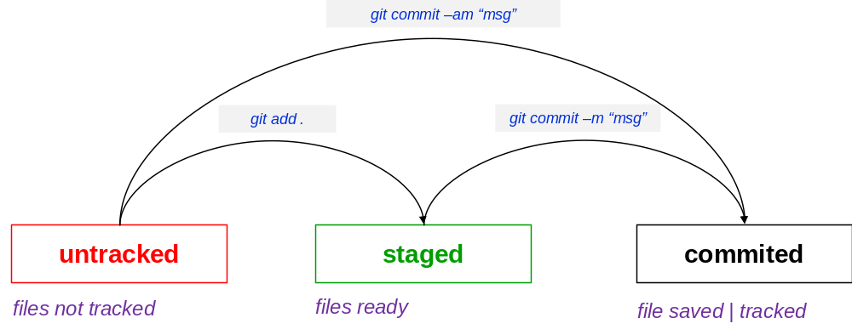
Git
Versions management

Slide 10
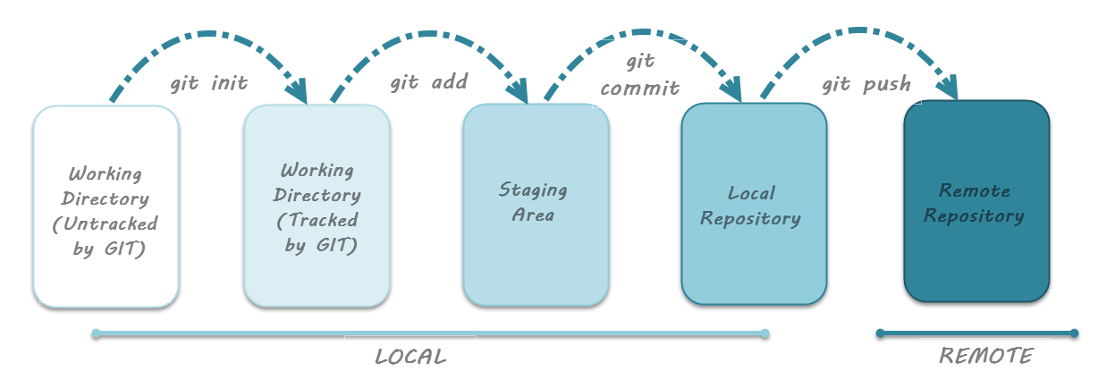
Git
Versions management
https://www.toolsqa.com/git/git-life-cycle/

Slide 11
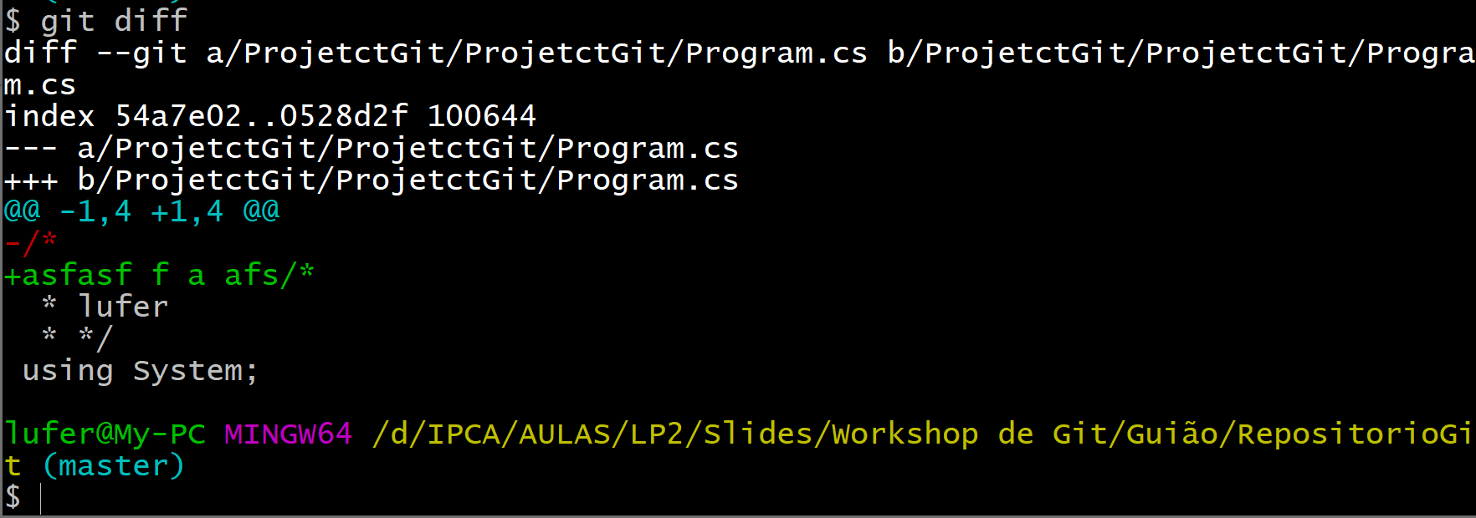
Git
Versions management
Comparing local with “staged” version:
  git diff
changes

Slide 12
Git
Versions management
Discard recent changes…before staged:
  git clean -df
  git checkout -- . //all changed files
  or
  git checkout filename // particular changed file
Discard recent changes…after staged (after git add .):
  git reset HEAD filename //unstage fileName

Slide 13
Git
Versions management
Back to initial file, after staged:
  git reset HEAD filename
  git checkout fileName

Slide 14
Git
Versions management
Discard recent changes…after commit:
  git reset [--soft | --mixed | --hard]
    soft - back to staged
    mixed - back to modified
    hard - destroy commit
Discards the last commit (all changes!):
  git reset --soft HEAD~1 - maintains file changes (staged)
  git reset –mixed HEAD~1 - maintains file changes (unstaged)
  git reset --hard HEAD~1 - destroy all previous changes

Slide 15
Git
Versions management
Discards the last commit (all changes!):
  git reset --soft HEAD~1 - maintains file changes (staged)
  git reset –mixed HEAD~1 - maintains file changes (unstaged)
  git reset --hard HEAD~1 - destroy all previous changes
  ATTENTION: it must be selected the commit after the one we intend to “destroy”

Slide 16

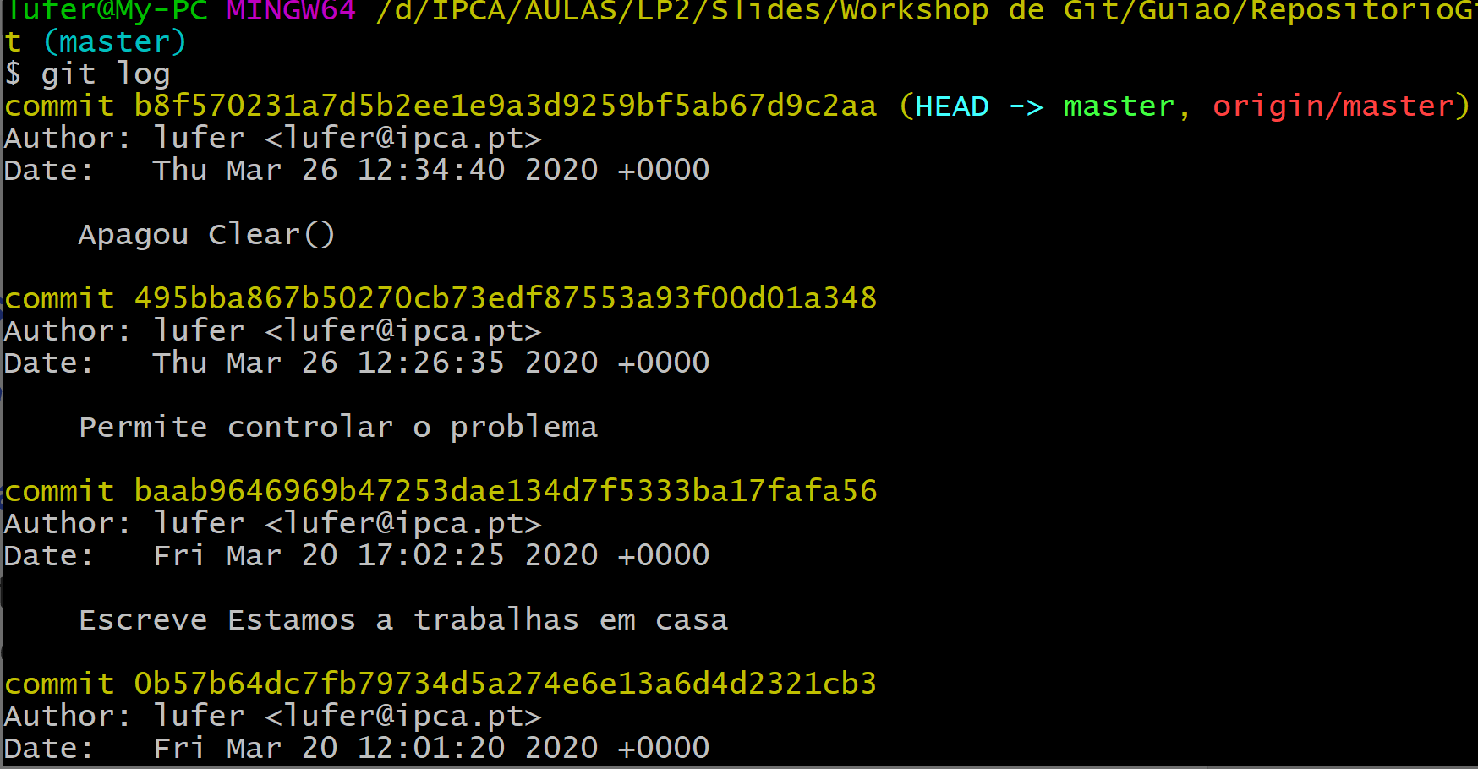
Git
Versions management
Discards the last commit (all changes!):
  git reset --soft HEAD~1 - maintains file changes (staged)
  git reset –mixed HEAD~1 - maintains file changes (unstaged)
  git reset --hard HEAD~1 - destroy all previous changes
  ATTENTION: it must be selected the commit after the one we intend to “destroy”
Destroy this commit
Mantain this commit

Slide 17
Git
Versions management
Navigate between commits:
  git must be synchronized, i.e., everything is committed
  git checkout <N> - “jump” to commit N
  git checkout <nomeBranch> - returns to last commit

Slide 18
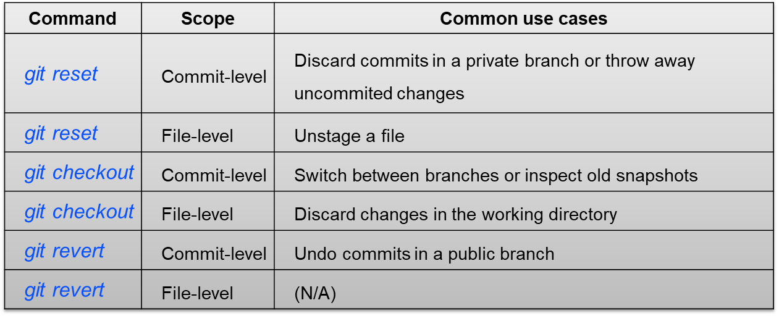
Git
Versions management
https://www.atlassian.com/git/tutorials/resetting-checking-out-and-reverting

Slide 19
Git
Versions management
git diff .
git add .
git commit –m “msg”
git checkout
untracked
staged
commited
files not tracked
files ready
file saved | tracked
git reset HEAD
git reset

Slide 20
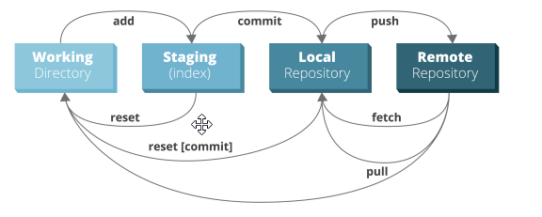
Git
Versions management
https://www.toolsqa.com/git/git-life-cycle/

Slide 21
Git
Collaboration: several users in the same rep.
Let multiple users work together!
“Fork and Branch” Concepts:
  branch
  clone
  pull
  merge
  (next workshop)

Slide 22
Git
More Git relevant commands
git config --list –show-origin //show paths and details
git config --global core.editor "'C:/Program Files/Notepad++/notepad++.exe' -multiInst -notabbar -nosession -noPlugin“ // use notepad++ as editor
git log –oneline // all commits resumed
git shortlog //all commits
git show tagCommit //commit details
https://git-scm.com/book/en/v2/Getting-Started-First-Time-Git-Setup

Slide 23
Git
Git summary
Install
Configure (user, password, editor) (git config --global …)
Create repository (git init)
Managing versions
    commit
    checkout
    reset

Slide 24
Git
Git References
https://githowto.com/ //tutorial
https://git-scm.com/book/en/v2/Getting-Started-First-Time-Git-Setup
https://www.git-tower.com/learn/git/ebook/en/command-line/introduction#start
Udemy free course:
  https://www.udemy.com/course/git-e-github-para-iniciantes/learn/lecture/5120486#overview

