Slide 1
CSE 101- Winter ‘18 Discussion Section Week 9

Slide 2
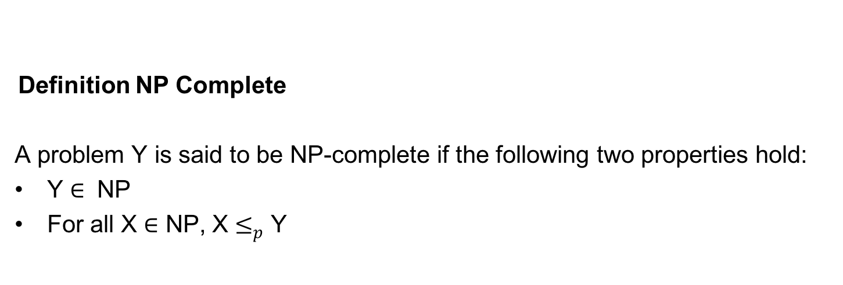
NP-Complete: Reductions
Definition NP Complete
A problem Y is said to be NP-complete if the following two properties hold:
Y $∈$ NP
For all X $∈$ NP, X $≤_{p}$ Y

Slide 3
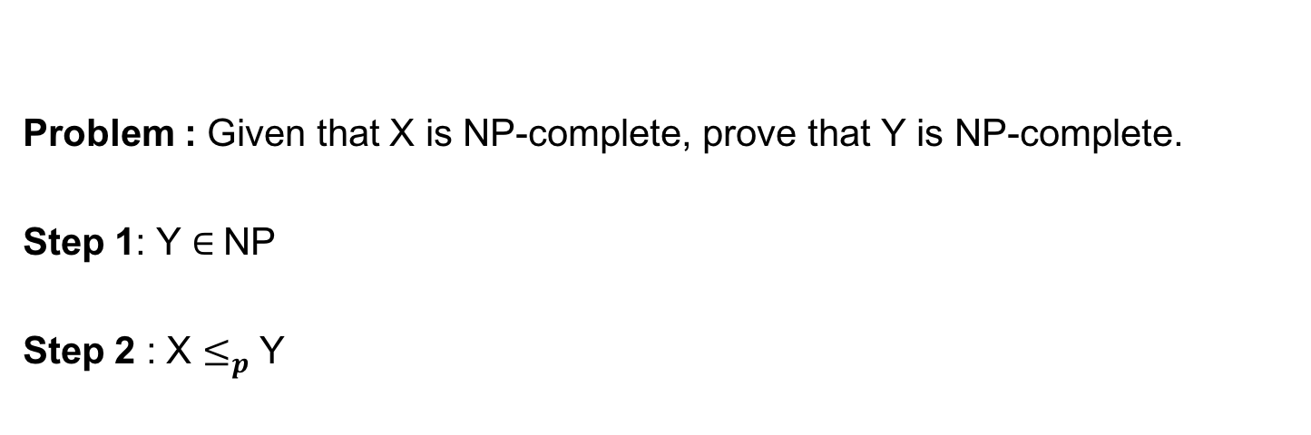
NP-Complete: Reductions
Problem : Given that X is NP-complete, prove that Y is NP-complete.
Step 1: Y $∈$NP
Step 2 : X $≤_{p}$ Y

Slide 4
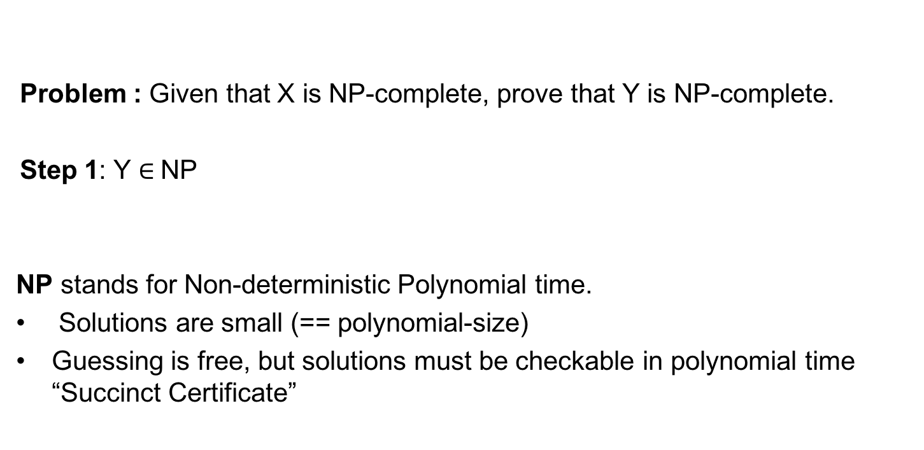
NP-Complete: Reductions
Problem : Given that X is NP-complete, prove that Y is NP-complete.
Step 1: Y $∈$NP
NP stands for Non-deterministic Polynomial time.
Solutions are small (== polynomial-size)
Guessing is free, but solutions must be checkable in polynomial time “Succinct Certificate”

Slide 5
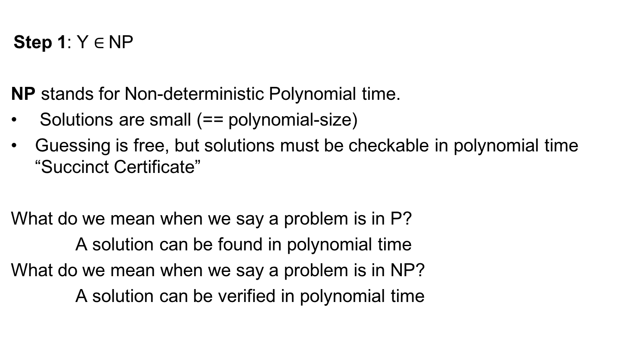
NP-Complete: Reductions
Step 1: Y $∈$NP
NP stands for Non-deterministic Polynomial time.
Solutions are small (== polynomial-size)
Guessing is free, but solutions must be checkable in polynomial time “Succinct Certificate”
What do we mean when we say a problem is in P?
A solution can be found in polynomial time
What do we mean when we say a problem is in NP?
A solution can be verified in polynomial time

Slide 6
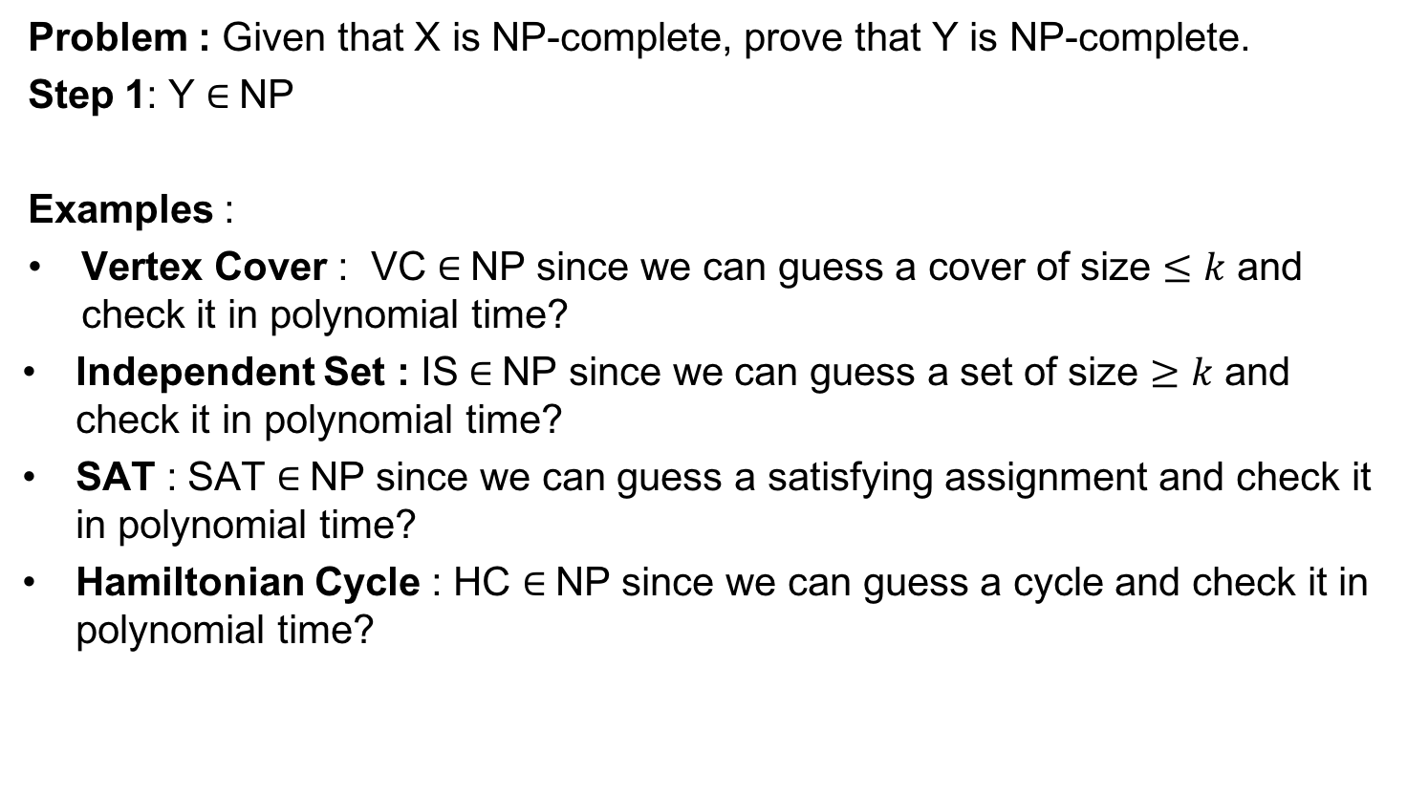
NP-Complete: Reductions
Problem : Given that X is NP-complete, prove that Y is NP-complete.
Step 1: Y $∈$NP
Examples :
Vertex Cover : VC $∈$NP since we can guess a cover of size $≤k$ and check it in polynomial time?
Independent Set : IS $∈$NP since we can guess a set of size $≥k$ and check it in polynomial time?
SAT : SAT $∈$NP since we can guess a satisfying assignment and check it in polynomial time?
Hamiltonian Cycle : HC $∈$NP since we can guess a cycle and check it in polynomial time?

Slide 7
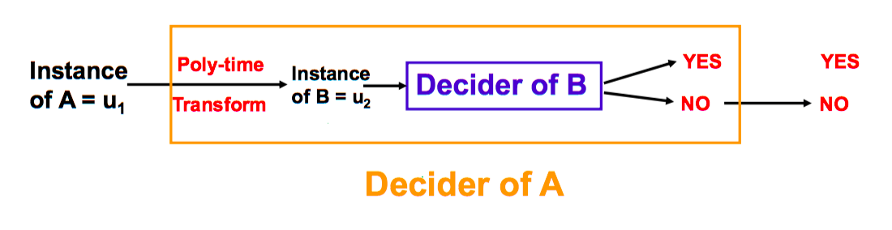
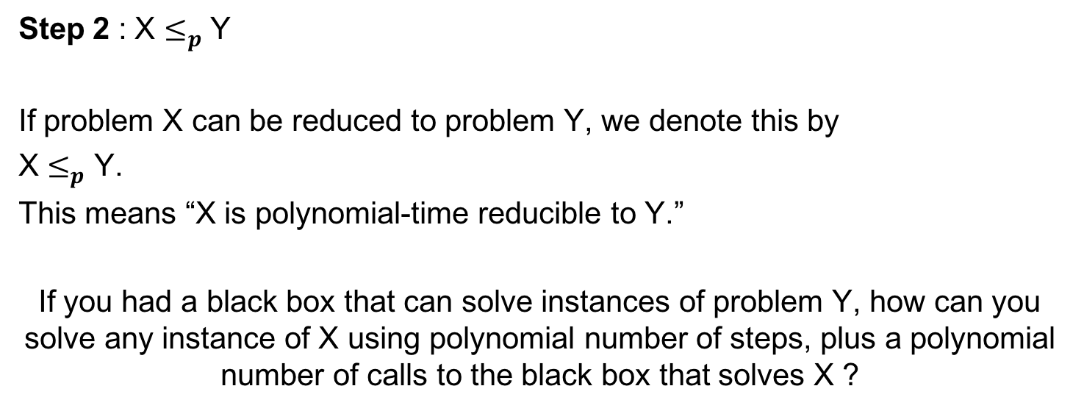
Polynomial-Time Reducibility
Step 2 : X $≤_{p}$ Y
If problem X can be reduced to problem Y, we denote this by
X $≤_{p}$ Y.
This means “X is polynomial-time reducible to Y.”
If you had a black box that can solve instances of problem Y, how can you solve any instance of X using polynomial number of steps, plus a polynomial number of calls to the black box that solves X ?
Y
X
Y
X

Slide 8
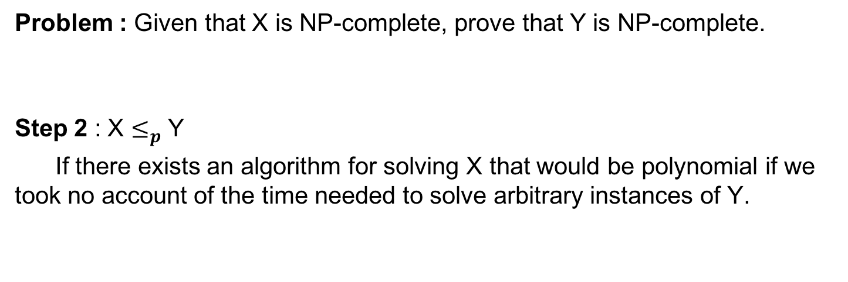
NP-Complete: Reductions
Problem : Given that X is NP-complete, prove that Y is NP-complete.
Step 2 : X $≤_{p}$ Y
If there exists an algorithm for solving X that would be polynomial if we took no account of the time needed to solve arbitrary instances of Y.
Y
X
Y
X

Slide 9
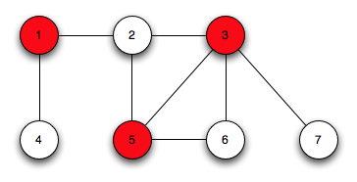
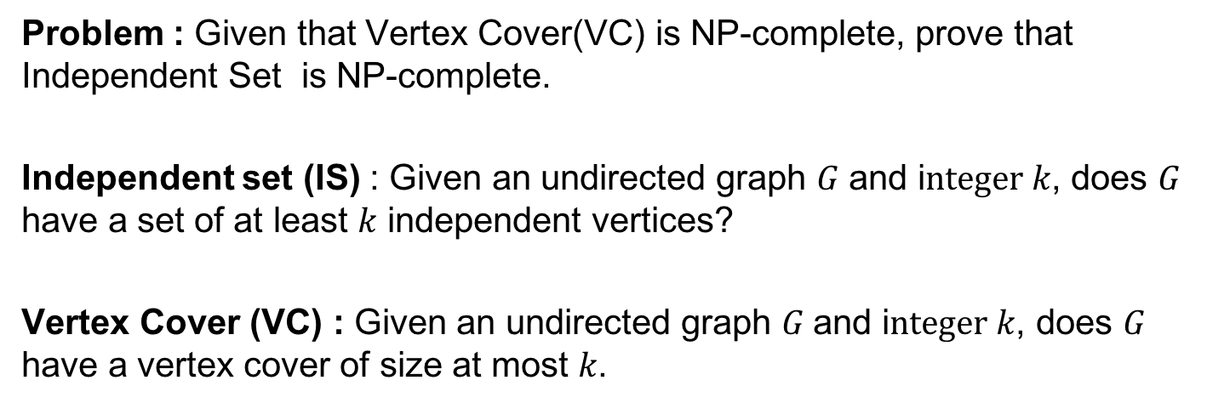
Independent set (IS)
Problem : Given that Vertex Cover(VC) is NP-complete, prove that Independent Set is NP-complete.
Independent set (IS) : Given an undirected graph $G$ and i$nteger k$, does $G$ have a set of at least $k$ independent vertices?
Vertex Cover (VC) : Given an undirected graph $G$ and i$nteger k$, does $G$ have a vertex cover of size at most $k$.

Slide 10
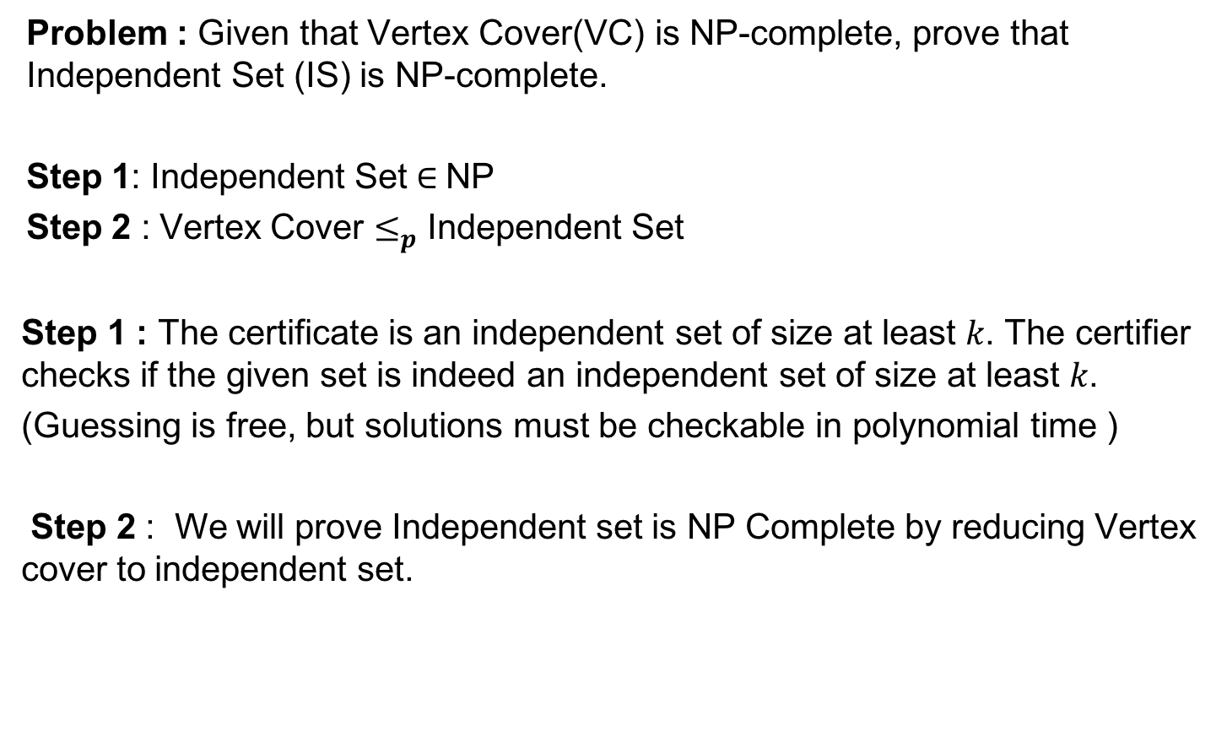
Independent set (IS)
Problem : Given that Vertex Cover(VC) is NP-complete, prove that Independent Set (IS) is NP-complete.
Step 1: Independent Set $∈$NP
Step 2 : Vertex Cover $≤_{p}$ Independent Set
Step 1 : The certificate is an independent set of size at least $k$. The certifier checks if the given set is indeed an independent set of size at least $k$.
(Guessing is free, but solutions must be checkable in polynomial time )
Step 2 : We will prove Independent set is NP Complete by reducing Vertex cover to independent set.

Slide 11
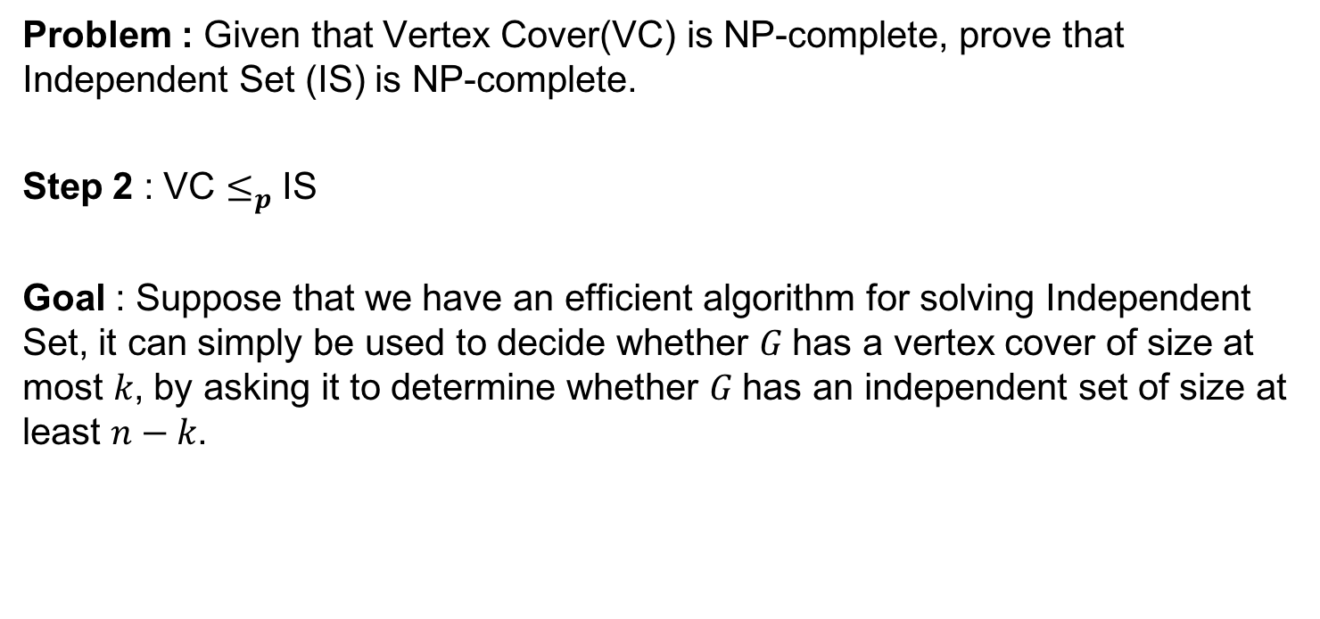
Independent set (IS)
Problem : Given that Vertex Cover(VC) is NP-complete, prove that Independent Set (IS) is NP-complete.
Step 2 : VC $≤_{p}$ IS
Goal : Suppose that we have an efficient algorithm for solving Independent Set, it can simply be used to decide whether $G$ has a vertex cover of size at most $k$, by asking it to determine whether $G$ has an independent set of size at least $n−k$.

Slide 12
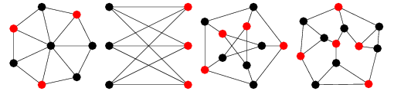
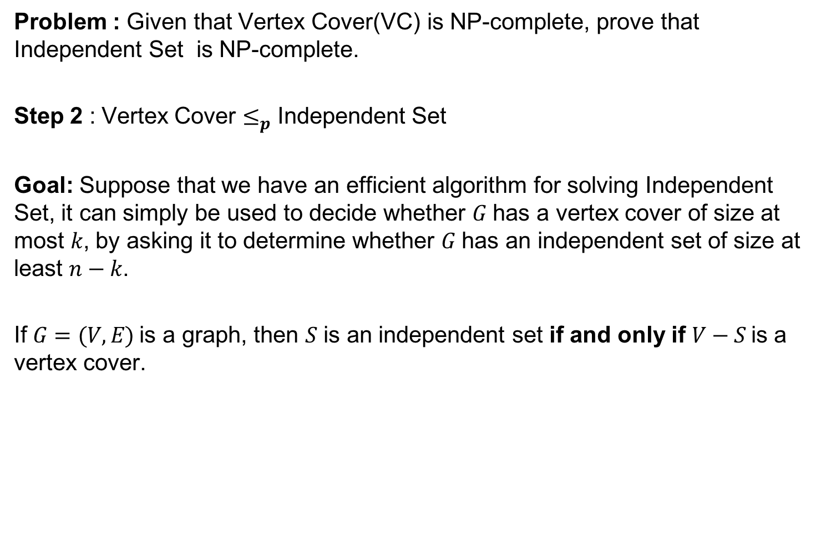
Independent set (IS)
Problem : Given that Vertex Cover(VC) is NP-complete, prove that Independent Set is NP-complete.
Step 2 : Vertex Cover $≤_{p}$ Independent Set
Goal: Suppose that we have an efficient algorithm for solving Independent Set, it can simply be used to decide whether $G$ has a vertex cover of size at most $k$, by asking it to determine whether $G$ has an independent set of size at least $n−k$.
If $G=(V, E)$is a graph, then $S$ is an independent set if and only if $V−S$is a vertex cover.

Slide 13
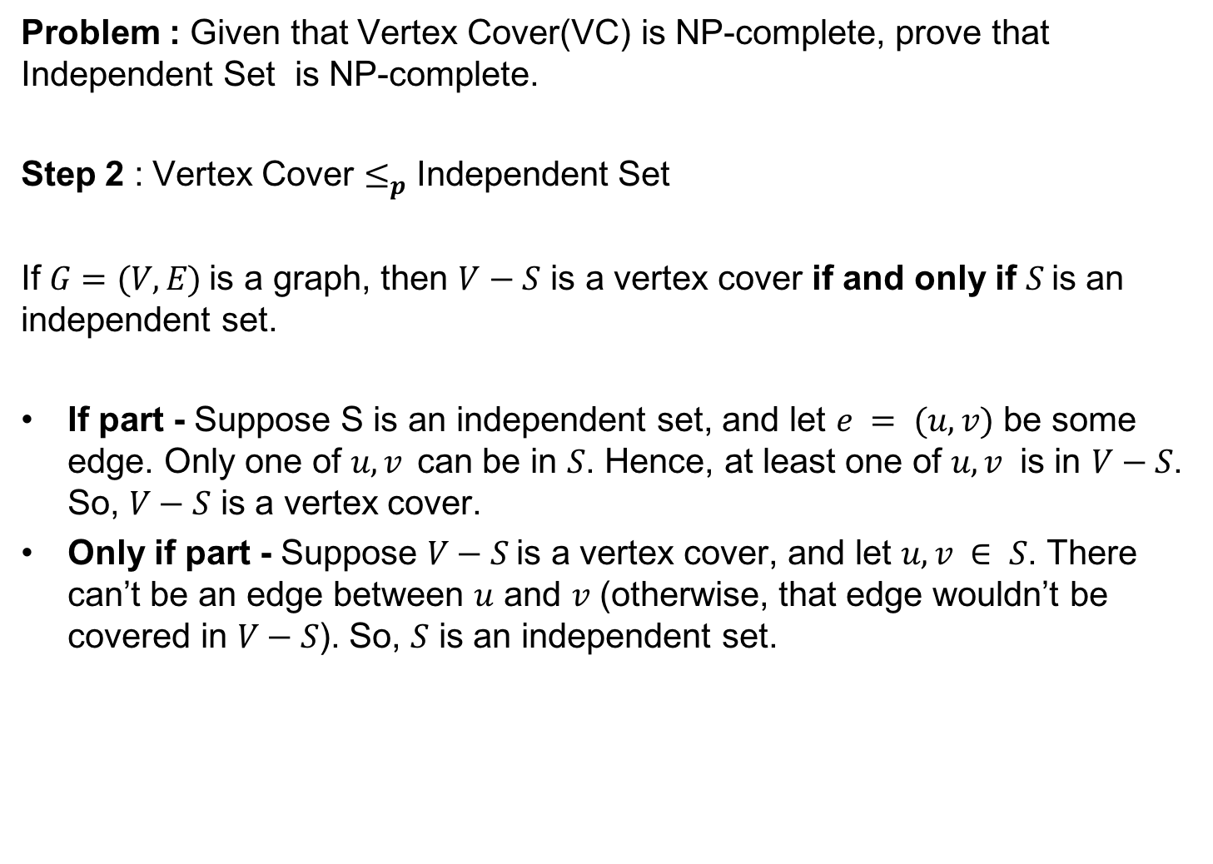
Independent set (IS)
Problem : Given that Vertex Cover(VC) is NP-complete, prove that Independent Set is NP-complete.
Step 2 : Vertex Cover $≤_{p}$ Independent Set
If $G=(V, E)$is a graph, then $V−S$ is a vertex cover if and only if $S$is an independent set.
If part - Suppose S is an independent set, and let $e = (u, v)$ be some edge. Only one of $u, v$can be in $S$. Hence, at least one of $u, v$ is in $V−S$. So, $V−S$ is a vertex cover.
Only if part - Suppose $V−S$is a vertex cover, and let $u, v ∈ S$. There can’t be an edge between $u$ and $v$ (otherwise, that edge wouldn’t be covered in $V−S$). So, $S$ is an independent set.

Slide 14
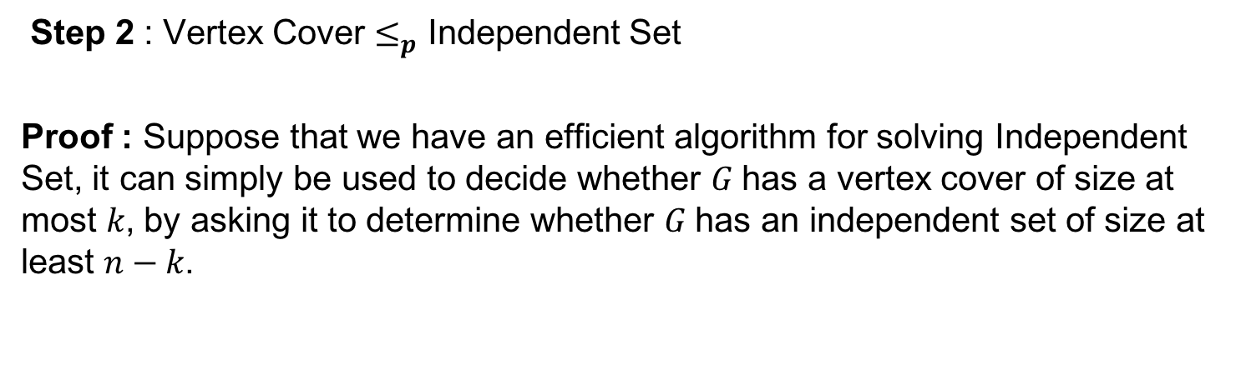
Independent set (IS)
Step 2 : Vertex Cover $≤_{p}$ Independent Set
Proof : Suppose that we have an efficient algorithm for solving Independent Set, it can simply be used to decide whether $G$ has a vertex cover of size at most $k$, by asking it to determine whether $G$ has an independent set of size at least $n−k$.

Slide 15
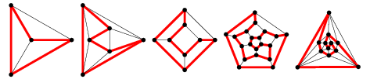
Hamiltonian Path (HP)
HAMILTONIAN-CYCLE (HC): Given an undirected graph,
determine if there is a Hamiltonian cycle in the graph.
Hamiltonian cycle: A cycle that visits each vertex exactly once.

Slide 16
Hamiltonian Path (HP)
HAMILTONIAN-CYCLE (HC): Given an undirected graph,
determine if there is a Hamiltonian cycle in the graph.
Hamiltonian cycle: A cycle that visits each vertex exactly once.
HAMILTONIAN-PATH (HP): Given an undirected graph G, determine if
there is a Hamiltonian path in the graph.
Hamiltonian path : A path in any directed graph that visits each
vertex exactly once.

Slide 17
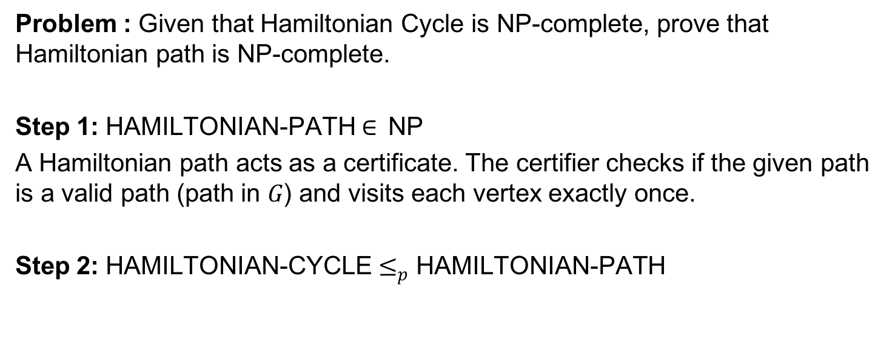
Hamiltonian Path (HP)
Problem : Given that Hamiltonian Cycle is NP-complete, prove that Hamiltonian path is NP-complete.
Step 1: HAMILTONIAN-PATH $∈$NP
A Hamiltonian path acts as a certificate. The certifier checks if the given path is a valid path (path in $G$) and visits each vertex exactly once.
Step 2: HAMILTONIAN-CYCLE $≤_{p}$ HAMILTONIAN-PATH

Slide 18
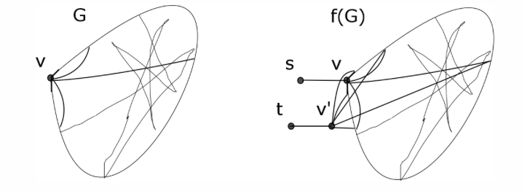
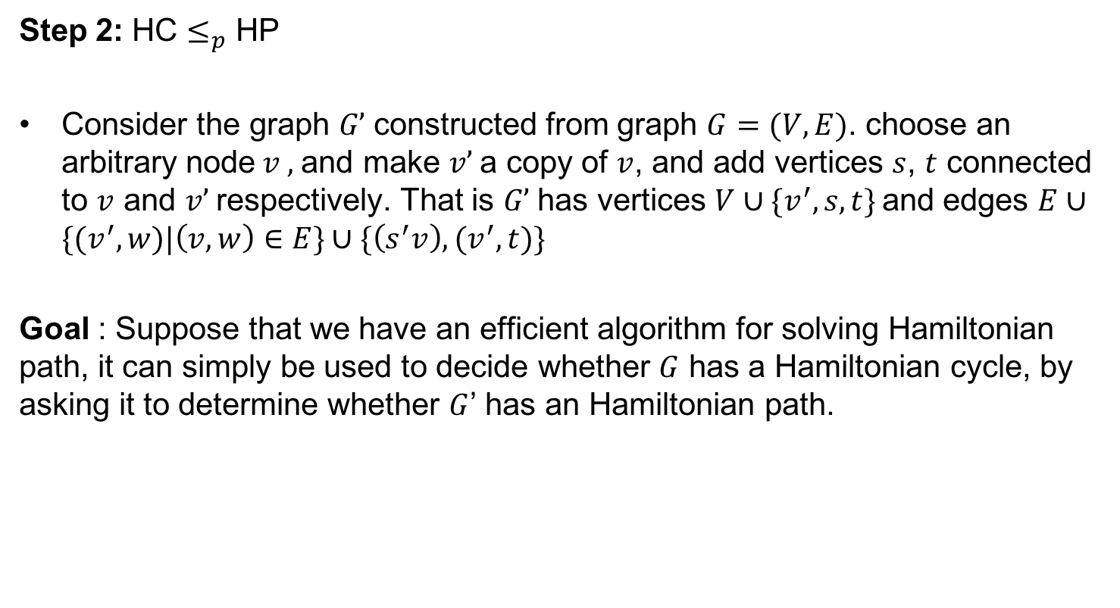
Hamiltonian path (HP)
Step 2: HC $≤_{p}$ HP
Consider the graph $G’$ constructed from graph $G=(V,E)$. choose an arbitrary node$v ,$and make $v’$a copy of $v$, and add vertices $s$, $t$ connected to $v$ and $v’$respectively. That is $G’$has vertices $V∪\{v^{′}, s, t\}$ and edges $E∪\{(v^{′},w)|\left(v,w\right)∈E\}$ $∪\{\left(s^{′}v\right), (v^{′},t)\}$
Goal : Suppose that we have an efficient algorithm for solving Hamiltonian path, it can simply be used to decide whether $G$ has a Hamiltonian cycle, by asking it to determine whether $G$’ has an Hamiltonian path.
G
G’

Slide 19
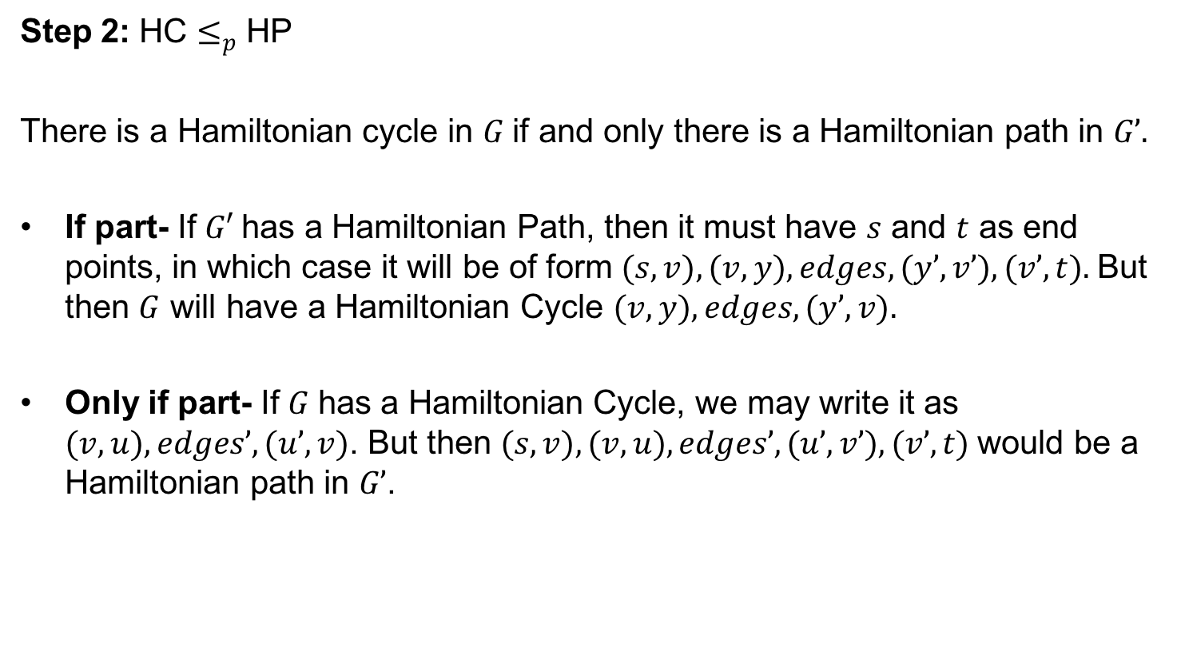
Hamiltonian path (HP)
Step 2: HC $≤_{p}$ HP
There is a Hamiltonian cycle in $G$ if and only there is a Hamiltonian path in $G’.$
If part- If $G′$has a Hamiltonian Path, then it must have $s$ and $t$ as end points, in which case it will be of form $(s, v), (v, y), edges, (y’, v’), (v’, t).$But then $G$ will have a Hamiltonian Cycle $(v, y), edges, (y’, v).$
Only if part- If $G$ has a Hamiltonian Cycle, we may write it as $(v, u), edges’, (u’, v)$. But then $(s, v), (v, u), edges’, (u’, v’), (v’, t)$would be a Hamiltonian path in $G’$.

Slide 20
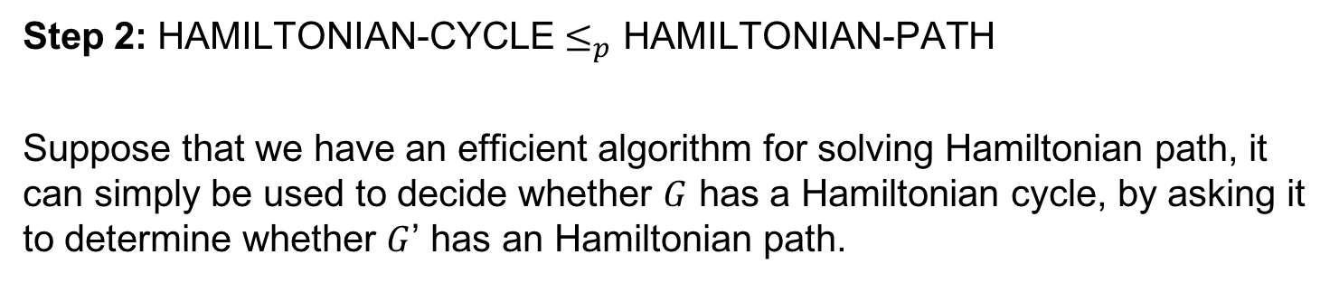
Hamiltonian path (HP)
Step 2: HAMILTONIAN-CYCLE $≤_{p}$ HAMILTONIAN-PATH
Suppose that we have an efficient algorithm for solving Hamiltonian path, it can simply be used to decide whether $G$ has a Hamiltonian cycle, by asking it to determine whether $G$’ has an Hamiltonian path.
G
G’

Slide 21
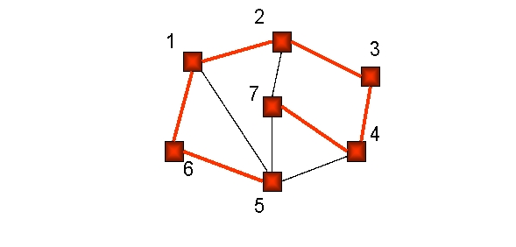
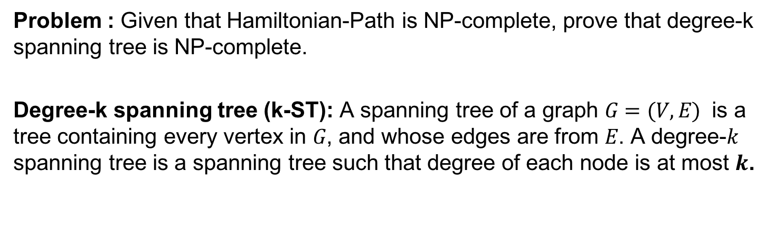
Degree bounded Spanning Tree(k-ST)
Problem : Given that Hamiltonian-Path is NP-complete, prove that degree-k spanning tree is NP-complete.
Degree-k spanning tree (k-ST): A spanning tree of a graph $G=(V,E)$ is a tree containing every vertex in $G$, and whose edges are from $E$. A degree-$k$ spanning tree is a spanning tree such that degree of each node is at most $k$.

Slide 22
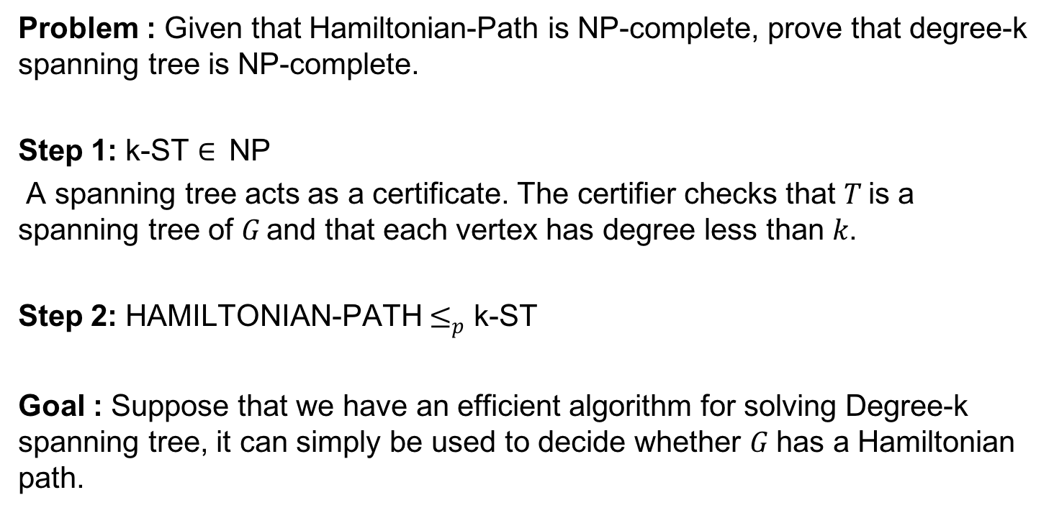
Degree-k Spanning Tree(k-ST)
Problem : Given that Hamiltonian-Path is NP-complete, prove that degree-k spanning tree is NP-complete.
Step 1: k-ST $∈$NP
A spanning tree acts as a certificate. The certifier checks that $T$is a spanning tree of $G$and that each vertex has degree less than $k$.
Step 2: HAMILTONIAN-PATH $≤_{p}$ k-ST
Goal : Suppose that we have an efficient algorithm for solving Degree-k spanning tree, it can simply be used to decide whether $G$ has a Hamiltonian path.

Slide 23
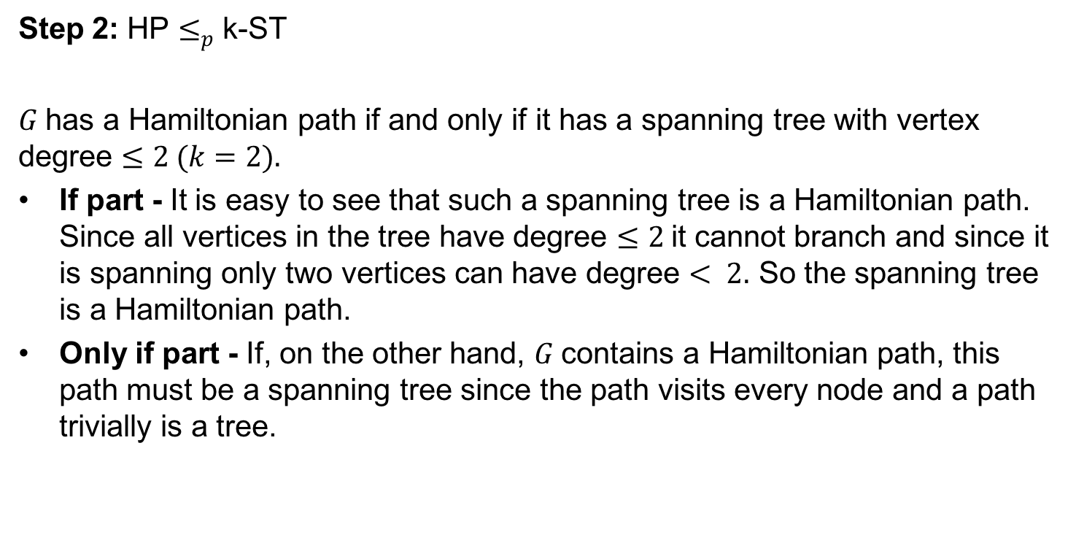
Degree-k Spanning Tree(k-ST)
Step 2: HP $≤_{p}$ k-ST
$G$ has a Hamiltonian path if and only if it has a spanning tree with vertex degree $≤2 (k=2).$
If part - It is easy to see that such a spanning tree is a Hamiltonian path. Since all vertices in the tree have degree $≤2$it cannot branch and since it is spanning only two vertices can have degree $< 2.$ So the spanning tree is a Hamiltonian path.
Only if part - If, on the other hand, $G$ contains a Hamiltonian path, this path must be a spanning tree since the path visits every node and a path trivially is a tree.

Slide 24
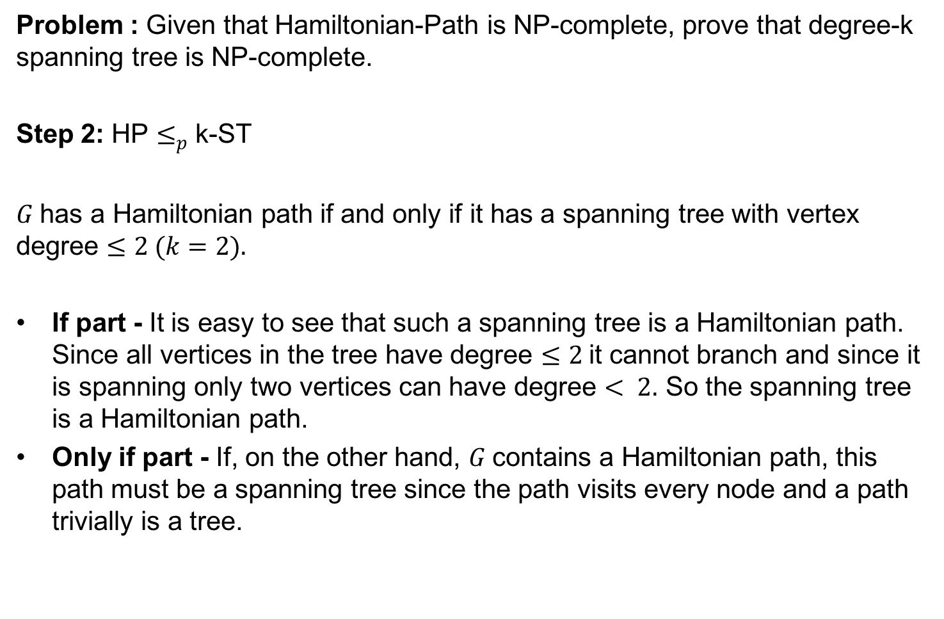
Degree-k Spanning Tree(k-ST)
Problem : Given that Hamiltonian-Path is NP-complete, prove that degree-k spanning tree is NP-complete.
Step 2: HP $≤_{p}$ k-ST
$G$ has a Hamiltonian path if and only if it has a spanning tree with vertex degree $≤2 (k=2).$
If part - It is easy to see that such a spanning tree is a Hamiltonian path. Since all vertices in the tree have degree $≤2$it cannot branch and since it is spanning only two vertices can have degree $< 2.$ So the spanning tree is a Hamiltonian path.
Only if part - If, on the other hand, $G$ contains a Hamiltonian path, this path must be a spanning tree since the path visits every node and a path trivially is a tree.

Slide 25
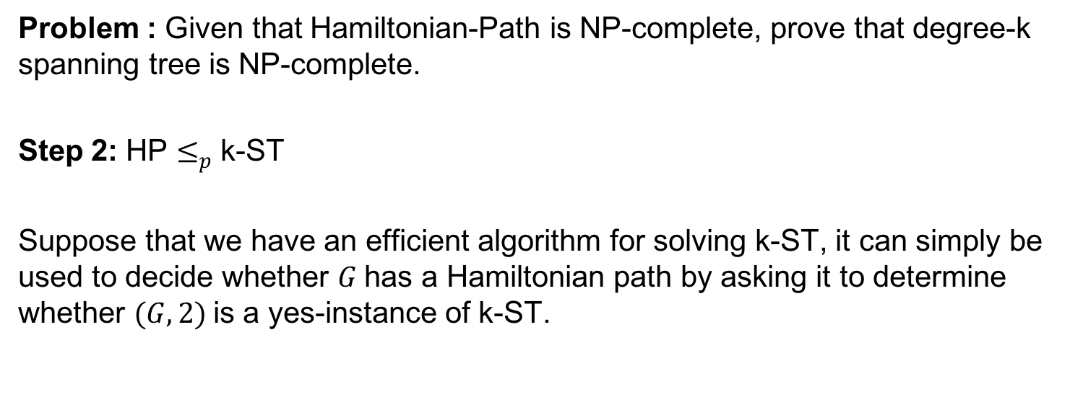
Degree-k Spanning Tree(k-ST)
Problem : Given that Hamiltonian-Path is NP-complete, prove that degree-k spanning tree is NP-complete.
Step 2: HP $≤_{p}$ k-ST
Suppose that we have an efficient algorithm for solving k-ST, it can simply be used to decide whether $G$ has a Hamiltonian path by asking it to determine whether $(G, 2)$is a yes-instance of k-ST.

Slide 26
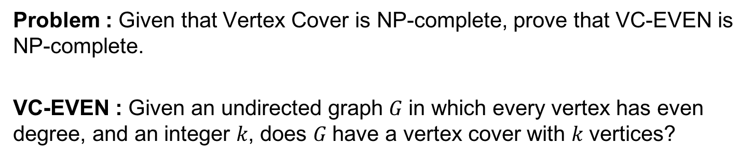
Even VC
Problem : Given that Vertex Cover is NP-complete, prove that VC-EVEN is NP-complete.
VC-EVEN : Given an undirected graph $G$ in which every vertex has even degree, and an integer $k$, does $G$ have a vertex cover with $k$ vertices?

Slide 27
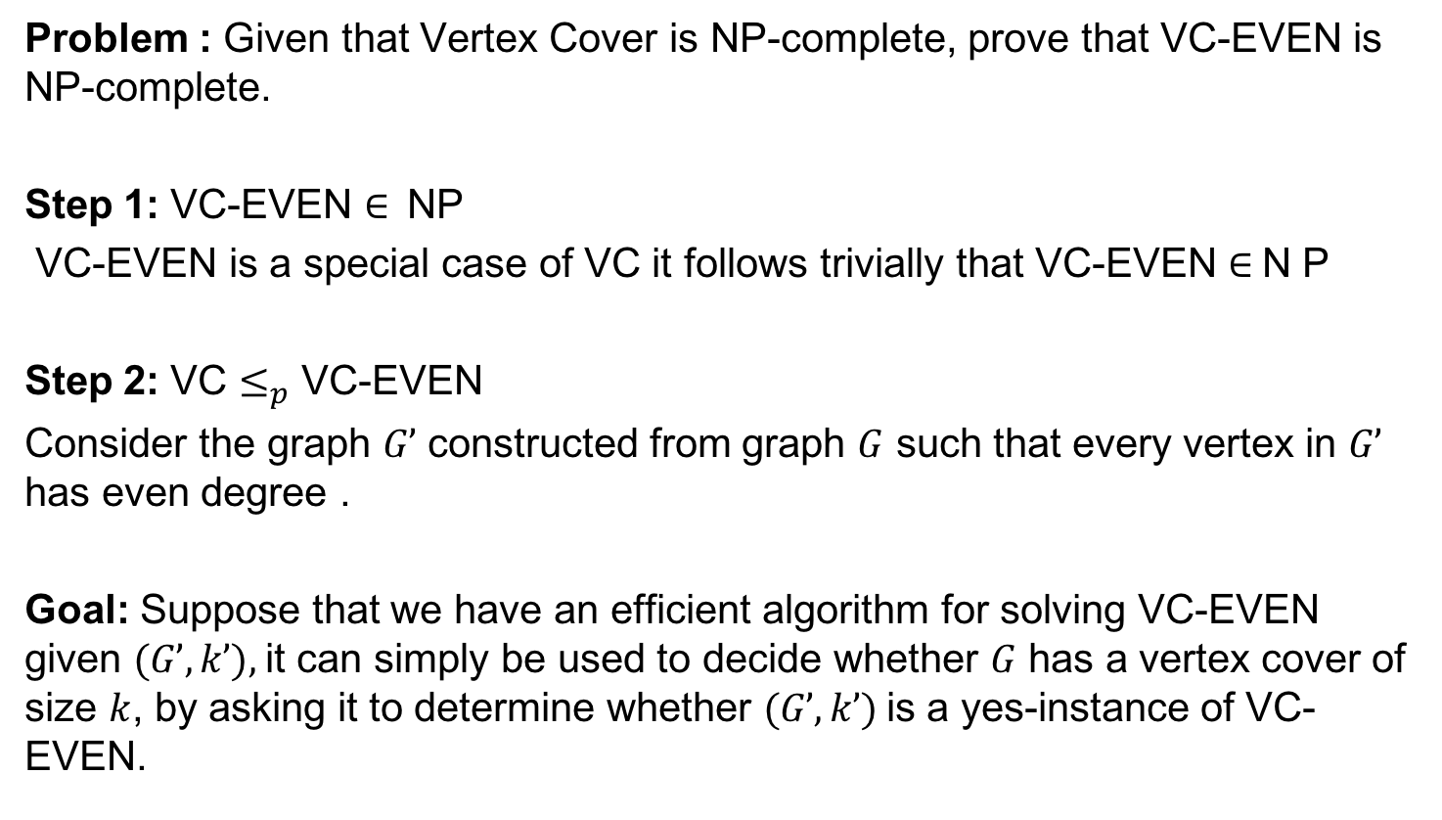
Even VC
Problem : Given that Vertex Cover is NP-complete, prove that VC-EVEN is NP-complete.
Step 1: VC-EVEN $∈$NP
VC-EVEN is a special case of VC it follows trivially that VC-EVEN $∈$N P
Step 2: VC $≤_{p}$ VC-EVEN
Consider the graph $G’$ constructed from graph $G$ such that every vertex in $G’$ has even degree .
Goal: Suppose that we have an efficient algorithm for solving VC-EVEN given $(G’, k’),$it can simply be used to decide whether $G$ has a vertex cover of size $k$, by asking it to determine whether $(G’, k’)$is a yes-instance of VC-EVEN.

Slide 28
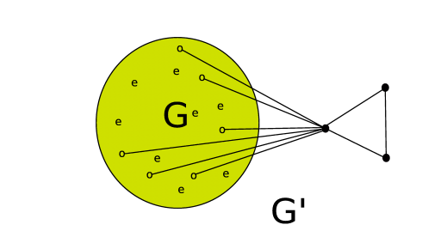
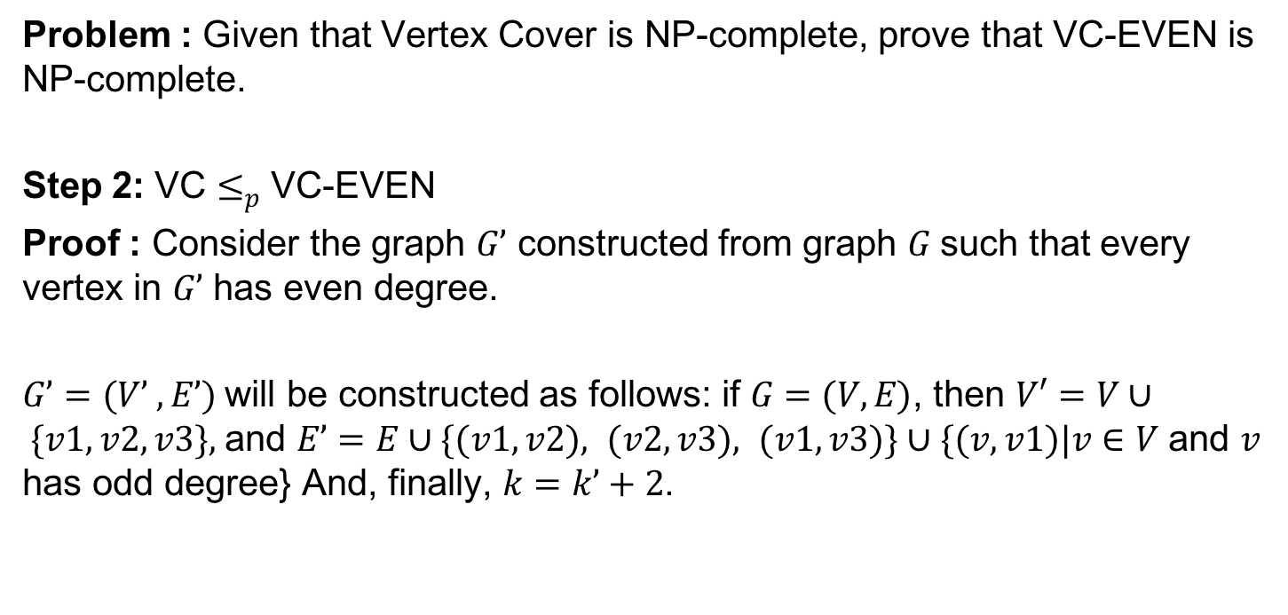
Even VC
Problem : Given that Vertex Cover is NP-complete, prove that VC-EVEN is NP-complete.
Step 2: VC $≤_{p}$ VC-EVEN
Proof : Consider the graph $G’$ constructed from graph $G$ such that every vertex in $G’$ has even degree.
$G’=(V’ , E’)$will be constructed as follows: if $G=(V, E)$, then $V′=V∪ \{v1, v2, v3\},$and $E’=E∪\{(v1, v2), (v2, v3), (v1, v3)\}∪\{(v, v1)|v∈V$ and $v$ has odd degree} And, finally, $k=k’+2$.

Slide 29
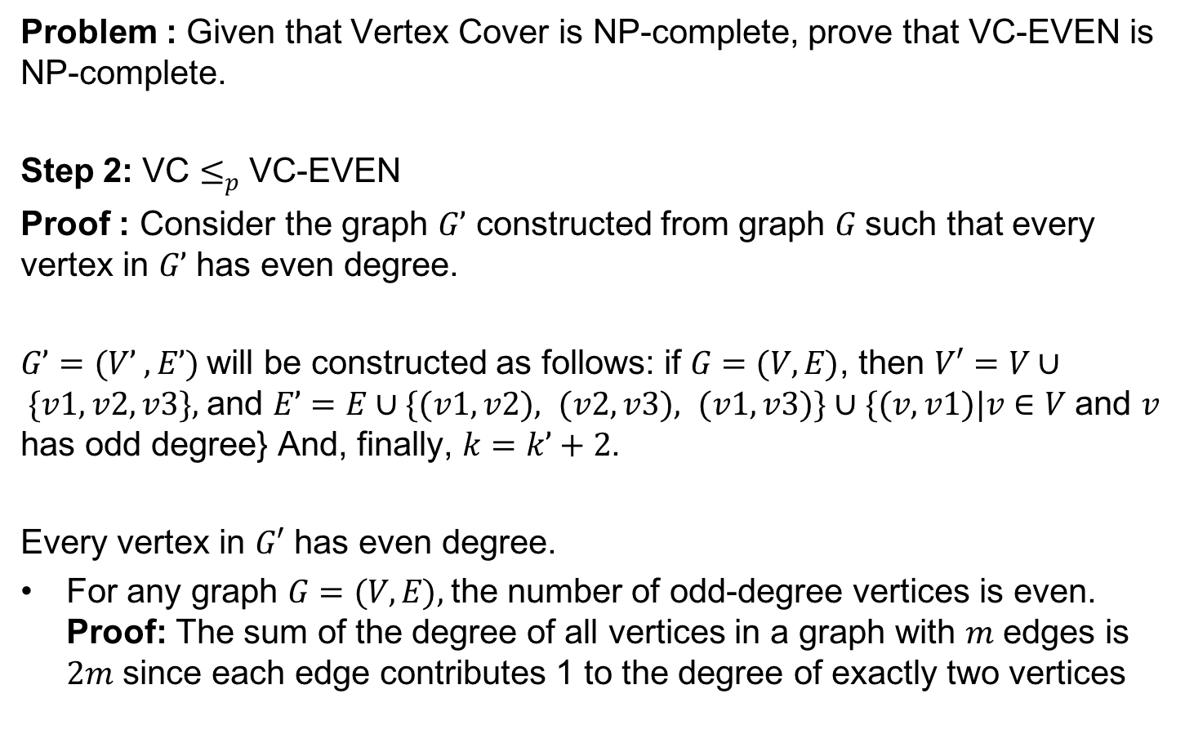
Even VC
Problem : Given that Vertex Cover is NP-complete, prove that VC-EVEN is NP-complete.
Step 2: VC $≤_{p}$ VC-EVEN
Proof : Consider the graph $G’$ constructed from graph $G$ such that every vertex in $G’$ has even degree.
$G’=(V’ , E’)$will be constructed as follows: if $G=(V, E)$, then $V′=V∪ \{v1, v2, v3\},$and $E’=E∪\{(v1, v2), (v2, v3), (v1, v3)\}∪\{(v, v1)|v∈V$ and $v$ has odd degree} And, finally, $k=k’+2$.
Every vertex in $G′$ has even degree.
For any graph $G=(V, E),$the number of odd-degree vertices is even. Proof: The sum of the degree of all vertices in a graph with $m$ edges is $2m$ since each edge contributes 1 to the degree of exactly two vertices

Slide 30
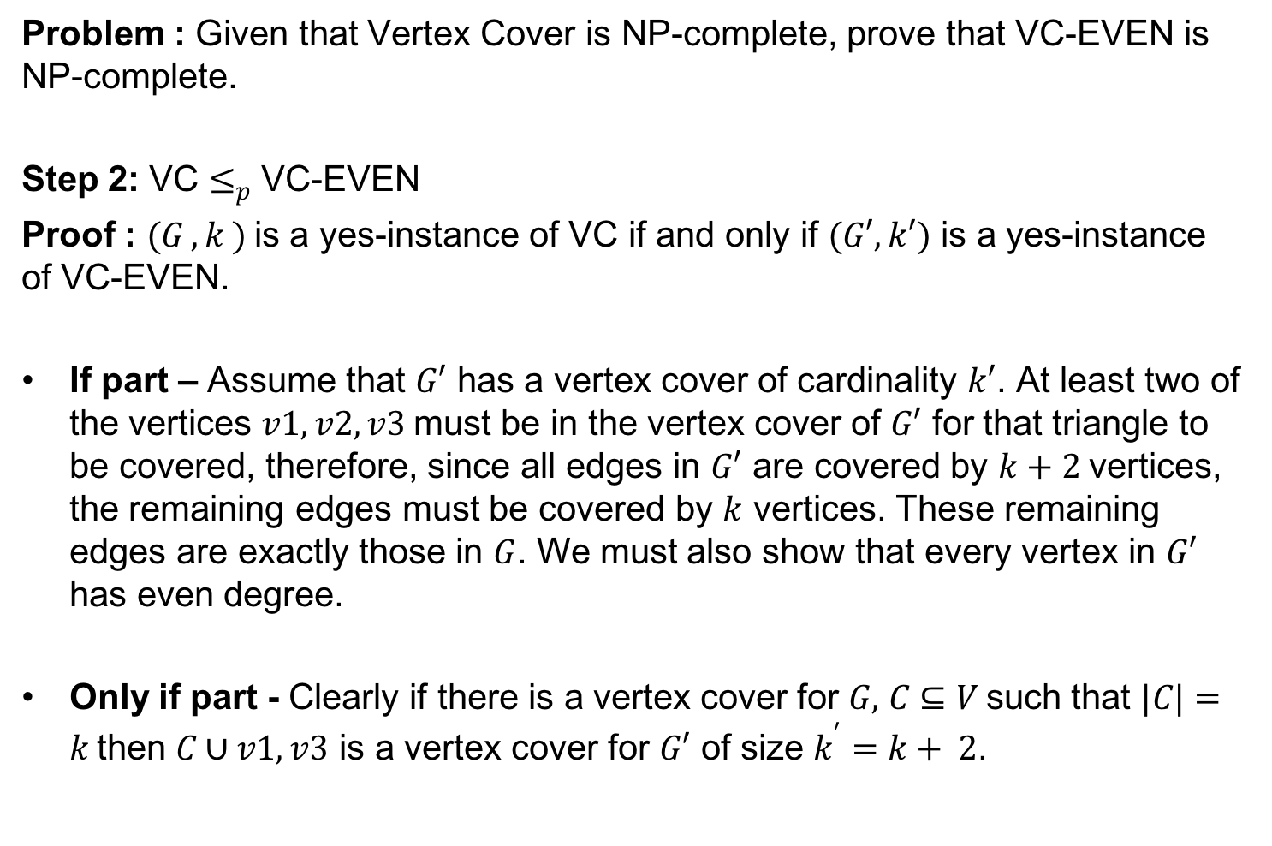
Even VC
Problem : Given that Vertex Cover is NP-complete, prove that VC-EVEN is NP-complete.
Step 2: VC $≤_{p}$ VC-EVEN
Proof : $(G , k )$is a yes-instance of VC if and only if $(G′, k′)$ is a yes-instance of VC-EVEN.
If part – Assume that $G′$ has a vertex cover of cardinality $k′$. At least two of the vertices $v1, v2, v3$must be in the vertex cover of $G′$ for that triangle to be covered, therefore, since all edges in $G′$ are covered by $k+2$vertices, the remaining edges must be covered by $k$ vertices. These remaining edges are exactly those in $G$. We must also show that every vertex in $G′$ has even degree.
Only if part - Clearly if there is a vertex cover for $G,$ $C⊆V$such that $|C|=k$then $C∪v1, v3$ is a vertex cover for $G′$ of size $k^{′}=k+ 2$.

Slide 31
Bin Packing
Given an infinite supply of unit-capacity bins, and a list of items i₁, i₂, …, pack the items into a minimum number of bins without exceeding any bin capacity.
Online Bin Packing: Must assign each item to a bin as soon as it arrives (!)
Bagging groceries, cutting stock (pipes, lumber), etc.
Performance Ratio: For a given instance (list of items) L, the performance ratio of an online bin packing heuristic H is the limit, as the number of items in L → ∞, of the maximum ratio
(#bins used by H to pack L) / (Opt #bins needed to pack L)

Slide 32
Questions/ Topic to Discuss?
.

