Slide 1
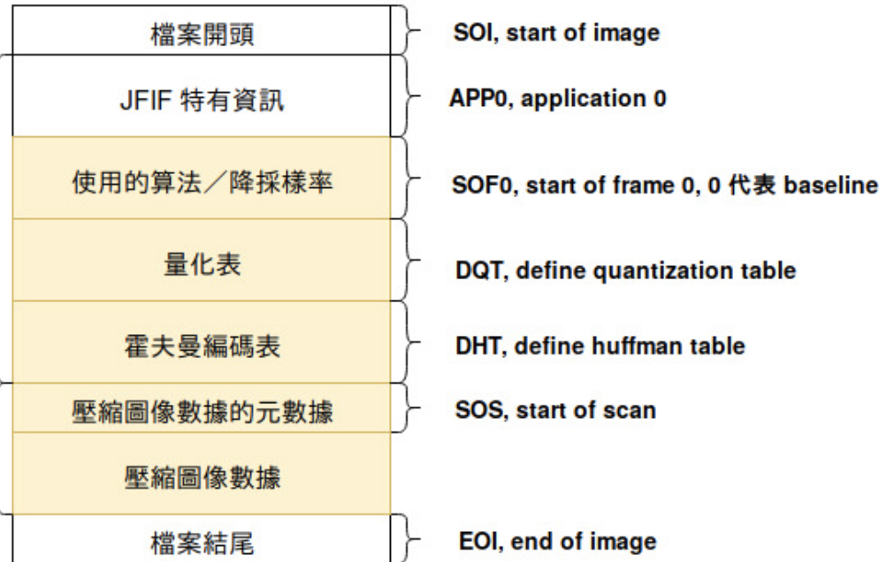
Phase1
newJPEG1
DHT
SOS
Compressed image data
Newdata1
Common JPEG markers
SOI , Start Of image
APPn , Application n
SOFn , Start of Frame n
DQT , Deline Quantization Table
DHT , Define Huffman Table
SOS , Start of Scan
Compressed Image Data
EOI , End of Image
AC 0
AC 1
DC 0
DC 1
JPEG1
DHT
SOS
Compressed image data
dataBFhuffman
Newdata
AC 0
AC 1
DC 0
DC 1
JPEG2
DHT
SOS
Compressed image data
NewHuffman
newJPEG2
DHT
SOS
Compressed image data
Newdata2
newJPEG1
DHT
SOS
Compressed image data
Newdata1
Phase2
FinalJPEG1
DHT
SOS
Compressed image data
Newdata1
Index1
chunk
hash
hash
block1
. . .
. . .
dedup
index
newJPEG2
DHT
SOS
Compressed image data
Newdata2
hash
FinalJPEG2
DHT
SOS
Compressed image data
Newdata2
Index2
block2
Backend

