Slide 1
完成
12/20 closed

Slide 2
initial design
Phase one (decoding and encoding of JPEG):
1. Decode JPEG files, extract 4 Huffman tables (DHT sections) for each JPEG file, respectively (DC 0/1 AC 0/1). Decode the JPEG compressed image data (SOS section) to the previous level, which is the data (dataBFhuffman) after quantization processing.
2. Use the Huffman tables of all JPEG files in the directory to reconstruct 4 new Huffman tables (NewHuffman)
3. Recompress dataBFhuffman according to NewHuffman, call it NewData and store it back to the original JPEG file.
4. NewHuffman will be stored in the file directory
Phase two (deduplication phase):
1. Divide NewData into small blocks, which can be adjusted here, and initially set to 16 * 16 pixel blocks.
2. Build an index of the blocks of all JPEG files in the directory
3. Calculate the hash value of each block, deduplicate the block according to the hash value, and update the index. Finally, only one copy of the same block will be left in the server.
4. Finally write the index back into each JPEG file and place the deduplicated blocks under the file directory.

Slide 3
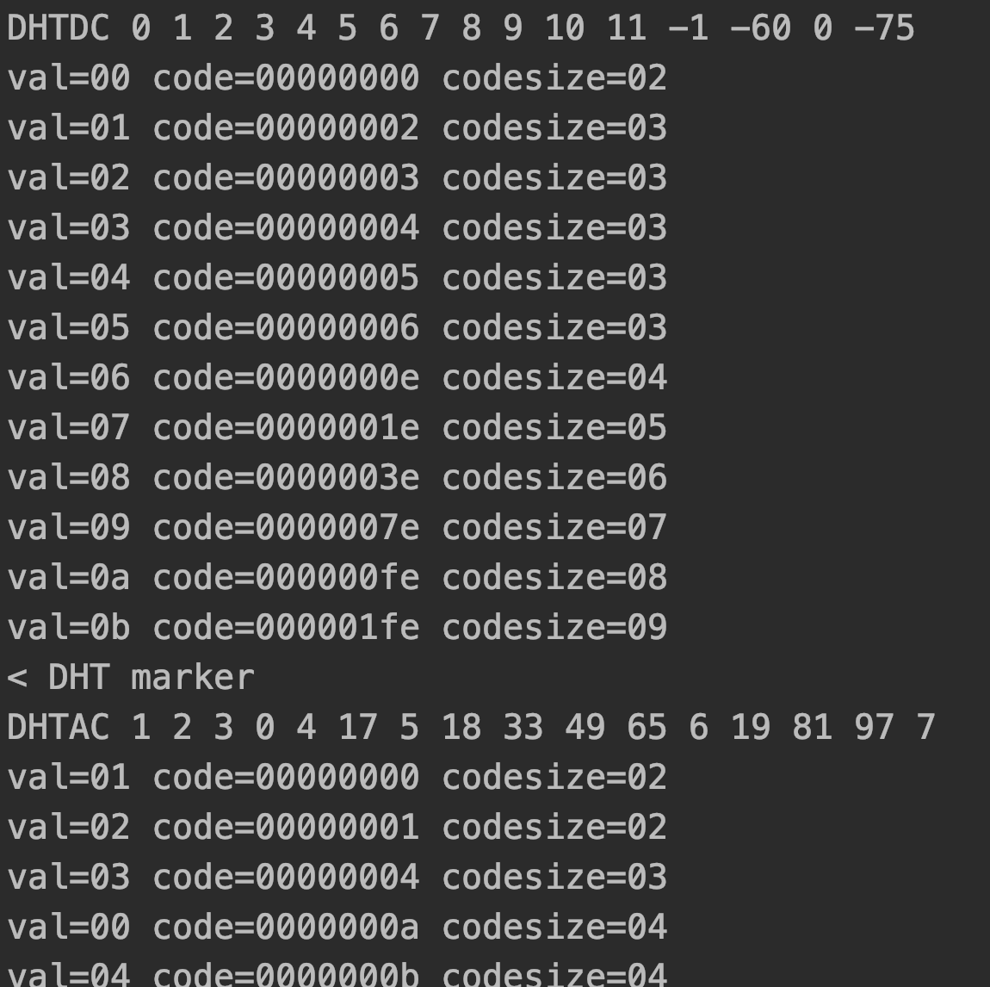
Huffman提取

Slide 4
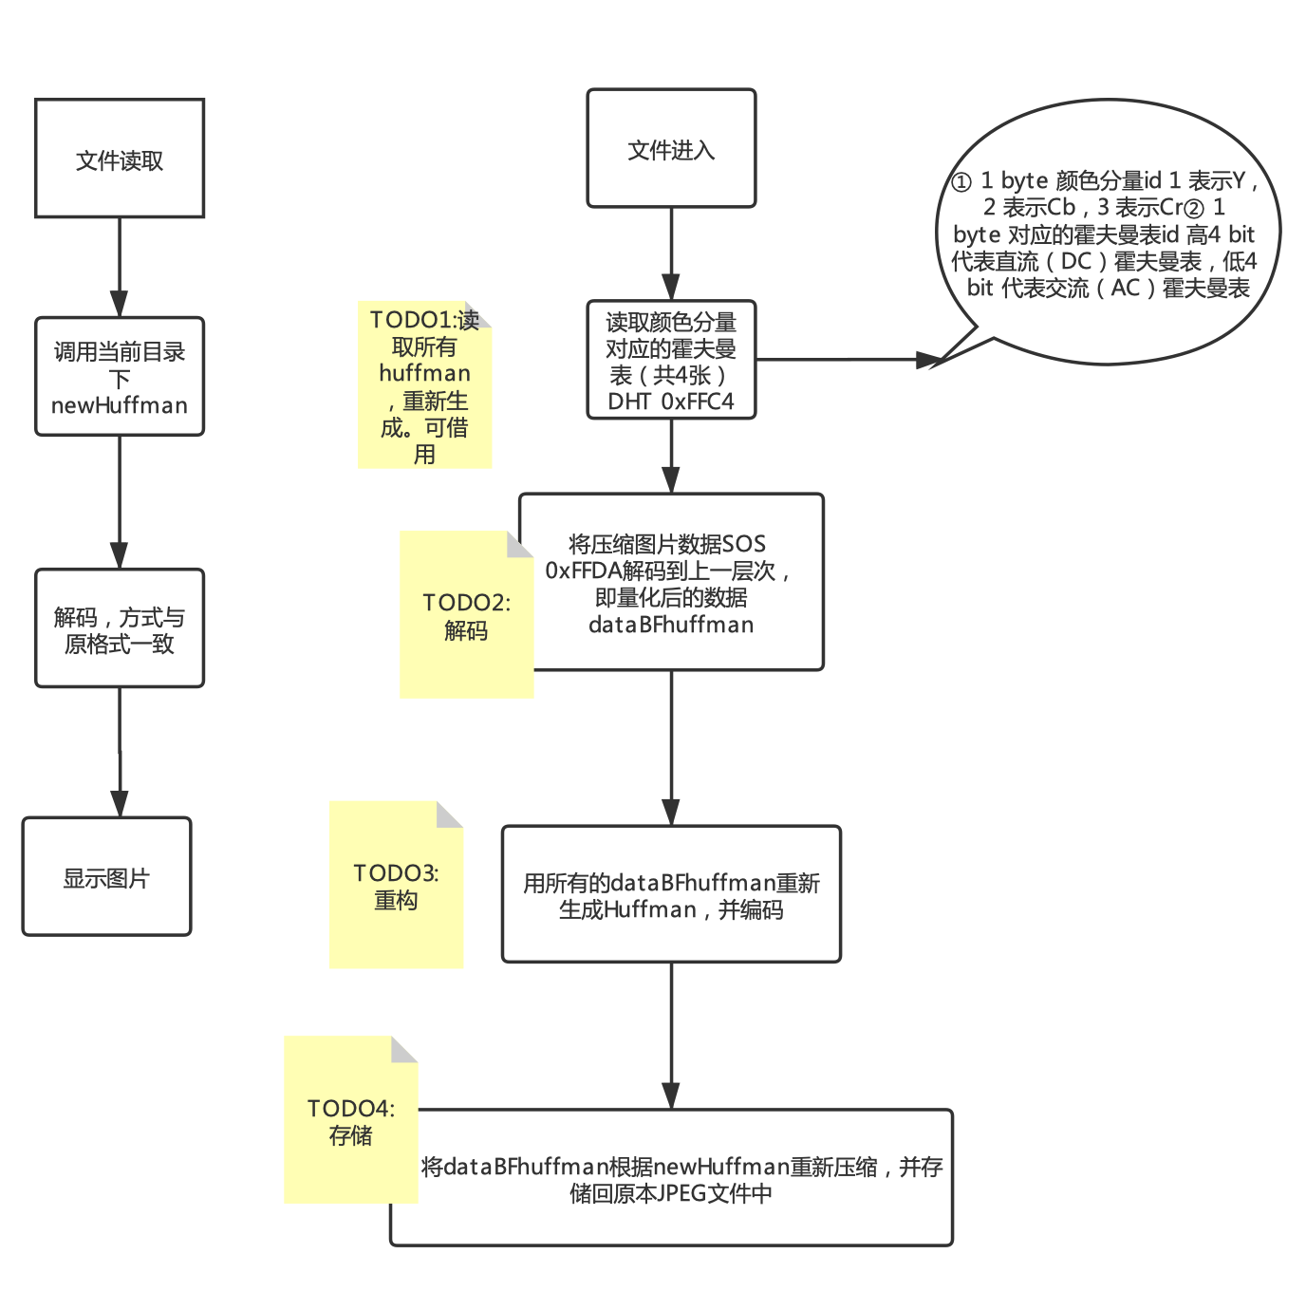
完成
完成
12/21 open

Slide 5
Huffman重构

