Slide 1
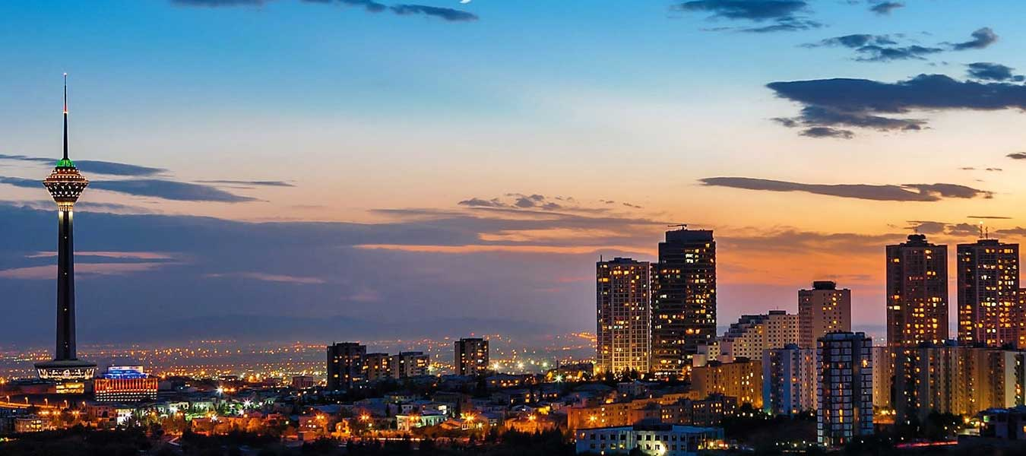
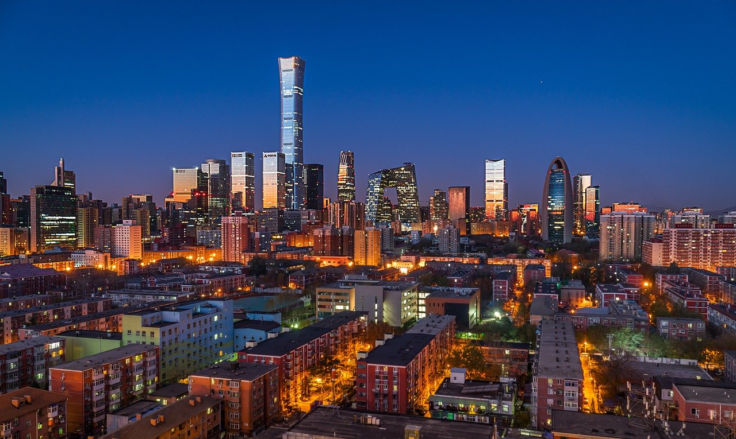
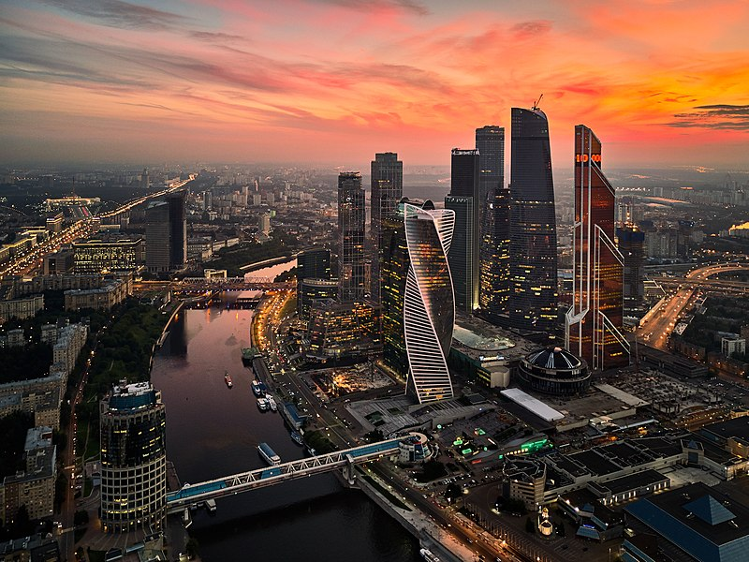


Political Culture & Participation
Unit 3
Notes:
Pictured: Tehran, Beijing, Tehran, Moscow
Photo attributiom: https://commons.wikimedia.org/wiki/File:North_Tehran_Towers.jpg
https://pixabay.com/de/photos/peking-stadt-nacht-china-horizont-5808012/
https://commons.wikimedia.org/wiki/File:Moscow-City_(36211143494).jpg

Slide 2
The knowledge you need to demonstrate at the end of this topic:
Define the term civil society.
Describe civil society.
Explain the role of civil society in each of the course countries.

Slide 3
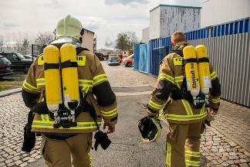
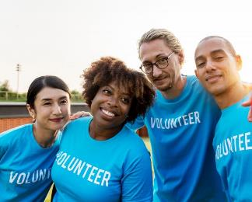
Unit 3.1 Civil Society
LO. Describe civil society and the explain the role of civil society among course countries
Civil Society Groups: chance for citizens w/common interests to associate together
such as community’s basketball league, NGOs
NGOs can provide services gov’t also provide.
volunteer fire depts, Foster children advocacy groups
international emergency relief & health assistance to global crisis areas: Amnesty International, Green Peace, Doctors w/o Borders
Influences on Civil Society
Regime type:
democratic regimes: culture of civil society tends to be pluralistic w/ citizens free to join wider variety of groups w/fewer gov’t restrictions
authoritarian regimes: more likely to monitor & restrict these groups
Gov’t limits
Registration
monitoring
Freedom of Assembly: most vital civil liberty protecting civil liberty groups
National Constitution Center’s “Rights Around the World” lists different countries constitutional rights
Notes:
Photo attribution: https://pxhere.com/en/photo/1508755
https://pxhere.com/en/photo/1040589

Slide 4
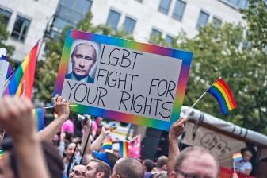
Unit 3.1 Civil Society
Russia
Secular Groups
constitution states, “Citizens of the Russian Federation shall have the right to gather peacefully, without weapons, and to hold meetings, rallies, demonstrations, marches, and pickets.”
does allow some groups to protest policies, but gov’t enacted series of laws since 2012 that criminalize organization of protests not approved by gov’t
allows citizens to form independent NGOs, but 2012 law requires political groups who receive funding from international sources to register as “foreign agents.” Finances of these groups then monitored more closely by gov’t
2013 protests against homophobia
Notes:
Photo attribution: https://www.flickr.com/photos/marcofieber/9639353304

Slide 5
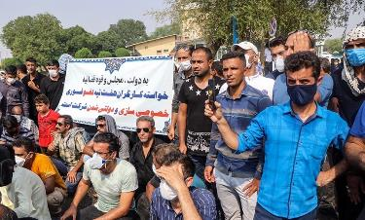
Unit 3.1 Civil Society
Iran
Secular Groups
Constitution states, “Public gatherings and marches may be freely held, provided arms are not carried and that they are not detrimental to the fundamental principles of Islam.”
2014, President Rouhani stated some independent NGOs organizations helped gov’t improve services
But gov’t used domestic terrorism laws & coercive tactics to restrict some independent groups
increased after gov’t used coercion & violence to suppress widespread protests ( 2009 presidential election)
Democracy movements ongoing since 1979 election
Notes:
Photo attribution: By Fars Media Corporation, CC BY 4.0, https://commons.wikimedia.org/w/index.php?curid=92822203
https://iran-hrm.com/wp-content/uploads/2020/05/followers-of-the-Bahai-faith.jpg

Slide 6
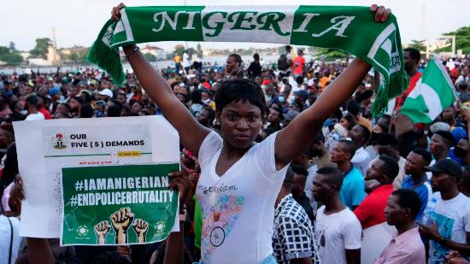
Unit 3.1 Civil Society
Nigeria
Secular Groups
Constitution states, “Every person shall be entitled to assemble freely & associate w/other persons, and in particular he may form or belong to any political party…provided [they do not conflict with] other powers [given] in this constitution.”
(2018) legislature declined to pass legislation requiring more gov’t monitoring of finances & approval of projects by some civil society groups & NGOs
(2018) But, Amnesty International reported gov’t inadequately protecting religious groups from Boko Haram attacks in central Nigeria, military leaders threatened to shut Amnesty’s office in Nigeria
(2020) gov’t authorities in national & local gov’t, used COVID pandemic lockdowns to harass & assault civil society groups working to hold officials accountable for gov’t pandemic response
End police brutality protest in 2017
Notes:
Photo attribution: https://www.vaticannews.va/en/world/news/2020-10/nigeria-protest-police-brutality-endsars.html
https://en.wikipedia.org/wiki/Nigeria

Slide 7
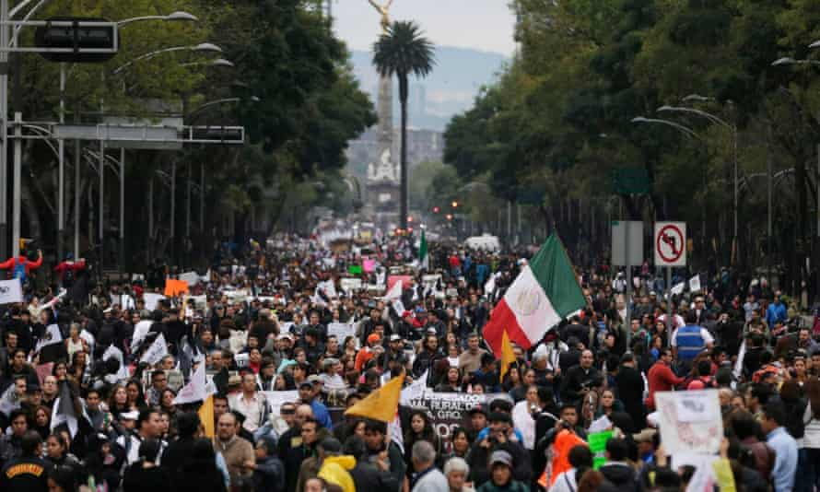
Unit 3.1 Civil Society
Mexico
Secular Groups
Constitution states, “the right to assemble or associate peacefully for any lawful propose shall not be restricted, but only citizens of the Republic may do so to take part in political affairs of the country. No armed deliberative meeting or gathering is authorized.”
(1985) Mexico City Earthquake inspired civil organizations to push gov’t into action (See later slides)
2014, protest against 43 missing students possibly handed over by the police to cartels & then massacred
Notes:
Photo attribution: https://www.theguardian.com/world/2014/nov/21/mexicans-protesting-about-missing-students-scuffle-with-police

Slide 8
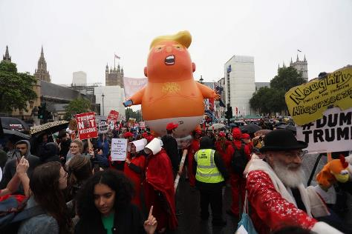
Unit 3.1 Civil Society
UK
freedom to join civil society groups is an agent of democratization & is as vital to democracy as competitive elections
Secular Groups: UK has no written constitution, but laws. The Human Rights Act (1998) states, “everyone has the right to freedom of peaceful assembly & to freedom of association w/others…no restrictions shall be placed on …these rights, other than [those required] in the interests of national security or public safety, for the prevention of disorder or crime, or protest of health or morals or for the protection of rights and freedoms of others. “
democratic gov’t but still w/some registration requirements
doesn’t strictly monitor & restrict actions of civil society groups like more authoritarian gov’ts
(2019) Trump’s UK visit protests
Notes:
Photo attribution: https://en.wikipedia.org/wiki/Religion_in_the_United_Kingdom#Christianity
https://www.nbcnews.com/think/opinion/trump-s-u-k-visit-protests-are-so-hilarious-because-ncna1013656

Slide 9
Comprehension Check
Q: How does civil society correlate with political legitimacy?
Correlate: 2 variables are connected in some way
Political legitimacy: believe the gov’t has the right to use their power
A: Civil society & political society positively correlate: they both go up together & down together
Q. T or F: only authoritarian regimes place restrictions on civil society groups.
A. False.
Q. Do civil society groups have to be political?
A. Nope.

Slide 10
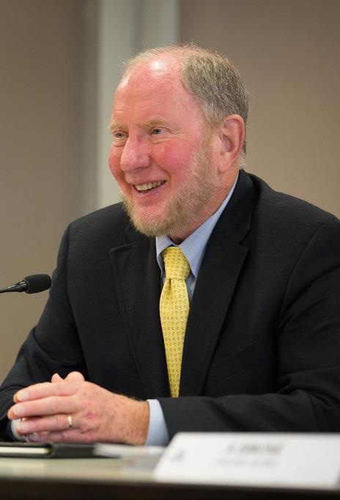
Robert Putnam, American political scientist specializing in comparative politics. Professor of Public Policy at the Harvard University JFK School of Government.
Political scientists documented citizens who belong to any civil society groups more likely to participate politically
Putnam wrote extensively about how civil society groups heighten political participation & are a necessary foundation in democratic political culture. Putnam concluded, citizens participate more in large & small political efforts when they are more involved in civil society groups.
It doesn’t matter if these groups are international NGOs like Amnesty International or a recreational sports league like a weekly bowling group. When citizens belong to civil society groups, it is more likely those citizens will have conversations that lead to complaints about gov’t. These complaints often lead to group members contacting gov’t officials to address these complaints which can be just as important to a democracy as holding a competitive election.
Notes:
Photo attribution: https://www.flickr.com/photos/forumpa/21567393524

Slide 11
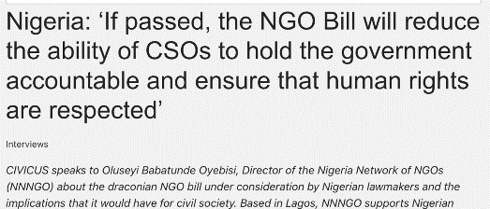
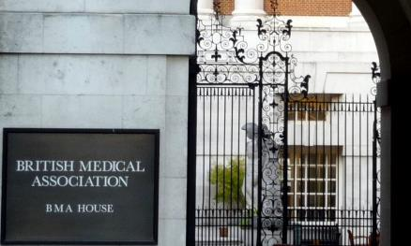
Unit 3.1 Civil Society
civil society organizations (1) monitor & lobby the gov’t (2) expose gov’t malfeasance
(3) represent interests of members (4) provide members w/organizational experience
Website news headline (2018)
Nigeria
Nigeria Labour Congress is umbrella organization for nearly 30 labor unions that represent interests of about 4 million workers & advocate for favorable workforce policies
(2018) Civil society groups & NGOs organized pressure to reject proposed national legislation that would have required more gov’t monitoring of finances & approval of projects by some civil society groups & NGOs
UK
UK headquarters some of best known international NGOs that attempt to shape policies & change gov’t behaviors in UK & globally
Oxfam & Save the Children address poverty
Amnesty International addresses human rights & advocates to abolish death penalty worldwide
The British Medical Association (BMA) is a pressure group that attempts to influence health care policy
During Covid-19 pandemic, local gov’ts initiated efforts to offer financial aid to help sustain civil society groups during healthcare & economic crisis
Notes:
Photo attribution: https://www.civicus.org/index.php/fr/medias-ressources/122-news/interviews/3043-nigeria-if-passed-the-ngo-bill-will-reduce-the-ability-of-csos-to-hold-the-government-accountable-and-ensure-that-human-rights-are-respected
https://commons.wikimedia.org/wiki/File:Facade-BMA-detail.JPG

Slide 12
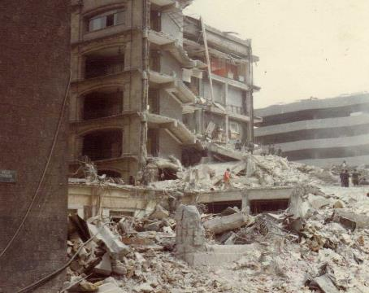
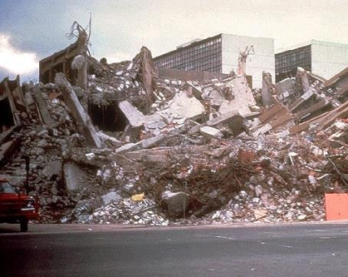
Mexico City Earthquake 1985
some political scientists trace origins of Mexico’s democratization to role civil society groups played in aftermath of Mexico City’s 1985 earthquake that killed about 5,000 residents.
Govt, run by PRI dominant party, incapable of addressing devastation of thousands of survivors trapped under destroyed buildings in megacity where about 5 million residents left w/no electricity or drinkable water
civil society groups formed & citizen volunteers coordinated efforts to rescuing those trapped in rubble & help address lack of electricity & drinking water.
Months later, groups began organizing pressure on PRI gov’t to address housing & reconstruction efforts for poor in Mexico City.
led to creation of Democratic Revolutionary Party (PRD) whose candidate is widely thought to have won 1988 presidential election over PRI dominant party candidate in 1988 until PRI stole victory away through election fraud.
chain of public movements to pressure PRI to reform Mexico’s elections & resulted in a non-PRI candidate being elected president 3x since 2000.
Civil society groups organizing & address crisis rather than waiting for a gov’t response started political reform effort in Mexico.
MORE RECENTLY: During Covid-19 pandemic, pluralism that had developed in w/many different civil society groups allowed them to advocate for/ work to implement different social & health policies when gov’t was strained due to increase of citizens’ needs during the pandemic.
Notes:
By Content Providers: CDC - phil.cdc.gov picture id=#1195Also previously uploaded at fr.wikipedia; description page is/was here.2004-06-18. Earlier Wikipedia uploader was Ske at fr.wikipedia, Public Domain, https://commons.wikimedia.org/w/index.php?curid=2623732
By Commons:Images donated by Roberto Esquivel Sánchez family, CC BY-SA 4.0, https://commons.wikimedia.org/w/index.php?curid=35514033

Slide 13
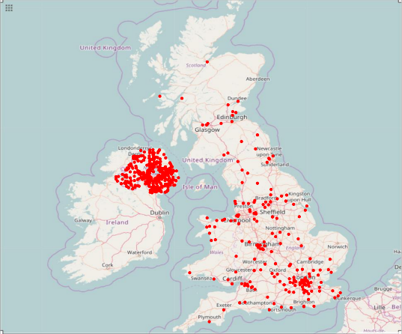
Unit 3.1 Civil Society
not all civil society groups are civil
Groups can form from common interest w/intent to shape policies to oppress or use violence to hurt other groups
In more democratic countries, freedom of association can be used by some criminal & terrorist groups to organize some activities which can make gov’ts focus on how to best balance protection of both liberty & order
Terrorist incidents map of the UK 1970–2015, w/a total of 4,972 incidents plotted. Northern Ireland and London are major hotspots for incidents. In 2017, there was a major attack in Manchester, following a concert by Ariana Grande.
Notes:
By Phoenix7777 - Own workData source:National Consortium for the Study of Terrorism and Responses to Terrorism. (2016). Global Terrorism Database (globalterrorismdb_0616dist.xlsx). Retrieved from https://www.start.umd.edu/gtd University of MarylandNational Consortium for the Study of Terrorism and Responses to Terrorism. (2016). Global Terrorism Database (gtd1993_0616dist.xlsx). Retrieved from https://www.start.umd.edu/gtd University of Maryland, CC BY-SA 4.0, https://commons.wikimedia.org/w/index.php?curid=59711959

Slide 14
Country Summary
Country | Strength of Civil Society | Specifics
Iran | Weak | Religious Control
Mexico | Growing | Transitioned from PRI party (corporatist groups) to democracy
Nigeria | Weak | Ethnic & religious divisions
Russia | Weak | Registration of groups required
UK | Strong | Log tradition of civil liberty protection

Slide 15
Conceptual Analysis FRQ 20 mins 4 points
Since 2000, the Russian government has undermined civil society groups.
Describe two restrictions to civil society adopted after Vladimir Putin became president in 2000.
Explain why the Russian government restricts civil society.
Describe one activity that indicates civil society has persisted despite these restrictions.
Explain why the Russian government continues to allow some civil society groups.

Slide 16

Unit 3.2 Political Culture
Political culture: SHARED beliefs & values that address the tension between order & liberty
Political cultural shapes the relationship btwn a state & its citizens
What role do citizens expect to play in the selection of gov’t officials?
What individual freedoms & liberties do citizens expect to be protected by gov’t?
What role do citizens think they should be able to play in influencing gov’t policy making?
How limited should powers of gov’t be?
Political is culture learned through political socialization: lifelong process of acquiring one’s beliefs, values, & orientations toward political system. Learned through: family, schools, peers, religious institutions, media, & social environments, civic organizations
Notes:
Photo attribution: https://pixabay.com/de/illustrations/feedback-r%C3%BCckmelden-gesch%C3%A4ftsleute-2990424/

Slide 17
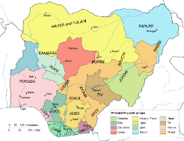
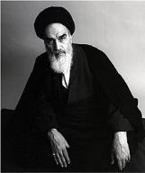
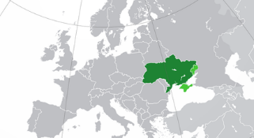
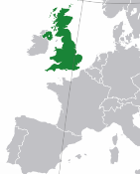
Unit 3.2 Political Culture
Political culture is influenced by geography, religious traditions, history
Ukraine
Ruhollah Khomeini
1t supreme leader
Nigeria | Iran | Russia | UK
History: political culture shaped by British colonialism. In creating boundaries of Nigeria, British colonial rulers divided/merged powers btwn different ethnic groups that still causes tension Before independence (1960) colonialism shaped: oil industry in south (economy) use of a common law (gov’t) independent judiciary (gov’t) | Religion: theocracy’s political culture shaped by principle of the Guardianship of the Islamic Jurist (Vilayat-e Faqih.) religious oversight of gov’t ensures Iran as an Islamic theocracy even w/ direct election of some gov’t officials. | History: political culture shaped w/fall of USSR & economic chaos this created in early 1990s. Russian politicians can often gain more support w/policies that reassert Russia’s regional influence in defiance of NATO such as the takeover of Crimea from Ukraine in 2014. Same cannot be said for possible Ukraine Invasion in 2022 | Geography: an island Kingdom and this impacts how they see their relationship with EU
Click to reveal
Click to reveal
Click to reveal
Click to reveal
Notes:
Photo attribution: https://en.wikipedia.org/wiki/Islamic_Government#/media/File:Roollah-khomeini.jpgKhomeini,
https://en.wikipedia.org/wiki/Nigeria#/media/File:Nigeria_linguistical_map_1979.svg
https://en.wikipedia.org/wiki/Ukraine#/media/File:Europe-Ukraine_(%D0%B8_%D0%BD%D0%B5_%D0%BA%D0%BE%D0%BD%D1%82%D1%80%D0%BE%D0%BB%D0%B8%D1%80%D1%83%D0%B5%D0%BC%D1%8B%D0%B5).png
https://en.wikipedia.org/wiki/United_Kingdom#/media/File:Europe-UK.svg

Slide 18
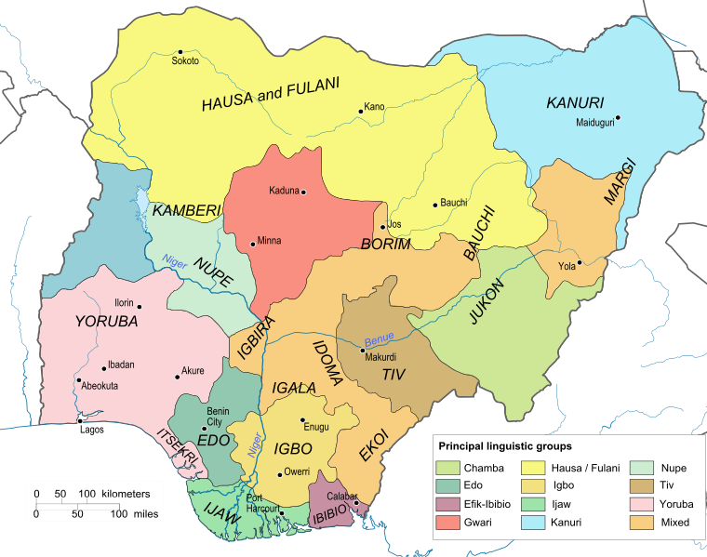
Nigeria’s ethnic groups
99% Muslim

Slide 19
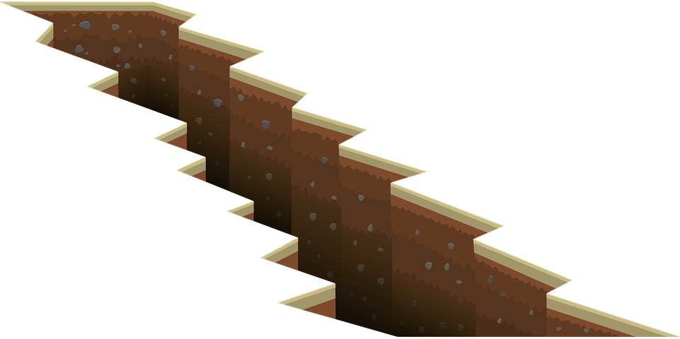
Unit 3.2 Political Culture
Social cleavages influence political socialization
Russia, Iran, Mexico
Urban v Rural Cleavages: more industry (urban & wealthy) v. agricultural (rural & poorer)
Nigeria
ethnic & geographical cleavages:
Igbos (east), Hausa-Fulani (north) & Yoruba (west).
religious & geographical cleavages:
Muslims (north), Christians (south), & mix of Muslims, Christians & animists (central/middle belt)
Wealth cleavages:
oil industry (south) , agrarian (north)
Iran
urban-rural social cleavage shaped citizen responses to 2009 presidential election
urban citizens support relaxing Iran’s gender disparity laws versus rural citizens support gov’ts strict regulations of gender disparity (dress requirements for females to cover skin)
Mexico
(1990s) urban v. rural cleavage shaped Zapatista uprising →less affluent & indigenous southern (Chiapas) protesting & attacking gov’t buildings to demand land rights & economic benefits
opposed gov’ts implementation of NAFTA
United Kingdom
Class distinctions: House of Lords (originally reserved for upper class members who had inherited seats) v. House of Commons (“commoners” not in upper class)
traditional social class cleavages: upper-elite Conservative Party v. working class Labour Party, Middle Class spit in btwn
social class still a role in political socialization → shapes party preference, political participation rates, policy preference for Brexit, etc
Notes:
Photo attribution: https://pixabay.com/de/vectors/riss-boden-kluft-oberfl%c3%a4che-erde-576083/

Slide 20
Comparative Analysis FRQ 20 mins 5 points
a) Select two countries that have different political systems, principles, institutions, processes, policies, and behaviors.
B) What comparison could you make about the political culture in the two countries you selected?
Authoritarian: Iran, Russia
In UK: social agents are the same, such state run media (BBC in UK)
Democratic: UK, Mexico, Nigeria
Remember: comparison doesn’t just mean similarities, you must also discuss differences
The UK does nothing similar to this.

