Slide 1
Timetable Optimisation
Using Genetic Algorithms
222BDA03 Jason Alvin Chesney
222BDA17 Lajiya Aleena Saji
222BDA31 Shivani M
222BDA52 Sanjay Karthik M
222BDA63 Alvina Joanna

Slide 2
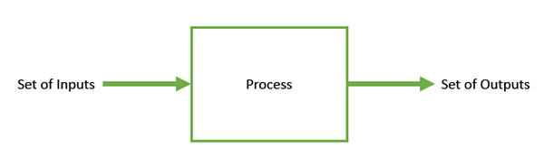
Optimization:
Optimization is the process of making something better. In any process, we have a set of inputs and a set of outputs as shown in the following figure. Optimization refers to finding the values of inputs in such a way that we get the “best” output values.

Slide 3
What is the Genetic Algorithm?
Genetic Algorithm (GA) is a search-based optimization technique based on the principles of Genetics and Natural Selection. It is frequently used to solve optimization problems.
The areas of application of GAs include the following:
Finding the shortest paths (traveling salesman problem)
Tasks of placement and scheduling

Slide 4
Parameters Considered
In the timetables that we generated and compared, we assume:
3 teachers
3 slots (periods) in a day
3 teaching days (in a week)

Slide 5
Constraints that were used in our usecase
Hard Constraints
Two teachers cannot teach one class in the same slot
Two classes cannot be taught by one teacher in the same slot
Soft Constraints
A teacher may not teach more than three hours in three days

Slide 6
Basic Terminology
Population − It is a subset of all the possible (encoded) solutions to the given problem. The population for a GA is analogous to the population for human beings except that instead of human beings, we have Candidate Solutions representing human beings.
class1 class2
 | p1 | p2 | p3
Mon | 1 | (1,3) | (2,3)
Tue | (1,3) | (2,3) | (2,3)
Wed | 1 | (1,3) | (1,3)
 | p1 | p2 | P3
Mon | Nan | 1 | 1
Tue | (1,3) | (1,3) | 1
Wed | (2,3) | 3 | (1,2,3)

Slide 7
Chromosomes − A chromosome is one such solution to the given problem.
Class 1
 | Monday |  |  | Tuesday |  |  | Wednesday
Teachers | Period 1 | Period 2 | Period 3 | Period 1 | Period 2 | Period 3 | Period 1 | Period 2 | Period 3
1 | 1 | 1 | 0 | 1 | 0 | 0 | 1 | 1 | 1
2 | 0 | 0 | 1 | 0 | 1 | 1 | 0 | 0 | 0
3 | 0 | 1 | 1 | 1 | 1 | 1 | 0 | 1 | 1
Class 2
 | Monday |  |  | Tuesday |  |  | Wednesday
Teachers | Period 1 | Period 2 | Period 3 | Period 1 | Period 2 | Period 3 | Period 1 | Period 2 | Period 3
1 | 1 | 1 | 0 | 1 | 0 | 0 | 1 | 1 | 1
2 | 0 | 0 | 1 | 0 | 1 | 1 | 0 | 0 | 0
3 | 0 | 1 | 1 | 1 | 1 | 1 | 0 | 1 | 1

Slide 8
Gene − A gene is one element position of a chromosome.
Allele − It is the value a gene takes for a particular chromosome.

Slide 9
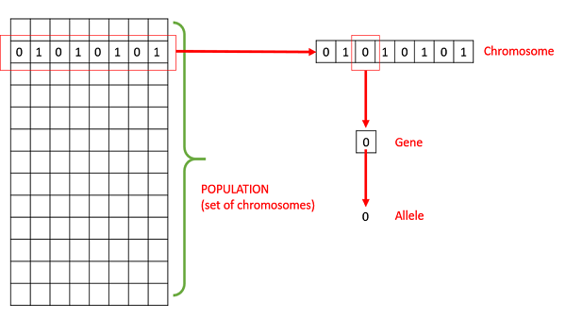

Slide 10
Fitness Function
The fitness function is used to determine the individual's fitness level in the population.
It means the ability of an individual to compete with other individuals. In every iteration, individuals are evaluated based on their fitness function.
It is a measure of how well an individual solves a problem.
Fitness = 1/(1+Collision count)
Whenever the Fitness = 1,we can say that the individual is well fitted to the population.
Here for example, if there are 2 collisions , the fitness would be,
Fitness = 1/(1+2) = 1/3 =0.3333
If there is 1 collision, then,
Fitness = 1/(1+1) =1/2 =0.5
Hence if there is no collision, i.e, collision = 0, then,
Fitness = 1/(1+0) = 1 , which means the individual is well fitted to the population.

Slide 11
GENETIC OPERATORS
A genetic operator is an operator used in genetic algorithms to guide the algorithm towards a solution to a given problem.
Genetic operators play a role in changing the genetic composition of the next generation.
There are three main types of operators:
→ Selection
→ Cross Over
→ Mutation

Slide 12

SELECTION
The selection phase involves the selection of individuals for the reproduction of offspring.
Selection itself does not generate the new population; it is only responsible for selecting individuals that can leave the offspring.
There are three types of Selection methods available, which are:
Roulette wheel selection
Tournament selection
Rank-based selection

Slide 13
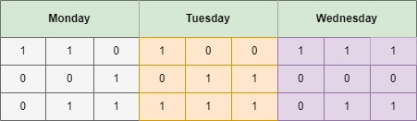








However in this genetic algorithm for timetable optimisation, we are actually doing selection line by line.
Consider chromosomes for the Class 1.We are selecting Faculty_1 teaching in Class 1 on Monday, Tuesday and Wednesday
Faculty _1

Slide 14
CROSSOVER
.
The crossover plays a most significant role in the reproduction phase of the genetic algorithm.
In this process, a crossover point is selected at random within the genes.
The main purpose of crossover is the exchange of genetic information, and to transfer the accumulated experience to the offspring. The child should not be very different from the parents.

Slide 15
Parent:1
+
+
+
+
+
+
+
+
=
6
Parent:2
=
5
Parent:3
=
4

Slide 16
Child:1
=
3
Child:2
=3
Child:3
=3

Slide 17
MUTATION
The mutation operator inserts random genes in the offspring (new child) to maintain the diversity in the population.
It can be done by flipping some bits in the chromosomes.
Now consider Faculty_1, Faculty_2
Faculty_1
= 3
Collision
Faculty_2
= 3
=3
Thus mutation between genes would avoid collisions
Thus mutation between genes would avoid collisions

Slide 18
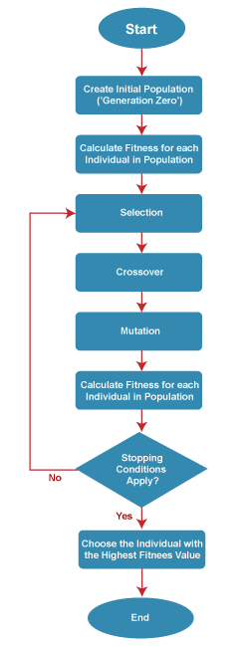
General Workflow of a Simple Genetic Algorithm

Slide 19
Thank You
We’re grateful for the opportunity to work on this project and especially to those who contributed towards the final output.
Special mention to: Praveen Kumar, Jayati Kaushik, Jayati and our loving classmates
Reference literature:
A Review of Optimisation Algorithms for University Timetable Scheduling by students of the Umm Al Qura University
Learning Genetic Algorithms with Python by Ivan Gridin

