Slide 1
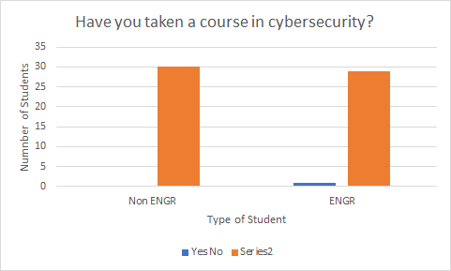
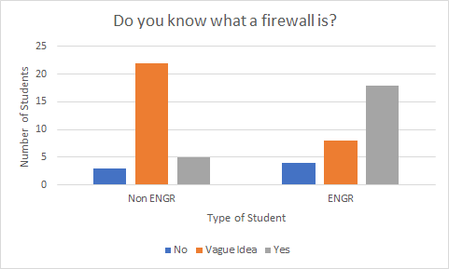
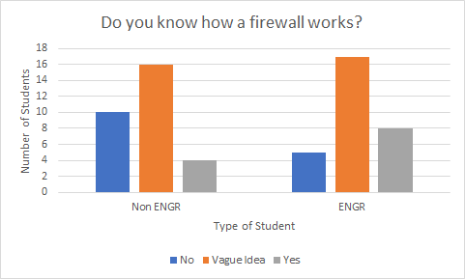
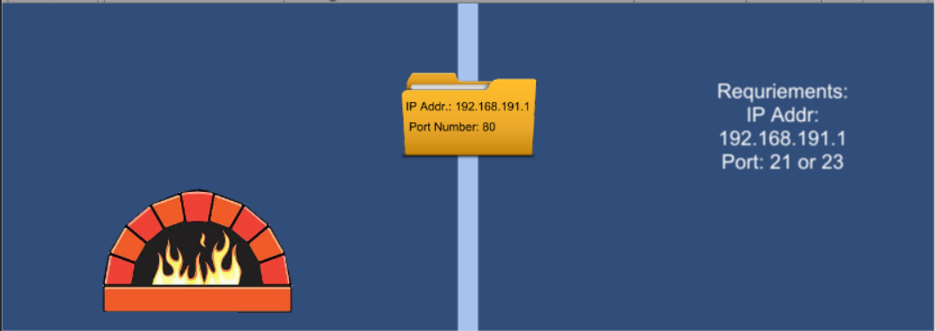
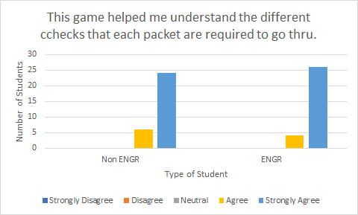
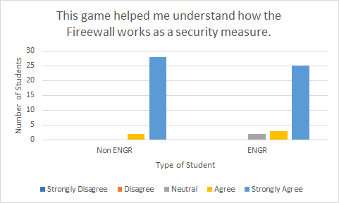
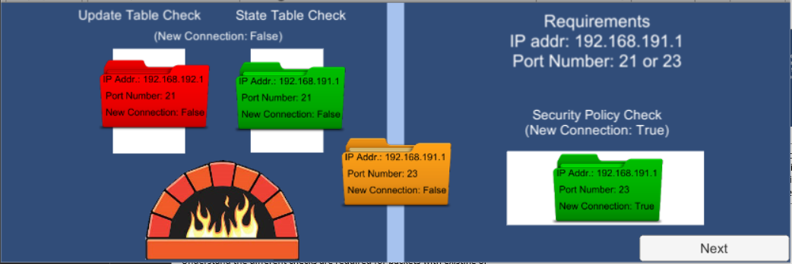
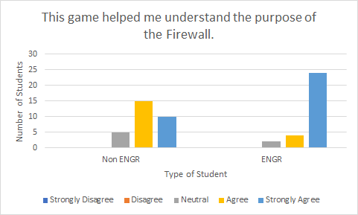
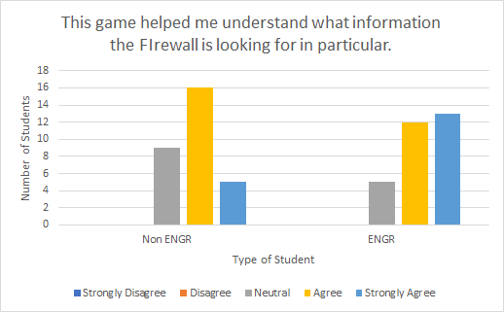
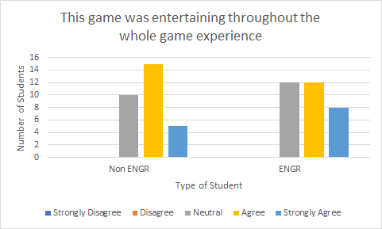
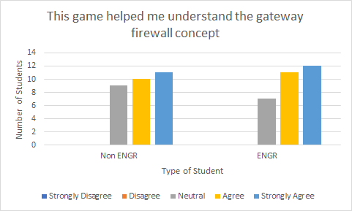
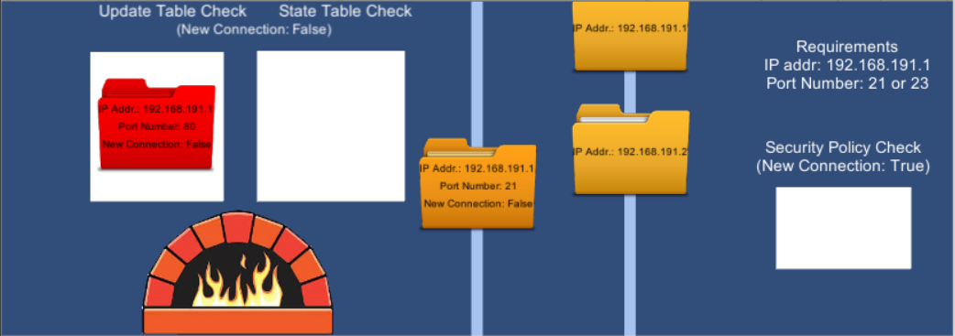
Introduction
Firewall Education Game
Pre Survey
A lot of the current network security games is directed towards young children to protect their identity and to encourage safe practices. I wanted to create a game that would be more directed towards college students interested in a more in depth understanding of network security. Therefore, I wanted this game to have higher level concepts taught in this course, such as as buffer overflow, worms, and bots. In the end, this game strictly focuses on the concept of the firewall, what it is and how it works.
Josephine Cornelius
This game was distributed to 30 engineering non computer science student and 30 non engineering student.
Game Design
The main game design throughout the game is the player acting as a firewall. Before each level, there will be an informative screen that will educate the player on concepts and instructions for the level. In each level, the player will sort through the good packets and the bad packets. Allowing the good packets thru and disposing the bad packets by dragging and dropping it into the furnace. As each packet comes down vertically across the screen, the player must determine if it should be disposed before it reaches the bottom of the screen. Each level builds upon the level previous.
Previous Work
-McAfee’s Cybersecurity Game
Directed towards kids
Mission based game to secure documents using multi factor authentication.
-PBS NOVA Cybersecurity Lab Game
Player must complete challenges to strengthen their defenses and thwart attackers
CynjaSpace Cybersecurity Game App
Teaching children at an early age how to be safe online
Includes ISACA’s cybersecurity guidance
TAMU IT Cybersecurity Game- Keep Tradition Secure
Q and A based game
Packet Filtering Level
The player will filter the packets using the given IP address and port number.
Post Survey
Learning Objectives
Session Filtering Level
Similar to any course, after completing this game, the player should be able to meet these learning objectives.
-Understand what a packet is
-Understand the purpose of the Firewall
-How it works as a security measure to the computer
-Understand what information on the packet is the Firewall looking for in particular
Port
IP address
-Understand the different checks are required for packets with existing or new connections
State and Update Table
Security Policy
-Understand the gateway concept
The player will filter the packets by determining if they pass certain checks. If it is a new connection, they must drag the packet to the security policy check and the packet will change color, red or green, good or bad. If it is an existing connection they must check with both the update table and state table.
Gateway Level
Goals
The player will check for outgoing packets and check with a given IP address.
In order for this game to be a successful educational game, there are five goals this game should accomplish:
-Include details
-Have appropriate context
-Balance between instruction and entertainment
-Adequate feedback
-Appropriate challenging levels
Future Developments
In the future, I hope to add more games surrounding other cybersecurity topics, such as buffer overflow, viruses, worms, bots, phishing. And with a more complete game I would like to introduce this game to cyber security classes as a new way to teach students basic cyber security concepts.

