Slide 1
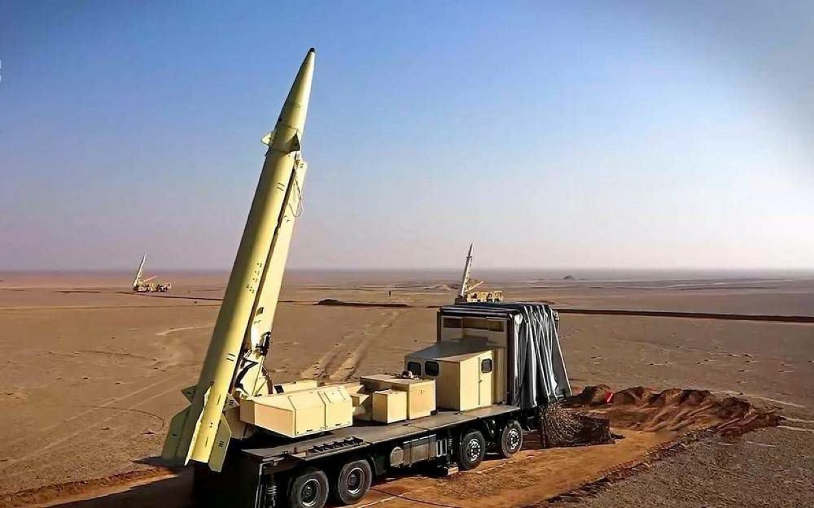
Presented by:-Roshan Kailas badgujar. Roll no:-19. Subject:-Controll System. Prn:-201105020
Topic - Automated Controller Design for a Missile Using Convex Optimization

Slide 2
Content:-
Convex Optimization
BACKGROUND THEORY FOR THE CONTROL OF MISSILES.
Controller Possibilities
Automation
Controller Design Using Convex Op- timization

Slide 3
The focus of the present master thesis is the automation of an existing controller design for a missile using two aerodynamic actuating systems.
The motivation is to evaluate more missile concepts in a shorter period of time. The option used is trimming and linearization of a highly nonlinear missile at specfic conditions.
According to these conditions, either a two-dimensional operating point grid defined by Mach number and height or three-dimensional operating point grid defined by Mach number, height and angle of attack is generated for the whole operating range of the missile.
The controllers are designed at these points using convex optimization.
These controllers describe a validity area where the missile can be stabilized.

Slide 4
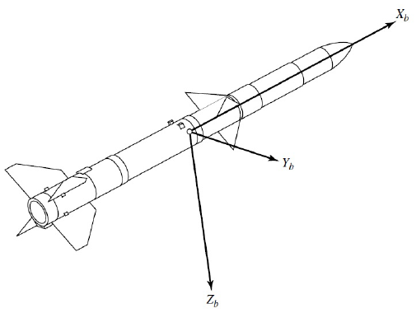
The convex set defines the pole placement area which is constrained by linear matrix inequalities according to the dynamic behavior of the missile at the operating point conditions.
These controllers describe a validity area where the missile can be stabilized.
This area consists all neighboring operating points and defines therefore the grid density which can differ at specfic regions of the operating range.
Illustration of the body-fixed frame of a missile

Slide 5
Convex Optimization
Convexification is to express control problems as convex optimization problems, so that their solution becomes tractable, hence can be automated. This allows us to solve complex control problems very efficiently, potentially in real-time.

Slide 6
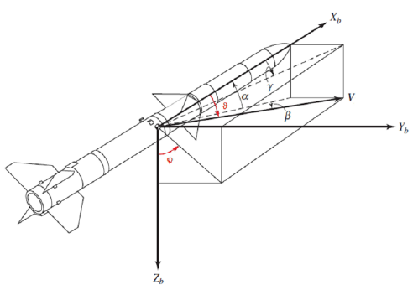
BACKGROUND THEORY FOR THE CONTROL OF MISSILES
The control of a technical system requires a detailed mathematical copy of it. This can be realized by the related differential equations which describe its motion.
Therefore, all exterior forces and moments which act on the missile are needed in order to get all equations of motion, representing the six Degrees of Freedom (DOF) behavior of the missile.
The forces and moments are caused by gravity, aerodynamics and the missile’s thrust.
Enhanced by the aerodynamic angles

Slide 7
Controller Possibilities
Various controllers can be employed to stabilize a missile and guide it to their target. For the consideration of a proper controller many influences have to be taken into account.
These influences depend on the aim of the missile. For example if the missile should be used to intercept objects in great heights, a DACS is needed in order to ensure high agility in the upper thin atmosphere.

Slide 8
Automation
The whole automated controller design using convex optimization was mainly applied to one specific missile and small areas of the operating range but the scope of this thesis is to extend the concept to the whole flight envelope.

Slide 9
Controller Design Using Convex Op- timization
Controller Design Using Convex Op- timization
The controllers will be designed for the flight conditions of the various operating points. Since the behavior of the missile differs according to the current flight conditions, i.e. OP, the algorithm needs to adapt the design parameters.
They should lead to more dynamical controllers when the missile has either a large ve-locity, low altitude or low angle of attack or to controllers which are less dynamical for conditions like high altitude, large angle of attack or small Mach number.

Slide 10
Thank You..😊

