Slide 1
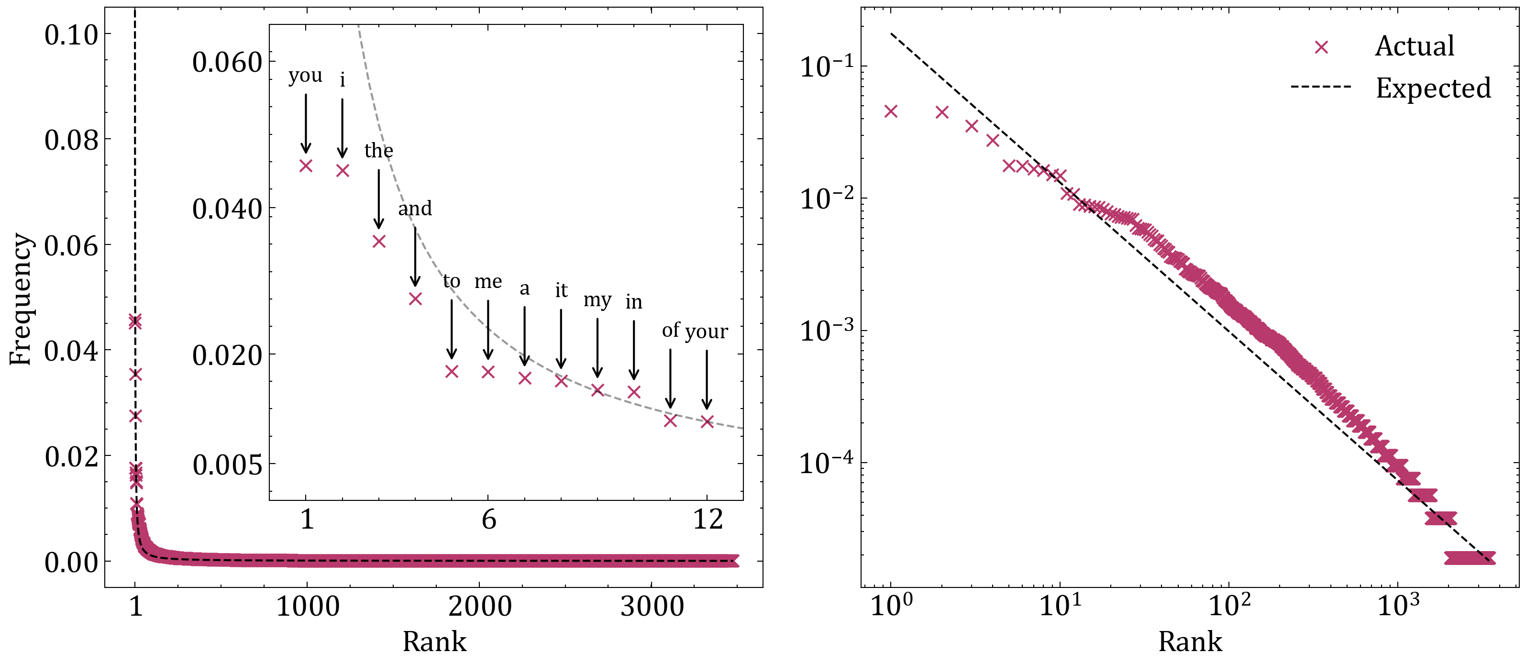
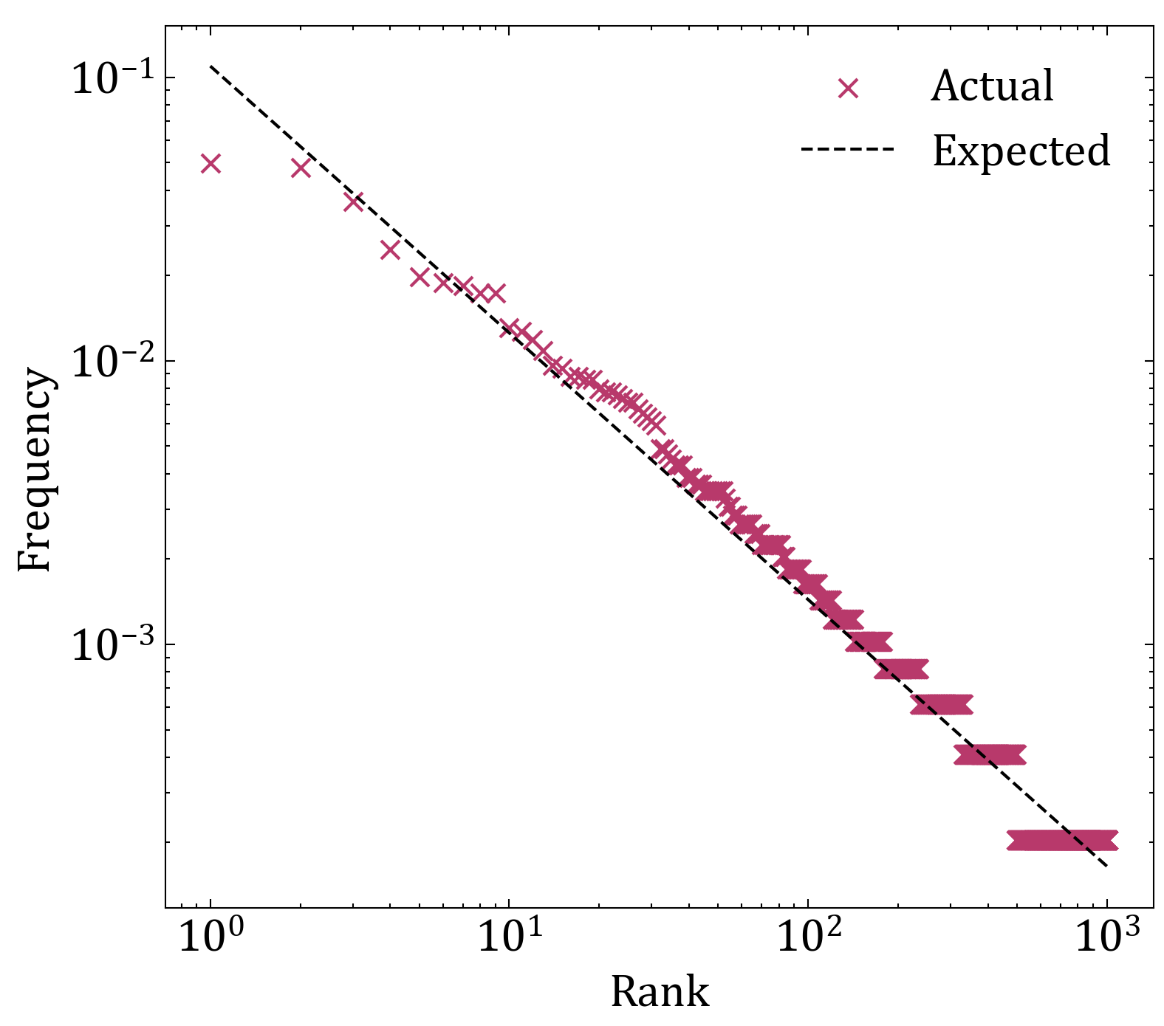
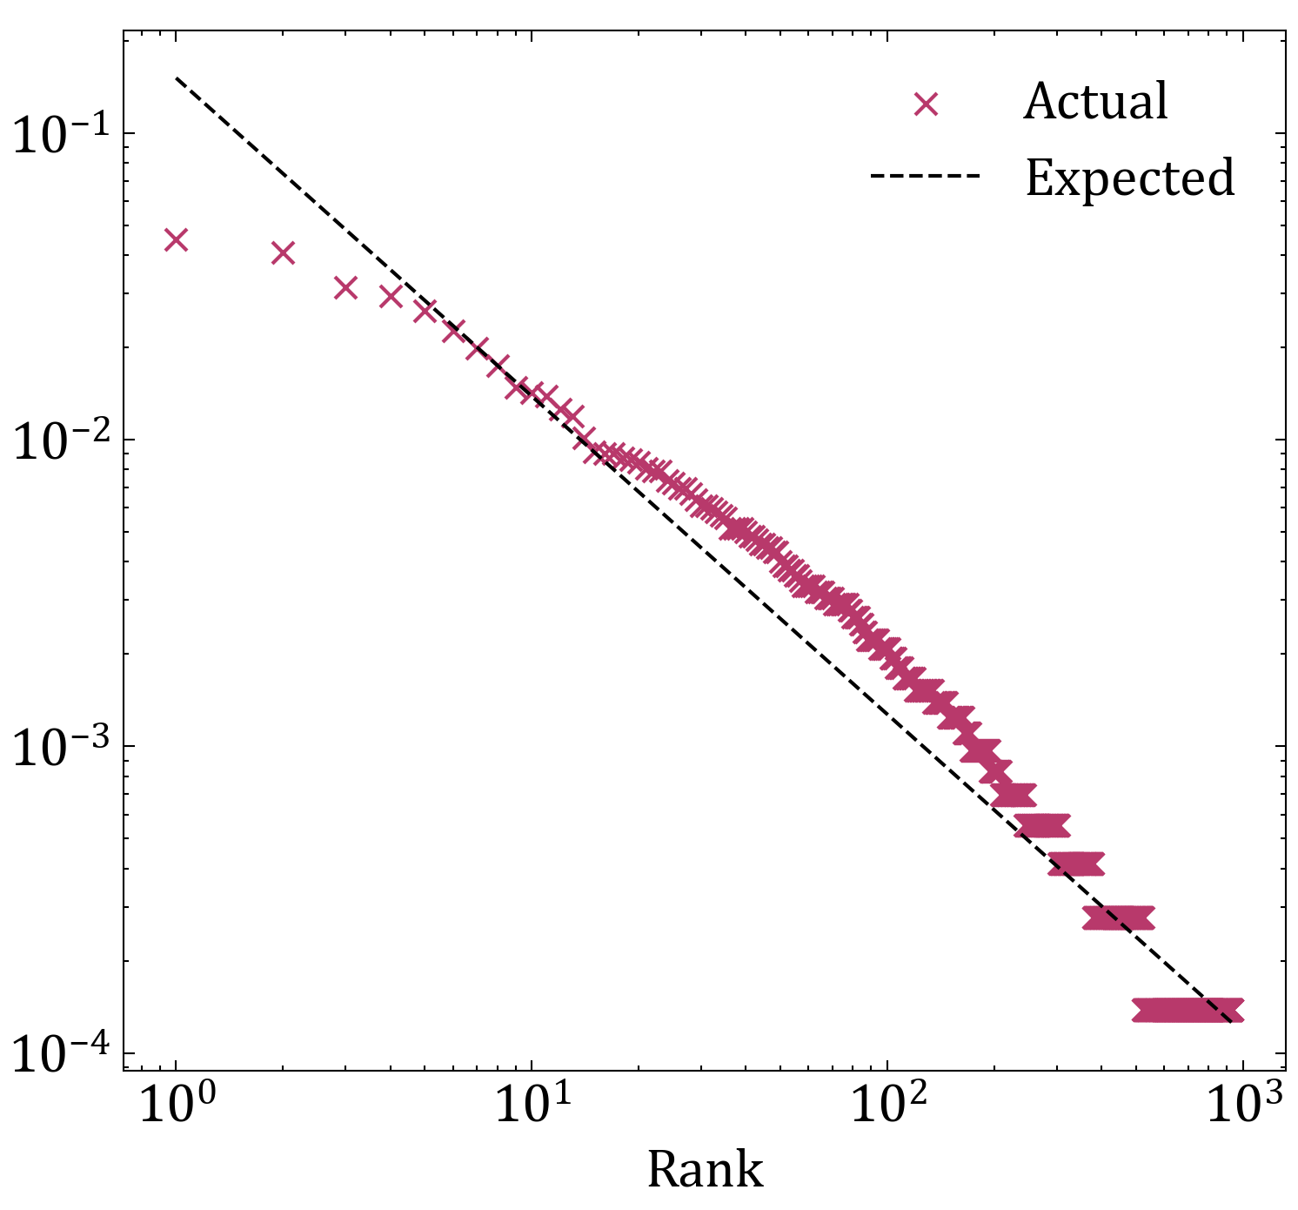
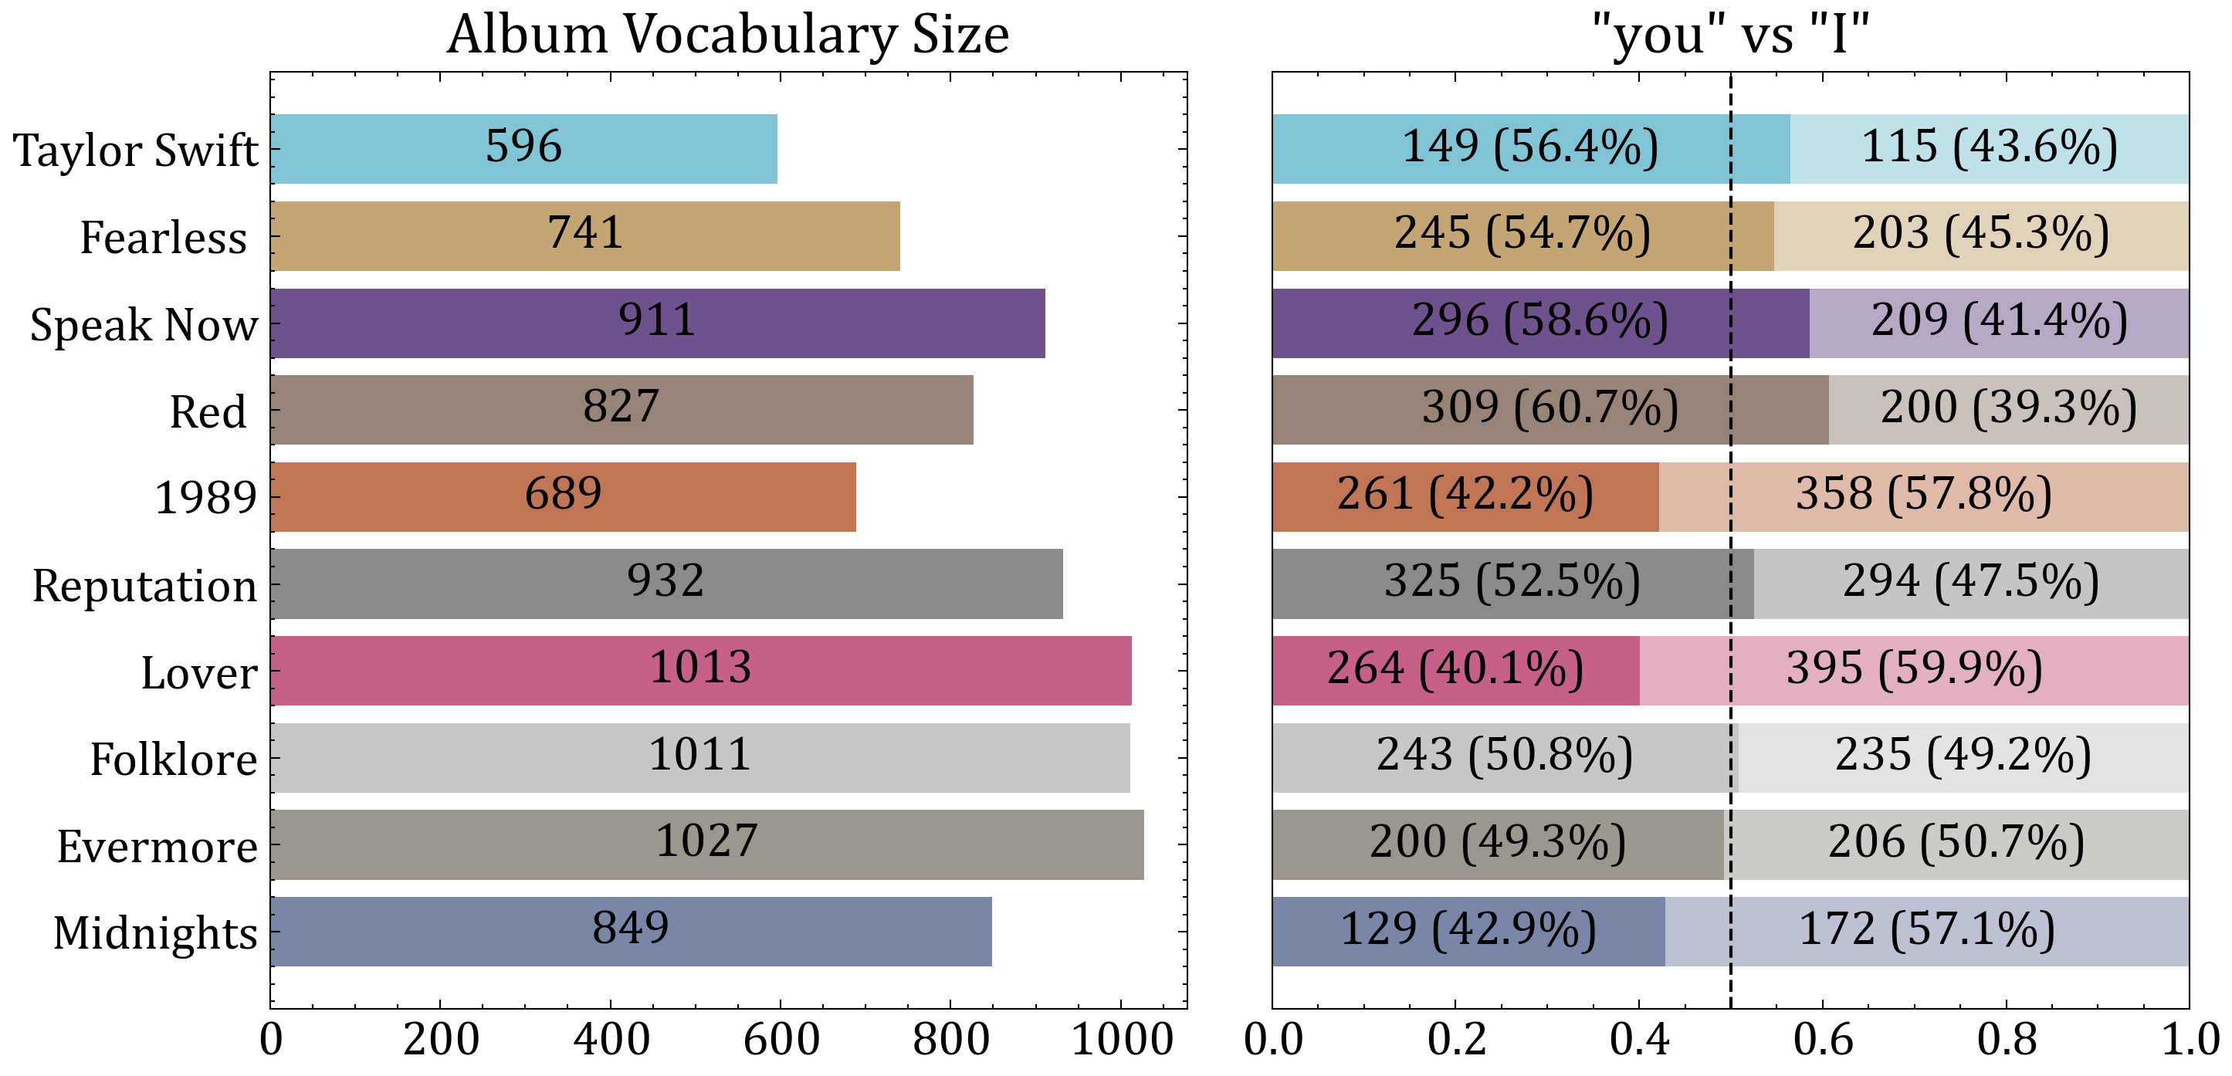
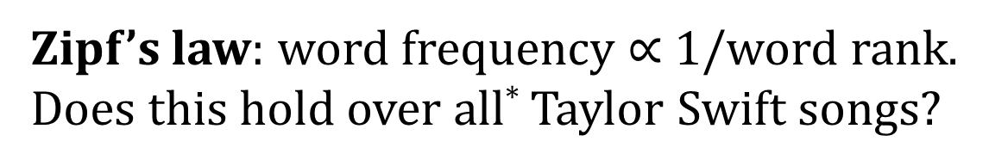
Taylor Zipft
Zipf’s law: word frequency $∝$ 1/word rank.
Does this hold over all* Taylor Swift songs?
Complete Vocabulary Analysis
The complete vocabulary is 3471 words, and 1423 words are only used once** Top words are different to common English:
1. You 2421 uses, normally 18th
2. I 2387 uses, normally 10th
3. The 1875 uses, normally 1^{st***}
Many of the top words occur less frequently than Zipf’s law would predict
As the most common word is expected to occur twice as often as the second most common, three times as often as the third most common, etc., a log-log plot of frequency vs rank should reveal a straight line (power law)
Folklore
Reputation
Out of all albums, Folklore is the closest to a Zipf distribution, while Reputation is the furthest away
For the album 1989, “shake” is the 12th most common word, despite usually being the 1537th most common
The distribution for Folklore is close to a straight line, but the most common word is still not twice as common as the second most common word
Reputation is quite curved, with deviation at the start and at the middle
Over time, album vocabulary size has generally grown, and albums have shifted from “you”-focused to “I”-focused.
https://github.com/JAEarly/tidytuesday
#TidyTuesday @JosephAEarly 19/10/23
* Lyrics from 144 songs across ten albums ** 3109/3471 are actual words in a US Dictionary. The remainder include outliers such as “cheapassscrewtop” and 10+ versions of “ohohoh”
*** OEC rankings from “Most common words in English – Wikipedia”

