Slide 1
Under the Guidance of Mrs VIJAYALAKSHMI (phd) Department of Computer Science and Engineering Sri Sai Ram Institute of Technology, Chennai, Tamil Nadu, India
Secure Authentication through Encodable Distorted Images: A Graphical Scheme with Image Distortion and Rotation"
By
MOHAMMED DANISH 412417104044
JAGADISH TIDKE 412419104039
SRI RAM A 412419104125

Slide 2
OVERVIEW
Problem statement
Objective
Abstract
SDG GOAL justification
Domain Explanation
Existing System and Disadvantages
Proposed System and Advantages
Tools Used
Literature Survey(compulsory 5 literature survey)
System Architecture
Data flow diagram
Conclusion and future enhancement
References

Slide 3
PROBLEM STATEMENT

Slide 4
OBJECTIVE
The main objective of this work is to detect ******* accurately at early stage by using an algorithm which automatically analyze the ******* images and classify whether it is a*******

Slide 5
SDG GOAL
GOAL 9: Industry, Innovation and Infrastructure

Slide 6
ABSTRACT
In today's digital age, the need for secure authentication methods has become paramount. With the rise of screenshot attacks, traditional authentication methods such as passwords and PINs have become increasingly vulnerable to breaches.
Each authentication attempt generates a unique distorted image, and the user is required to select a specific portion of the image to complete the process.
This prevents unauthorized access by ensuring that authentication attempts are made using a live session, rather than a screenshot.
Furthermore, the unique nature of the encodable distorted images means that they cannot be replicated or reused, providing an additional layer of security.
The scheme can be easily implemented in various applications, including online banking and e-commerce.
The use of encodable distorted images as a means of authentication can prevent unauthorized access to sensitive information, protecting both users and businesses from potential breaches

Slide 7
EXISTING SYSTEM & LIMITATIONS
Should be in points
Existing system methodology which should be the proposed methodology in your base paper
Disadvantages
Should be reasonable and also keep valid points with justification

Slide 8
PROPOSED SYSTEM & ADVANTAGE
The proposed EYEDi graphical authentication scheme utilizes encodable distorted images generated by applying image distortion and rotation algorithms to the origina image.
The use of image distortion and rotation algorithms makes it difficult for attackers to capture the image accurately, making it impossible to replicate or reuse the image. This provides an additional layer of security, ensuring that unauthorized access to the system is prevented.
The scheme can be easily implemented in various applications, including online banking and e-commerce, and can prevent unauthorized access to sensitive information.

Slide 9
REQUIREMENTS
Software Requirements
Front end Tools - Android XML
Back end Tools - Java Firebase
IDE - Android studio
Simulation Tools - Android Emulator
Hardware Requirements
RAM -
Hard Disk -
System Type - 32 bit / 64 bit
Operating System - WINDOWS 7/8/8.1/10

Slide 10
LITERATURE SURVEY
S no | Title | Name Of The Author | Name Of the Journal and year | Work/ Algorithm carried Out | Drawbacks
1 | Automated Diagnosis of Glaucoma Using Empirical Wavelet Transform and Correntropy Features Extracted from Fundus Images | Shishir Maheshwari, Ram Bilas Pachori, and U. Rajendra Acharya | IEEE Journal of Biomedical and Health Informatics, 2016. | Emprical Wavelet transform used for decompose the image. | Expensive in terms of time and memory
2 | Detection of Optic Disc and Cup from Color Retinal Images for Automated Diagnosis of Glaucoma | Megha Lotankar, Kevin Noronha, Jayasudha Koti | IEEE UP Section Conference on Electrical Computer and Electronics (UPCON) 2015 | Extraction of vertical disc and cup-ratio. | Doesn’t work well with non-globular clusters.

Slide 11
LITERATURE SURVEY
S no | Title | Name Of The Author | Name Of the Journal and year | Work/ Algorithm carried Out | Drawbacks
3 | Automated Diagnosis of Glaucoma Using Empirical Wavelet Transform and Correntropy Features Extracted from Fundus Images | Shishir Maheshwari, Ram Bilas Pachori, and U. Rajendra Acharya | IEEE Journal of Biomedical and Health Informatics, 2016. | Emprical Wavelet transform used for decompose the image. | Expensive in terms of time and memory
4 | Detection of Optic Disc and Cup from Color Retinal Images for Automated Diagnosis of Glaucoma | Megha Lotankar, Kevin Noronha, Jayasudha Koti | IEEE UP Section Conference on Electrical Computer and Electronics (UPCON) 2015 | Extraction of vertical disc and cup-ratio. | Doesn’t work well with non-globular clusters.

Slide 12
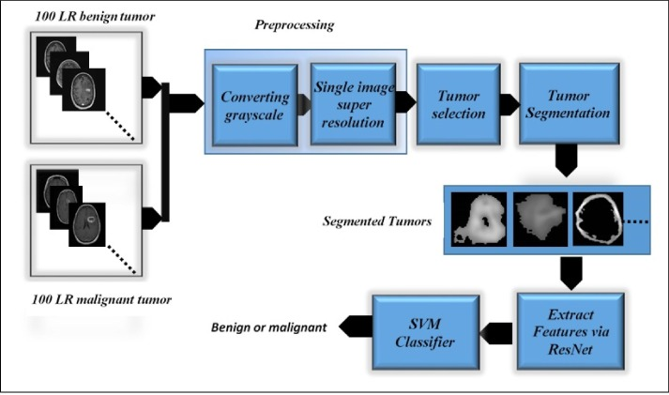
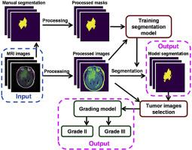
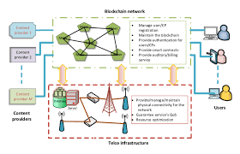
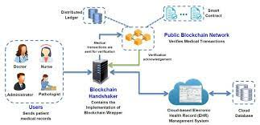
ARCHITECTURAL DIAGRAM
Enlarge the image and refer the archietecture diagram

Slide 13
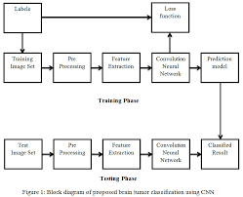
FLOW DIAGRAM

Slide 14
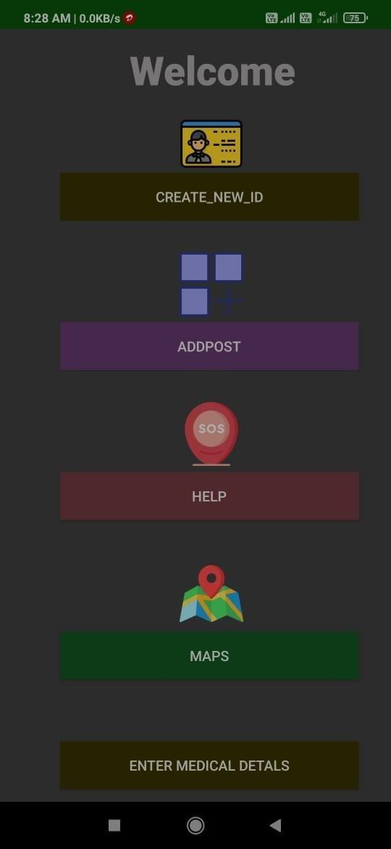
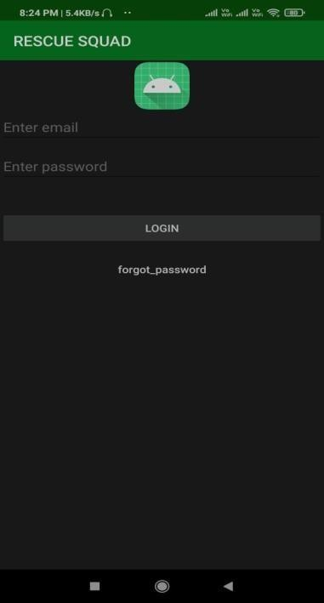
RESULTS
User Menu
Login Page

Slide 15
CONCLUSION & FUTURE ENHANCEMENTS
In recent years, mobile phones have become extremely useful, with a plethora of features. This application was created to monitor forest activities and officers, as well as to keep a proper daily record by each beat officer during their duty period.
Additionally, the safety of the beat officer must be ensured. For the safety app, a very basic framework was created, with XML as the frontend, Java used to build user interfaces, and Firebase handling authentication and storage utilities.
Additional features such as sending alerts during forest fires, auto detection of encroachment area, and auto navigation for pre-set paths can be added to the proposed system in future.

Slide 16
REFERENCES
Bai, Y., Li, S., & Liu, S. (2020). A review of graphical passwords authentication systems. Journal of Ambient Intelligence and Humanized Computing, 11(9), 4003-4016.
Biddle, R., Chiasson, S., & Van Oorschot, P. C. (2012). Graphical passwords: Learning from the first twelve years. ACM Computing Surveys (CSUR), 44(4), 19.
Cao, Q., Liu, X., Chen, J., & Tan, J. (2017). A survey on graphical passwords. Journal of Computer Science and Technology, 32(2), 235-257.
Das, S., & Maiti, S. (2019). Secure and usable graphical password authentication scheme. Computers & Security, 83, 276-295.
Das, S., Maiti, S., & Paul, T. (2021). An effective authentication scheme based on image and graphical passwords. Journal of Ambient Intelligence and Humanized Computing, 12(6), 6549-6568.
De Luca, A., Hang, A., Brudy, F., & Lindner, M. (2015). Towards a user-centered framework for developing secure graphical passwords. In Proceedings of the 2015 Symposium on Usable Privacy and Security (pp. 285-298).
Dhamija, R., & Perrig, A. (2000). Déjà Vu: A user study using images for authentication. In Proceedings of the 9th USENIX Security Symposium (pp. 7-7).
Dhamija, R., Perrig, A., & Hearst, M. (2004). Deconstructing web page authentication. In Proceedings of the 10th ACM Conference on Computer and Communications Security (pp. 290-299).
Hong, J., & Kim, M. (2020). Personalized graphical password authentication using images. Journal of Ambient Intelligence and Humanized Computing, 11(10), 4719-4730.
Kaur, H., & Kumar, N. (2017). A review on graphical password authentication schemes. Journal of Theoretical and Applied Information Technology, 95(6), 1236-1251.

Slide 17
THANKYOU

