Slide 1

Centre for Development of Advance Computing
PG Diploma in Embedded System and Design
Hackathon
“Smart Fire Detection System”
Prepared by-
Rakesh Honnappagol
Ranveer Singh
Samarth patil
Sandesh kale
Sanjay Chaurasia

Slide 2



01
Introduction To The Topic
02
Block Diagram
03
Schematic of system
Table Of Contents
04
Flow chart
05
Components
06
RTOS
07
Cloud
08
Result
09
Q/A

Slide 3
Introduction of Topic
In recent years, the integration of Internet of Things (IoT) technologies has significantly enhanced the capabilities of various systems, including fire detection and prevention. One such innovative solution is the Smart Fire Detection System, which leverages components such as a Flame Sensor, DHT11 (temperature and humidity sensor), ESP32 (a powerful microcontroller), a Buzzer, and Blynk for efficient communication.
In this topic we implement –
Detect Temperature of the room
Detect the flame in the room
Alert the people
Stop the alarm using the button.
Send the data to the cloud.

Slide 4
Block Diagram

Slide 5
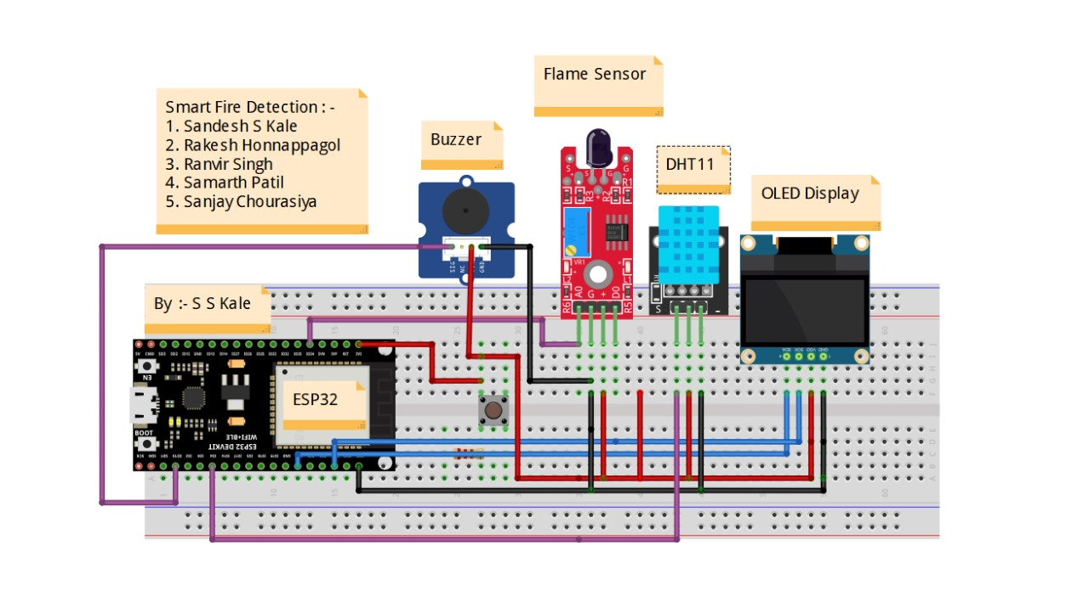
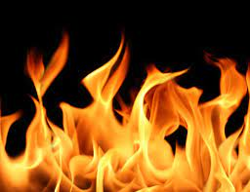
Schematic diagram
Schematic of system

Slide 6
Flow chart

Slide 7
Components
Sr.No | Name | Quantity
1 | ESP32 | 1
2 | DHT 11 Sensor | 1
3 | Flame Sensor | 1
4 | Buzzer | 1
5 | Button | 1
6 | Jumper Wire | As per required
Pin Connection
Sr.No | Name | ESP32 Connected Pin Number
1 | ESP32 LED | 2
2 | DHT 11 Sensor | 4
3 | Flame Sensor | 34
4 | Buzzer | 2
5 | Button | 15

Slide 8
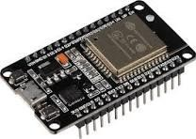
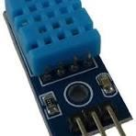
Specifications
ESP32
32-bit architecture Operating frequency
Typically runs at 160 or 240 MHz
Internal RAM: Varies between 448 KB and 520 KB
External RAM: Can be added externally for additional memory
Typically operates at 3.3V
GPIO (General Purpose Input/Output) pins
I2C, SPI, UART, I2S for communication with other devices
PWM (Pulse Width Modulation) for controlling analog devices
ADC (Analog-to-Digital Converter) for analog sensor input
DAC (Digital-to-Analog Converter) for analog output
DHT 11
Typically measures temperatures between 0°C to 50°C (32°F to 122°F)
Typically measures relative humidity in the range of 20% to 90%
Temperature accuracy is around ±2
Humidity accuracy is around ±5%
The sensor requires a minimum interval of 2 seconds between measurements
Typically operates at 3.3V or 5V

Slide 9
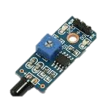
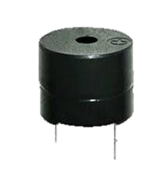
3.Flam Sensor
Flame Sensor Module can detect flames in the 760 – 1100 nanometer wavelength range.
The sensor has a digital and analog output and sensitivity can be adjusted via the blue potentiometer.
The module has 2 outputs: Analogue, which gives a real-time voltage output signal on thermal resistance, and digital which allows temperature thresholds to be set via a potentiometer.
Operating voltage: 3.3 volt
Buzzer
Operation Voltage: 3-24V DC.
Current: <15mA.
Color: Black.
Operating Temperature: - 20° to +60°C

Slide 10
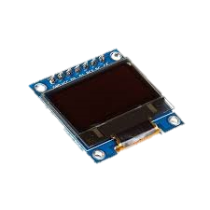
5.OLED
OLED Driver IC: SSD1306
Resolution: 128 x 64Visual Angle: >160°
Display Colour: Area Color (White)
Input Voltage: 3.3V ~ 6V
Working temperature: -30°C ~ 70°C
Interface: I2C

Slide 11

RTOS
Typically Real-time operating systems (RTOS) are designed to meet the specific requirements of real-time systems, where timely and deterministic responses to events are crucial. Here are some reasons why real-time operating systems are used.
Predictable Timing: RTOS ensures predictable and deterministic timing behavior. In real-time systems, tasks must be completed within specified time constraints. RTOS provides mechanisms to guarantee that tasks are executed within their deadlines.
Task Scheduling: RTOS includes specialized scheduling algorithms that prioritize tasks based on their urgency and deadlines. This ensures that critical tasks are given precedence, helping meet timing requirements.

Slide 12

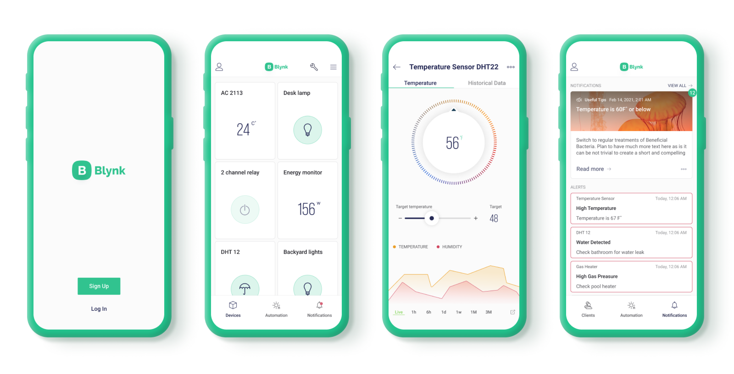
Cloud
Blynk is a cloud service that enables the prototyping, deployment, and remote management of connected electronic devices at any scale.
Whether it's personal IoT projects or commercial connected products in the millions, Blynk empowers users to connect their hardware to the cloud and create iOS, Android, and web applications, analyze real-time and historical data from devices, remotely control them from anywhere, receive important notifications, and much more.

Slide 13
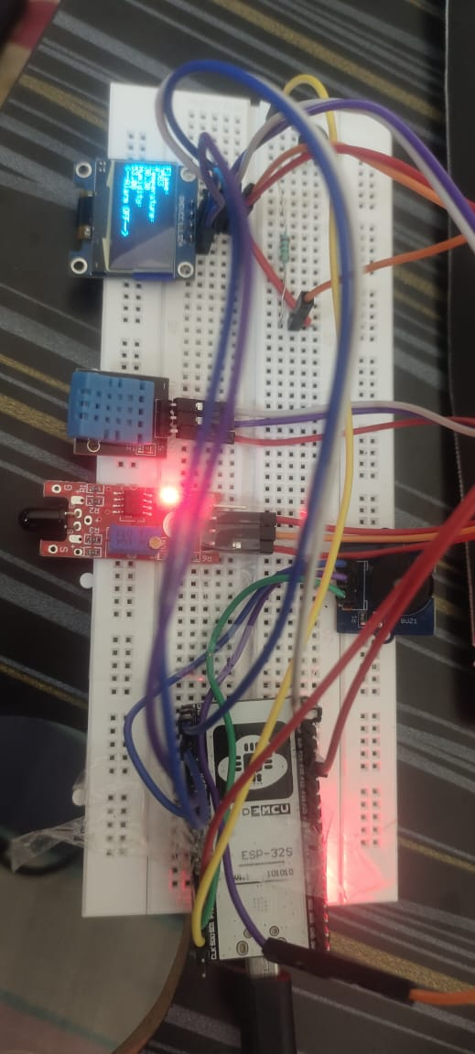
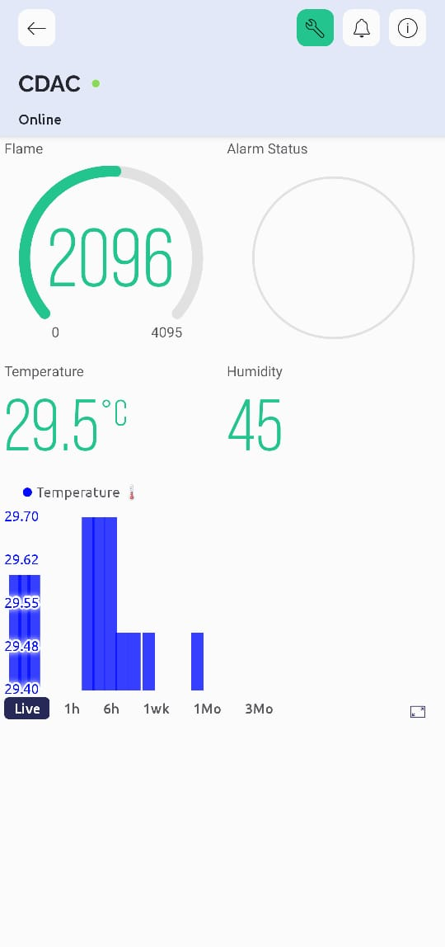
Result

Slide 14
Thank You

