Slide 1
Welcome
to
National Hackathon
on Frontier Technologies

Slide 2
Premier University Chittagong
Team Name: Innovative Solvers

Slide 3
Team members
1. Eshrat Jahan Trisha
Role: Software Developer
Contact: 01521327358
2. Md. Sirajul Munir
Role: IOT manager
Contact: 01831013421
3. Songita Das
Role: Business manager
Contact: 01887907150

Slide 4
We are from
Chattogram Division

Slide 5
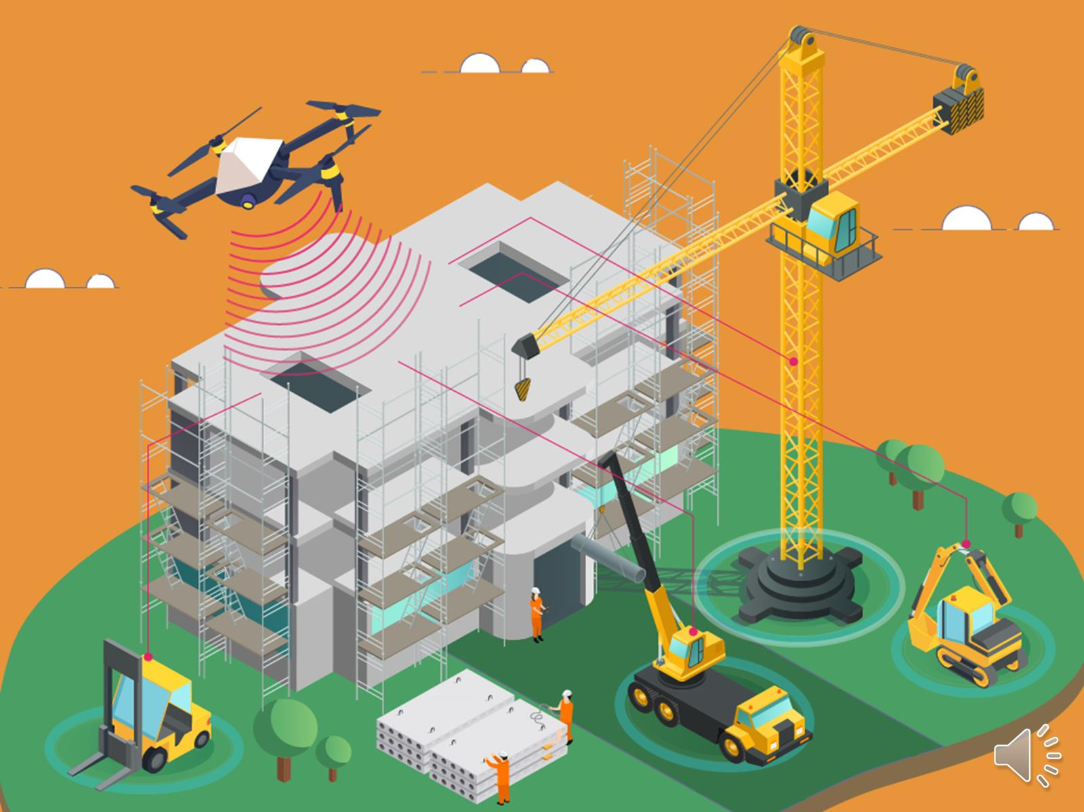
Our selected Challenge
Real Time Building Construction Monitoring System

Slide 6
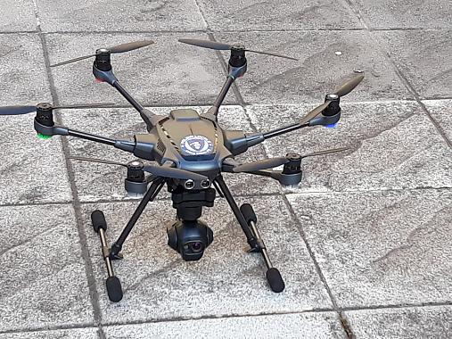
Solution status:
Building defect detection and measurement solution using drone.

Slide 7
Contact person: Name: Eshrat Jahan Trisha Mobile: 01521327358 E-mail: eshrat.trisha15@gmail.com Address: Kobi Nazrul Islam Road, Sadarghat, Chattogram.

Slide 8
Name of solution:
Real Time Building Construction Monitoring System using drone and frontier technologies.
Target Group:
Building Construction
Mass people
CDA
Civil Engineers
Public Works Department
.

Slide 9
Project brief: In this project, drone will provide a video of construction site, using image processing and deep learning technique, it sends report to the database of the authority, if it gets any fault in construction work, it will give red signal. Then the monitoring officer inform the engineers to reconstruct the defect area, After that, the work will start again.

Slide 10
Solution topic:
After completing the building design plan, many people do not follow CDA rules during construct their buildings. But it is not possible to monitor whole work by CDA authority. So we monitor this work by drone from our office.

Slide 11
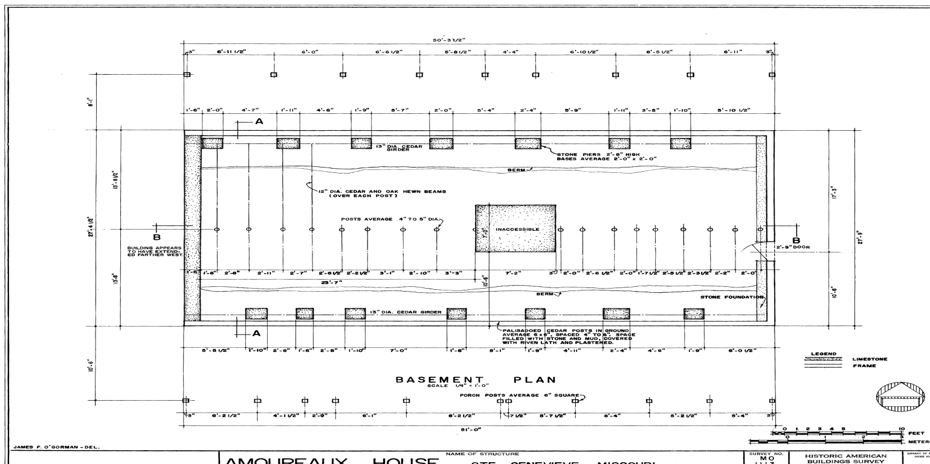
Problem: RAJUK/CDA only check the design plan of building. Solution: 1. Taking structural plan. 2. Monitoring the area using drone. Structural design

Slide 12
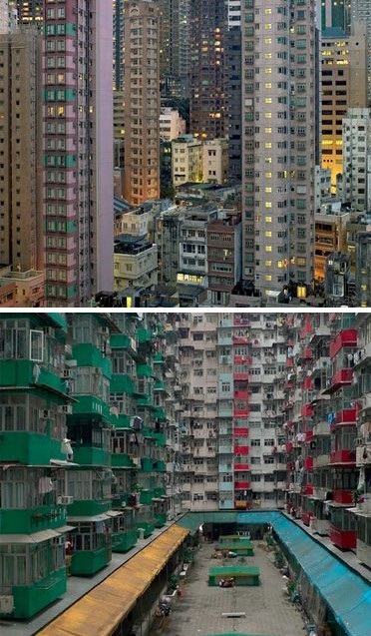
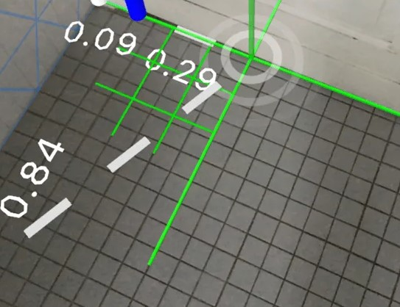
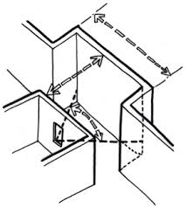
Problem: People make congested building not to maintain CDA/RAJUK rules. Solution: 1. Measurement technique by using drone. Technique: 1. Image processing and machine learning. Congested area Drone measurement using image processing Right measurement change the wall

Slide 13
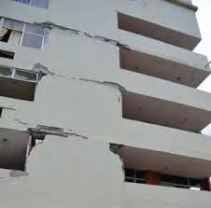
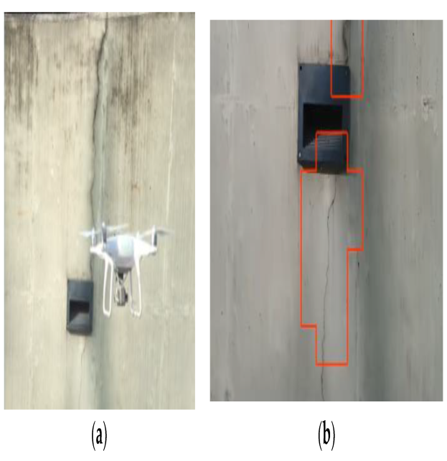
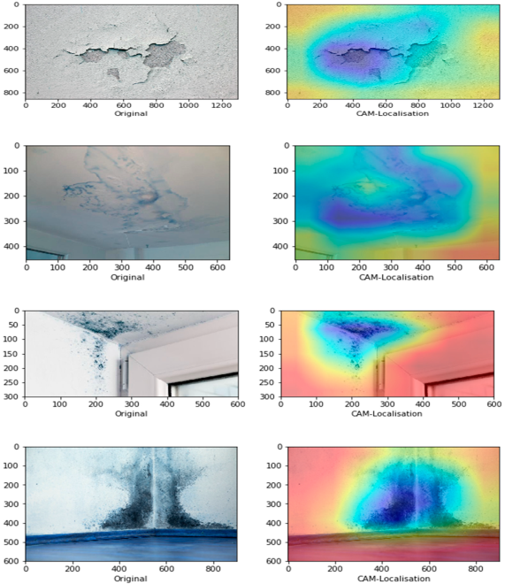
Problem: Crack in the wall. Solution: 1. Detect it with drone. Technique: 1. Image processing and deep learning. Crack in the building wall Drone capture the image inside the drone detect crack

Slide 14
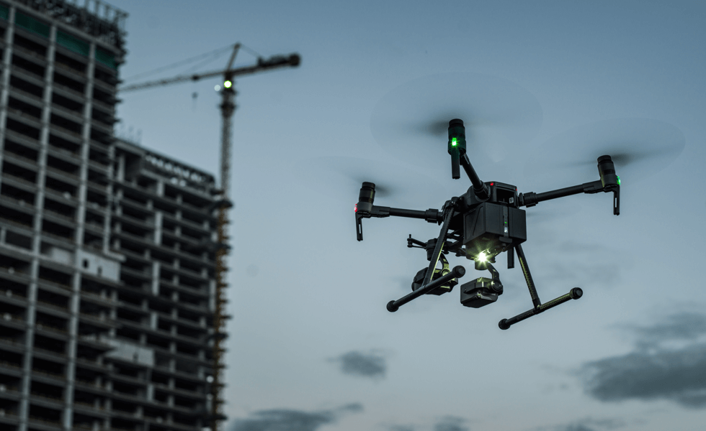
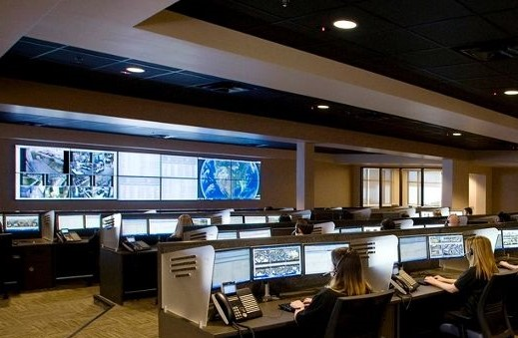
Problem: It is difficult to monitor different construction site daily. Solution: 1. Using drone we can monitor the construction area from office. Technique: 1. Image processing system. Drone in construction area to monitor it monitoring the drone from office

Slide 15
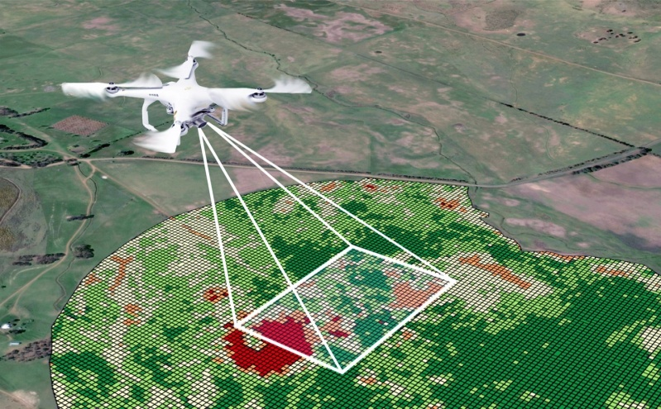
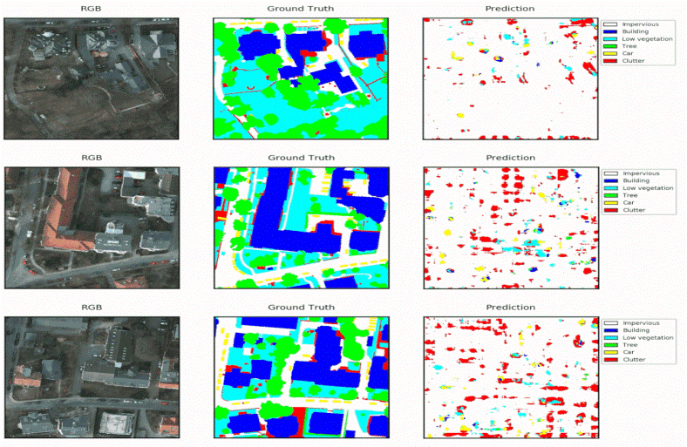
Problem: The limitation of Monitoring officer/ Not sufficient time to visit the construction area. Solution: 1. By using drone mapping system. 2. GPS area measurement system of drone. Mapping system in drone Inside drone track the area

Slide 16
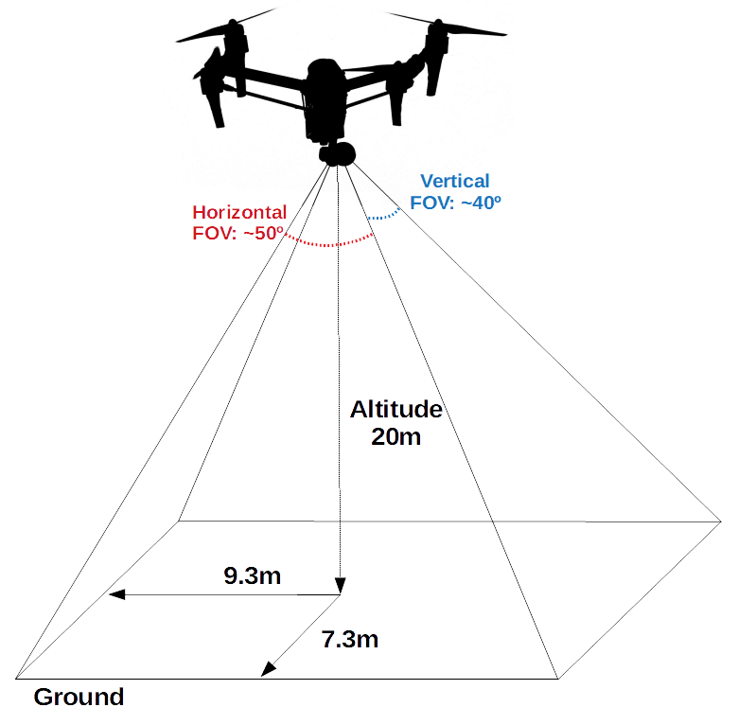
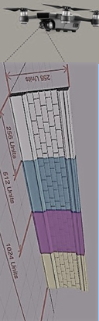
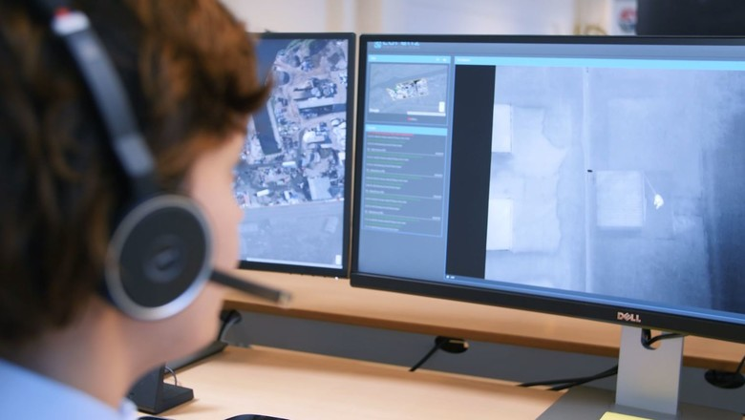
Problem: Data collection of construction area. Solution: 1. Automatic data send using drone. Technique: 1. IOT. Drone measure the area inside building and outside the area of building Measure the outside in the wall to maintain CDA rules Officer(CDA) observe the construction area

Slide 17
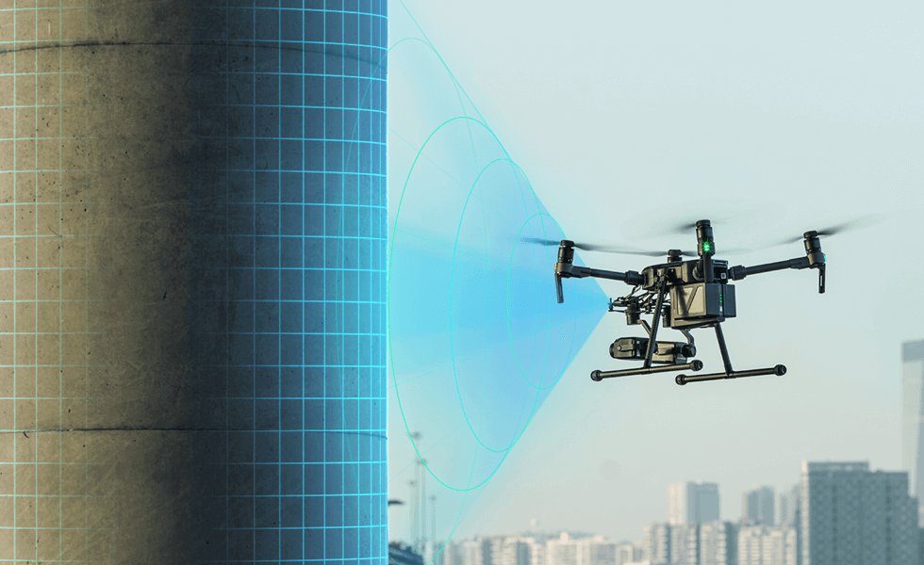
Project:
It is both hardware and software based project.

Slide 18
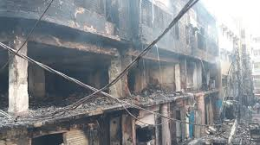
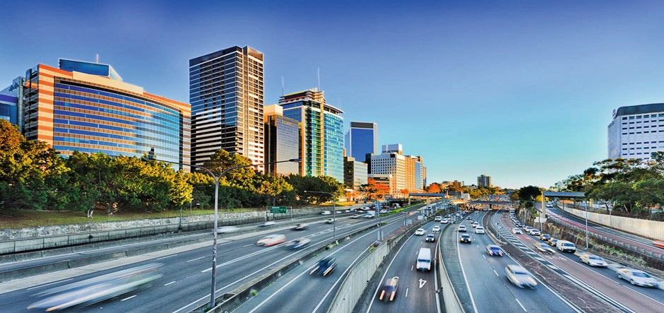
Advantage of using drone: 1. Solar panel for reducing charging problem. 2. Distance measuring system. 3. Simultaneously monitoring different construction site. 3. Reduce time. 4. Prevent building collapse. exp: Rana plaza etc. 5. Reduce cost. . After risk reducing & proper monitoring

Slide 19
Safety Issue: 1.The drone is located within 5 nautical miles of a fire affected area or built up area. 2. It has to maintain proper distance of any object or person. 3.It can move 360 degree angle to visit the area.

Slide 20
Estimate Budget: 1.The approximate value to make multi- functional drone is: a) High resolution camera(image processing), b) Distance measurement System, c) Defect Detection(Crack), d) GPS mapping, e) Solar system, f) monitor 6,00,000 BDT Revenue: Revenue = (6,00,000+3,00,000) BDT (approximate) Marketing: 1. Web based application for marketing 2. App for common people 3. Advertise in social networking site

Slide 21
Expectation From Startup Bangladesh: 1. Training 2. Mentoring 3. Lab Support 4. Legal Support

Slide 22
Probable risks: 1. To establish solar panel in drone. 2. To take legal actions, if- a) find the construction building in harmful condition(the engineer must answer for that) within 3 years. b) homeowner or renter must not be told to servicing the building after 3 years of building it.

Slide 23
