Slide 1

DEPARTMENT OF ARTIFICIAL INTELLIGENCE AND DATA SCIENCE ACADEMIC YEAR 2025 - 2026 SEMESTER III ARTIFICIAL INTELLIGENCE LABORATORY MINI PROJECT REVIEW Exam Hall Seating Arrangement using Backtracking Algorithm
REGISTER NUMBER | 2117240070121
NAME | A.B.JAHNAVI
YEAR | 2025-2026
SECTION | B
FACULTY IN-CHARGE | Mrs. M. Rubina begam

Slide 2
PROBLEM STATEMENT
Artificial Intelligence (AI) enables computers to perform reasoning, problem-solving, and learning tasks. It includes algorithms like search, optimization, and logic-based systems to solve real-world problems efficiently.Clearly introduce the topic, provide background context, explain why the problem matters, and highlight what the project aims to accomplish.
The project automates exam hall seat allocation using Backtracking, ensuring that no two adjacent students belong to the same department — improving fairness and reducing manual workload.Expected result and the possibilities for the given problem statement
To generate a valid seating arrangement for an exam hall where adjacent students do not belong to the same department, applying Constraint Satisfaction and Backtracking techniques.

Slide 3
THEORETICAL BACKGROUND
The project is modeled as a Constraint Satisfaction Problem (CSP).
Each seat is a variable, and departments are the possible values.
Constraints ensure no adjacent seats have the same department.
Algorithm Used: Backtracking
A depth-first recursive method that explores possible arrangements.
If a seat assignment violates constraints, the algorithm backtracks.
Justification:
Backtracking is chosen because it:
Guarantees a correct solution.
Works well for small to medium exam halls.
Is simple and adaptable for constraint-based problems.

Slide 4
IMPLEMENTATION AND CODE
Link to code in Git-hub Repository
List | Git-hub Repository Links
Implementation of Code Link
Word Document Report Link
PPT Link

Slide 5
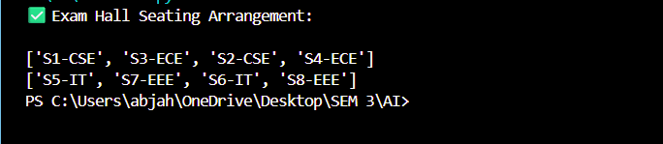
OUTPUT AND RESULTS
OUTPUT:
Expected Result
A seat layout that satisfies adjacency constraints, ensuring department diversity in seating positions.
Explanation
Each student is placed without adjacency conflict.
The algorithm ensures a valid arrangement automatically.

Slide 6
OUTPUT AND RESULTS
Future Enhancements:
Include gender or roll number constraints.
Add a graphical user interface (Tkinter / Flask).
Integrate student database for dynamic data input.
Export arrangement as a PDF or Excel sheet.
Result:
Constraint satisfaction achieved using backtracking.
Demonstrates AI’s ability to solve real-world scheduling problems efficiently.

Slide 7
REFERENCES
Stuart Russell & Peter Norvig, Artificial Intelligence: A Modern Approach, Pearson, 4th Edition, 2021.
Ian Millington, Artificial Intelligence for Games, CRC Press, 2nd Edition, 2009.
TutorialsPoint, Backtracking Algorithms – Concepts and Examples, www.tutorialspoint.com
GeeksforGeeks, Constraint Satisfaction and Backtracking in Python, www.geeksforgeeks.org
Coursera – AI Search and Problem Solving Techniques, University of London, 2023.

