Slide 1

Project Title – FarmStats -SEASONAL AGRICULTURE PERFORMANCE ANALYSIS
Student Name: Samala Jahnavi
College Name: Sridevi Women’s Engineering College
AICTE STU ID : STU6809cae2dda7e1745472226

Slide 2

PROBLEM STATEMENT
Agricultural performance varies across seasons due to differences in environmental conditions, farming practices, resource usage and market conditions. This project analyses agricultural data to identify seasonal patterns, trends, relationships and variations in yield, profitability and resource utilization.

Slide 3
Seasonal Agriculture Performance Analysis is a data-driven study of agricultural performance across Kharif, Rabi and Zaid seasons. The project involves data cleaning, exploratory analysis, statistical analysis and visualization to study crop yield, production, profitability, environmental conditions, resource utilization and irrigation practices. The analysis identifies high-performing crop-season combinations and provides evidence-based recommendations for better agricultural planning.
Project Description

Slide 4

WHO ARE THE END USERS?
Farmers – for crop and seasonal planning
Agricultural Planners – for resource allocation
Agricultural Researchers – for identifying trends and relationships
Government Agencies – for agricultural policy and planning
Agribusinesses – for understanding crop profitability

Slide 5

Technology Used
Programming Language
Python
Libraries
Pandas
NumPy
Matplotlib
Seaborn
Environment
Jupyter Notebook
Techniques
Data Cleaning
Exploratory Data Analysis
Statistical Analysis
Correlation Analysis
Data Visualization

Slide 6
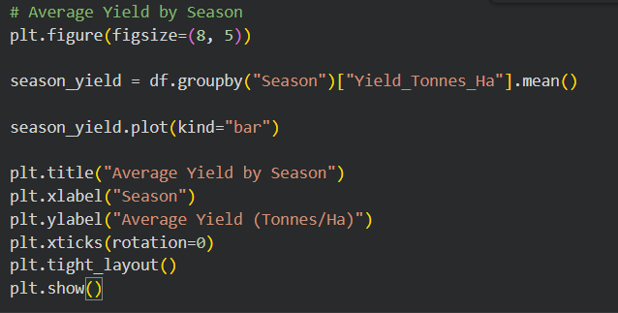
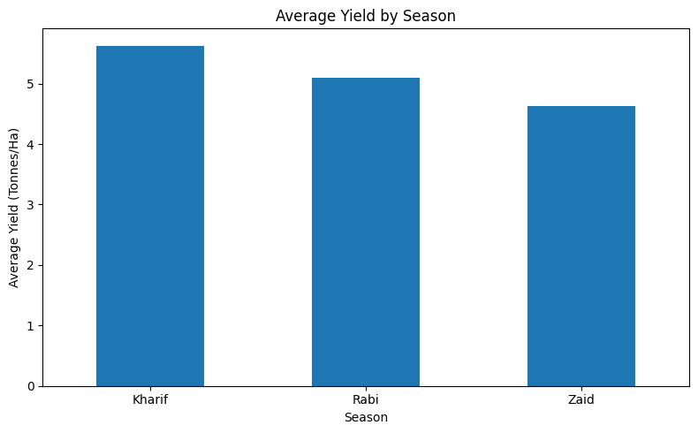
RESULTS
Seasonal Performance
Kharif achieved the highest average yield of 5.63 tonnes/ha, followed by Rabi at 5.09 tonnes/ha and Zaid at 4.63 tonnes/ha.

Slide 7
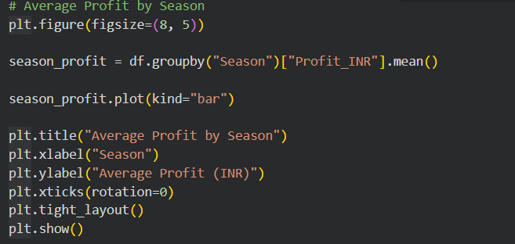
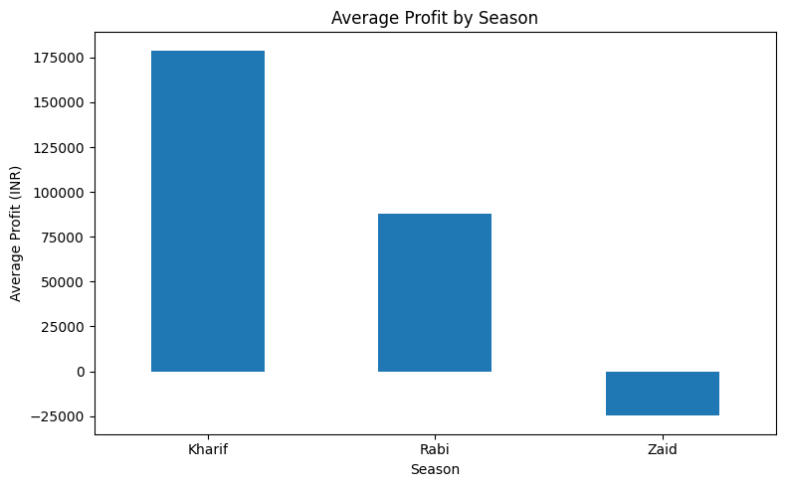
RESULTS
Seasonal Profitability
Kharif recorded the highest average profit of ₹1.79 lakh, while Zaid recorded a negative average profit of ₹24,805.

Slide 8
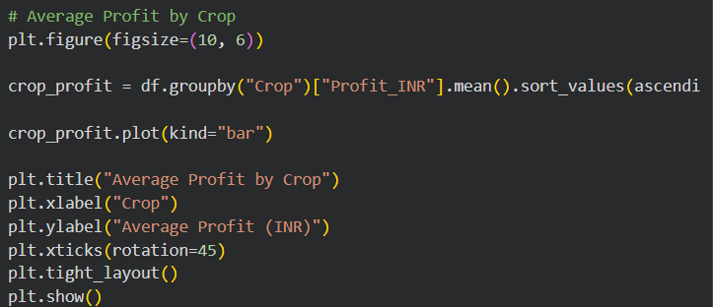
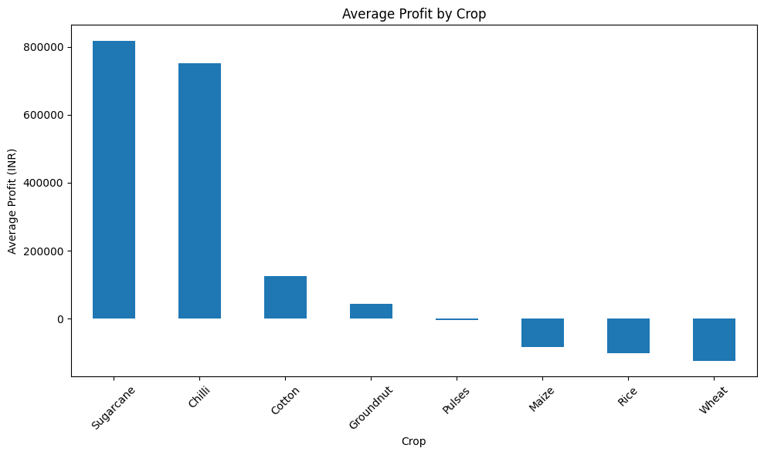
RESULTS
Crop Profitability
Sugarcane and Chilli were the most profitable crops, with average profits of approximately ₹8.17 lakh and ₹7.51 lakh, respectively.

Slide 9
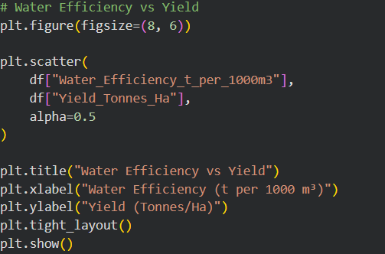
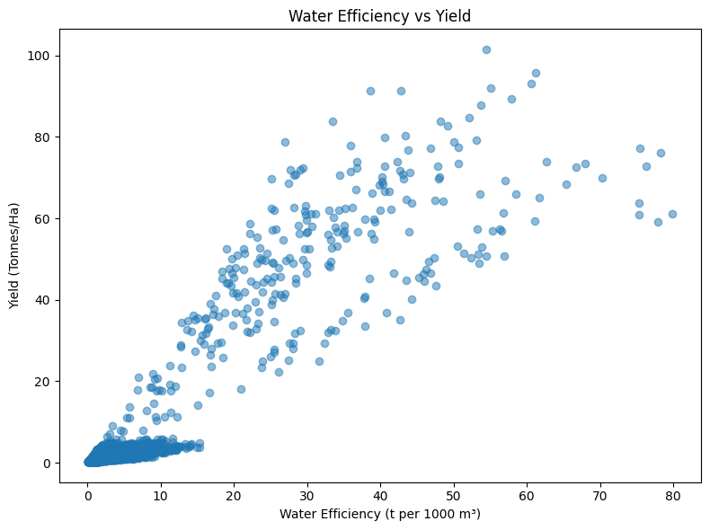
RESULTS
Water Efficiency
Water-use efficiency showed a very strong positive correlation with yield (r = 0.92), highlighting the importance of efficient water utilization.

Slide 10
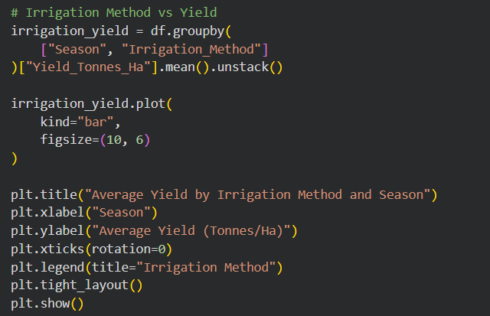
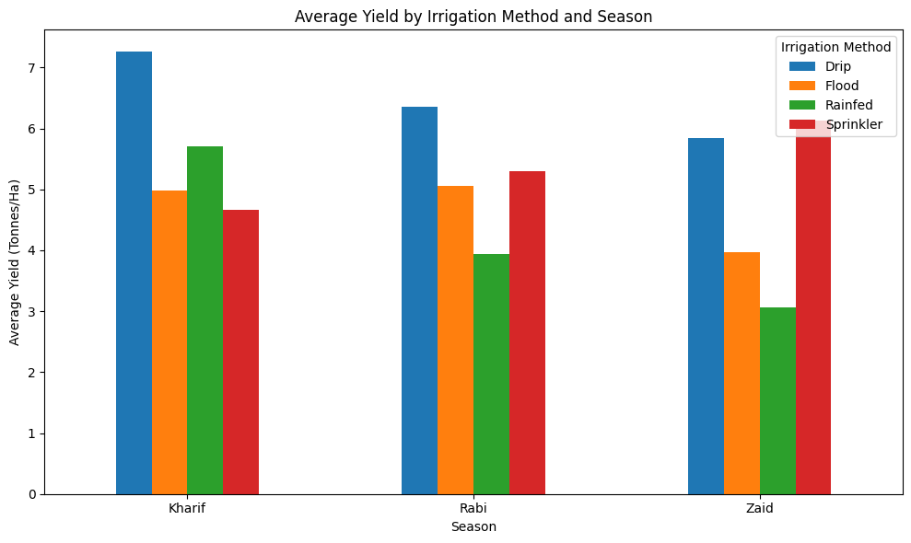
RESULTS
Irrigation Analysis
Drip irrigation recorded the highest average yield in Kharif and Rabi, while Sprinkler recorded the highest yield in Zaid.

Slide 11
Future scope
Develop ML models for yield and profit prediction
Build a crop recommendation system
Integrate real-time weather and soil data
Include market-price forecasting
Develop an interactive agricultural dashboard
Expand analysis to larger multi-year datasets

Slide 12
GitHub Link
https://github.com/JAHNAVI-SAMALA/seasonal-agriculture-performance-analysis

Slide 13

VOIS Course completion certificate - Course name- Data Visualization

Slide 14
Thank you
FarmStats- Seasonal Agriculture Performance Analysis Samala Jahnavi B.Tech – CSE | Sridevi Women’s Engineering College
.
.

