Slide 1


21AIE315 AI IN SPEECH PROCESSING
Robust Hybrid Deep Learning Model For Fake Speech Detection
Team-19
DINGARI JAHNAVI – CH.EN.U4AIE21111
PULATA SANDEEP – CH.EN.U4AIE21137
SASANK SAMI – CH.EN.U4AIE21160

Slide 2
ABSTRACT
This project aims to develop a robust speech accent recognition system using advanced techniques, specifically Mel-Frequency Cepstral Coefficients (MFCCs), and two different architectures: a hybrid model consisting of Convolutional Neural Networks (CNNs) with Gated Recurrent Units (GRUs), and a separate Random Forest model. Leveraging the Speech Accent Archive dataset, we trained and evaluated both models to accurately identify and distinguish between various accents in spoken English. Our results demonstrate promising performance metrics, highlighting the system's potential to enhance communication diversity and inclusivity in language processing technologies.

Slide 3
PROBLEM STATEMENT
Developing a speech accent recognition system to accurately identify and distinguish between different accents in spoken English, enhancing communication inclusivity and understanding across diverse linguistic backgrounds. Addressing the challenge of accurately recognizing and distinguishing between various accents in spoken English through the development of a robust speech accent recognition system. This system aims to improve language processing technologies by promoting inclusivity and facilitating effective communication across diverse linguistic communities.

Slide 4
OBJEVTIVES
Train the Random Forest classifier on the Speech Accent Archive dataset to classify accents in spoken English.
Evaluate the classifier's performance using metrics such as accuracy, precision, recall, and F1-score to gauge its effectiveness in accent recognition.
Employ visualization techniques like confusion matrices to gain insights into the classifier's behavior and identify areas for improvement.
Compare the performance of the Random Forest model with the CNN-GRU hybrid model to assess its suitability for accent recognition tasks.
Explore ensemble methods and hyperparameter tuning to optimize the Random Forest classifier's performance and enhance its accuracy and robustness.

Slide 5
LITERATURE REVIEW
Title | Year | Dataset | Evaluation Metrics | Key Findings
Towards the Development of a Real-Time Deepfake Audio Detection System in Communication Platforms | 2024 | ASV Spoof 2019 | Tandem detection cost function (t-DCF) and the equal error rate (EER). | The outcome of the research is the development of static deepfake audio detection models and a software application capable of real-time execution. The models achieved benchmark performances compared to ASVspoof 2019 challenge baselines. However, there were limitations observed when deploying the models in real-time communication scenarios.
Deep generative variational autoencoding for replay spoof detection in automatic speaker verification | 2020 | ASV Spoof 2017&2019 | Tandem detection cost function (t-DCF) and the equal error rate (EER). | The results indicate that the C-VAE model outperforms both the naive VAE and the baseline Gaussian Mixture Model (GMM) by a significant margin in terms of EER and t-DCF on the ASVspoof 2017 and 2019 datasets. Additionally, the study proposes VAE residuals as features for spoof detection and demonstrates substantial improvement over the VAE backend use case when combined with a convolutional neural network classifier

Slide 6
Title | Year | Dataset | Evaluation Metrics | Key Findings
The Effect of Deep Learning Methods on Deepfake Audio Detection for Digital Investigation. | 2023 | Silicon Valley AI Lab | Tandem detection cost function (t-DCF) and the equal error rate (EER). | Aims to assist digital forensic investigators in distinguishing between synthetic and real voices by evaluating the effectiveness of deep learning models for deepfake audio detection.
MLAAD: The Multi-Language Audio Anti-Spoofing Dataset | 2024 | Audio Anti-Spoof Dataset (MLAAD) | Accuracy | Demonstrates that MLAAD exhibits superior performance compared to other datasets when used for training deepfake detection models. Additionally, MLAAD complements existing datasets such as ASVspoof 2019, showing high performance across different evaluation datasets
Deep Fake Generation and Detection: Issues, Challenges, and Solutions | 2023 | -Celeb DF, FaceForensics++, DFDC, and DF-TIMIT | Accuracy, precision, recall, and F1-score | Aim to overcome limitations in existing methods by addressing challenges such as image details generation, handling occlusion, and integrating audio processing with computer vision techniques. The article emphasizes the importance of a comprehensive approach to tackle the deepfake problem.

Slide 7
Title | Year | Dataset | Evaluation Metrics | Key Findings
Pre-Training of Multi-Order Acoustic Simulation for Replay Voice Spoofing Detection | 2023 | VCTK | Accuracy | Aims to improve the performance of replay voice spoofing detection by leveraging pre-training based on multi-order acoustic simulation.
Deepfake Detection and Low-Resource Language Speech Recognition Using Deep Learning | 2019 | ASV SPOOF 2019 | WER | Proposed methods and architectures to improve ASR performance for low-resource languages and detect audio spoofing using deep learning techniques. Contribution to the advancement of technology for preserving endangered languages and combating fake audio content
Speaker Identification, Differentiation and Verification Using Deep Learning for Human Machine Interface | 2023 | TIMIT, VoxCeleb | Equal Error Rate (EER), Accuracy (AC) | comprehensive approach to speaker recognition using deep learning, addressing tasks such as speaker identification, verification, and differentiation. It demonstrates the effectiveness of the proposed model in accurately distinguishing between speakers and detecting fake speech.

Slide 8
Title | Year | Dataset | Evaluation Metrics | Key Findings
Enhancing Voice Spoofing Detection Models with Wav2vec 2.0 | 2024 | ASV SPOOF 2019 | Tandem detection cost function (t-DCF) and the equal error rate (EER). | incorporating wav2vec 2.0 as a front-end in spoofing detection systems led to significant performance enhancements compared to traditional handcrafted features. The optimized wav2vec 2.0 models, particularly when combined with certain spoofing detection back-end models, achieved state-of-the-art results in terms of EER and t-DCF on the ASVspoof 2019 LA dataset.
Anti DeepFake: AI for Deep Fake Speech Recognition | 2024 | LJ Speech | Accuracy, precision, recall, and F1-score | Proposes the AntiDeepFake system, which demonstrates high accuracy and robustness in recognizing deepfake speech. The system utilizes SOTA AI models trained on significant features extracted from real and synthetic audio samples

Slide 9
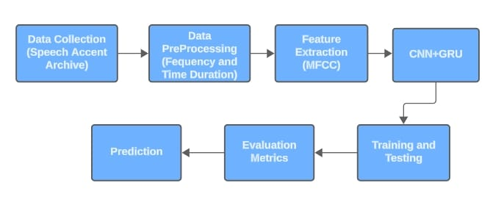
PROPOSED SYSTEM

Slide 10
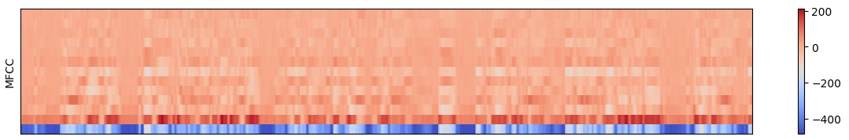
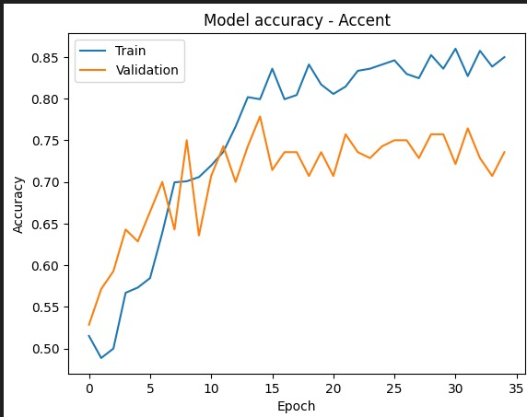
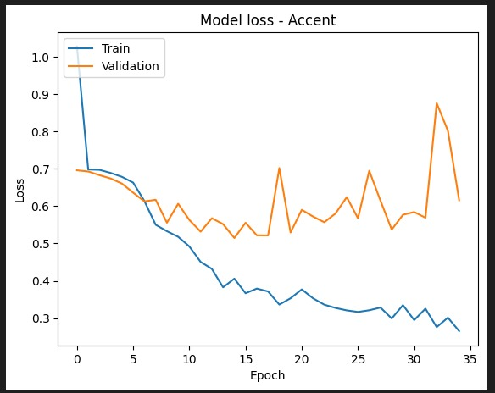
METHODOLOGY
Preprocessing:
Clean and standardize audio data.
Extract features like Mel-Frequency Cepstral Coefficients (MFCCs).
Normalize data for model input.
Model Architecture:
Utilize a Convolutional Neural Network (CNN) with Gated Recurrent Units (GRUs).
CNN extracts spatial features from MFCCs.
GRU captures temporal dependencies in sequential data.
Training:
Split dataset into training, validation, and test sets.
Train CNN-GRU model using stochastic gradient descent with momentum.
Implement learning rate scheduling for optimization.

Slide 11
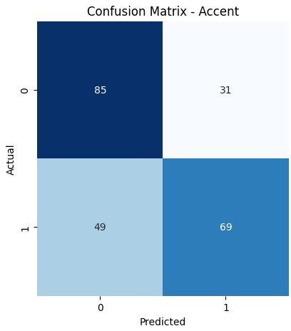
RESULTS
Performance Metrics: Achieved high accuracy, precision, recall, and F1-score in accent recognition tasks, indicating the model's effectiveness in distinguishing between accents.
Robustness: Demonstrated robustness in discriminating between different accents, showcasing the model's ability to handle diverse linguistic variations.
Generalization: Showed strong generalization ability across different accents not present in the training data, highlighting the model's adaptability to unseen accent variations.
Real-world Applicability: The CNN-GRU and RF model's performance underscores its potential utility in real-world applications, such as speech-to-text transcription, language learning tools, and cross-cultural communication platforms.

Slide 12
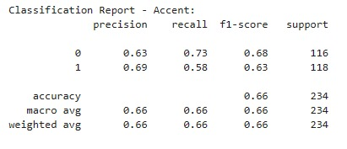
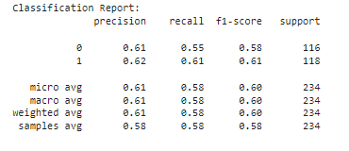
RESULTS
Random Forest
CNN+GRU

Slide 13
CONCLUSION
Our speech accent recognition system, utilizing CNNs and GRUs, effectively identifies accents in spoken English with high accuracy and robustness. CNN-GRU architecture demonstrates potential for real-world applications, including language technology enhancement and cross-cultural communication facilitation. Additionally, exploring Random Forest classifiers offers insights into alternative approaches for accent recognition tasks, complementing the strengths of CNN-GRU models. Through thorough evaluation, our system aims to provide valuable insights into accent recognition methodologies, contributing to linguistic inclusivity and understanding.

Slide 14
REFERENCES
Shergill, J., Pravin, C., & Ojha, V. (2021). Accent and Gender Recognition from English Language Speech and Audio Using Signal Processing and Deep Learning. In Proceedings of the International Conference on Artificial Intelligence and Data Engineering (ICAIDE 2021) (pp. 62-72). Springer. DOI: 10.1007/978-3-030-73050-5_7
Cetin, O. Accent Recognition Using a Spectrogram Image Feature-Based Convolutional Neural Network. Arab J Sci Eng 48, 1973–1990 (2023). https://doi.org/10.1007/s13369-022-07086-9
D. S. Widyowaty and A. Sunyoto, "Accent Recognition by Native Language Using Mel-Frequency Cepstral Coefficient and K-Nearest Neighbor," 2020 3rd International Conference on Information and Communications Technology (ICOIACT), Yogyakarta, Indonesia, 2020, pp. 314-318, doi: 10.1109/ICOIACT50329.2020.9332026.
Zhong, Jiang et al. “Adaptive recognition of different accents conversations based on convolutional neural network.” Multimedia Tools and Applications 78 (2018): 30749 - 30767.

Slide 15

5) Huang, H., Xiang, X., Yang, Y., Ma, R., & Qian, Y. (2021). AISPEECH-SJTU accent identification system for the
Accented English Speech Recognition Challenge. Accepted to ICASSP 2021. arXiv preprint arXiv:2102.09828.
Retrieved from https://arxiv.org/abs/2102.09828
6) Lesnichaia, M., Khaustova, V., Bogach, N., Lezhenin, I., Blake, J., & Pyshkin, E. (2022). Classification of
Accented English Using CNN Model Trained on Amplitude Mel-Spectrograms. In Proceedings of Interspeech
2022 (pp. 3669-3673). DOI: 10.21437/Interspeech.2022-462.
7) S. Darshana, H. Theivaprakasham, G. Jyothish Lal, B. Premjith, V. Sowmya and K. Soman, "MARS: A Hybrid
Deep CNN-based Multi-Accent Recognition System for English Language," 2022 First International Conference
on Artificial Intelligence Trends and Pattern Recognition (ICAITPR), Hyderabad, India, 2022, pp. 1-6, doi:
10.1109/ICAITPR51569.2022.9844177.
8) Widyowaty, D. S., Sunyoto, A., & Al Fatta, H. (2021). Accent Recognition Using Mel-Frequency Cepstral
Coefficients and Convolutional Neural Network. In Proceedings of the International Conference on Innovation in
Science and Technology (ICIST 2020) (Series: Advances in Engineering Research, Vol. K, pp. XX-XX). DOI:
10.2991/aer.k.211129.010

Slide 16
9) Tong, F., Li, T., Liao, D., Xia, S., Li, S., Hong, Q., & Li, L. (2022). The XMUSPEECH System for Accented
English Automatic Speech Recognition. Applied Sciences, 12, 1478. DOI: 10.3390/app12031478
A. Ahmed, P. Tangri, A. Panda, D. Ramani and S. Karmakar, "VFNet: A Convolutional Architecture for Accent
Classification," 2019 IEEE 16th India Council International Conference (INDICON), Rajkot, India, 2019, pp. 1-4, doi:
10.1109/INDICON47234.2019.9030363.

Slide 17


