Slide 1
DOMESTIC WASTE MANAGEMENT
PIP4004 University Project-II
Review-1
NAMES | ROLL NUMBER
KOLIMI JAHNAVI | 20211CSE0036
TATICHERLA VARSHA | 20211CSE0136
SADDALA HARSHITHA | 20211CSE0027
R GAGANA SHREE | 20211CSE0038
Under the Supervision of
Dr . Hassan Hussain S
Professor , Computer Science

Slide 2
Abstract
Abstract for Domestic Waste Management Project
Effective waste management is essential for maintaining a clean and healthy environment.
This project aims to develop a software application that allows users to report waste accumulation in their locality by uploading images and providing location details.
The system will use geotagging to pinpoint the exact location and notify the concerned waste management authorities for timely action.
Users can also track the status of their complaints, ensuring transparency and accountability.
The platform will feature a centralized dashboard for authorities to manage reports efficiently, prioritize waste clearance, and analyze waste accumulation patterns using data analytics.
By leveraging technology and citizen participation, this project enhances urban cleanliness, promotes environmental awareness, and improves the efficiency of waste disposal systems.

Slide 3
Literature Review
1.Paper Title: "Smart Waste Management System Using IoT and Mobile Application"
Authors: A. S. Bagade, P. P. Kulkarni
Summary: Explores an IoT-based waste management system with real-time data collection to optimize waste disposal.
2.Paper Title: "Geotagging and Mobile-Based System for Effective Waste Management"
Authors: R. J. Thomas, M. S. Naik
Summary: Focuses on geotagging to improve waste tracking and enhance coordination between users and authorities.
3.Paper Title: "A Cloud-Based System for Urban Waste Management"
Authors: S. Verma, K. Jain
Summary: Discusses a cloud-integrated solution for managing user-reported waste data and automating task assignments.
4.Paper Title: "Citizen-Centric Platform for Waste Reporting and Monitoring"
Authors: T. N. Gupta, R. Sharma
Summary: Highlights a mobile platform to engage citizens in reporting waste and monitoring resolution status effectively.
5.Paper Title: "Data Analytics in Waste Management: Trends and Applications"
Authors: P. K. Singh, L. A. Deshmukh
Summary: Examines the role of data analytics in identifying waste accumulation patterns and improving resource allocation.

Slide 4
Objectives
Following are some of our objectives:
Enable users to report waste accumulation via photos and addresses.
Provide geotagged data for precise location tracking.
Streamline communication between citizens and waste management authorities.
Enhance waste clearance efficiency through real-time reporting and task assignment.
Promote environmental cleanliness and reduce health hazards

Slide 5
Existing Methods & Drawbacks
Landfilling – Waste is dumped in designated landfill sites.
Drawbacks: Causes land pollution, groundwater contamination, and emits methane,
contributing to climate change.
Incineration – Burning waste to reduce volume and generate energy.
Drawbacks: Releases harmful pollutants, requires high energy, and is expensive to
maintain.
Recycling – Processing waste materials into reusable products.
Drawbacks: Not all materials are recyclable, high processing costs, and contamination
reduces efficiency.
Composting – Organic waste is decomposed into nutrient-rich compost.
Drawbacks: Requires space, slow process, and cannot handle plastic or hazardous
waste.
Municipal Waste Collection – Government-run waste collection and disposal.
Drawbacks: Inefficient collection schedules, lack of tracking, and improper disposal lead
to environmental hazards.

Slide 6
Proposed Method
We propose a software application that empowers users to report waste accumulation in their locality effectively. The application will allow users to:
Capture and Upload: Take pictures of the waste in their locality and provide details such as the exact address.
Geotagging: Automatically attach GPS coordinates to ensure precise location tracking.
Real-time Reporting: Submit the report through a dedicated portal accessible to waste management authorities.
Status Tracking: Monitor the status of their report, from acknowledgment to waste clearance.
Feedback Mechanism: Provide feedback on the quality and timeliness of the waste clearance service.

Slide 7
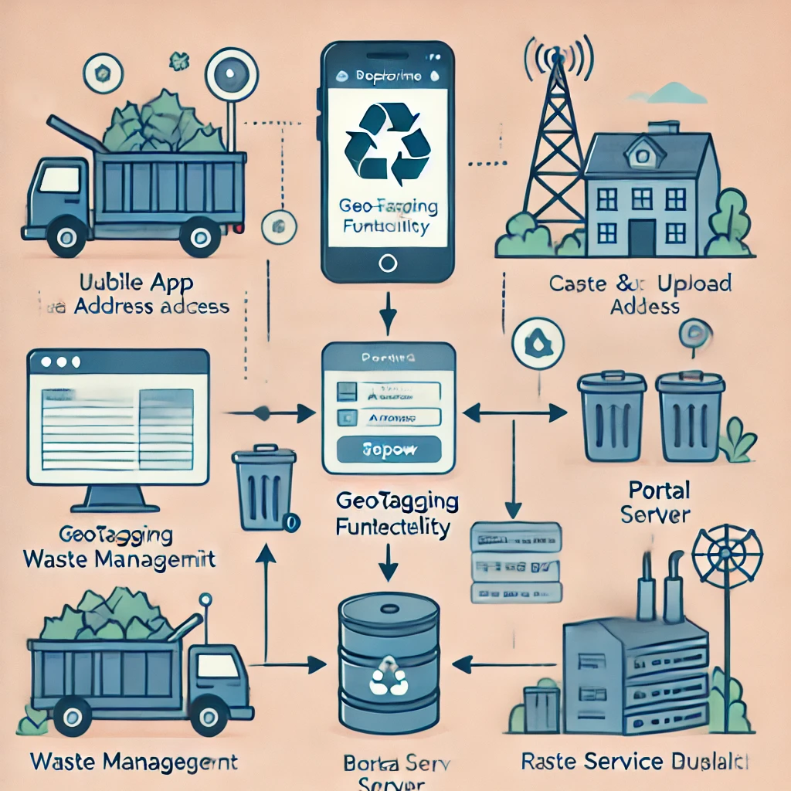
Architecture Diagram

Slide 8
Modules
Key Modules for Domestic Waste Management System
User Management Module
User registration, login, profile management, and complaint submission with image upload & geotagging.
Reporting & Tracking Module
Users report waste accumulation, track complaint status, and receive real-time updates & notifications.
Admin & Authority Dashboard Module
Authorities manage complaints, assign cleanup tasks, and update resolution progress.
Feedback & Analytics Module
Users provide feedback, and the system analyzes waste trends to improve efficiency.
Location & Mapping Module
GPS-based geotagging for accurate waste location tracking and integration with maps.

Slide 9
Hardware and Software used
Frontend:
React.js
HTML, CSS
JavaScript
Backend:
Node.js with Express.js
Python/Django
Database:
MongoDB/MySQL
Firebase

Slide 10
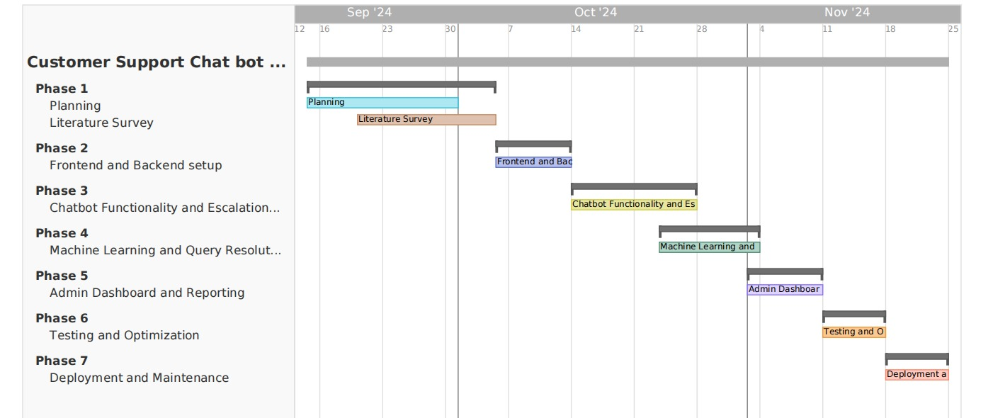
Timeline of Project

Slide 11
References
, ,
, ,
, ,
Gupta, P., Sinha, R., & Shukla, S. (2021). Smart Waste Management System Using IoT and Machine Learning.
International Journal of Environmental Science and Technology, 18(4), 1125-1138.
Discusses the implementation of IoT and ML in waste tracking and management.
Kumar, A., & Raj, P. (2020). A GIS-Based Approach for Effective Waste Collection and Disposal.
Journal of Urban Planning and Development, 146(3), 103-117.
Explores how GIS-based geotagging helps in optimizing waste collection routes.
Sharma, V., & Patel, D. (2019). Design and Implementation of a Citizen-Centric Smart Waste Reporting System.
IEEE International Conference on Smart Cities, 245-250.
Focuses on mobile-based waste reporting and real-time tracking of complaints.
Ramesh, S., & Verma, K. (2021). A Cloud-Based Waste Monitoring System for Urban Localities.
Sustainable Computing: Informatics and Systems, 30, 124-136.
Discusses the role of cloud technology in real-time monitoring of waste management.
Fernandez, M., & Joseph, B. (2022).
Enhancing Municipal Waste Collection Efficiency through Data-Driven Decision Making.
Waste Management Journal, 79, 65-78.
Explores data analytics and AI-based optimizations for waste management operations.

Slide 12
Thank You

