Slide 1
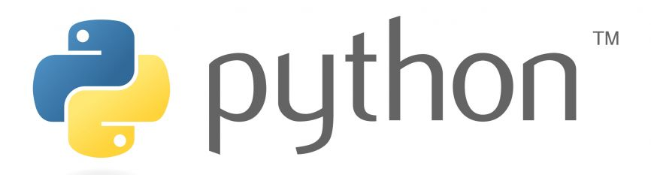

Default Queue Automation Code KT Python Programming Language

Slide 2
What is Python?
Python is an interpreted, object-oriented, high-level programming language with dynamic semantics
Interpreted Language: Python is an interpreted language where the script/code is executed in line-by-line basis. This allows the use of Shell Scripting/Command Line Scripting where each instruction can be manually entered, and the result can be instantly verified.
Object Oriented: Python is an Object Oriented Programming (although not strict Object Oriented like Java, Ruby). This provides the freedom to developer to use Object Oriented design paradigm to manage large codebases or simply use scripting for faster development times.
Every data structure, variable and component in Python is an Object. They contain Member Functions along with the actual data. They also allow further inheritance to customize the object to suit special needs.
High-Level Programming Language: Python is a High-Level Programming Language with minimal syntax and near resemblance to plain English. This eases the learning process and reduces the actual development time. It allows for easier code maintaince.
Dynamic Semantics: Variables in Python are dynamic objects. Essentially, it’s just another aspect of Python being a high-level language. There is no need to define the datatype of a variable while initializing the variable. It can change any point in code and at runtime through the use of typeconversion.

Slide 3
Brief history of Python
Python is Invented in February 1991 (33 years ago) by Guido van Rossum. Python is older than Java.
Python is Open-Source programming language. Anyone from around the world can review the code of Python and can contribute to it. [https://github.com/python/cpython]
CPython is the original and currently used version of Python. The internal machinery of Python is coded in C Language and Python code is converted to C ByteCode for Faster code execution.
Similar to Java, Python uses a two-step execution process where the code is compiled to Bytecode (C in case of Python, Kind of) and the bytecode is interpreted by interpreter.
Jython (Java implementation), MicroPython (for Microcontrollers), PyPy (uses JIT Compiler)
Current Stable version of Python is 3.12.3

Slide 4
Advantages of Python
Readable and Maintainable Code: Python syntax is straightforward and has no complex structures, like C++ or Java. Also, it emphasizes code readability by using English keywords and eliminating the need for delimiters
Supports Multiple Programming Paradigms: Python supports object-oriented, procedural, and functional programming paradigms. The object-oriented programming approach facilitates code reusability, extensibility, and modularity. The functional programming paradigm helps developers write clearer and more bug-resistant code.
Extensive Standard Library: The extensive, robust library is an advantage for Python over other programming languages. It consists of multiple packages and modules to enhance the functionality of your Python application. By using Python Package Installer (PIP) which comes with the python installation we can simply install any package/module for desired task. https://pypi.org/ (Link to PIP Homepage)
High Compatibility: Python is compatible with various operating systems. Being a cross-platform and portable language, developers can run the same code, written in one platform, on other platforms without any changes.

Slide 5
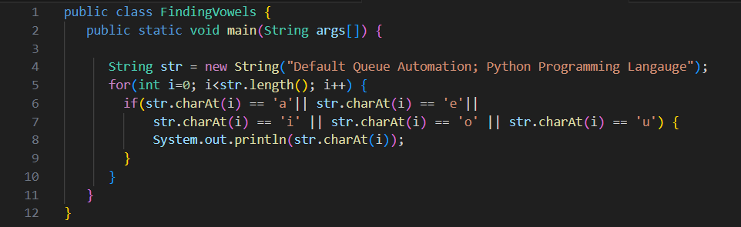
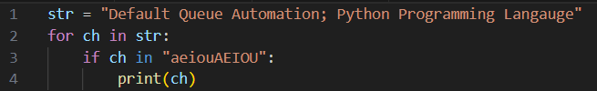
Java vs Python – Print Vowel in given string
Java
Python

Slide 6
Disadvantages of Python
Slow Execution Speed: Python is an interpreted language that works with an interpreter, not a compiler. As a result, the interpreter executes code relatively slower than a compiler
CPU and Memory demanding: Python's data structures demand more memory space. It is not suitable to use for development under limited memory restrictions. It is the extremely dynamic nature of Python that eats all the CPU: all of those attribute lookups/method dispatches add up.
Less secure: Python is considered to be less secure than some other programming languages such as Java or C++. This is because Python is a dynamically typed language, which means that data types are determined at runtime.
Poor multithreading: Python does have a threading module, it is not truly multithreaded due to the Global Interpreter Lock (GIL). The GIL ensures that only one thread can execute Python bytecode at a time, even on multi-core systems. This means that while multiple threads can be created in Python, they cannot run in parallel, limiting the potential performance gains from using multithreading.

Slide 7
Execution Speed Analysis of Python
Following tests are results of Matrix Multiplications of size 2048 by 2048 ran for 5 Iterations.
[Medium Article]

Slide 8
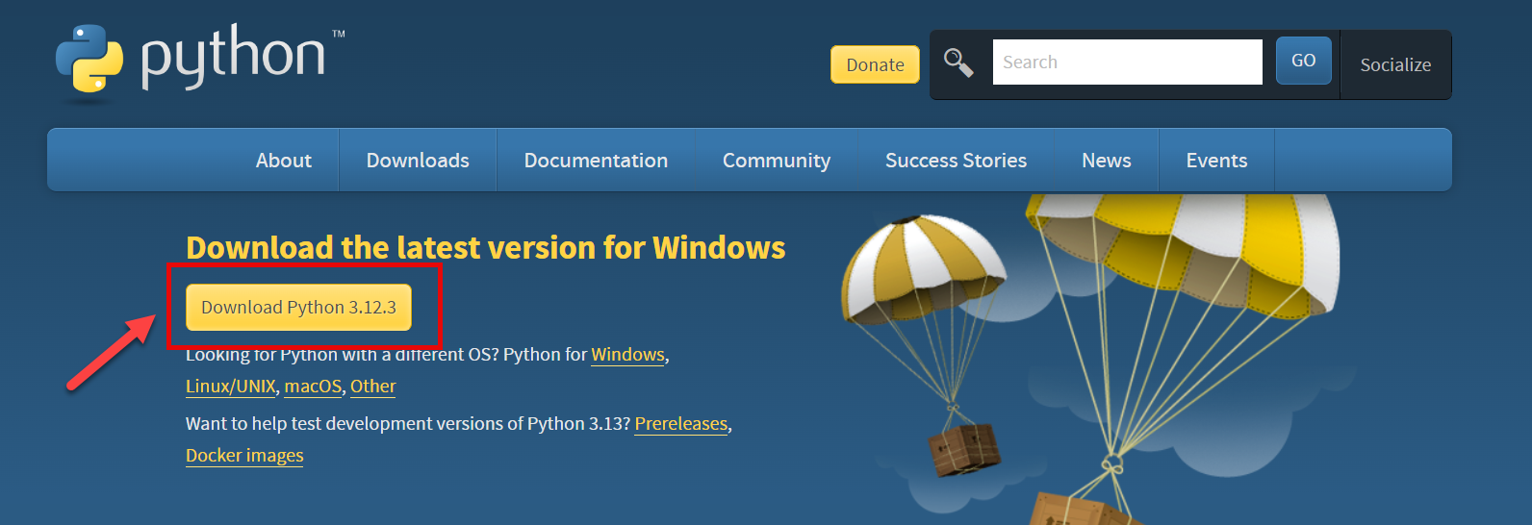
Installation of Python in Non-ADP Systems
Goto https://www.python.org/downloads/
Download the latest version based on Operating system
3. Click the download executable and proceed with installation

Slide 9
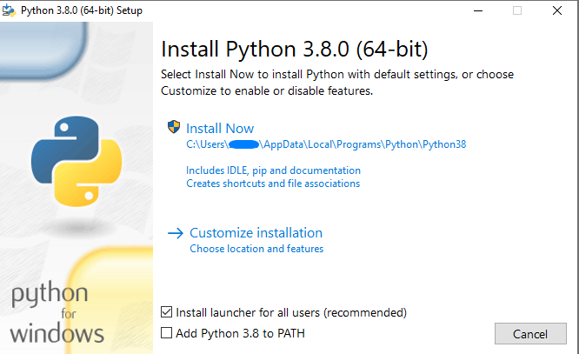
Installation of Python in Non-ADP Systems
4. Click on Install Now and make sure to check “Add Python 3.x.x to PATH”. This will add python binaries to Windows Path environment variable so python can be used anywhere in the system.

Slide 10
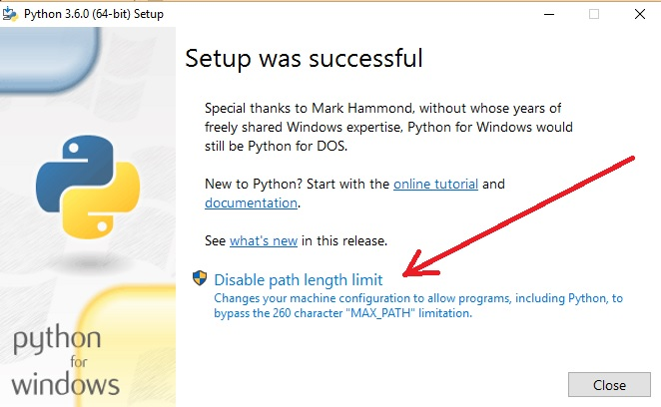
Installation of Python in Non-ADP Systems
5. At the end, click “Disable Path length limit”

Slide 11
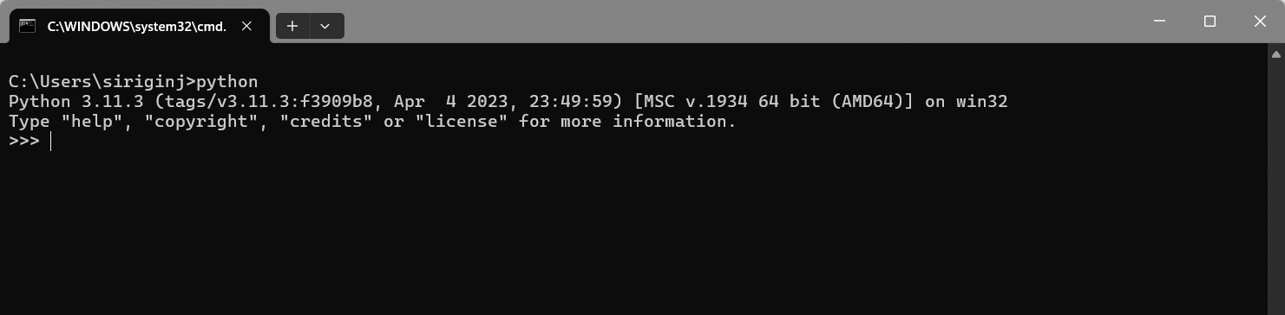
Installation of Python in Non-ADP Systems
6. Confirm if Python installation is successful by executing “python” in Command Prompt. It should open Python Interactive Shell.

Slide 12
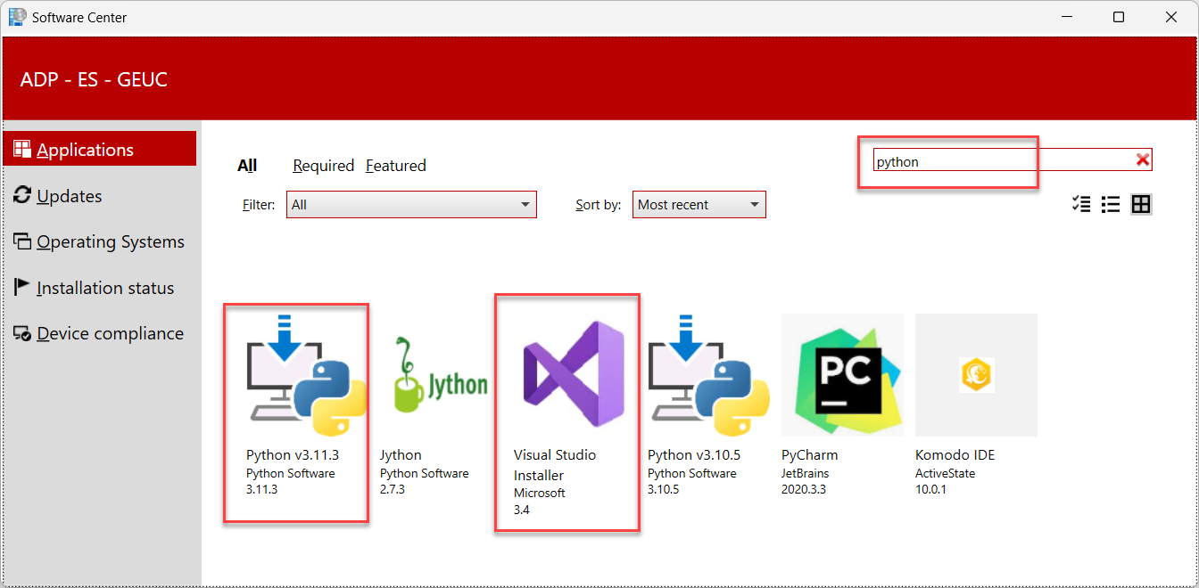
Installation of Python in ADP Systems
Open “Software Center” and search for “Python”. The following window should show up

Slide 13
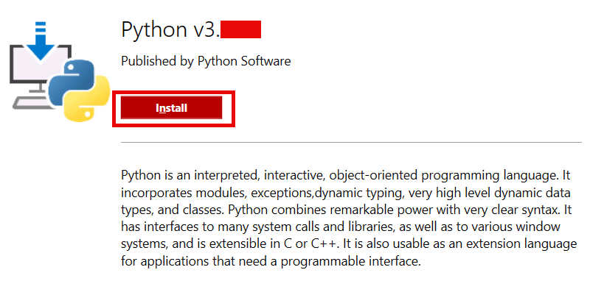
Installation of Python in ADP Systems
Open the latest version and click install. Also install VS Code which is the suitable IDE for python

Slide 14
Installation of Python in ADP Systems
Once python is installed, we should set the path in Windows System Environment Variables. You need to reach out to TechCafe for safe procedure.
For temporary testing you can use the following command in command prompt. This will temporarily set the path but will be removed after system restart.
Here Python311 can vary based on your python installation. You can verify your Python installation by Opening C:\Program Files and search for folder starting with python.
Now copy the path for Python folder and Scripts folder. Execute the above command in Command Prompt.
set path=%PATH%;C:\Program Files\Python311\Scripts\;C:\Program Files\Python311\

Slide 15
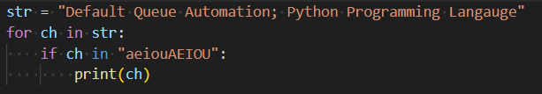
Python Syntax
Whitespaces: Generally, whitespaces are ignored in other Programming Languages unless enclosed in Quotes. But in Python whitespaces are used indent and define the scope of program.
Colon at end of statement defines start of new indent and code block
No Braces { } are needed to define the code block
Single Whitespace can be used as valid indent but 3 Whitespaces are used for clear indentation.

Slide 16
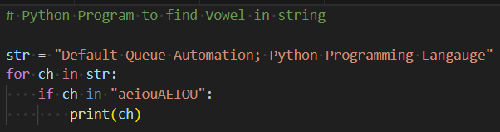
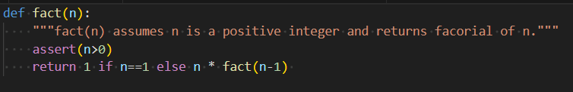
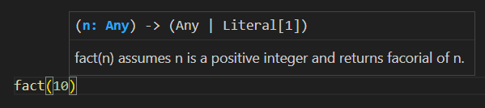
Python Comments
Start comments with #, rest of line is ignored
Can include a “documentation string” as the first line of a new function or class you define
Modern IDEs like VS code are designed to show the “documentation string” or “doc string” when the function is used. This helps the developer to know the intent of function

Slide 17

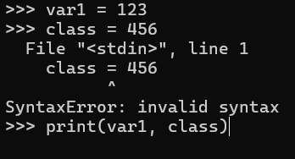
Naming Conventions
Names are case sensitive and cannot start with a number. They can contain letters, numbers, and underscores.
Some Valid Names: bob; Bob; _bob; _2_bob_; bob_2; BoB
Variable Names cannot contain the following reserved words
VS Code highlights any errors using squiggly line. Here, class is used as a variable which is not allowed

Slide 18
Type of Statements in Python
There are 3 statements in Python
Sequential Statements
These statements will be executed in Step-by-Step manner
If an error occurs in current statement (instruction), then the execution will be halted and there will error indicating the line number
Conditional Statements
These are the statements which branch into multiple statements
These statements will be executed passed on a condition
If the condition turns True, some set of statements will be executed and if not other set of statements will be executed
Repeating Statements
These statements will be executed multiple times until a given condition turns to be false
If a condition stays true, some set of statements will be executed and loop continues to run
The condition needs to be updated during loop body

Slide 19
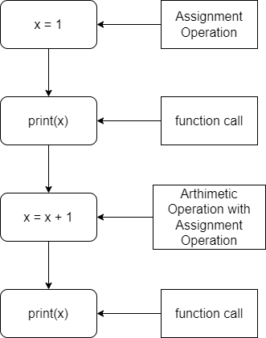
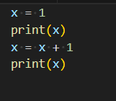
Sequential Statements

Slide 20
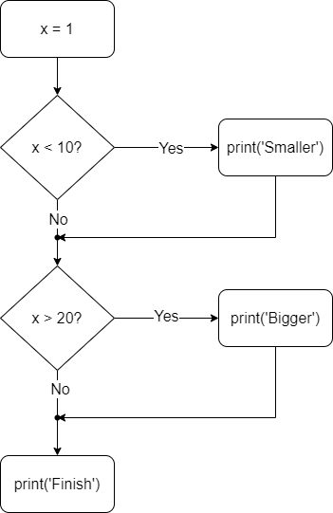
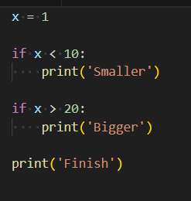
Conditional Statements

Slide 21
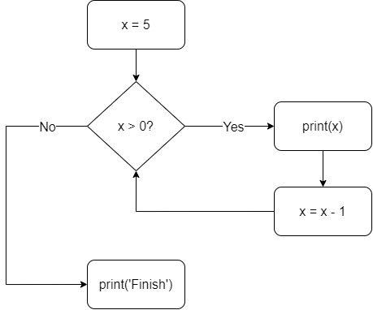
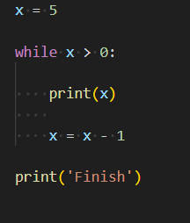
Iterative Statements

Slide 22
Data Types in Python
Data Type of Variable generally refers to type of data that a variable is going to store
Variables in Python are Dynamic Semantic in nature i.e., They don't have a constant data type, but they have the property of type of data they are storing.
These are the following data types present in python
Numeric Data Types
Integers (int)
Float (float)
Complex (complex, form a + bi)
String Data Type
Boolean Data type (bool)
Collection Data Type
List (list)
Tuple (tuple)
Dictionary (dict)
Set (set)

Slide 23
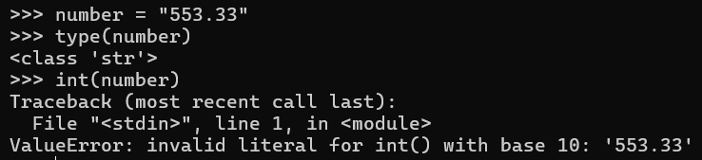
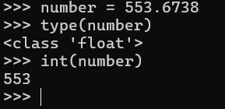
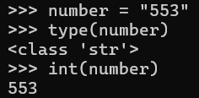
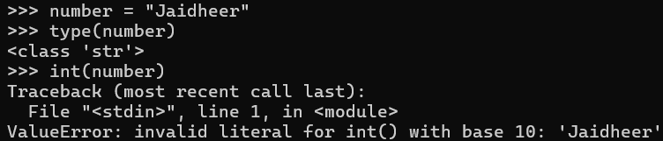
Integer Data Type
Integer data type holds Numeric Non-Decimal Values which can be positive, negative and zero.
Int() is the method that is used to convert other numeric variables to integer.
Int() can also be used to convert valid string representation to integer.

Slide 24
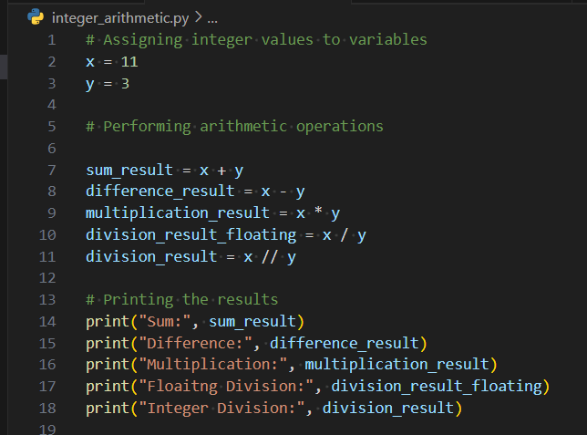
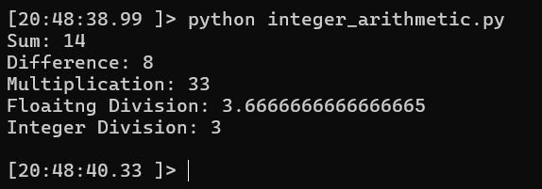
Arithmetic operations on Integers

Slide 25
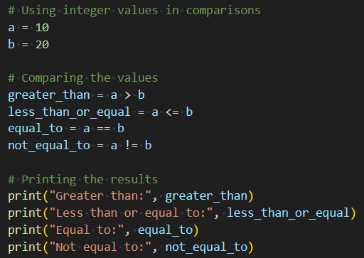
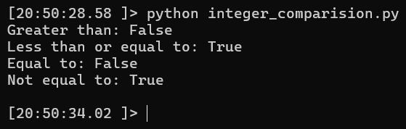
Comparison operations on Integers

Slide 26
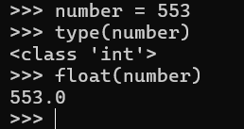
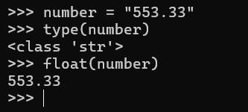
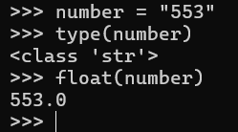
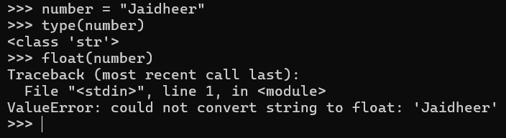
Float Data Type
Float data type holds Numeric Decimal Values which can be positive, negative and zero.
float() is the method that is used to convert other numeric variables to float.
float() can also be used to convert valid string representation to float.

Slide 27
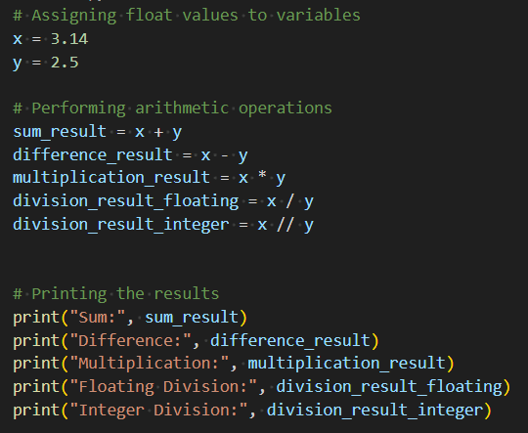
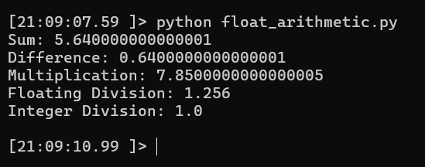
Arithmetic operations on Floats

Slide 28
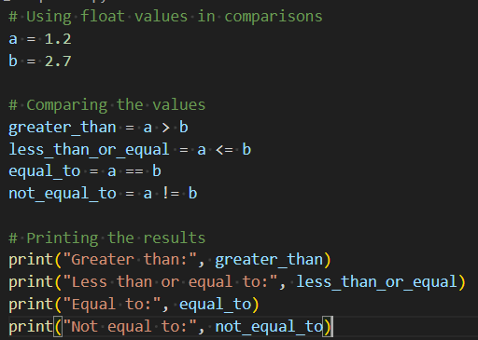
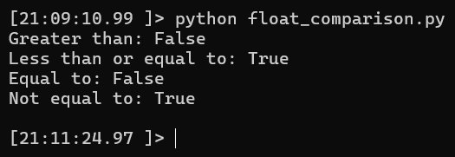
Comparison operations on Floats

Slide 29
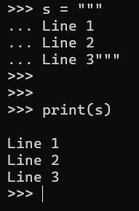
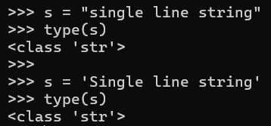
String Data Type
String Data type holds sequence of characters which can alphabets, numeric values, symbols etc.
Python Strings are UTF-8 Compatible
Strings are sequence data types. They can be Sliced using [:] and accessed using []
Strings are immutable. Once Created they cannot be changed again. To modify a string, we should create a new string or convert the string to list, apply the changes and convert it back to string.
Double Quotes and Single Quotes can be used to define a single line string.
Multi Line strings can be initialized using three double quotes (""")

Slide 30
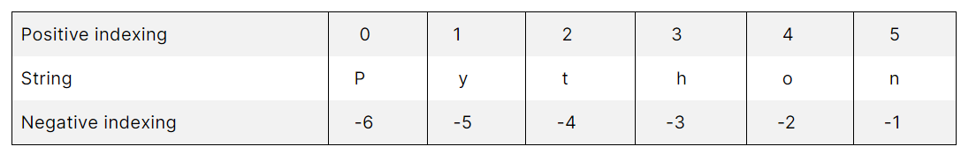
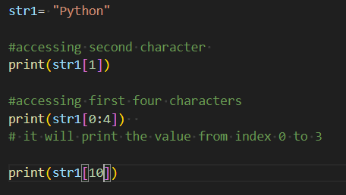
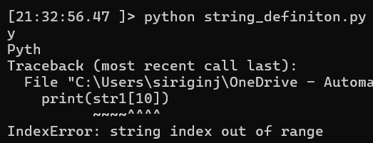
String Accessing and String Slicing
Individual characters can be accessed using [] operator. Indices should be starting with '0' and length of string – 1. If the index is outside of the range of acceptable values, it will throw an error.

Slide 31
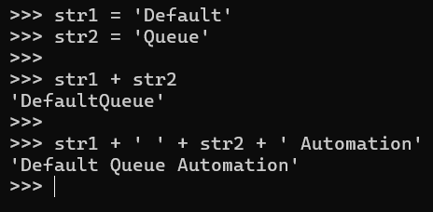
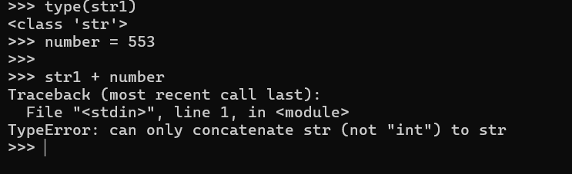
Operations on Strings
Concatenation operation allows to join two or more strings using ' + ' operator

Slide 32
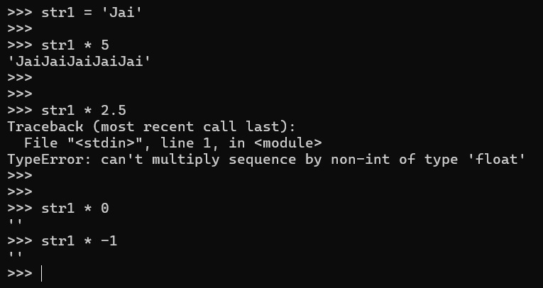
Operations on Strings
Repetition Operation allows to repeat a string 'n' number of time by using ' * ' operator
The numerical value can be non-decimal number. Negative and Zero numerical value will result in an empty string

Slide 33
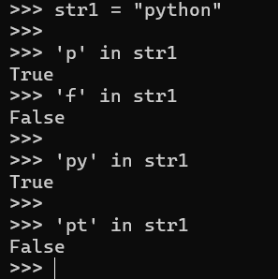
Operations on Strings
Membership Operation helps to check whether a given character is present in the string or not with the help of two operators in and not in

Slide 34
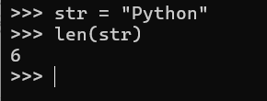
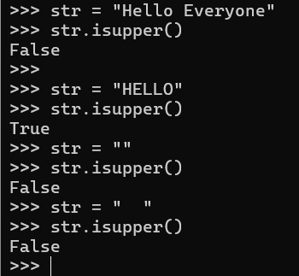
Built-In Methods in String
len() method is used to find the length of string or any other collection data type. It is a standard function available in Python
isupper() method checks if entire string is in Upper Case or not

Slide 35
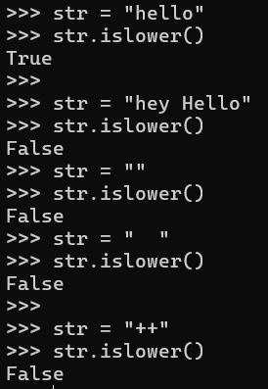
Built-In Methods in String
islower() method checks if entire string is in lower Case or not

Slide 36
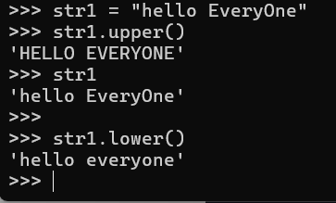
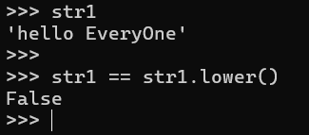
Built-In Methods in String
lower() and upper() methods converts the given string to lower and upper case respectively

Slide 37


Boolean Data Type
The Boolean python data types in Python represents logical values of True and False.
It is used to evaluate conditions and make logical decisions in a program
Booleans are the result of comparisons and logical operations.

Slide 38
Truth Tables for Boolean Data Type
X | Y | X and Y | X or Y | not(X) | not(Y)
True | True | True | True | False | False
True | False | False | True | False | True
False | True | False | True | True | False
False | False | False | False | True | True

Slide 39
Collection Data Types
Collection data types in Python are used to store and organize multiple values into a single entity.
Python provides several built-in collection data types such as
Lists
Tuples
Set
Dictionary

Slide 40

List Data Type
The list data type in Python is used to store multiple items in a single variable
Lists are ordered, mutable, and can contain elements of different data types
They are created by enclosing comma-separated values within square brackets [ ].

Slide 41


Accessing Elements of the List
Elements of the list are accessed in the same as that of string that is with the help of positive and negative indexing
Slicing is also used to access the list elements in which more than a single element is accessed at a time
Positive Index | 0 | 1 | 2 | 3
List Element | apple | 123 | Mango | [2, 3, 4]
Negative Index | -4 | -3 | -2 | -1

Slide 42


Tuple Data Type
tuples are immutable. Once you create a tuple, you cannot modify its elements.
Lists are mutable whereas tuples are immutable data types
They are created by enclosing comma-separated values within round brackets ().

Slide 43


Set Data Type
The set data type in Python is an unordered collection of unique elements
Used to store multiple items without any duplicates
You create sets by enclosing comma-separated elements within curly braces { } or by using the set() constructor.

Slide 44



Set Operations

Slide 45

Dictionary Data Type
Dictionary is a special data type that is a mapping between a set of keys and a set of values
It represents a key-value pair enclosed in curly brackets, and each element is separated by a comma
Additionally, key-value pairs are separated by a colon. Furthermore, the elements of the dictionaries are unordered, and the key is unique for each value in the dictionary
The elements of the dictionary are mutable that is its elements can be changed once it is created.

Slide 46




Built-in Functions in the Dictionary
items(): items() function returns a list of tuples of key-value pair of the dictionary.
keys(): This function returns the list of keys in the dictionary.
values(): It returns the list of values in the dictionary.
get(): Returns the associated value with given key. If the key is not present, will return None as default. If any redundant value is given, it will return it.

Slide 47




Maintain count of elements using Dictionary

Slide 48

Functions in Python
function is a self-contained block of code that encapsulates a specific task or related group of tasks
Component | Meaning
def | The keyword that informs Python that a function is being defined
<function_name> | A valid Python identifier that names the function
<parameters> | An optional, comma-separated list of parameters that may be passed to the function
: | Punctuation that denotes the end of the Python function header (the name and parameter list)
<statement(s)> | A block of valid Python statements

Slide 49


Functions in Python

Slide 50


Function Call Tracing in Python

Slide 51


Positional Arguments
The most straightforward way to pass arguments to a Python function is with positional arguments (also called required arguments). In the function definition, you specify a comma-separated list of parameters inside the parentheses

Slide 52


Keyword Arguments
When you’re calling a function, you can specify arguments in the form <keyword>=<value>. In that case, each <keyword> must match a parameter in the Python function definition. For example, the previously defined function f() may be called with keyword arguments as follows:
Referencing a keyword that doesn’t match any of the declared parameters generates an exception:

Slide 53


Default Arguments
If a parameter specified in a Python function definition has the form <name>=<value>, then <value> becomes a default value for that parameter. Parameters defined this way are referred to as default or optional parameters. An example of a function definition with default parameters is shown below:
When this version of f() is called, any argument that’s left out assumes its default value:

Slide 54
Object Oriented Programming Paradigm
Object Oriented Programming Paradigm emphasizes mainly on Data rather than procedure of the code.
OOP places restrictions on free Data manipulation by other functions by encapsulating data with entity called Objects
Objects can contain both data and code. Data will be stored in Data in form of fields or Data Members. The visibility and accessibility of data members can be controlled through different mechanisms
Code will be stored as Member Functions or Stored Procedures. These Member Functions have access to data that an object holds.
Outside functions can modify or fetch the Data through the member functions effectively controlling the level of access.
Significant object-oriented languages include Ada, ActionScript, C++, Common Lisp, C#, Dart, Eiffel, Fortran 2003, Haxe, Java,[4] Kotlin, Logo, MATLAB, Objective-C, Object Pascal, Perl, PHP, Python, R, Raku, Ruby, Scala, SIMSCRIPT, Simula, Smalltalk, Swift, Vala and Visual Basic.NET.

Slide 55

Main Principles of Object-Oriented Programming

Slide 56

Main Principles of Object-Oriented Programming
Class: Class is a template through which we can define the properties and behavior of an object
In Python we can define a class using “class” keyword, with class name and ending with colon “:”

Slide 57


Main Principles of Object-Oriented Programming
Object: Object is the real-world entity of a class. Objects can hold real data and occupy memory in system space.
In Python we can create object of class by calling class as function i.e., class_name(arguments)
When an object is created, a reference variable (self) will be assigned to the object location in memory. We can access the Data Members and Member Functions of a particular object by using this reference variable.

Slide 58

Main Principles of Object-Oriented Programming
Data Member Definition will be in class scope, but the actual data will be in the scope of newly created object.

Slide 59
Encapsulation in OOPS
Encapsulation is one of the fundamental concepts in object-oriented programming (OOP). It describes the idea of wrapping data and the methods that work on data within one unit. This puts restrictions on accessing variables and methods directly and can prevent the accidental modification of data.
A class is an example of encapsulation as it encapsulates all the data that is member functions, variables, etc. The goal of information hiding is to ensure that an object’s state is always valid by controlling access to attributes that are hidden from the outside world.
To prevent accidental change, level of access for a Data Member or Member Function can be set using Access Modifiers
Python Doesn’t have separate keywords to define access modifier but relies on naming convention of the Variable or Method.
If the name starts with single underscore, it is a protected variable. If it starts with double underscore, it is a private variable.
Access Modifiers are not strictly enforced in Python. They are just good coding conventions and only Public and Private access modifiers are enforced

Slide 60

Access Modifiers in Python

Slide 61

Polymorphism in OOPS
The word polymorphism means having many forms. In programming, polymorphism means the same function name (but different signatures) being used for different types. The key difference is the data types and number of arguments used in function.
Polymorphism can be seen in Simple functions which accept different arguments. The Interpreter will decide to call which function based on the arguments provided

Slide 62


Polymorphism in OOPS
Polymorphism can be observed in Inherited classes.

Slide 63
Polymorphism in OOPS
Polymorphism can be observed in Inherited classes.

Slide 64
Exception Handling in Python
Even if a statement or expression is syntactically correct, it may cause an error when an attempt is made to execute it. Errors detected during execution are called exceptions and are not unconditionally fatal
Some errors are not found by Python Interpreter and they occur while program execution. This can lead to uncalled program termination which results in erogenous outputs.
To manage these exceptions, we will be using Python Exception Handling mechanism called Try and Except
The code which might cause Exception is enclosed in Try Block and possible exception will be handled by the following try block.
Try Block accepts a exception class argument. If the exception class argument is mentioned in the try block, the code mentioned in try block will be executed if same exception is raised
We can use “raise” keyword and Exception class name to manually raise an exception

Slide 65




Exception Handling in Python

Slide 66

Exception Class Hierarchy

Slide 67
Python Modules
Modular programming refers to the process of breaking a large, unwieldy programming task into separate, smaller, more manageable subtasks or modules. Individual modules can then be cobbled together like building blocks to create a larger application.
Simplicity: Rather than focusing on the entire problem at hand, a module typically focuses on one relatively small portion of the problem. If you’re working on a single module, you’ll have a smaller problem domain to wrap your head around. This makes development easier and less error-prone.\
Maintainability: Modules are typically designed so that they enforce logical boundaries between different problem domains. If modules are written in a way that minimizes interdependency, there is decreased likelihood that modifications to a single module will have an impact on other parts of the program.
Reusability: Functionality defined in a single module can be easily reused (through an appropriately defined interface) by other parts of the application. This eliminates the need to duplicate code.
Scoping: Modules typically define a separate namespace, which helps avoid collisions between identifiers in different areas of a program.

Slide 68


Python Modules

Slide 69


Python Modules
An alternate form of the import statement allows individual objects from the module to be imported directly into the caller’s symbol table

Slide 70


Python Modules
It is also possible to import individual objects but enter them into the local symbol table with alternate names:

Slide 71





Working with Files
Reading and writing data to files using Python is straightforward. To do this, you must first open files in the appropriate mode. Here’s an example of how to use Python’s “with open(…) as …” pattern to open a text file and read its contents

Slide 72

PIP - Package Installer for Python
PIP is the Package Installer for Python. It is used to install packages from Python Package Index (PyPI) and other indexes.
PyPI is the default repository of Python packages for Python community that includes frameworks, tools and, libraries. Python developers can install and use packages in the Python application. It is open to all Python developers to consume and distribute their distributions. Developers can search or browse projects from pypi.org.

Slide 73
PIP - Package Installer for Python
PIP is the Package Installer for Python. It is used to install packages from Python Package Index (PyPI) and other indexes.
PyPI is the default repository of Python packages for Python community that includes frameworks, tools and, libraries. Python developers can install and use packages in the Python application. It is open to all Python developers to consume and distribute their distributions. Developers can search or browse projects from pypi.org.

