Slide 1
Polar Codes Group – 6(2)
Group 6(2)

Slide 2
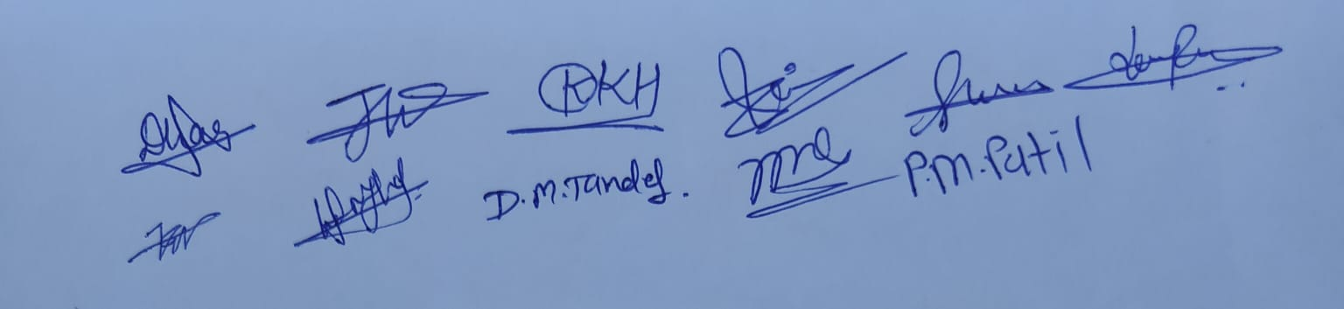
Honour code
We, declare that the work presented is our own work.
We have not copied the work that someone else has done.
Concepts, understanding and insights we will be describing are our own.
Wherever we have relied on an existing work is not our own, we have provided a proper reference citation. We make this pledge truthfully.
We know that violation of this solemn pledge can carry grave consequences.
Signed by :

Slide 3
Group Members
202201462 -> Darpan Lunagariya
202201467 -> Dharmi Patel
202201469 -> Divya Tandel
202201475 -> Krutarth Kadia
202201478 -> Shrey Bavishi
202201484 -> Jaikrit Sanandiya
202201504 -> Kishan Pansuriya
202201515 -> Het Shah
202201527 -> Zenil Rupareliya
202101409 -> Monil Rathod
202101431 -> Prince Patil

Slide 4
Why do we need Polar Codes?
Discovered by Erdal Arikan in 2008.
Polar codes are used for channel encoding because they have rate near Shannon's channel capacity at larger value of N. Meaning they achieve very close to the theoretical maximum data transmission rate for a given channel. Additionally, polar codes have low encoding and decoding complexity, making them practical in real world implementations.

Slide 5
Channel Polarization
Polar codes are based on the idea of Channel Polarization.
Channel polarization includes the process of channel combining and channel splitting, that results in extremely noisy (“bad channel” - with higher error probability) channel and perfectly noiseless(“good channel” - lower error probability) channel.
So, we transmit information bits through good channels and foreknown bits through bad channels.

Slide 6
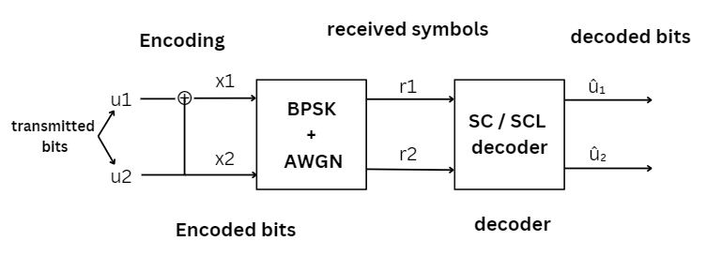
Block Diagram for Polar Codes

Slide 7

Construction of Polar Codes
It refers to choosing k most reliable polarizing channels in N polarizing channels to transmit information bits. The reliability of channel is calculated by a parameter named Bhattacharya parameter.
Bhattacharyya parameter :
Z(W_{2N} ^{(2i-1)}) <= 2Z(W_{N} ^{(i)}) - Z(W_{N} ^{(i)})²
Z(W_{2N} ^{(2i)}) = Z(W_{N} ^{(i)})²
More the value of Z(W), less reliable channel and vice versa.
Image credits : this image of equation is taken from our report.

Slide 8

For AWGN Channel Polar Construction
In AWGN channel, the Bhattacharya parameter is approximated by gaussian distribution.
Let, y = x + n
where, y = received signal.
x = transmitted signal
n = normally distributed noise with mean 0 and variance σ²
LLR for original channel W can be represented as below:
Image credits : this image of equation is taken from our report.

Slide 9


Final expression after the calculation is represented as:
By looking an expression for LLR, we can say that it follows gaussian distribution with mean
2 /σ² and variance 4/σ² .
By calculating Bhattacharyya parameter Z(W) for Gaussian Channel,
We know that higher the Bhattacharya Parameter of channel, lesser the reliability of channel. After approximating Z(W) for each channels, we can sort them in increasing order and get channels in decreasing order of reliability.
Image credits : this image of equation is taken from our report.

Slide 10
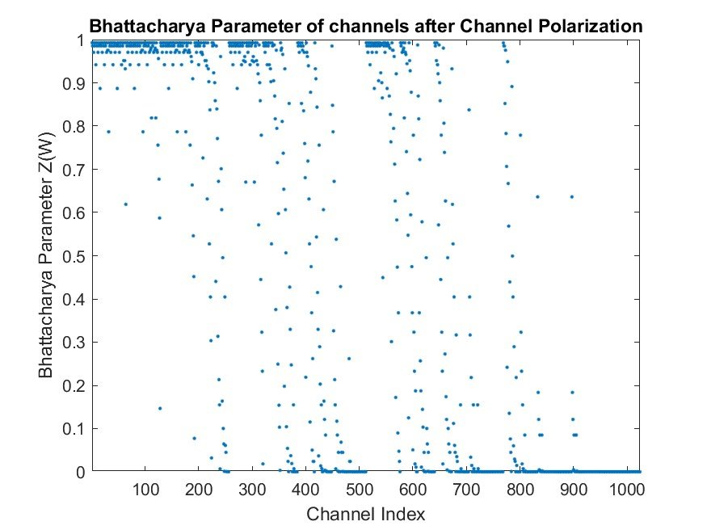
UnSorted values

Slide 11
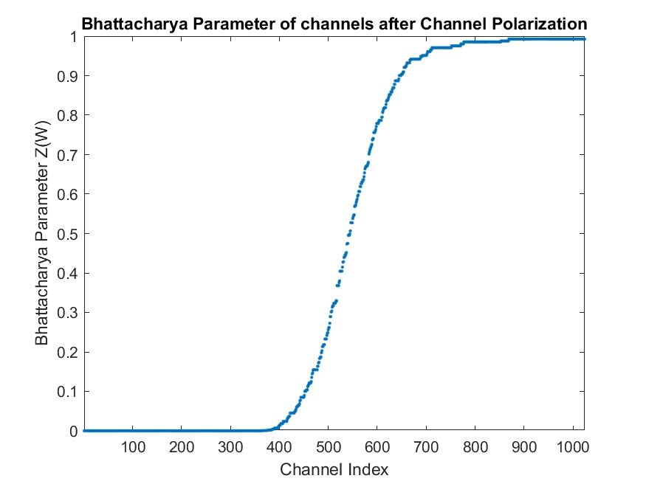
Sorted values

Slide 12

For BEC Channel Polar Construction
The calculation formula of Bhattacharyya parameter for BEC is defined as:
Z(W_{2N} ^{(2i-1)}) = 2Z(W_{N} ^{(i)}) - Z(W_{N} ^{(i)})²
Z(W_{2N} ^{(2i)}) = Z(W_{N} ^{(i)})²
We have the relation between Bhattacharyya parameter and Channel Capacity,
Here, we select those bits whose Bhattacharyya parameter is smaller to transmit information bits.
We can calculate, Bhattacharyya parameters of complementary channel erasure probability according to complementarity and complete the selection of information bits and frozen bits.
Image credits : this image of equation is taken from our report.

Slide 13
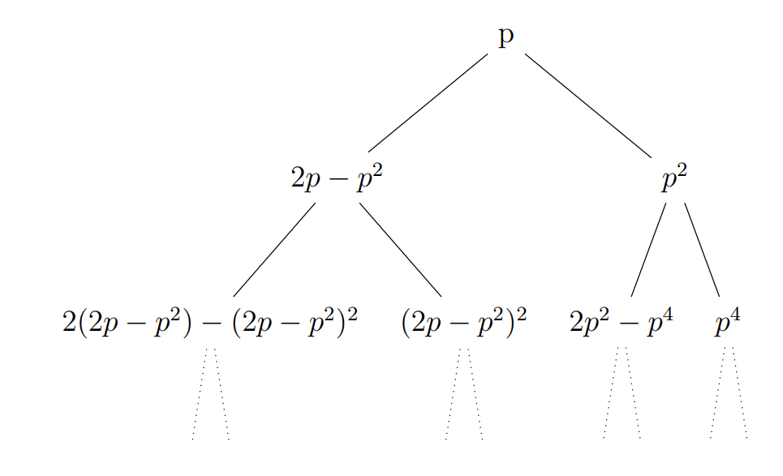
THE COMPLEMENTARY CHANNEL ERASURE PROBABILITY IS AS FOLLOWS:

Slide 14
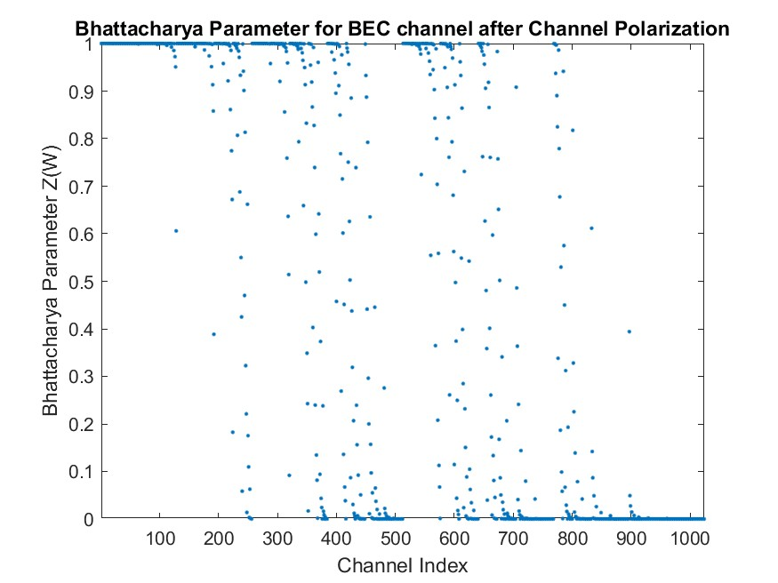
UNsorted values

Slide 15
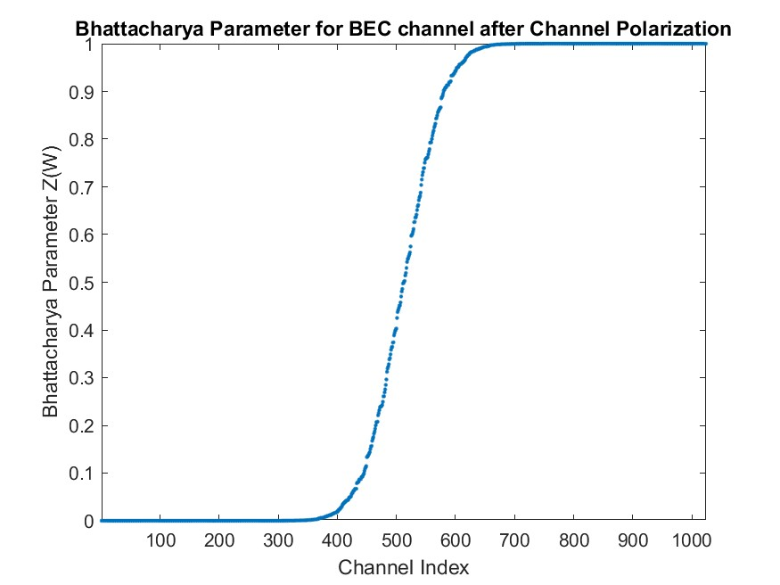
Sorted values
Sorted Values

Slide 16
Reliability Sequence
The reliability sequence which is found by Bhattacharyya parameter is in the order of reliability from lowest reliable to highest reliable index.
For N=16, we have standard reliability sequence as follows:
[1 2 3 5 9 4 6 10 7 11 13 8 12 14 15 16]
Let us take 8 msg bit u = [1 1 1 0 0 0 1 0]
For first 8 index of reliability sequence, bits are "frozen" and remaining are msg bits at those indices.
Msg =[0 0 0 0 0 0 1 0 0 0 1 0 1 0 1 0]

Slide 17
The above example contains 8 message bits and 8 frozen bits according to reliability sequence.
It is represented as (N,K) polar codes.
Here , N = total number of bits
N-K = number of frozen bits
K = number of message bits
Above shown example is of (16,8) polar codes.

Slide 18

Encoding of Polar Codes
Generator matrix:
To get encoded message, we take multiplication of the message bits with generator matrix.
Generator matrix is got using the below formula given below which represents that for N bit message we need generator matrix of N X N matrix for that we take Kronecker product of G₂ matrix n times were N=2^{n}.
Image credits : this image of matrix is taken from our report.

Slide 19
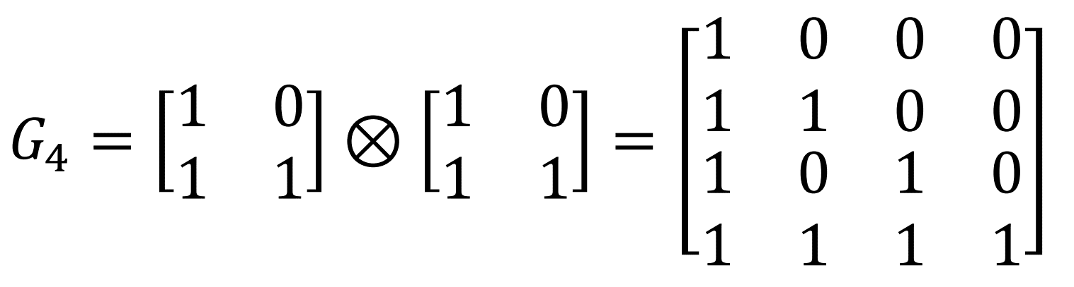
KRONECKER PRODUCT EXAMPLE
Here is an example showing the calculation for generator matrix of size 4 X 4.
G₄ = G₂ ⊗ G₂
Image credits : this image of matrix is taken from our report.

Slide 20
TO GET ENCODED SEQUENCE
[u₁, u₂, u₃, u₄]G₄ = [u₁ +₂ u₂ +₂ u₃ +₂ u₄ , u₂ +₂ u₄, u₃ +₂ u₄, u₄]
Here u₁, u₂, u₃, u₄ represents message bits. And +₂ represents mod-2 sum.
For N=8 we have considered message u = [m1, m2, m3, m4].
(N,K)=(8,4)
N-K frozen bits will be chosen according to reliability sequence, below shown is message:
Msg = [0 0 0 m1 0 m2 m3 m4]
In the next slide, for N=8 we have tree representation shown for encoding.

Slide 21
0
0
0
m1
0
m2
m3
m4

Slide 22
u⁽²⁾₁ = [0, 0]
u⁽²⁾₄ = [m3 +₂ m4, m4]
u⁽²⁾₂ = [m1, m1]
u⁽²⁾₃ = [m2, m2]
0
0
0
m1
0
m2
m3
m4
0

Slide 23
u⁽³⁾₁ = [m1, m1, m1, m1]
u⁽²⁾₁ = [m2 +₂ m3 +₂ m4, m2 +₂ m4, m3 +₂ m4, m4]
u⁽²⁾₁ = [0, 0]
u⁽²⁾₃ = [m2, m2]
u⁽²⁾₄ = [m3 +₂ m4, m4]
u⁽²⁾₂ = [m1, m1]
0
0
0
m1
0
m2
m3
m4
0
0

Slide 24
u⁽⁴⁾₁ = [m1 +₂ m2 +₂ m3 +₂ m4, m1 +₂ m2 +₂ m4, m1 +₂ m3 +₂ m4, m1 +₂ m4, m2 +₂ m3 +₂ m4, m2 +₂ m4, m3 +₂ m4, m4]
u⁽³⁾₁ = [m1, m1, m1, m1]
u⁽²⁾₁ = [m2 +₂ m3 +₂ m4, m2 +₂ m4, m3 +₂ m4, m4]
u⁽²⁾₁ = [0, 0]
u⁽²⁾₄ = [m3 +₂ m4, m4]
u⁽²⁾₂ = [m1, m1]
u⁽²⁾₃ = [m2, m2]
0
0
0
m1
0
m2
m3
m4
0

Slide 25
Decoding of Polar Codes
Decoding of polar codes have two methods:
(1) Successive cancellation decoder
(2) Successive cancellation list decoder

Slide 26
Successive Cancellation Decoder
It is a sequential decoder, meaning that it decodes the bits one by one and it uses the previous decoded bit to decode the next one.
Both the transmitter and the receiver have the reliability sequence and know which positions in the transmission are frozen. So decoder does not have to decode those bits instead it moves to next bit.
It uses soft decision on non-frozen bits.
It is called a soft decoder since it uses the value obtained straight from the decision variable at the output of the demodulator, before making a hard decision (0 or 1) for the received bit.

Slide 27
G₂ IS AN INVERTIBLE MATRIX. SO RELATION BETWEEN X_{1 ,} X₂ AND U₁ , U₂ .
X=
[x₁ x₂] = [u₁ + u₂ u₂]
u₁ = x₁+ x₂
u₂ = x₂

Slide 28



Then knowing that r1 and r2 are beliefs for x1 and x2, a function known as minsum is used to get the soft belief for u1 which can further be used to get the hard decision by putting a threshold.
Minsum function :
Here if the value of f(r₁ , r₂) then and then
After u₁ is obtained , it is assumed to be correct and further used to decode.
$${f(r}_{1},r_{2})=\operatorname{sgn}\left(r_{1}\right)∗\operatorname{sgn}\left(r_{2}\right)∗min⁡(\left|r_{1}\right| , |r_{2}|)$$
$${\hat{u}}_{1}=0$$
$${f(r}_{1},r_{2})<0$$
$${\hat{u}}_{1}=1$$

Slide 29
After u₁ is obtained, it is assumed to be correct and further used to decode u₂. If u^₁ is 0, then what was initially transmitted was [u₂, u₂], meaning that both r₁ and r₂ are actually beliefs for u₂, so r₁+r₂ will be final belief for u₂.
If u^₁ is 1, then what was transmitted was [1 + u₂, u₂] which is the complement of u₂ and u₂. This means that r₁ is the belief for the complement of u₂, making -r₁ belief for u₂. Also, r₂ is a belief for u₂, hence the final belief for u₂ will be r₂−r_{1.} This is shown in the figure in next slide.
The function is defined as: g(r₁, r₂, u₁) = r₂ + (1 − 2u₁)r₁
g(r1, r2, u1)<=0, û₁ = 0 and g(r1, r2, u1)>0, û₁ = 1. (hard decision)

Slide 30
u^₁
0
1
[0+u₂ , u₂] = [r₁ , r₂]
[1+u₂ ,u₂] = [r₁ , r₂]
u^₂ = r₁ + r₂
u^₂ = r₂+ (-r₁)

Slide 31
The decoding is done by traversing the tree using the following 3 steps:
The traversal starts from root node.
Step 1(L):we will go to the left child of the node, doing the minsum function until a leaf node is encountered. When the leaf node is reached, the belief for the first bit is obtained and is sent back up to the parent node.
Step 2(R): when a node receives a belief from its left child. In this step, the node goes to its right child using the g function and the belief for its left child to find a belief for the right child.
Step 3(U): when a node receives a belief from its right child, then, it will send the beliefs for its left and right child to its parent node.
On the next slide the tree traversal is shown for N=8.

Slide 32
R = [r₁ r₂ r₃ r₄ r₅ r₆ r₇ r₈]
L = [f(r1,r5) f(r2,r6) f(r3,r7) f(r4,r8)]
[ û₁⊕û₂⊕û₃⊕û₄ û₂⊕û₄ û₃⊕û₄ û₄]
A = [g(r1,r5,û₁⊕û₂⊕û₃⊕û₄ ) g(r2,r6,û₂⊕û₄) g(r3,r7,û₃⊕û₄) g(r4,r8,û₄)]
X = [f(L1,L3) f(L2,L4)]
[û₁⊕û₂ û₂ ]
[û₅⊕û₆ û₆]
B = [f(A1,A3) f(A2,A4)]
Y=[g(L1,L3,û₁⊕û₂ ) g(L2,L4, û₂ )]
C=[g(A1,A3,û₅⊕û₆ ) g(A2,A4, û₆ )]
[û₄⊕û₃ û₄]
[f(X1,X2)]
[f(Y1,Y2)]
û₃
[f(B1,B2)]
[f(C1,C2)]
û₁
û₅
û₇
[g(X1,X2,û₁)]
û₄
û₂
û₆
[g(C1,C2,û₇)]
[g(Y1,Y2,û₃)]
[g(B1,B2,û₅)]
û₂ û₃ û₄ û₅ û₆ û₇ û₈
û₁

Slide 33
Successive Cancellation List Decoder
An SCL decoder can be viewed as multiple copies of successive cancellation (SC) decoder.
By using multiple SC decoders for the same codeword, the chance of finding the correct decoding sequence is significantly improved.
The basic difference between the SC and SCL decoder is the decision making processes.
For SC decoder we took decision on the leaf node according to the value of f or g function based on whether it is right or left node.
On the other hand in SCL decoding we take both possible decisions For a node.

Slide 34
CONCEPT OF PATH METRIC AND DECISION METRIC
In the SCL decoding we use the concept of path metric and decision metric to get the most efficient decoded message sequence(having least error among all).
Decision metric(DM) is calculated on each leaf node when we make decision let us define function L equal to either f or g. so,
if L>=0 => (û = 0 has DM=0) & (û = 1 has DM=|L|)
if L < 0 => (û = 1 has DM=0) & (û = 0 has DM=|L|)
Note : if the bit is frozen then also we will take decision but we will always take bit as û=0.

Slide 35
Path metric(PM) is the sum of decision metrics(DMs) for a particular path.
Maximum List size is the maximum number of paths we will take which has less PMs. In short , we will take first m paths which has least PM after sorting the paths according to PMs in increasing order.
Here, m= maximum list size.

Slide 36
SC 1 (PM = 0)
u₁
0
1
SC 1 (DM₁ (0))
SC 2 (DM₁ (1))
u₂
u₂
1
0
1
0
SC 2
(DM₁(0) +DM₁₂(1))
SC 3
(DM₁ (1) + DM₂₂(0))
SC 4
(DM₁ (1) + DM₂₂(1))
SC 1
(DM₁(0) +DM₁ ₂(0))
These process continues for log(N) depth of the tree.

Slide 37
Cyclic Redundancy Checks(CRC)
CRCs are basically used for error detection in physical layer.
In real life implementations it adds some extra complexity but it plays a great role in improving the performance and efficiency.
Some of the examples for standard CRCs are as follows: CRC-8,CRC-12,CRC-16 etc...
For CRC-12 the equation is as follows: G(x) = x¹² + x¹¹ + x³ + x² + x¹ +1.
The block diagram for SCL decoding using CRCs is given in the next slide.

Slide 38
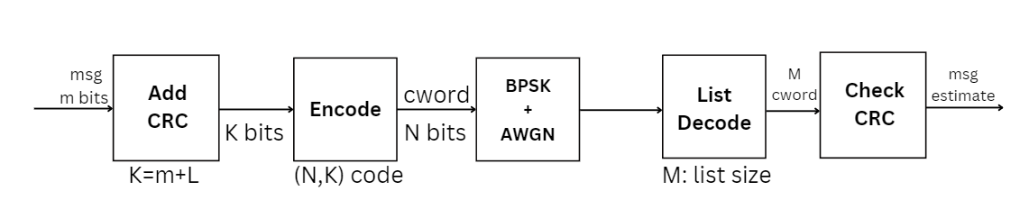
Block Diagram of SCL decoding algorithm using CRCs bits

Slide 39
Algorithm for SCL using CRCs:
Step 1: add CRC bits to the message bits. Let us say there are m message bits and L CRC bits. So it will become K = (m+L) bits.
Step 2: the K bits message will now be transmitted to encoder and then all the steps will be same as in normal SCL decoder.
Step 3: at last step when we'll have M codewords given by the List decoder then we will check for CRC to get our final estimated message.
All steps are shown on the block diagram on previous page.

Slide 40
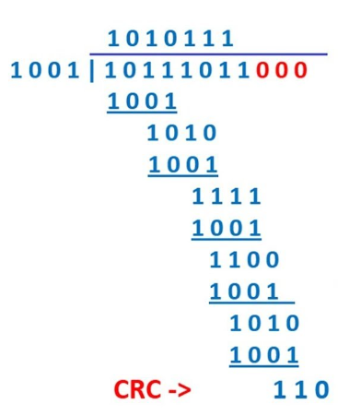
Calculation of CRC bits
On the left hand side the calculation for CRC is shown.
To calculate CRC bits for any polynomial (where polynomial is defined as the coefficients of the power of x in decreasing order.) in our case it will be binary numbers.
We will choose a divisor and divide our polynomial(dividend) with (size of divisor - 1) 0s appended to it.
The remainder for the polynomial division will be our CRC bits.
Image credits : icangetjob

Slide 41
At last we got the CRC bit which is padded into the dividend where there were zeros padded.
This K bit message is passed to encoder (N,K) and then to BPSK and AWGN channel.
Then SCL decoding is carried out.
At last we get total M codewords where M is list size, for these codewords CRC check is applied.
CRC check is a method in which all the codewords are divided by the old divisor used in calculating CRC.
SCL using CRC detect the error upto the length of CRC bits.

Slide 42
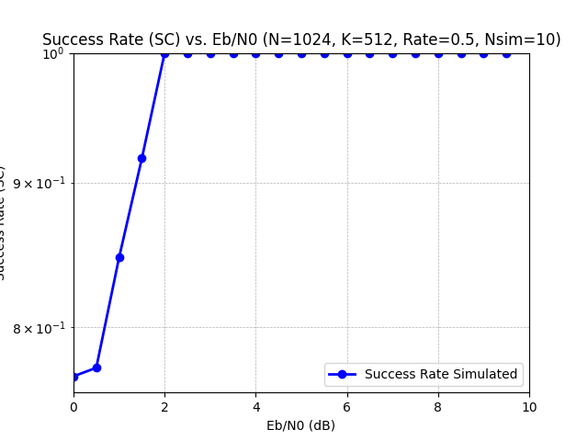
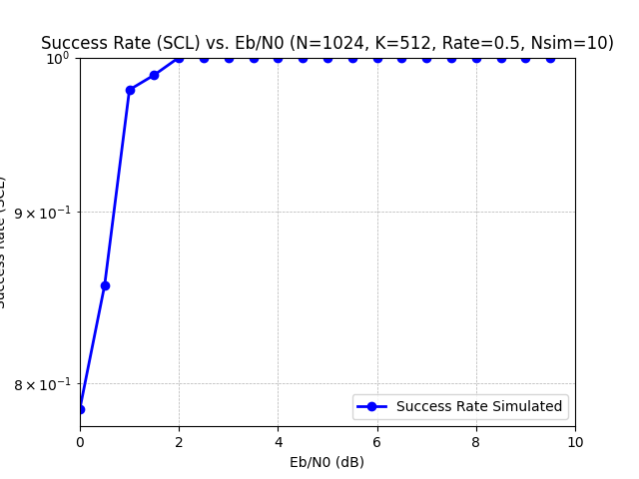
Results (n=1024,k=512,nsim=10)
Success Rate For SC Decoder
Success Rate For SCL Decoder

Slide 43
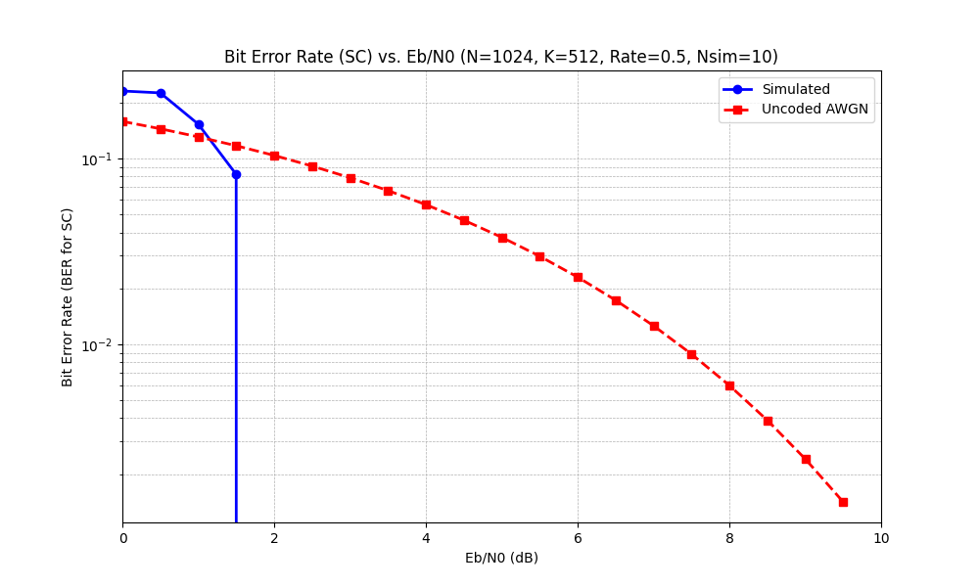
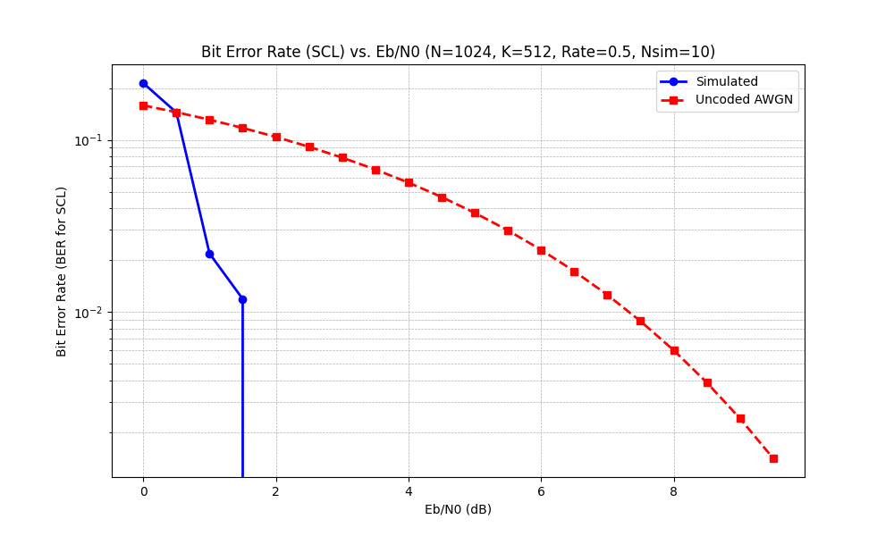
Bit Error Rate For SC Decoder
Bit Error Rate For SCL Decoder

Slide 44
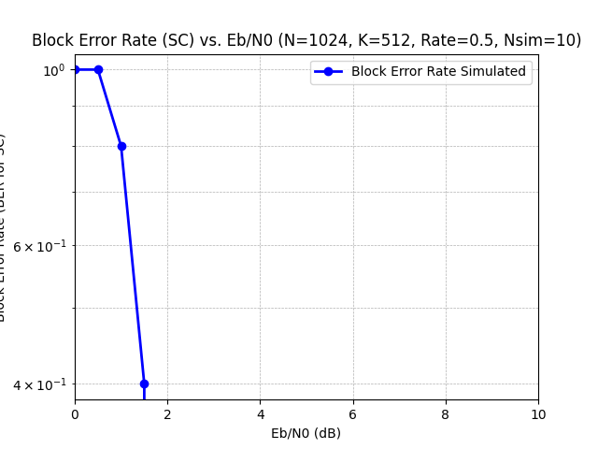
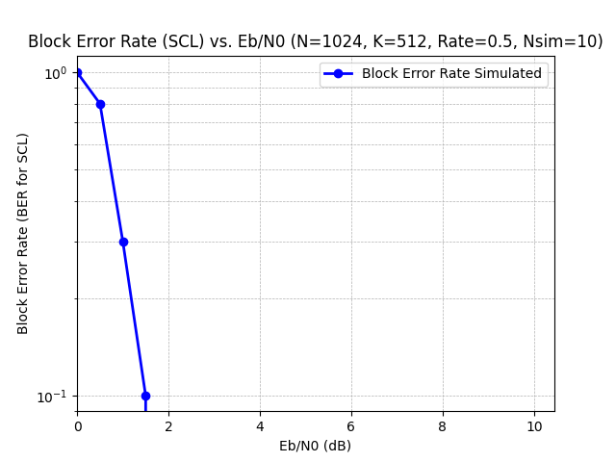
Block Error Rate For SC Decoder
Block Error Rate For SCL Decoder

Slide 45
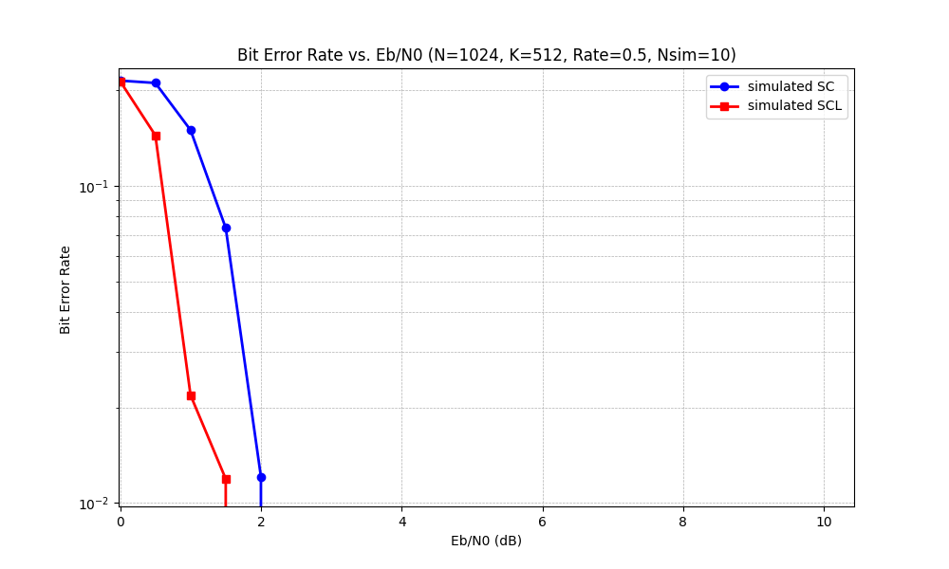
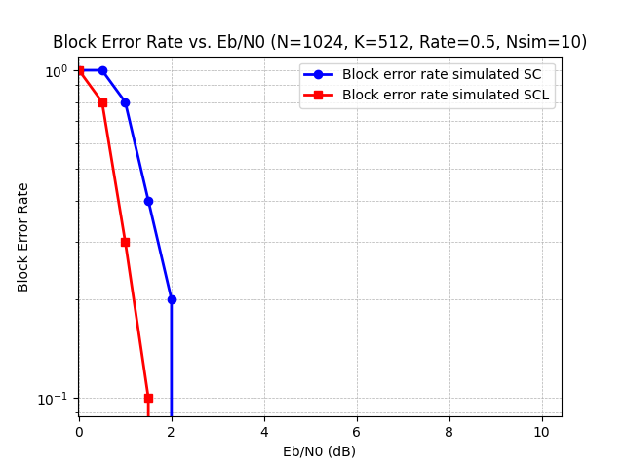
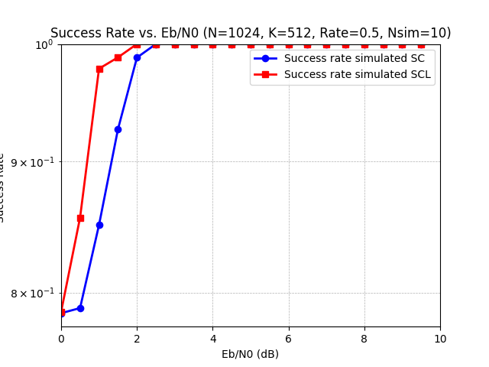
COMBINED RESULTS

Slide 46
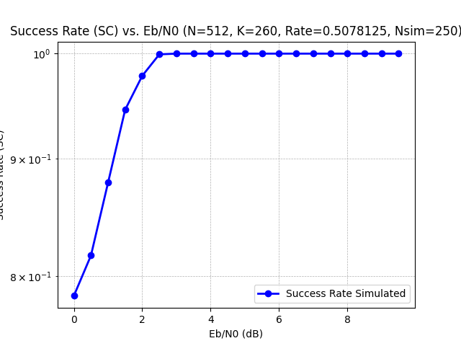
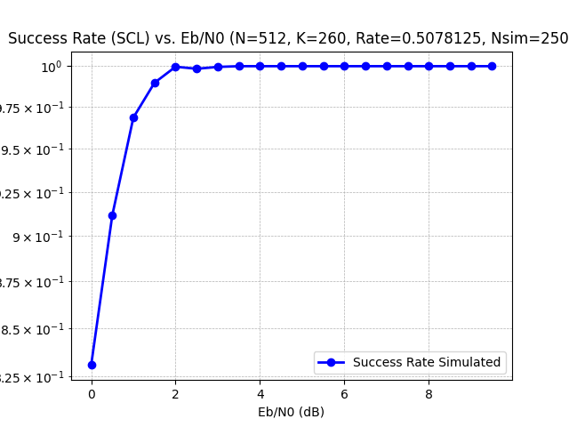
RESULTS (N=512,K=260,NSIM=250)
Success Rate in SC Decoder
Success Rate in SCL Decoder

Slide 47
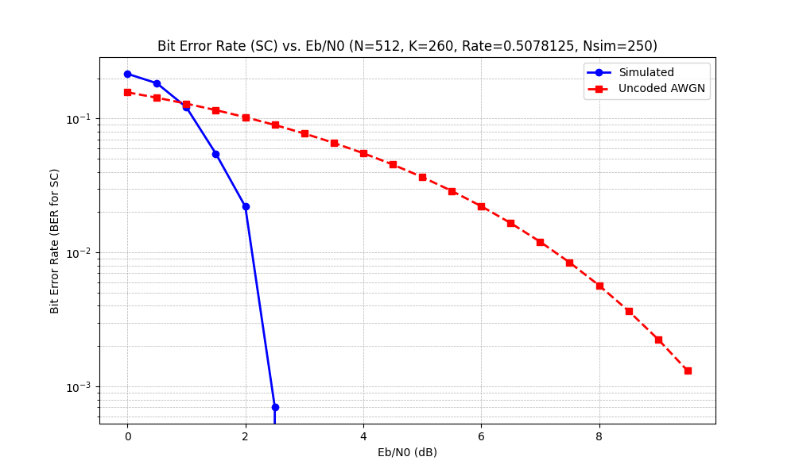
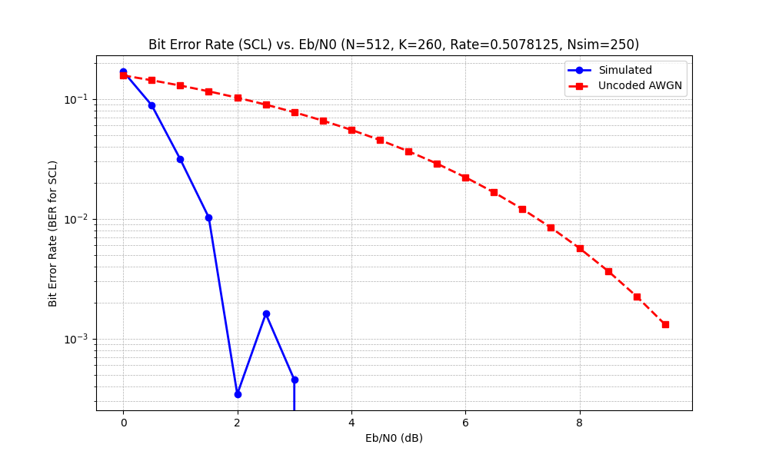
Bit Error Rate For SC Decoder
Bit Error Rate For SCL Decoder

Slide 48
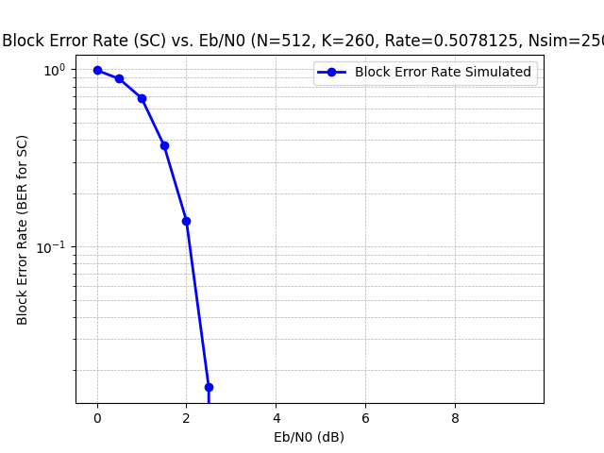
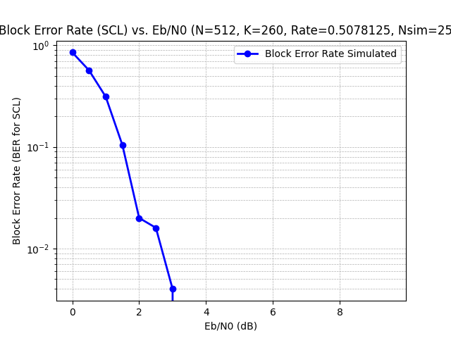
Block Error Rate For SC Decoder
Block Error Rate For SCL Decoder

Slide 49
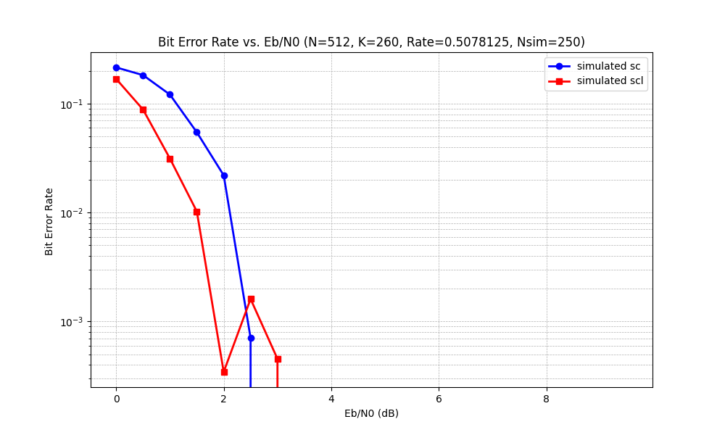
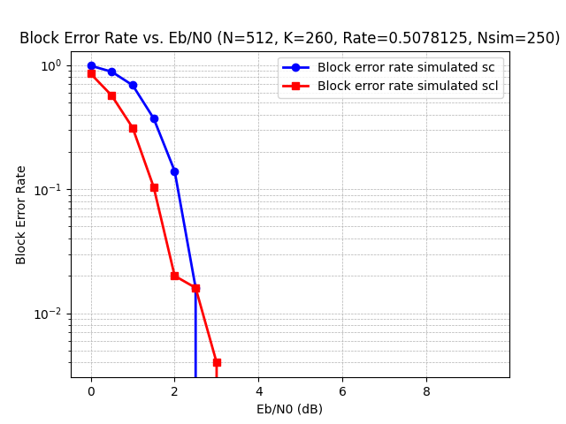
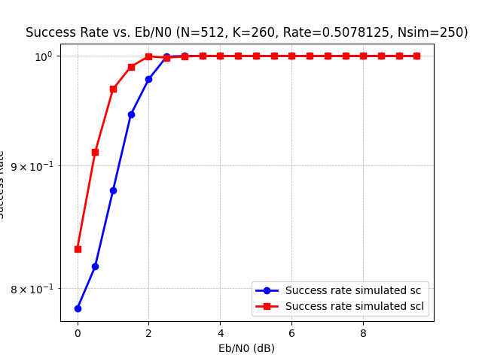
COMBINED RESULTS

Slide 50
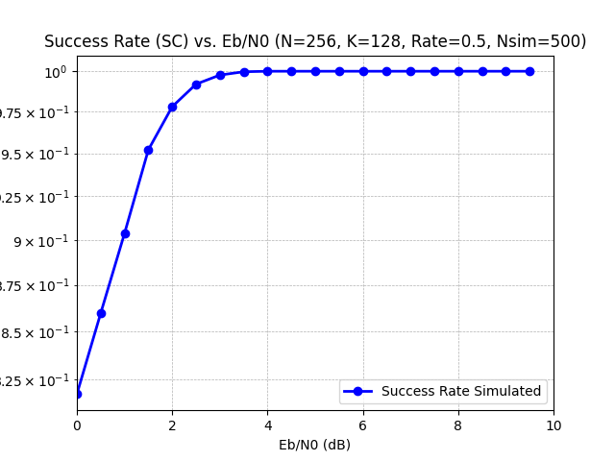
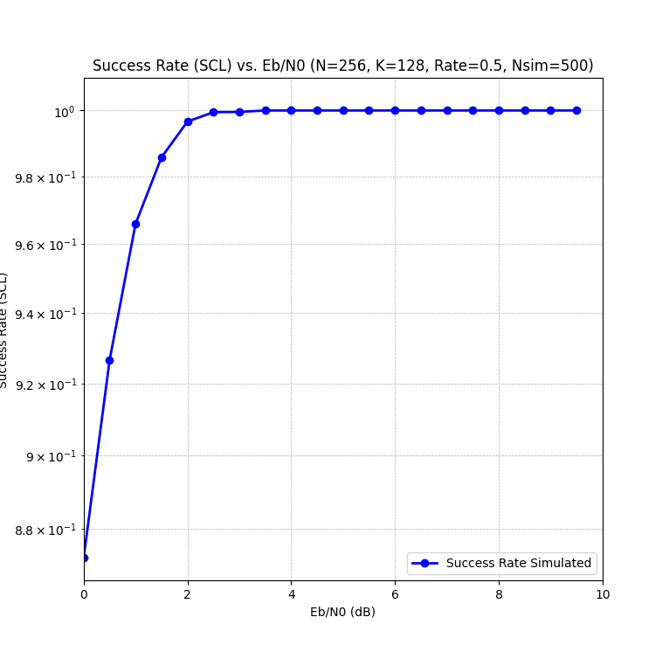
Results (N=256,k=128,Nsim=500)
Success Rate For SC Decoder
Success Rate For SCL Decoder

Slide 51
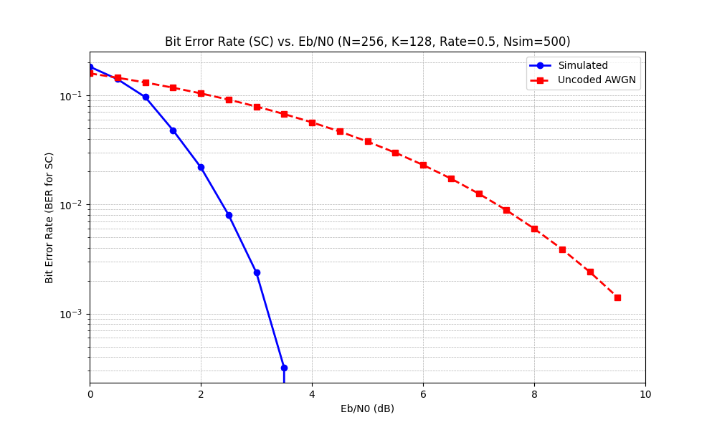
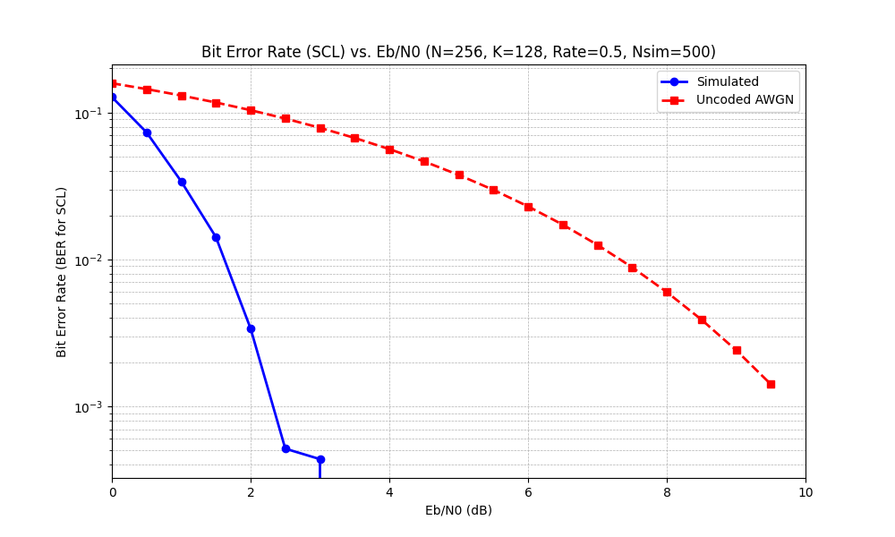
Bit Error Rate For SC Decoder
Bit Error Rate For SCL Decoder

Slide 52
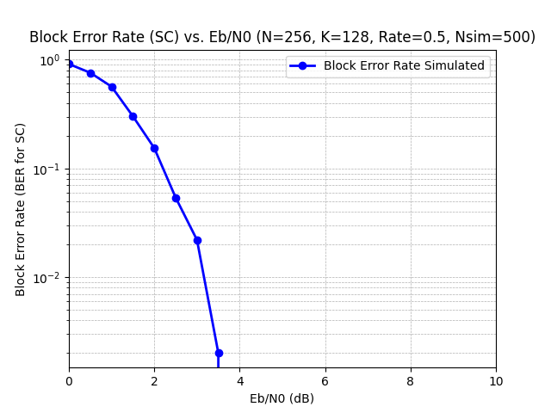
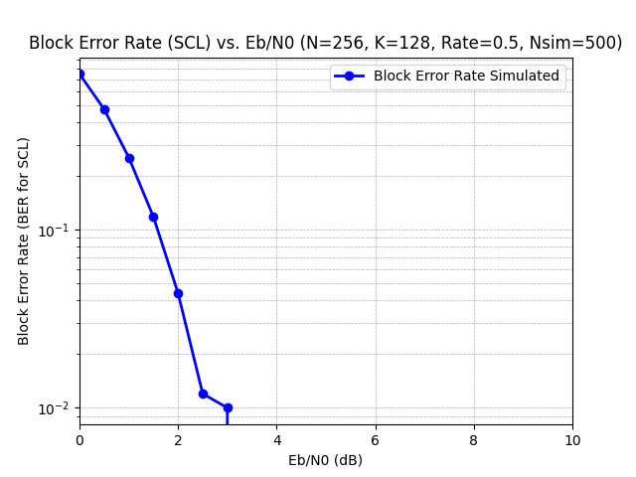
Block Error Rate For SC Decoder
Block Error Rate For SCL Decoder

Slide 53
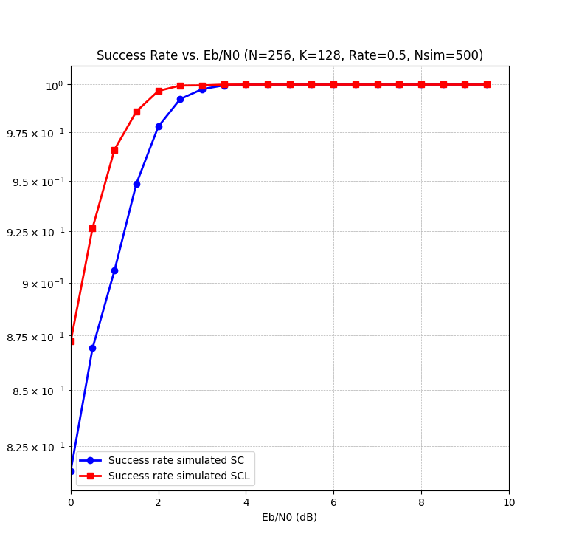
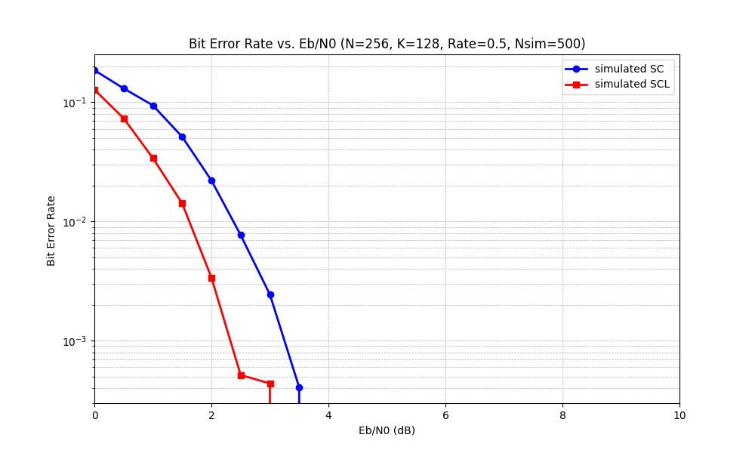
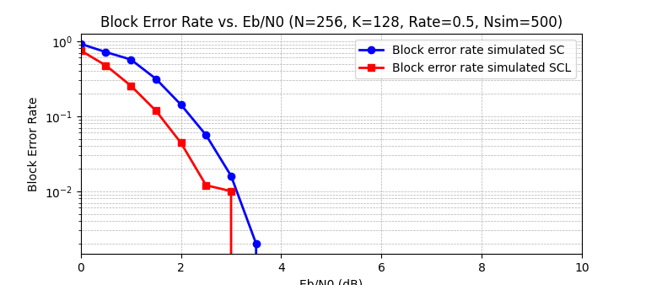
COMBINED RESULTS

Slide 54
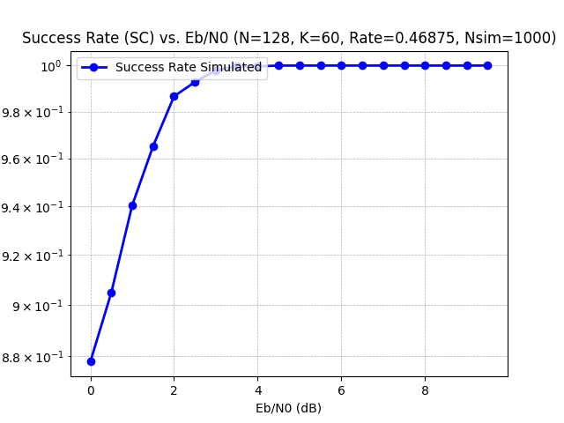
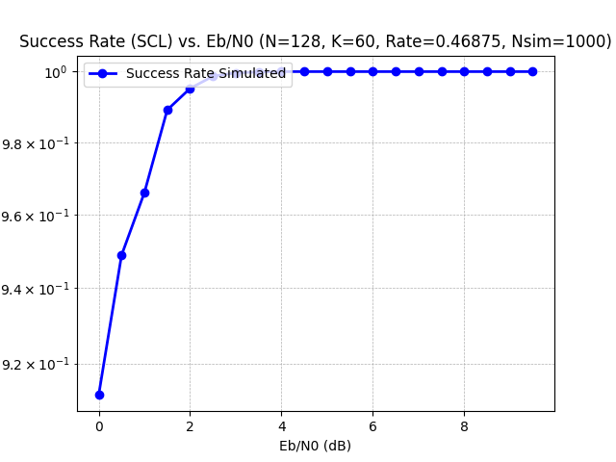
Results (N=128,k=60,Nsim=1000)
Success Rate For SC Decoder
Success Rate For SCL Decoder

Slide 55
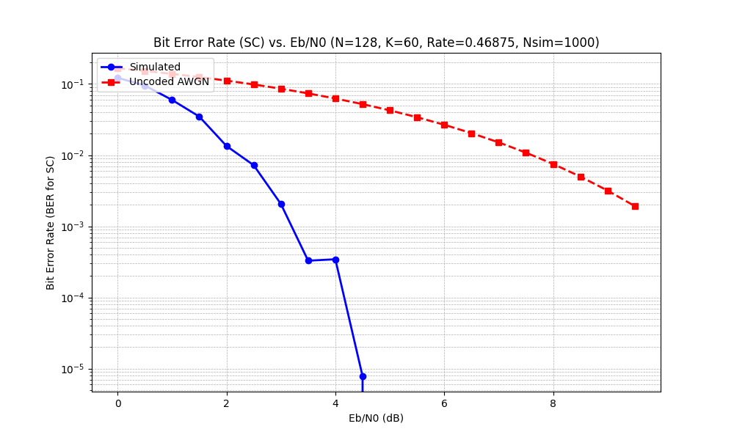
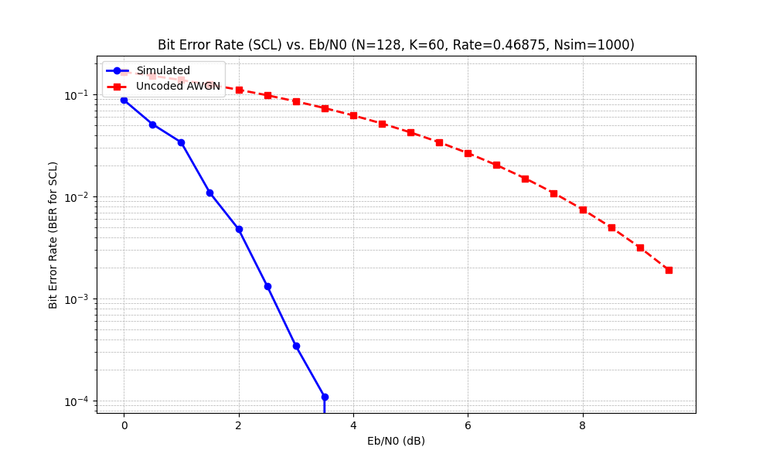
Bit Error Rate For SC Decoder
Bit Error Rate For SCL Decoder

Slide 56
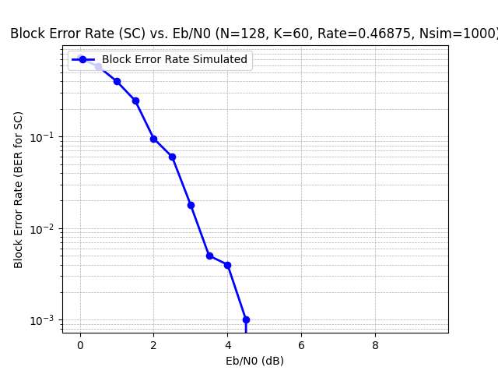
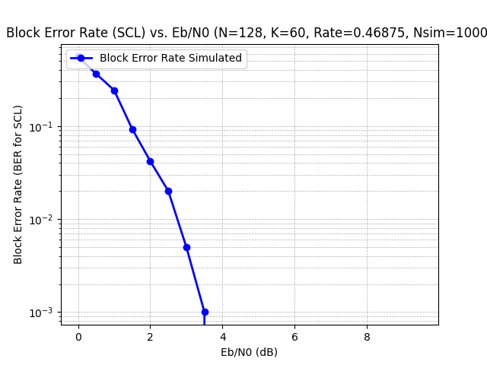
Block Error Rate For SC Decoder
Block Error Rate For SCL Decoder

Slide 57
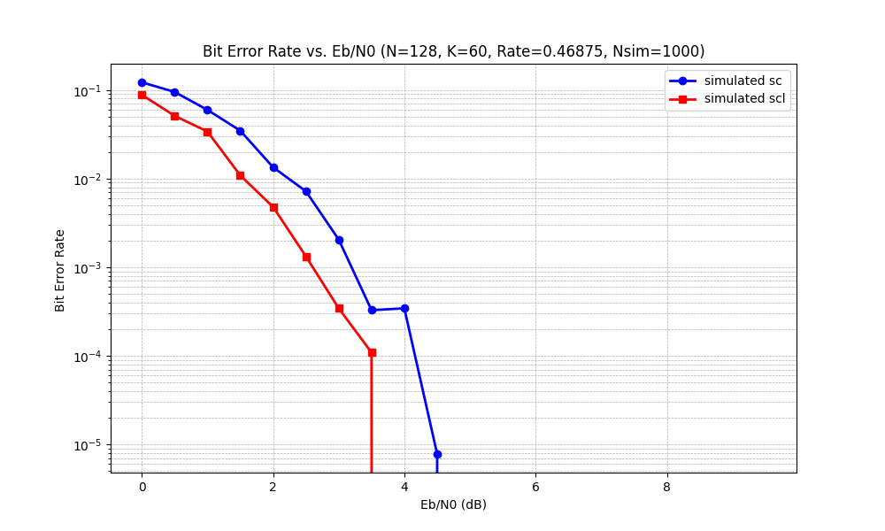
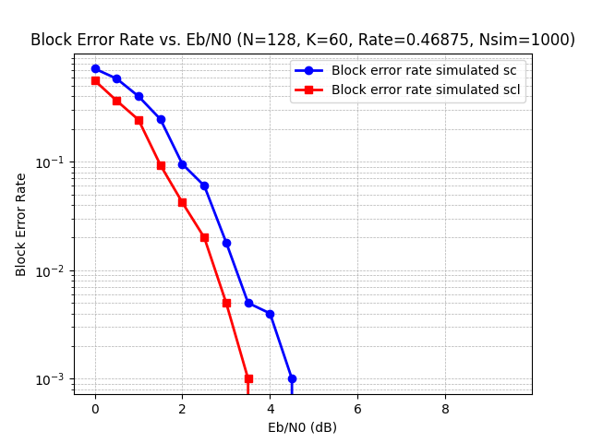
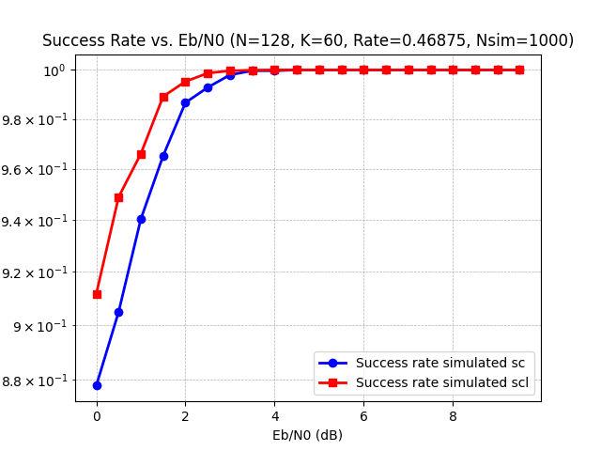
COMBINED RESULTS

Slide 58
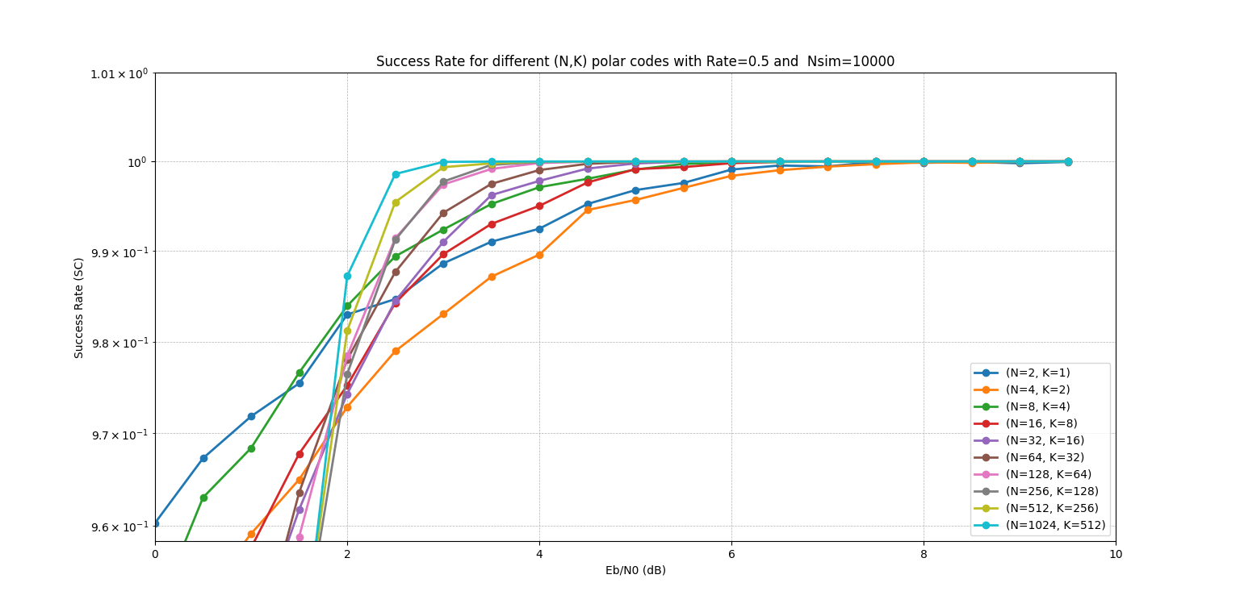
Success Rate for different values of N for SC Decoding

Slide 59
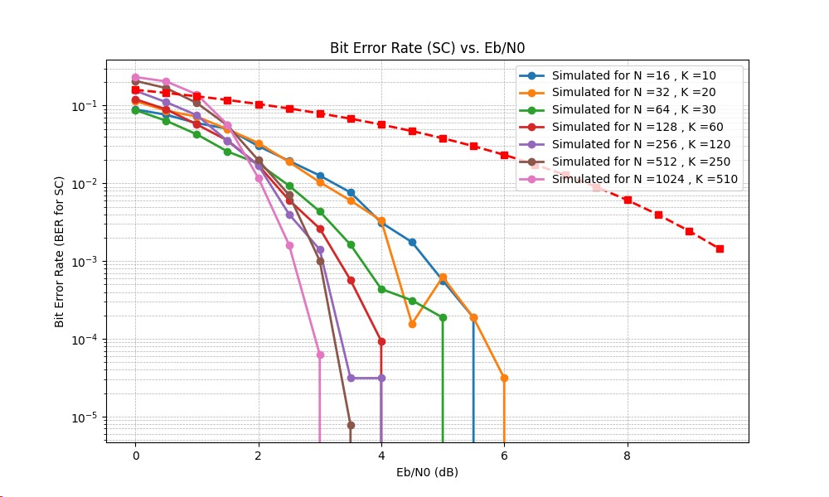
Bit Error Rate for different values of N for SC Decoding​

Slide 60
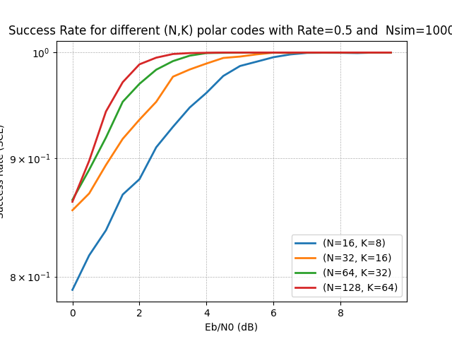
Success Rate for SCL Decoding using CRC bits

Slide 61
Conclusion
From the above graphs we have seen how SC and SCL differ in terms of success rate , BER and BLER.
Efficiency of SCL is more than SC.
Hence, the graphs of BER and BLER which is like water fall is more towards left side for SCL than SC.
For greater value of N, the success rate is greater for both SC and SCL.
By using CRC bits in the SCL decoder the complexity increases but along with that the efficiency also increases. So there is a trade off between complexity and efficiency.

Slide 62

Analysis for Approximation of Shannon's Capacity
Let's pass a message of K bits to BPSK+AWGN channel. And the channel capacity for this is defined as I(W), where W represents the channel.
For a binary sequence of K bits to achieve channel capacity of I(W) -> ϵ there exist constants a_{w} < ∞ and b_{w} > 0 such that the required block length for this rate is given by:
N >= a_{w} /ϵ²
The error of miscommunication is given by:

Slide 63

Now as N−→ ∞ then ϵ−→ 0, so that,
I(W) - ϵ -> I(W)
That shows as N goes large the channel capacity tends to Shannon’s channel capacity.
The law of capacity conservation and concept of level graph and Intermediate channels by martingale graph are explained in detail in the report.
Image credits : this image of equation is taken from our report.

Slide 64
References
[1] Andrew Thangaraj, NPTEL-NOC IITM
[2] Comparison of short block and low rate channel codes for UNB communication by stefan miclea
[3] Channel Polarization: A Method for Constructing Capacity-Achieving Codes for Symmetric Binary-Input Memoryless Channels Erdal Arıkan, Senior Member, IEEE
[4] Minimization of Bit Error Rate in Polar Codes for Achieving Channel Capacity Shoban Mude, Rajendra Naik Bhukya
[5] POLAR CODES FOR ERROR CORRECTION: ANALYSIS AND DECODING ALGORITHMS Tesi in Teoria dell’ informazione LM
[6] A practical construction method for Polar Codes in AWGN channels Huijun Li and Jinhong Yuan School of Electrical Engineering and Telecommunications The University of New South Wales, Sydney, NSW 2052, Australia
[7] Implementation and evaluation of Polar Codes in 5G,Tobias Rosenqvist Joël Sloof
[8] Construction and Performance of Polar Codes for Transmission over the AWGN Channel, Bashar Tahir, B.Sc.

Slide 65
THANK YOU

