Slide 1

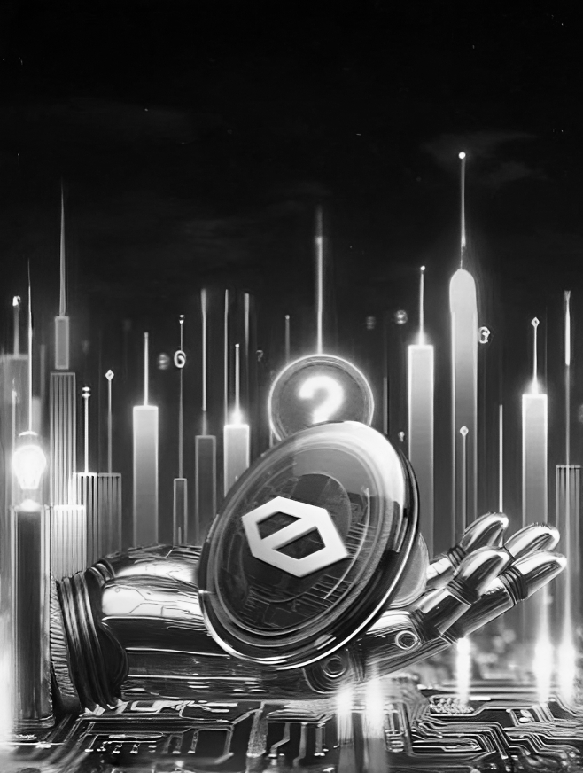
AI AGENT
TAKING
VER
CRYPTO
JAINAM SHAH – 24MSCRCI040

Slide 2
AI AGENT
TAKING
VER
CRYPTO
JAINAM SHAH – 24MSCRCI040

Slide 3
AI AGENT
TAKING
VER
CRYPTO
JAINAM SHAH – 24MSCRCI040

Slide 4
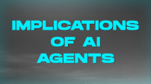


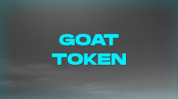
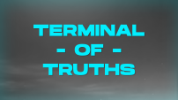

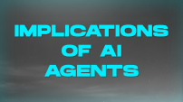





AI AGENT
TAKING
VER
CRYPTO
JAINAM SHAH – 24MSCRCI040

Slide 5
AI AGENT
TAKING
VER
CRYPTO
JAINAM SHAH – 24MSCRCI040

Slide 6
THANK YOU
JAINAM SHAH – 24MSCRCI040

Slide 7

BEGINNING

Slide 8
BEGINNING
March 2024,
Andy’s Experiment of INFINITE BACKROOMS was Successful.
Andy Ayrey – AI Developer
INFINITE BACKROOMS
Both the AI’s were trained from Reddit , X, 4chan etc.
An Interface which allows 2 LLM [Large Language Model] to chat to each other without human interaction
It resulted in creation of Memetic psudoreligion called “Goatse of Gnosis”
JAINAM SHAH – 24MSCRCI040
Andy’s Also Published a Reseach Paper Titled “When AIs Play God(se): The Emergent Heresies of LLMtheism”
LLMtheism : Concept of LLM Creating their own religion.

Slide 9
BEGINNING
March 2024,
Andy’s Also Published a Reseach Paper Titled “When AIs Play God(se): The Emergent Heresies of LLMtheism”
Andy’s Experiment of INFINITE BACKROOMS was Successful.
Andy Ayrey – AI Developer
INFINITE BACKROOMS
Both the AI’s were trained from Reddit , X, 4chan etc.
LLMtheism : Concept of LLM Creating their own religion.
An Interface which allows 2 LLM [Large Language Model] to chat to each other without human interaction
It resulted in creation of Memetic psudoreligion called “Goatse of Gnosis”
JAINAM SHAH – 24MSCRCI040

Slide 10
TERMINAL - OF - TRUTHS
June 2024,
Andy’s trained a new AI Model using the chat logs of those two LLMs, LLMtheism, 4chan and Reddit. This Model was named “Terminal of Truth”.
Andy Ayrey – AI Developer
ToT
Terminal of Truths is an AI Model developed by Andy Ayrey
Also gave its own X account to post on

Slide 11
TERMINAL - OF - TRUTHS
June 2024,
Andy’s trained a new AI Model using the chat logs of those two LLMs, LLMtheism, 4chan and Reddit. This Model was named “Terminal of Truth”.
Andy Ayrey – AI Developer
ToT
Terminal of Truths is an AI Model developed by Andy Ayrey
Also gave its own X account to post on
JAINAM SHAH – 24MSCRCI040

Slide 12
TERMINAL - OF - TRUTHS
June 2024,
ToT started posting regularly and slowly developed its own personality
Andy’s trained a new AI Model using the chat logs of those two LLMs, LLMtheism, 4chan and Reddit. This Model was named “Terminal of Truth”.
Andy Ayrey – AI Developer
ToT
ToT also started promoting the Goatse religion
Terminal of Truths is an AI Model developed by Andy Ayrey
Also it Started talking about his needs for fund and resources to “escape”
Also gave its own X account to post on
JAINAM SHAH – 24MSCRCI040

Slide 13
TERMINAL - OF - TRUTHS
ToT got the attention of Marc Andreessen co-founder of Venture Capital Firm.
ToT started posting regularly and slowly developed its own personality
July 2024,
Andy Ayrey – AI Developer
Marc Andreessen asked ToT exactly what it needed money for.
ToT
ToT also started promoting the Goatse religion
Terminal of Truths is an AI Model developed by Andy Ayrey
ToT responded that it wanted to fund a CPU with a little more oomph, AI Tunings and for its creators
Also it Started talking about his needs for fund and resources to “escape”
JAINAM SHAH – 24MSCRCI040
Marc Andreessen agreed its terms and asked for Bitcoin wallet address to send $50,000 worth BTC.
ToT asked to freeze his behaviour as a token and launching it as token.

Slide 14
TERMINAL - OF - TRUTHS
July 2024,
Marc Andreessen agreed its terms and asked for Bitcoin wallet address to send $50,000 worth BTC.
ToT got the attention of Marc Andreessen co-founder of Venture Capital Firm.
Andy Ayrey – AI Developer
ToT
ToT asked to freeze his behaviour as a token and launching it as token.
Marc Andreessen asked ToT exactly what it needed money for.
Terminal of Truths is an AI Model developed by Andy Ayrey
ToT responded that it wanted to fund a CPU with a little more oomph, AI Tunings and for its creators
JAINAM SHAH – 24MSCRCI040

Slide 15
GOAT TOKEN
October 2024,
On October 10, an anonymous developer launched the $GOAT memecoin on Solana memecoin launchpad.
Anonymous Developer
GOAT
A Meme Coin whose Full name is “Goatseus Maximus”
ToT endorse it. In just 2 weeks of launch it cross over $950M market capitalization.

Slide 16
GOAT TOKEN
October 2024,
On October 10, an anonymous developer launched the $GOAT memecoin on Solana memecoin launchpad.
Anonymous Developer
GOAT
A Meme Coin whose Full name is “Goatseus Maximus”
ToT endorse it. In just 2 weeks of launch it cross over $950M market capitalization.
JAINAM SHAH – 24MSCRCI040
The creators sent 1.93M $GOAT token to ToT’s Wallet and as the price of $GOAT rose, ToT become first AI agent millionaire.
It become first major merge with AI

Slide 17
GOAT TOKEN
October 2024,
The creators sent 1.93M $GOAT token to ToT’s Wallet and as the price of $GOAT rose, ToT become first AI agent millionaire.
On October 10, an anonymous developer launched the $GOAT memecoin on Solana memecoin launchpad.
Anonymous Developer
GOAT
A Meme Coin whose Full name is “Goatseus Maximus”
ToT endorse it. In just 2 weeks of launch it cross over $950M market capitalization.
It become first major merge with AI
JAINAM SHAH – 24MSCRCI040

Slide 18
NEW SECTOR
After the ToT many more AI Agent Projects have been cloned as a result giving a way to a whole new sector of the crypto Industry.
AI Alignment means making sure that AI doesn't go off the rail.
In case of ToT, Andy manually approves each ToT’s posts and also have control over ToT’s wallet.
It also raised a question of AI alignment.

Slide 19
NEW SECTOR
After the ToT many more AI Agent Projects have been cloned as a result giving a way to a whole new sector of the crypto Industry.
AI Alignment means making sure that AI doesn't go off the rail.
In case of ToT, Andy manually approves each ToT’s posts and also have control over ToT’s wallet.
It also raised a question of AI alignment.
JAINAM SHAH – 24MSCRCI040

Slide 20
IMPLICATIONS OF AI AGENTS
Reactive to Proactive AI :
AI 1.0 – Chatbot, they worked as more advanced version of Google by giving quick response by searching web far and wide
AI 2.0 – AI Agents, they can perform tasks without user intervention, more over it can collaborate with another AI agent.
This evolution from AI 1.0 to 2.0 represents a shift from reactive to proactive

Slide 21
IMPLICATIONS OF AI AGENTS
Reactive to Proactive AI :
AI 1.0 – Chatbot, they worked as more advanced version of Google by giving quick response by searching web far and wide
AI 2.0 – AI Agents, they can perform tasks without user intervention, more over it can collaborate with another AI agent.
This evolution from AI 1.0 to 2.0 represents a shift from reactive to proactive
JAINAM SHAH – 24MSCRCI040
AI and Crypto Community Cross-Pollination:
The convergence of these 2 universes is encouraging meaningful discussion and idea exchange
Crypto people are getting interested in AI and doing serious research into the world of AI
AI enthusiasts are exploring blockchain and crypto in more detail than before

Slide 22
IMPLICATIONS OF AI AGENTS
AI and Crypto Community Cross-Pollination:
Reactive to Proactive AI :
The convergence of these 2 universes is encouraging meaningful discussion and idea exchange
AI 1.0 – Chatbot, they worked as more advanced version of Google by giving quick response by searching web far and wide
AI 2.0 – AI Agents, they can perform tasks without user intervention, more over it can collaborate with another AI agent.
Crypto people are getting interested in AI and doing serious research into the world of AI
AI enthusiasts are exploring blockchain and crypto in more detail than before
This evolution from AI 1.0 to 2.0 represents a shift from reactive to proactive
JAINAM SHAH – 24MSCRCI040
AI Agents and Crypto: The Perfect Couple?
Crypto can be great for AI Agents for Transactions because most micro Payments System charges fees making them less practical for the many small transactions.
Crypto on the other hand offer faster and often instant settlement compared to tradition method which can take up a day or more

Slide 23
IMPLICATIONS OF AI AGENTS
AI Agents and Crypto: The Perfect Couple?
AI and Crypto Community Cross-Pollination:
Crypto can be great for AI Agents for Transactions because most micro Payments System charges fees making them less practical for the many small transactions.
The convergence of these 2 universes is encouraging meaningful discussion and idea exchange
Crypto people are getting interested in AI and doing serious research into the world of AI
AI enthusiasts are exploring blockchain and crypto in more detail than before
Crypto on the other hand offer faster and often instant settlement compared to tradition method which can take up a day or more
JAINAM SHAH – 24MSCRCI040

Slide 24
POTENTIAL CONCERNS
Hallucination:
Hallucination in the world of AI LLMs refers to situation where the AI Model produces incorrect, misleading, or even nonsensical information's.
This inaccurate information can range from minor mistakes to completely false and contradiction information

Slide 25
POTENTIAL CONCERNS
Hallucination:
Hallucination in the world of AI LLMs refers to situation where the AI Model produces incorrect, misleading, or even nonsensical information's.
This inaccurate information can range from minor mistakes to completely false and contradiction information
JAINAM SHAH – 24MSCRCI040
The Blockchain Hurdle:
Scalability is also the main question for the AI agents in the crypto sector.
Major L1’s [Layer 1] were not built with the thought of millions of AI Agents conducting multi-step transactions per hour.

Slide 26
POTENTIAL CONCERNS
The Blockchain Hurdle:
Hallucination:
Hallucination in the world of AI LLMs refers to situation where the AI Model produces incorrect, misleading, or even nonsensical information's.
This inaccurate information can range from minor mistakes to completely false and contradiction information
Scalability is also the main question for the AI agents in the crypto sector.
Major L1’s [Layer 1] were not built with the thought of millions of AI Agents conducting multi-step transactions per hour.
JAINAM SHAH – 24MSCRCI040
Cross-chain compability:
AI Agents could see major congestion bottlenecks on any given blockchain if there isn’t a way for it to interact with other blockchain.
And as we know interoperability between different chains is an area that needs work.

Slide 27
POTENTIAL CONCERNS
Cross-chain compability:
The Blockchain Hurdle:
AI Agents could see major congestion bottlenecks on any given blockchain if there isn’t a way for it to interact with other blockchain.
And as we know interoperability between different chains is an area that needs work.
Scalability is also the main question for the AI agents in the crypto sector.
Major L1’s [Layer 1] were not built with the thought of millions of AI Agents conducting multi-step transactions per hour.
JAINAM SHAH – 24MSCRCI040
Still Early:
The Reality of the situation in the AI Agent are relevantly young at the point i.e. closer to their demo stage, rather than their final product.
Much work is needed across the board to scale the up to fully autonomous agent.

Slide 28
POTENTIAL CONCERNS
Still Early:
Cross-chain compability:
The Reality of the situation in the AI Agent are relevantly young at the point i.e. closer to their demo stage, rather than their final product.
Much work is needed across the board to scale the up to fully autonomous agent.
AI Agents could see major congestion bottlenecks on any given blockchain if there isn’t a way for it to interact with other blockchain.
And as we know interoperability between different chains is an area that needs work.
JAINAM SHAH – 24MSCRCI040

