Slide 1


LINUX AND SHELL
PROGRAMMING
202106100110079 – JAINAM
202106100110100 - NAISHAL

Slide 2








LINUX AND SHELL
PROGRAMMING
202106100110079 – JAINAM
202106100110100 - NAISHAL

Slide 3
LINUX AND SHELL PROGRAMMING
202106100110079 – JAINAM
202106100110100 - NAISHAL

Slide 4
LINUX AND SHELL PROGRAMMING
202106100110079 – JAINAM
202106100110100 - NAISHAL

Slide 5
LINUX AND SHELL PROGRAMMING
202106100110079 – JAINAM
202106100110100 - NAISHAL

Slide 6
LINUX AND SHELL PROGRAMMING
202106100110079 – JAINAM
202106100110100 - NAISHAL

Slide 7
THANK YOU
202106100110079 – JAINAM
202106100110100 - NAISHAL

Slide 8

FILE ATTRIBUTES

Slide 9
NAME
TIME
AND DATE
IDENTIFIER
FILE ATTRIBUTES
PROTECTION
TYPE
SIZE
LOCATION

Slide 10
FILE
PERMISSION

Slide 11






READ PERMISSION
FILE
PERMISSION
WRITE
PERMISSIONS
EXECUTE PERMISSION

Slide 12
READ PERMISSION
Users who have file read permission can read or copy a file. Files that contain public information generally have read permission, Private files, however, should be read only by the user (owner). Of course, group files should be readable by anyone in the group.

Slide 13
WRITE
PERMISSIONS
Files with write permission can be changed. They can also be deleted. As with directories, you generally restrict write permissions to yourself (user) and other users in your group.

Slide 14
EXECUTE PERMISSION
With files, execute permission means that you can execute (run) programs, utilities, and scripts. Whether or not you grant execute permissions to others depends on what the program does. If it is benign and can't destroy anything or give out private information, execute permission is often granted.

Slide 15
CHANGING FILE
PERMISSION

Slide 16
CHANGING FILE
PERMISSION
When a Directory or a file is created,
the system automatically assigns
The Owner of the directory or file can change the permissions of directory or file by the command named
DEFAULT PERMISSIONS
CHMOD

Slide 17
DEFAULT PERMISSIONS
 |  | OWNER |  |  | GROUP |  |  | OTHERS
 | D | R | W | X | R | W | X | R | W | X
DIRECTORY | ✓ | ✓ | ✓ | ✓ | ✓ | - | ✓ | ✓ | - | ✓
FILE | x | ✓ | ✓ | - | ✓ | - | - | ✓ | - | -

Slide 18
CHMOD
chmod - change file mode bits.
The syntax for chmod command is :
chmod
[options]
mode
file/directory

Slide 19
options
CHMOD
OPTION | USE
-c, --changes | Like --verbose, but gives verbose output only when a change is actually made.
-f, --silent, --quiet | Quiet mode; suppress most error messages.
-v, --verbose | Verbose mode; output a diagnostic message for every file processed.
--no-preserve-root | Do not treat '/' (the root directory) in any special way, which is the default setting.
--preserve-root | Do not operate recursively on '/'.
--reference=RFILE | Set permissions to match those of file RFILE, ignoring any specified MODE.
-R, --recursive | Change files and directories recursively.
--help | Display a help message and exit.
--version | Output version information and exit.

Slide 20
CHMOD
mode
Symbolic
Octal

Slide 21
Symbolic
Code
When we use symbolic codes, we tell UNIX what permissions we want to set, and it does all of the work for us.
There are three sets of permissions:
User - u
Group - g
Others - o
To give permission to all :
All - a
There are three set of Operators :
= To Assign
+ To Add
- To Remove
WHO | OPERATROR | PERMISSION
u | = | r
g | + | w
o | - | e
a

Slide 22
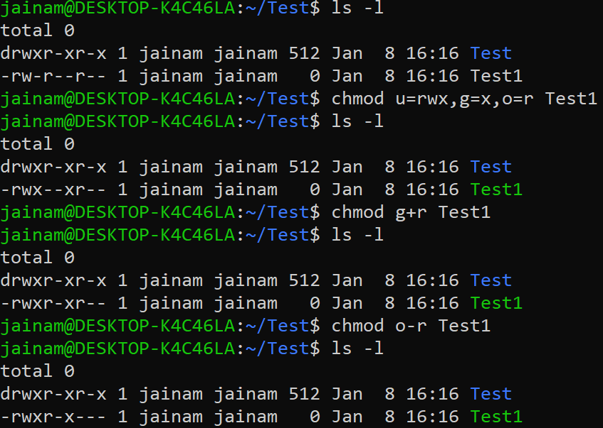
Symbolic
Code
Examples

Slide 23
Octal
Code
A faster way to enter permissions is to use the octal equivalent of the codes.
In an octal digit, there are three bit positions.
The three different permissions for each set of codes correspond to the three different bit positions in an octal digit.
2² 2¹ 2⁰
4 2 1
2² 2¹ 2⁰
4 2 1
2² 2¹ 2⁰
4 2 1
r w x
✓ ✓ ✓
r w x
✓ - ✓
r w x
✓ - ✓
User
Group
Other
chmod 755 <file_name>

Slide 24
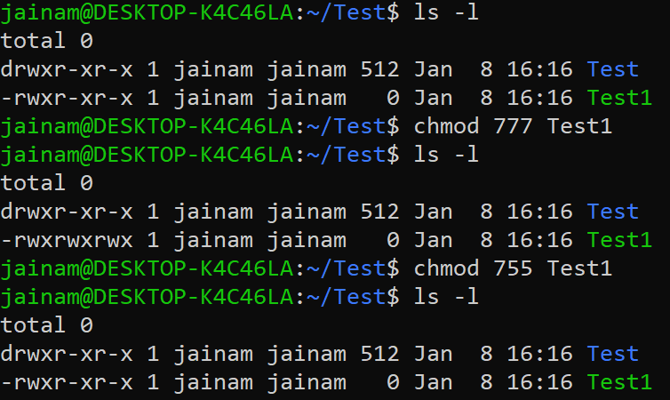
Octal
Code
Examples

Slide 25
USER MASK

Slide 26
USER MASK
The permissions are initially set for a directory or file using a three-digit octal system variable, the user mask (mask). Defined initially by the system administrator when your account is created, the mask contains the octal settings for the permissions that are to be removed from the default when a directory or file is created. You can change the settings by creating a mask entry in your login
When a new directory or file is created, the number in the mask is used to set the
Command :
DEFAULT PERMISSIONS
UMASK

Slide 27
UMASK
umask : Display or set file mode mask
The syntax for umask command is :
umask
[options]
code
OPTION | USE
-p | if MODE is omitted, output in a form that may be reused as input
-S | makes the output symbolic; otherwise an octal number is output
EXAMPLE

Slide 28
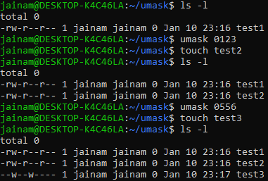
USER MASK
EXAMPLE
MASK | DIRECTORY | FILE
0 | 7 [Read, Write, Execute] | 6 [Read, Write]
1 | 6 [Read, Write] | 6 [Read, Write]
2 | 5 [Read, Execute] | 4 [Read]
3 | 4 [Read] | 4 [Read]
4 | 3 [Write, Execute] | 2 [Write]
5 | 2 [Write] | 2 [Write]
6 | 1 [Execute] | 0 [None]
7 | 0 [None] | 0 [None]

Slide 29
CHANGING OWNERSHIP & GROUP

Slide 30
CHANGING OWNERSHIP & GROUP
Every directory and file has an owner and a group. When you create a directory or file. you are the owner and your group is the group. There are two commands that allow the owner and group to be changed. But to change owner there should be other users so to add users we have command and to change group we must have other groups so to add group we have command. The change ownership ( ) command can change the owner or the owner and the group. The change group ( ) command can change only the group.
USERADD
GROUPADD
CHOWN
CHGRP

Slide 31
CHOWN
The owner and optionally the group are changed with the change ownership (chown) command.
The new owner may be a login name or a user id (UID). The group is optional. When it is used, it is separated from the owner by a colon or a period.
The group may be a group name or a group id (GID), and the new owner must be a member of the group.
The group does not have to be changed when the owner is changed unless the new owner is not a member of the current group.
Only the current owner or superuser may change the ownership or group. This means that once the ownership is changed, the original owner cannot claim it back. Either the new owner or the system administrator must change it back.
SYNTAX

Slide 32
USERADD
SYNTAX
useradd : create a new user or update default new user information
The syntax for useradd command is :
useradd
[options]
Name_of_user

Slide 33
GROUPADD
SYNTAX
groupadd : create a new group
The syntax for groupadd command is :
groupadd
[options]
Name_of_group

Slide 34
GROUPADD
SYNTAX
useradd : create a new user or update default new user information
The syntax for useradd command is :
chown
[options]
Name_of_user

Slide 35
CHOWN
SYNTAX
chown : change file owner and group
The syntax for chwon command is :
chown
[options]
Owner : [group]
filename

Slide 36
[options]
CHOWN
OPTION | USE
-c, --changes | Similar to --verbose mode, but only displays information about files that are actually changed. For example: changed ownership of 'dir/dir1/file1' from hope:neil to hope:hope
-v, --verbose | Display verbose information for every file processed. For example: changed ownership of 'dir/dir1/file1' from hope:neil to hope:hopeownership of 'dir/dir1' retained as hope:hope
-f, --silent, --quiet | Quiet mode. Do not display output.
--dereference | Dereference all symbolic links. If file is a symlink, change the owner of the referenced file, not the symlink itself. This is the default behavior.
-h, --no-dereference | Never dereference symbolic links. If file is a symlink, change the owner of the symlink rather than the referenced file.
--from=currentowner:currentgroup | Change the owner or group of each file only if its current owner or group match currentowner and/or currentgroup. Either may be omitted, in which case a match is not required for the other attribute.
--no-preserve-root | Do not treat / (the root directory) in any special way. This is the default behavior. If the --preserve-root option is previously specified in the command, this option will cancel it.
--reference=ref-file | Use the owner and group of file ref-file, rather than specifying ownership with new-owner.
-R, --recursive | Operate on files and directories recursively. Enter each matching directory, and operate on all its contents.

Slide 37
CHGRP
SYNTAX
chgrp : change group ownership
The syntax for chgrp command is :
chgrp
[options]
group
filename

Slide 38
CHGRP
[options]
OPTION | USE
-c --changes | Verbosely describe the action for each File whose group actually changes.
-f --silent --quiet | Do not print error messages about files whose group cannot be changed.
-f --no-dereference | Act on symbolic links themselves instead of what they point to. Only available if the 'lchown' system call is provided.
--reference=FILE | Use the group of the reference FILE instead of an explicit GROUP.
-v --verbose | Verbosely describe the action or non-action taken for every File.
-R --recursive | Recursively change the group ownership of directories and their contents.

