Slide 1
USB -
UNIVERSAL
SERIAL
BUS
MODES
PROBLEM
TOPOLOGY
HISTORY
SOLUTION
CLASSIFICATION
ARCHITECTURE
JAINAM : 202106100110079
NAISHAL : 202106100110100

Slide 2
PROBLEM BEFORE USB
A Few Years Ago - say mid 1990s
One major problem faced by PC Industries was ,PCs were intended to support all input output devices which includes devices such as mice , keyboard , modems, printers, joysticks etc. So Earlier each devices were having that own different cables and ports which leads to bulky ports and cables which were difficult to handle , also each were having their own protocols (For initiating and maintaining the connection) and their own drivers whose installation and loading drivers was major exercise.
MODES
PROBLEM
TOPOLOGY
HISTORY
SOLUTION
CLASSIFICATION
ARCHITECTURE

Slide 3
SOLUTION
To solve this all the major HW and SW Industries collaborated to define a Universal Serial Bus (USB) Standard. USB offers a common cable and connection configuration which supports a plug-and-play interface
The Industries considers a USB Interface to be HOT-SWAPPABLE - which means one can plug-out a device and plug-in another device in that same slot without rebooting a PC
USB Protocol automatically detects presence of a newly connected device, gives it a valid address and also identifies drivers to communicate with it
MODES
PROBLEM
TOPOLOGY
HISTORY
SOLUTION
CLASSIFICATION
ARCHITECTURE

Slide 4
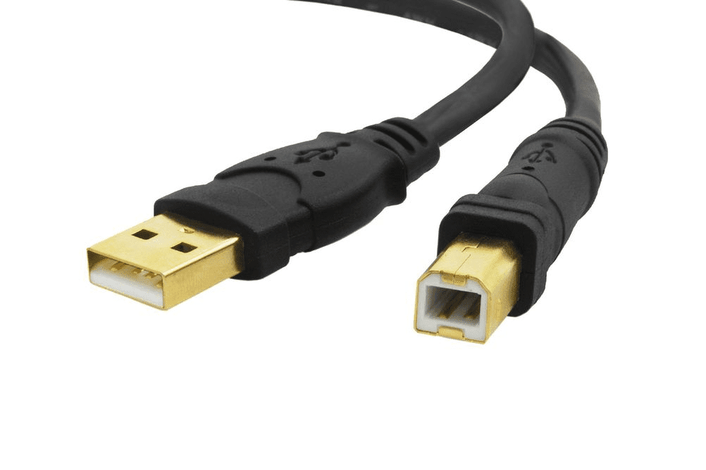
USB - A BRIEF HISTORY
The first USB specifications were formulated in mid 1990s.
USB 1.1 :
It was announced in 1995 and was released in 1996. It became very popular and remained popular till the year 2000
Within the frame of specification of USB 1.1, Intel announced USB host controller and Philips announced USB audio for isochronous (occurring at the same time) communication with customer electronic devices.
MODES
PROBLEM
TOPOLOGY
HISTORY
CLASSIFICATION
SOLUTION
ARCHITECTURE
USB 1.1

Slide 5
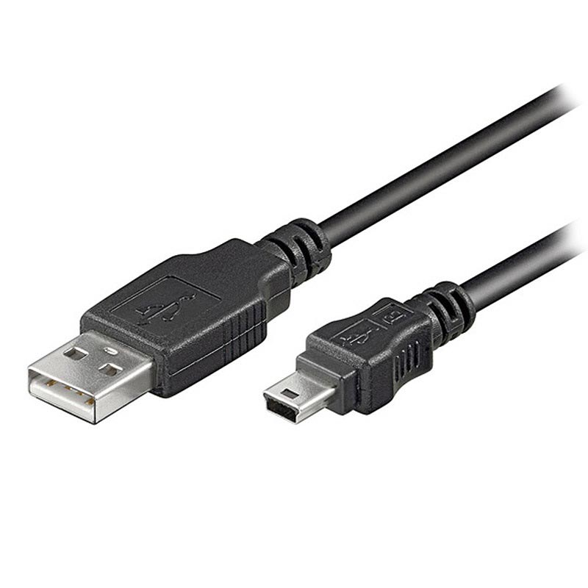
USB - A BRIEF HISTORY
USB 2.0 :
It was announced in April 2000.
USB Interface of most PCs supports USB 2.0.
Also USB 2.0 is used to obtain enhanced connection.
USB 2.0 cable may extend up to 5 m operating at 5v supply 500mA.
USB 2.0 is capable of utilizing up to 90% of USB bandwidth (speed).
MODES
PROBLEM
TOPOLOGY
HISTORY
CLASSIFICATION
SOLUTION
ARCHITECTURE
USB 2.0

Slide 6
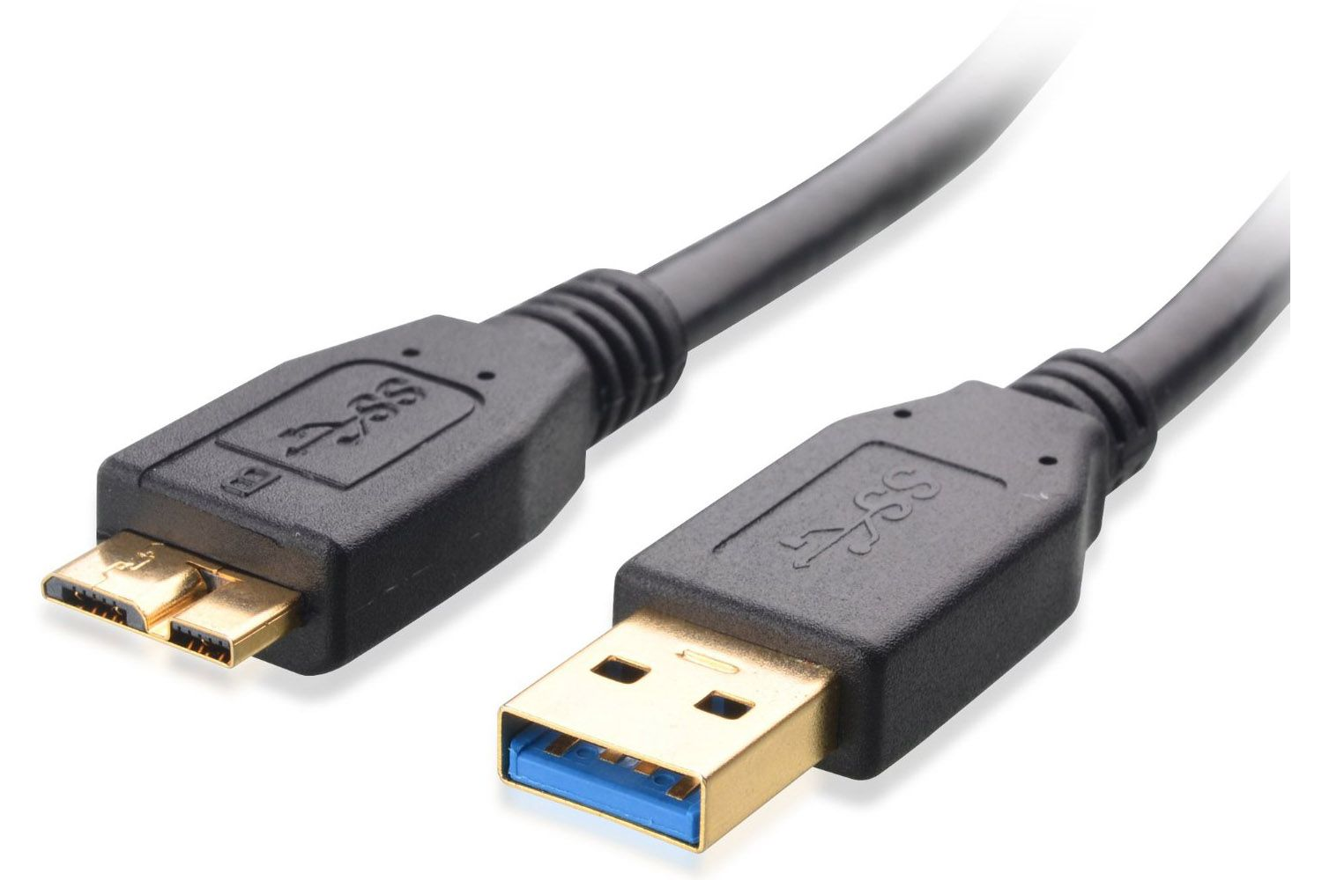
USB - A BRIEF HISTORY
USB 3.0 :
Its specification was announced on 17th November 2008.
The availability of USB 3.0 was extended to be from 2010.
USB 3.0 was officially termed to be “ SUPER-SPEED ”.
MODES
PROBLEM
TOPOLOGY
HISTORY
CLASSIFICATION
SOLUTION
ARCHITECTURE
USB 3.0

Slide 7
USB - A BRIEF HISTORY
Application’s environment | Speed | USB Specifications | Some Observations
Interactive I/P as in-games | Low 10- 100 kbps | USB 1.1(announced in 95, but released in 96, popular till 2000) | Low cost interface for human I/F devices like mouse, keyboards, joysticks
Bulk transfer for data services as required in ISDN, audio etc. | Medium 1.5-12 Mbps | USB 1.1(Intel announced USB host controller & Philips announced USB audio for isochronous communications with consumer electronics devices) | Useful when latency is to regularly guaranteed like in speech & audio.
Bulk transfer at high speed as required in LANs & video data | High 50- 480 Mbps | USB 2.0(announced in Apr 2000) | Useful for data transfers with very low latency(flash memory devices, projection devices)
Bulk transfer at ultra high speed | UHS 1-5 Gbps | USB 3.0 (announced Nov 2008) | Handles variety of real time media data at 500 Mbps or more
MODES
HISTORY
PROBLEM
TOPOLOGY
CLASSIFICATION
SOLUTION
ARCHITECTURE

Slide 8
CLASSIFICATION OF DEVICES
1
2
3
4
MODES
PROBLEM
TOPOLOGY
HISTORY
ARCHITECTURE
SOLUTION
CLASSIFICATION
Human Interaction Device Class
Communication Device Class
Printer Device Class
Mass Storage Device Class
Analog modems
DLS
Multi-function peripherals
Facsimile
Scanning
Hard-drives
CD ROMs
DVDs
Mice,
Keyboard
Joystick

Slide 9
MODES OF COMMUNICATION
1
For Devices like Keyborad, Mice, Joystick, etc.
Interrupt
TOPOLOGY
Usually medium speed devices like printer. One main characteristics of this transfer it is in “error correction mode”
MODES
PROBLEM
HISTORY
ARCHITECTURE
2
SOLUTION
CLASSIFICATION
Bulk Transfer
3
Usually for media like audio and video. These transfer are carried out without any error correction support. Mostly, the communication is for real time or near-real-time communication
Isochronous

Slide 10
THREE TIER ARCHITECTURE OF USB
USB Device communication supports a three tier architecture.
The tire specifies the device end point, function and the device features required by the client application.
TOPOLOGY
MODES
PROBLEM
HISTORY
SOLUTION
CLASSIFICATION
ARCHITECTURE
Client application’s requirement of device feature
USB Driver Selection
The Host Controller

Slide 11
THREE TIER ARCHITECTURE OF USB
A High level IO instruction in the application results in a system call for operating system.
The function call identifiers a specific driver along with required parameter.
The endpoint is on the device and identifies the final data source or sink.
It helps to define the directional character of the communication, i.e. unidirectional , half duplex.
The endpoint determines the communication mode and nature of the data transfer.
TOPOLOGY
MODES
PROBLEM
HISTORY
SOLUTION
CLASSIFICATION
ARCHITECTURE

Slide 12
TIERED STAR NEWORK TOPOLOGY
USB connects devices in “TIERED STAR NETWORK ” Topology.
The Root star node is the host with a spoke to a USB hub.
A USB hub simply divides a star to connect additional stars making it a tired star Network.
A powered HUB may connect up to 4 new port.
Hubs are used to support lower bandwidth devices.
Technically, a device may be connected six level away from host through the layers of hubs.
Theoretically, upto 127 devices can be connected including hub devices over a maximum of seven tiers including root.
MODES
PROBLEM
TOPOLOGY
HISTORY
SOLUTION
CLASSIFICATION
ARCHITECTURE

Slide 13
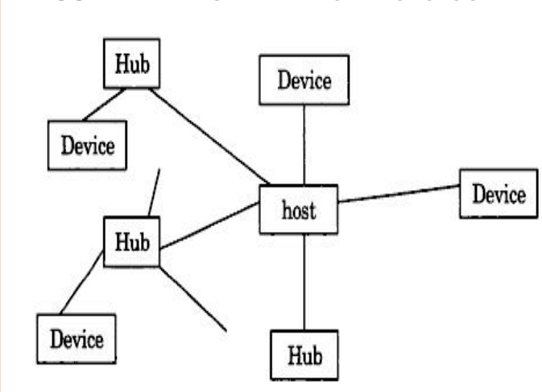
TIERED STAR NEWORK TOPOLOGY
MODES
PROBLEM
TOPOLOGY
HISTORY
SOLUTION
CLASSIFICATION
ARCHITECTURE

Slide 14
TIERED STAR NEWORK TOPOLOGY
USB HUB provisions are as follows :
Connectivity : Dynamic attachments for peripherals in the down-stream.
Power : For the attached device ports. Technically, hubs may be self-powered hub may support up to 500mA for the attached device ports. Also, for power management, host may direct shutting down inactive devices
Signal repetition : Communication, between host and peripherals needs to be repeated to ensure no loss in signal strength .
MODES
PROBLEM
TOPOLOGY
HISTORY
SOLUTION
CLASSIFICATION
ARCHITECTURE

Slide 15
ANY
QUERIES ?
MODES
PROBLEM
TOPOLOGY
HISTORY
SOLUTION
CLASSIFICATION
ARCHITECTURE

Slide 16
THANK
YOU
MODES
PROBLEM
TOPOLOGY
HISTORY
SOLUTION
CLASSIFICATION
ARCHITECTURE

