Slide 1
Pimpri Chinchwad Education Trust’s
Pimpri Chinchwad College of Engineering (PCCoE)
Affiliated to Savitribai Phule Pune University(SPPU)
Department of Information Technology
Third Year (2025-26 Sem – V)
Dust Detection and Maintenance Optimization for Solar PV Panels using CNN-RF and I-V Curve Data
Course Name-Fundamentals of Digital Image Processing
Formative Assessment II
Presented By :
Jai Chandegave 123B1F016
Guided By : Dr. Harsha Bhute

Slide 2
Aim:
To design an intelligent system using CNN-RF and I–V curve data for automatic dust detection and optimized cleaning of solar panels, improving efficiency and reducing maintenance costs.
Objectives:
To develop a CNN–RF model for accurate detection of dust presence and severity on solar panels.
To convert I–V curve data into RGB mosaic images for effective visual and computational analysis.
To design an optimized cleaning framework based on cost–benefit analysis of dust impact versus cleaning cost.
To minimize water and maintenance costs through intelligent, condition-based cleaning decisions.

Slide 3
Literature Survey:
Author & Year | Features | Methodology Used | Limitations
Abukhait (2024) | GLCM and LBP texture features extracted from visible light images | Combined Gray Level Co-occurrence Matrix (GLCM) and Local Binary Pattern (LBP) features with Support Vector Machine (SVM) classifier | Accuracy decreases under low-light conditions; lacks integration with automated cleaning or IoT systems
Onim et al. (2022) | Image-based features from solar panel surface conditions | Developed SolNet, a custom CNN architecture for classifying clean vs. dusty panels | Model limited to two classes (clean/dusty); does not estimate dust severity or suggest maintenance actions
Unluturk et al. (2019) | GLCM texture features from artificial lighting experiments | Used Artificial Neural Network (ANN) to estimate dust accumulation levels (three categories) | Performance validated only in laboratory settings; lacks real-world environmental testing
Bashir et al. (2025) | RGB mosaic images generated from I–V curve data | Proposed hybrid CNN–RF system for state classification and dust severity detection; included cleaning optimization framewor | Requires high computational resources; model yet to be tested extensively on large-scale solar farms

Slide 4

Methodology:
Data Collection: Gather I–V curve data and operational measurements from solar panels under various environmental and fault conditions.
2. Data Transformation: Convert numerical I–V data into RGB mosaic images for visual and feature-rich representation.
3. Feature Extraction & Classification: Use a CNN to extract spatial features and Random Forest for classification of panel state and dust severity.
4. Cleaning Optimization: Implement a cost-benefit decision model to evaluate when cleaning should be performed.
4

Slide 5
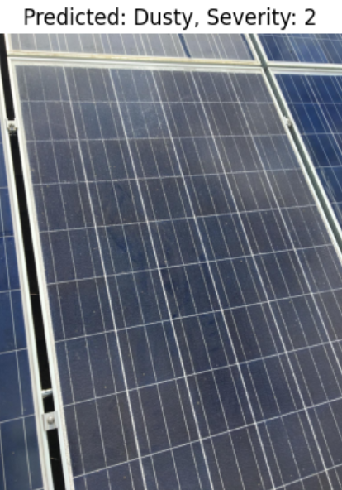
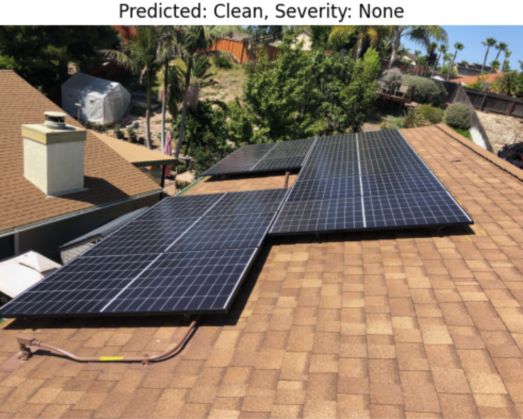
Output:
5

Slide 6
Conclusion:
The developed CNN–RF-based system efficiently detects dust and its severity on solar panels using RGB mosaic images. It optimizes cleaning schedules through a cost-benefit framework, reducing water and maintenance costs while improving energy efficiency and supporting sustainable solar operations.
6

