Slide 1


Supervised and unsupervised learning with Johnson & Johnson Support Ticket
Ignacio Palma, Jairo Melo, Jamil Mahboob and Vikram Khade
York University
ML1000, Project presentation
22 March , 2019

Slide 2
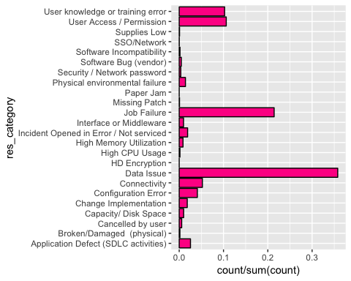
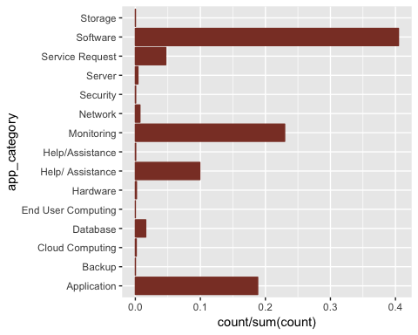
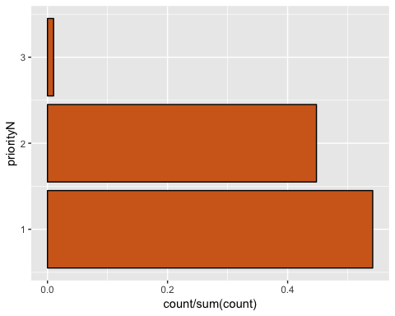
Introduction
Motivation / Objective :
Information Technology Service Management at Johnson and Johnson is always looking for opportunities to improve support services processes avoiding business impact reducing time and cost.

Slide 3
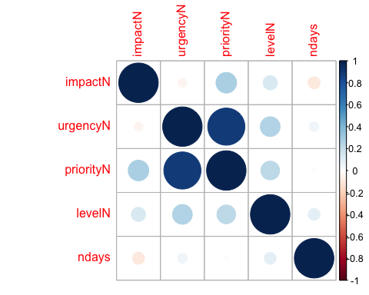
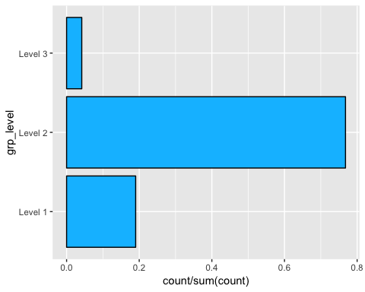
Supervised Learning
What is the Problem?
The resolution of an issue is time sensitive, and the escalation process is causing not only unplanned resource allocation but business impact. Reliability team needs to identify the Group Level who will finally be involved in the resolution of the a ticket while the ticket is being created.
Predicting Group Level

Slide 4
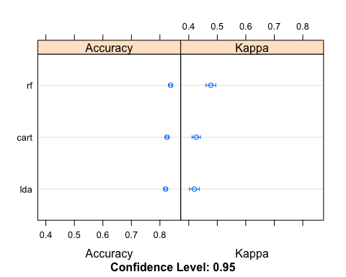
Supervised Learning
Solution
Predicting the Group Level using Random Forest
## Confusion Matrix and Statistics ## ## Reference ## Prediction Level 1 Level 2 Level 3 ## Level 1 385 164 12 ## Level 2 453 3185 155 ## Level 3 0 0 0 ## ## Overall Statistics ## ## Accuracy : 0.8199 ## 95% CI : (0.8082, 0.8312) ## No Information Rate : 0.7692 ## P-Value [Acc > NIR] : < 2.2e-16 ## ## Kappa : 0.4099 ## Mcnemar's Test P-Value : < 2.2e-16 ## ## Statistics by Class: ## ## Class: Level 1 Class: Level 2 Class: Level 3 ## Sensitivity 0.45943 0.9510 0.00000 ## Specificity 0.94994 0.3950 1.00000 ## Pos Pred Value 0.68627 0.8397 NaN ## Neg Pred Value 0.88057 0.7077 0.96164 ## Prevalence 0.19247 0.7692 0.03836 ## Detection Rate 0.08842 0.7315 0.00000 ## Detection Prevalence 0.12885 0.8712 0.00000 ## Balanced Accuracy 0.70469 0.6730 0.50000

Slide 5
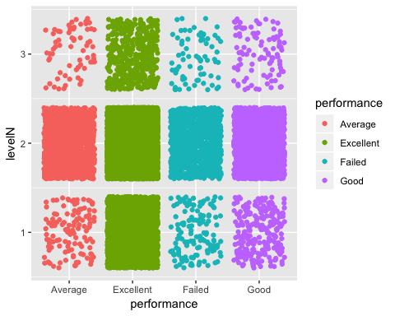
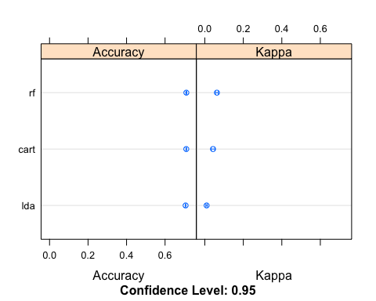
Supervised Learning
What is the Problem?
Users complain when the issue still outstanding without ETA, or the waiting time could have been used to escalate the issue or implement a workaround.
New Feature Performance = Resolved - Opened

Slide 6
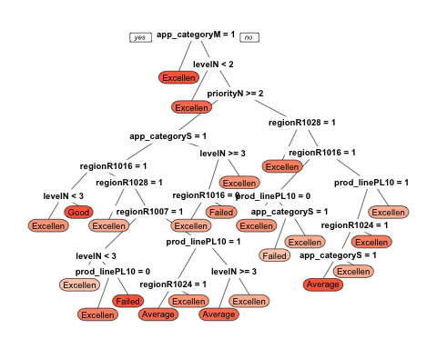
Supervised Learning
Solution
Predicting the performance of a new ticket using Classification and regression trees CART method
## Confusion Matrix and Statistics ## ## Reference ## Prediction Excellent Good Average Failed ## Excellent 3070 545 392 293 ## Good 3 5 0 0 ## Average 2 3 6 3 ## Failed 10 7 3 12 ## ## Overall Statistics ## ## Accuracy : 0.7104 ## 95% CI : (0.6967, 0.7238) ## No Information Rate : 0.7085 ## P-Value [Acc > NIR] : 0.4021 ## ## Kappa : 0.032 ## Mcnemar's Test P-Value : <2e-16 ## ## Statistics by Class: ## ## Class: Excellent Class: Good Class: Average ## Sensitivity 0.99514 0.008929 0.014963 ## Specificity 0.03073 0.999209 0.997976 ## Pos Pred Value 0.71395 0.625000 0.428571 ## Neg Pred Value 0.72222 0.872296 0.908986 ## Prevalence 0.70854 0.128617 0.092099 ## Detection Rate 0.70510 0.001148 0.001378 ## Detection Prevalence 0.98760 0.001837 0.003215 ## Balanced Accuracy 0.51294 0.504069 0.506469

Slide 7
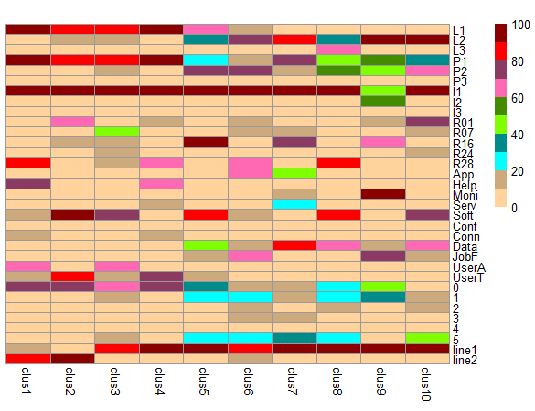
Clustering
PAM
Undersampling Level 1 and Level 2.

Slide 8
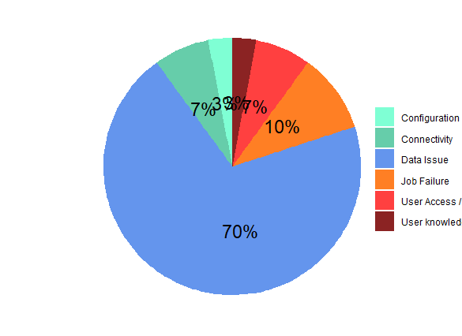
Cluster #8

Slide 9
Conclusions
Recommend Random Forest for predicting group level and performance.
Recommend segment given by cluster 8 for further analysis to J&J.

