Slide 1
Karate Tournament Management System
Group Number : 1
Submitted By :
Anandhuraj B | Aravind Ghosh
Aravind TA | Jaison Jose

Slide 2
Introduction
KARATE TOURNAMENT MANAGEMENT SYSTEM is a software being developed for managing various activities in a tournament including the management and administration.
Presently existing systems requires a large number of paper work and documentation and is time consuming.
New system aims at reducing the amount of work done manually.
This software includes three levels namely: - Administrator , Arbitrator , Registration with Administrator having the highest privilege .
Microsoft Access 2016 is used as the database server (Back end) and Microsoft Visual basic 2015 is used as the front end.

Slide 3
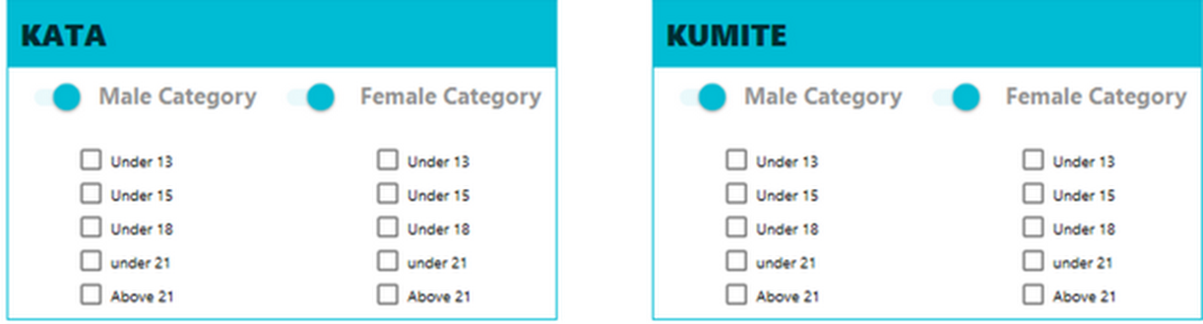
TERMS
Kumite -Freestyle fighting (sparring)
Kata -Japanese word describing detailed patterns of movements practiced either . solo or in pairs.
DOJO -School/place of martial arts
Registrar - Tournament official handling registration process.
Arbitrator -Match Area Controller

Slide 4
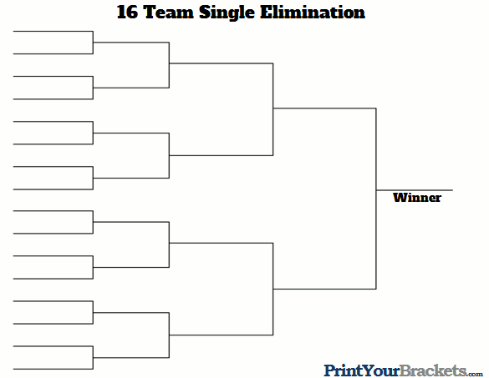

Slide 5
Existing System
Karate Tournament’s are still following the system of keeping records in papers which involves repetition of work, chances for data loss, time consuming and involves large amount of manual work.
Now the tournament officials have to manually group the participants into different categories from the participant list.
Then participant list for each event is made on each paper.
Arbitrator is given this list for conducting the event and the result is written on it after the event.
There is currently transfer of papers between admin & arbitrator before & after each event.
Then the administrator rewrites the results to a separate list to prepare certificates

Slide 6
Drawbacks of Existing System
Consumes large amount of Time in grouping participants into different categories
A typical tournament may have around 40 papers just for storing details of participants of each event.
More manual work is needed.
Lack of security of data
Hard to read handwriting which cause spelling mistakes on certificates
Human Error

Slide 7
Proposed System
The proposed system aims at reducing the amount of work done manually
The system has 3 main users: Arbitrator, Admin & Registrar
The participant access the system via registrar
The core function is to distribute participants correctly to their events just after the registration.
Admin decides the events to be conducted
Arbitrator conduct event & enter the result to the system
The system gives results & participant data sorted in the order of events , Dojo name , age which was herculean task otherwise.

Slide 8
Advantages of Proposed System
Automated system which makes all the event list and distribute the participants precisely to their systems
No transfer of papers is required between tournament officials.
Provides data security
Centralized control
Problem of spelling mistakes on certificates is solved
Redundancy is removed

Slide 9
Modules
This software includes three modules namely:
Administrator
Arbitrator
Registration

Slide 10
Administrator Module
Administrator has overall privilege upon the software .
Administrator access the event details, user details and arbitrator details.
Admin can set the Tournament configuration, change passwords.
Admin can add or remove arbitrators. He decides upon the events to be conducted in the tournament

Slide 11
Arbitrator Module
Arbitrator is the match area controller.
Arbitrator can use this software by approval of the administrator.
Arbitrator can View all participant’s details and published results.
He can conduct events and publish results to the system.

Slide 12
Registration Module
The participants interact with the system through this module.
The module deals with registration of participants & dojo(karate institutions).
It provide participant list & dojo list for the other modules

Slide 13
Software & Hardware Requirements
Software
OS: minimum Windows 7
.NET framework 4.5 or above
Microsoft access database engine
Hardware
1 gigahertz (GHz) faster 64-bit (x64) processor
2 GB RAM
20 GB available hard disk space (64-bit)
DirectX 9 graphics device with WDDM 1.0 or higher driver

Slide 14
DFD

Slide 15
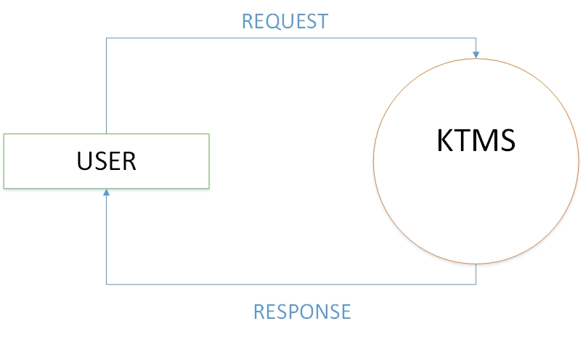
CONTEXT LEVEL

Slide 16
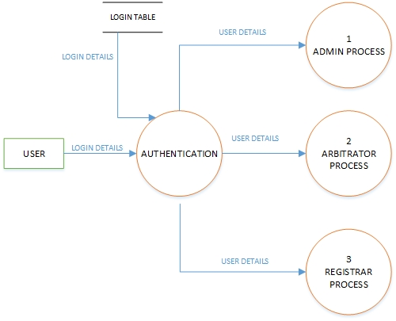
Level 1

Slide 17
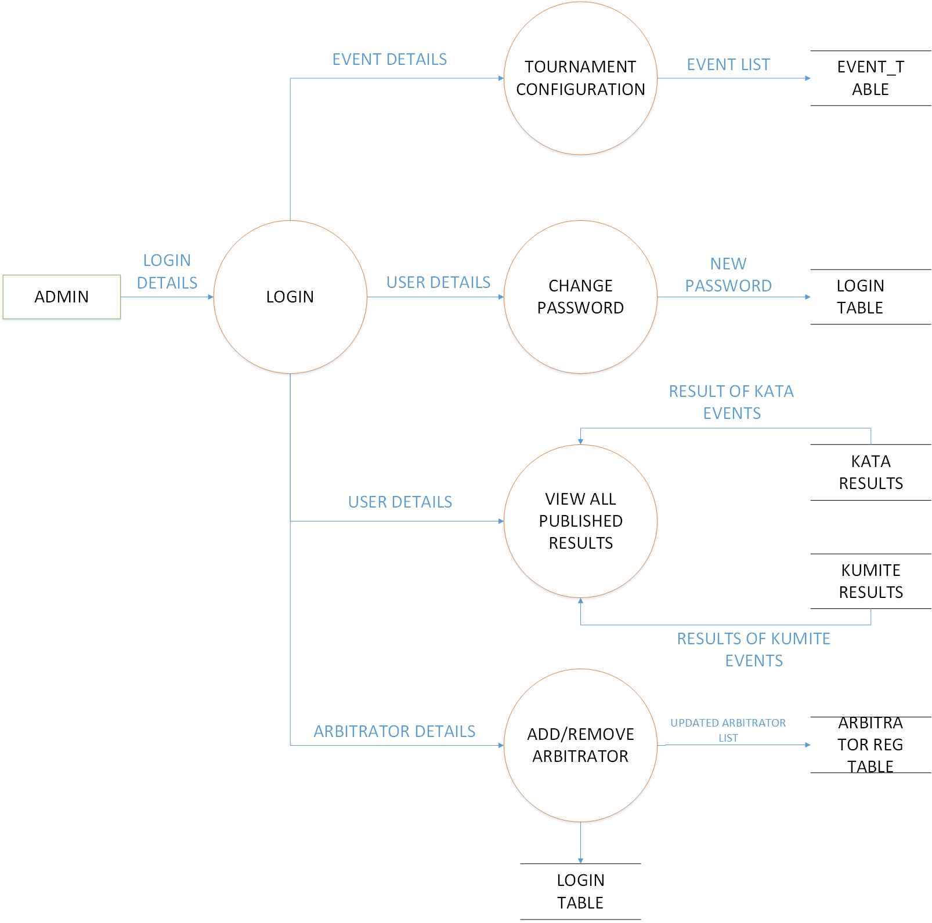
Level 2 : Administrator

Slide 18
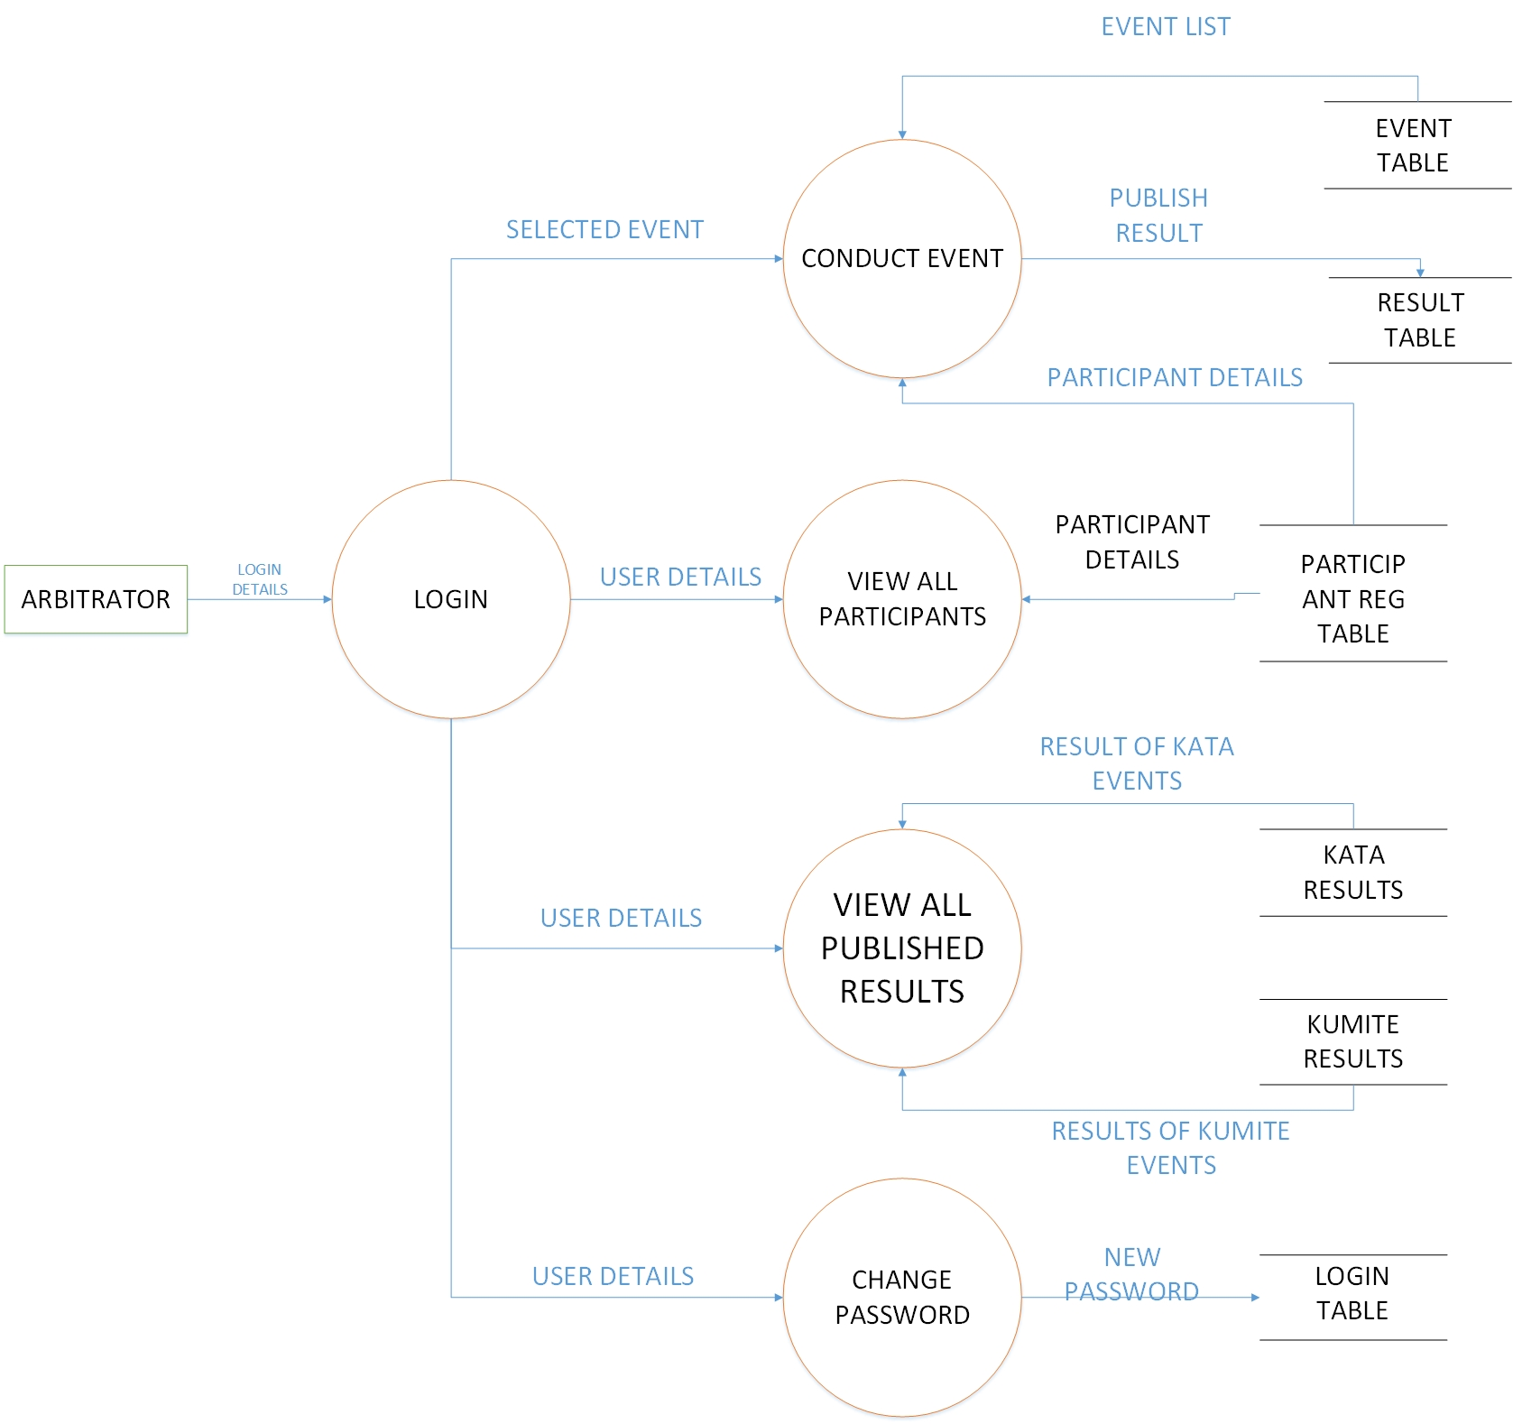
Level 2 : Arbitrator

Slide 19
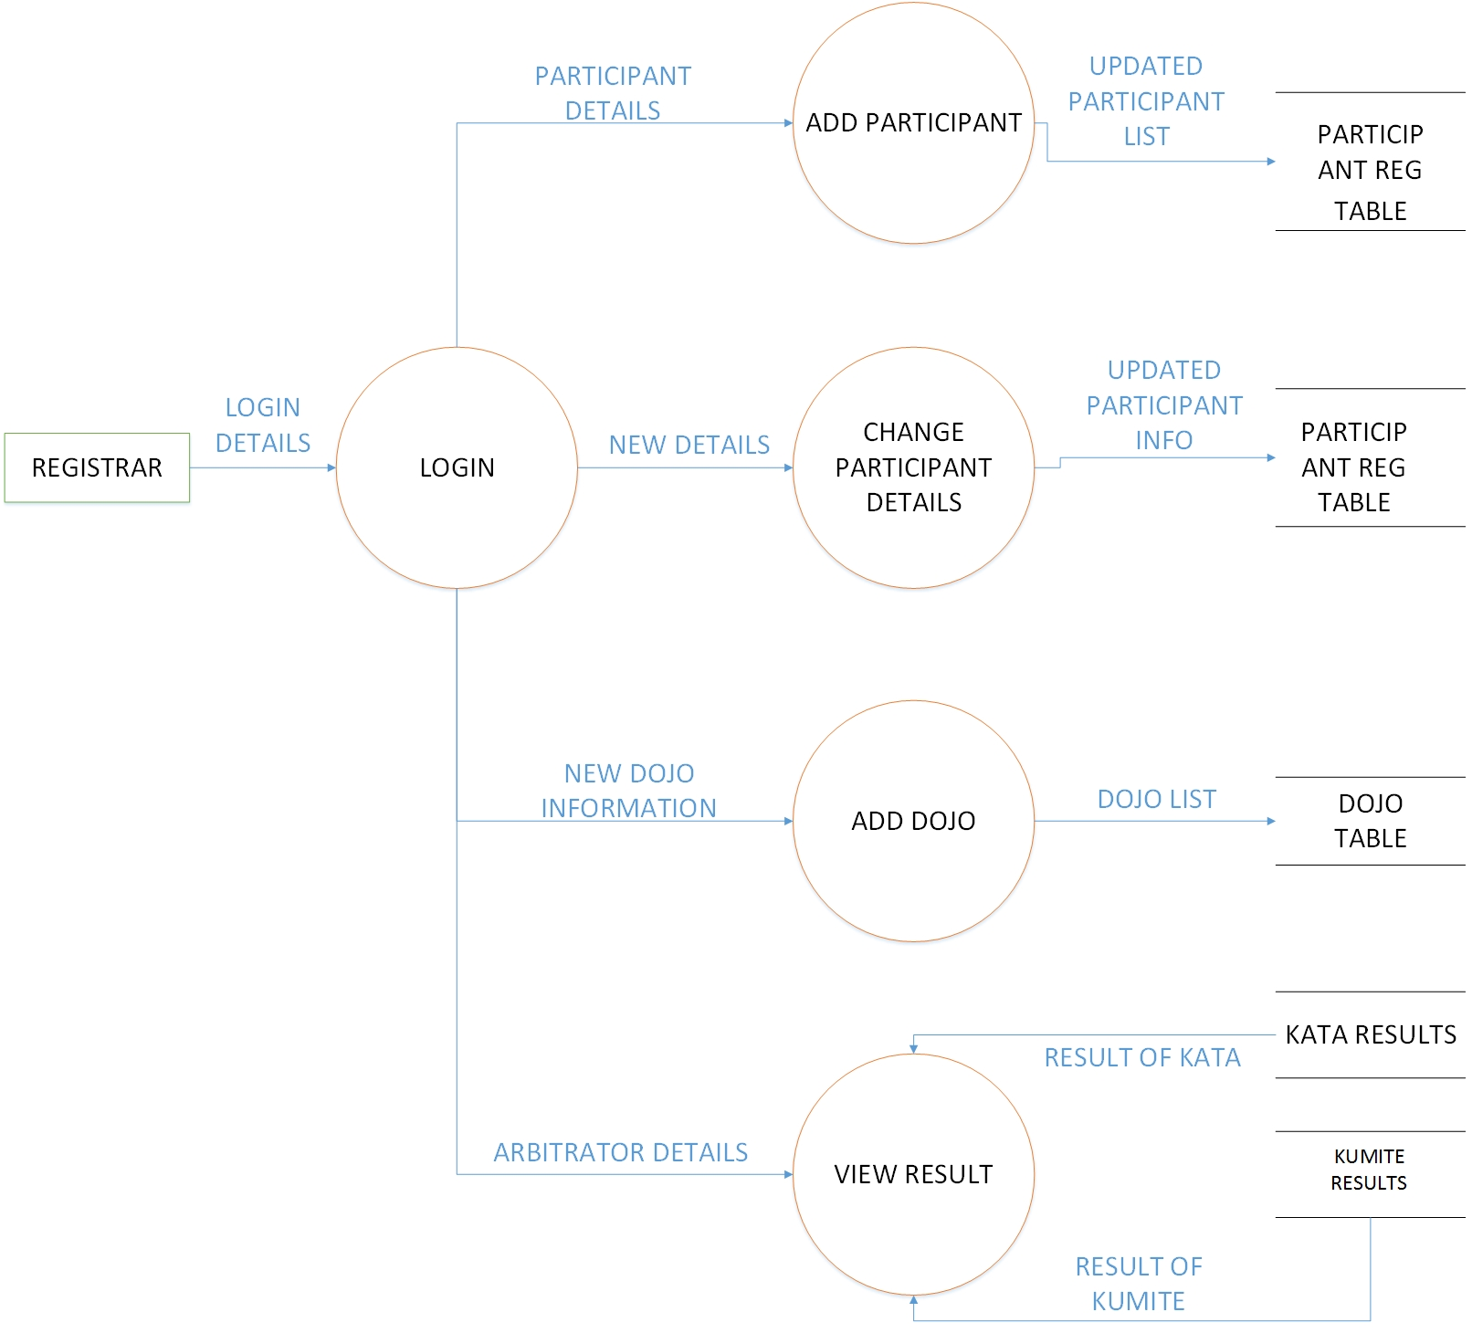
Level 2 : Registration

Slide 20
Database Tables

Slide 21
Participant registration table
Field Name | Data Type | Constraints
ID | Auto Number | Primary key
Name | Short Text | Not null
Age | Short Text | Not null
Dojo | Short Text | Not null
Grade | Short Text | Not null
Weight | Short Text | Not null
Mobile No | Number | Not null
Email | Long Text | Not null
Gender | Short Text | Not null
Address | Long Text | Not null
Kata | Boolean | Not null
Kumite | Boolean | Not null

Slide 22
Dojo Table
Field Name | Data Type | Constraints
ID | Auto Number | Primary key
Name | Short Text | Not null
Place | Short Text | Not null
Instructor Name | Short Text | Not null
Mobile No | Number | Not null
Instructor Address | Long Text | Not null
Email | Long Text | Not null

Slide 23
Arbitrator Registration table
Field Name | Data Type | Constraints
ID | Auto Number | Primary key
Name | Short Text | Not null
Age | Short Text | Not null
Mobile No | Number | Not null
Gender | Short Text | Not null

Slide 24
User login table
Field Name | Data Type | Constraints
ID | Auto Number | Primary key
User Name | Short Text | Not null
Password | Short Text | Not null
Privilege | Short Text | Not null

Slide 25
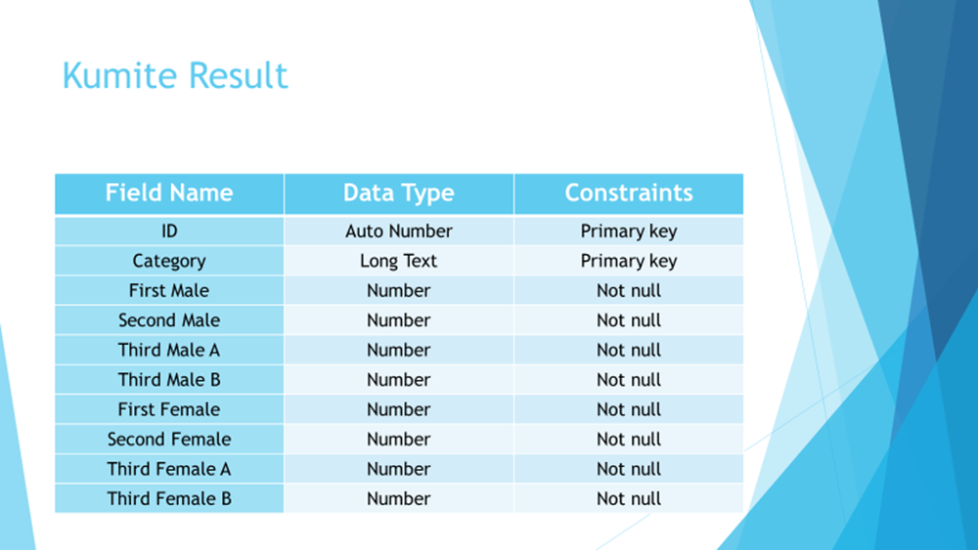

Slide 26
Create Event table
Field Name | Data Type | Constraints
ID | Auto Number | Primary key
Event Name | Long Text | Not null
Event Location | Long Text | Not null
Event Start Date | Date/Time | Not null
Event End Date | Date/Time | Not null
Kata Male Events | Long Text | Not null
Kata Female Events | Long Text | Not null
Kumite Male Events | Long Text | Not null
Kumite Female Events | Long Text | Not null
Category | Long Text | Not null

Slide 27
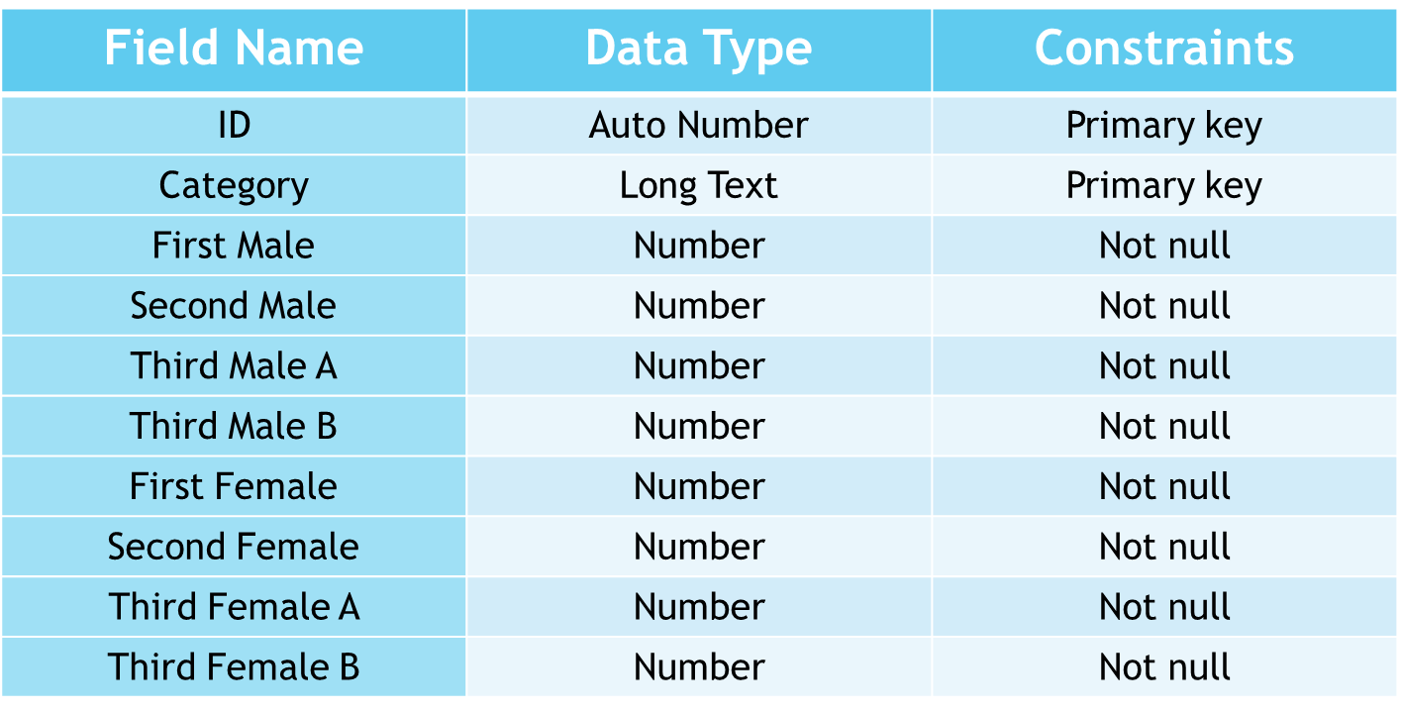
Kata Results

Slide 28
Screenshots

Slide 29
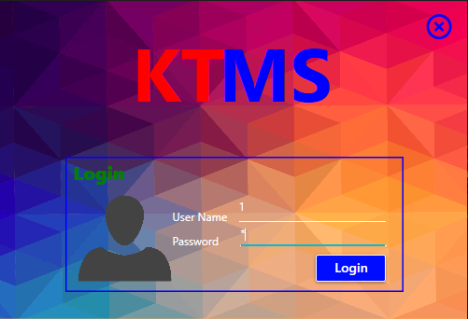

Slide 30
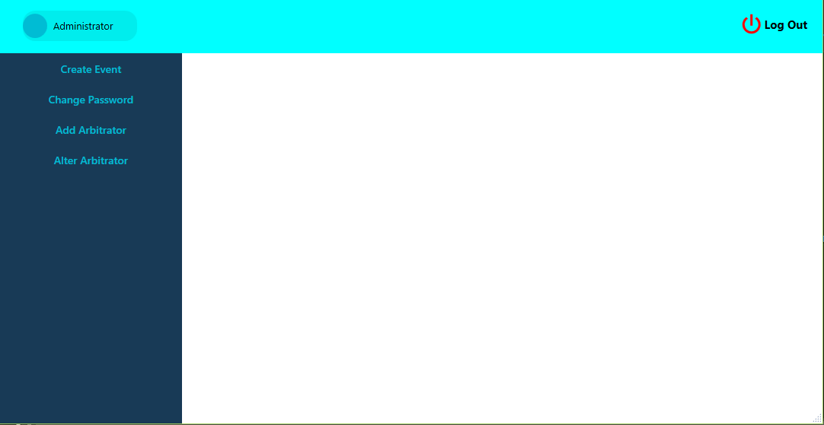

Slide 31
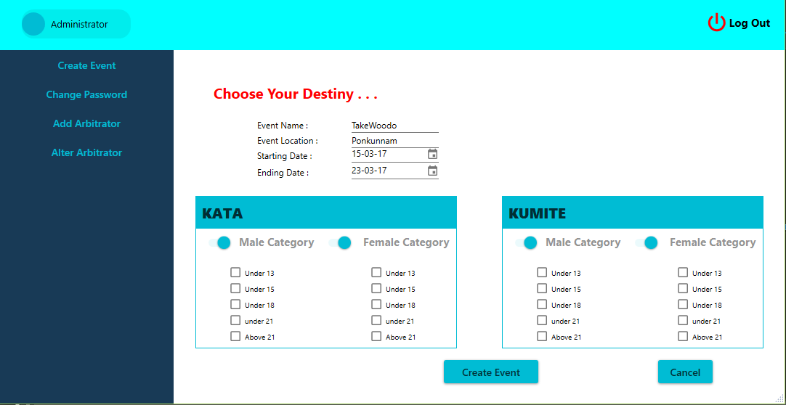

Slide 32
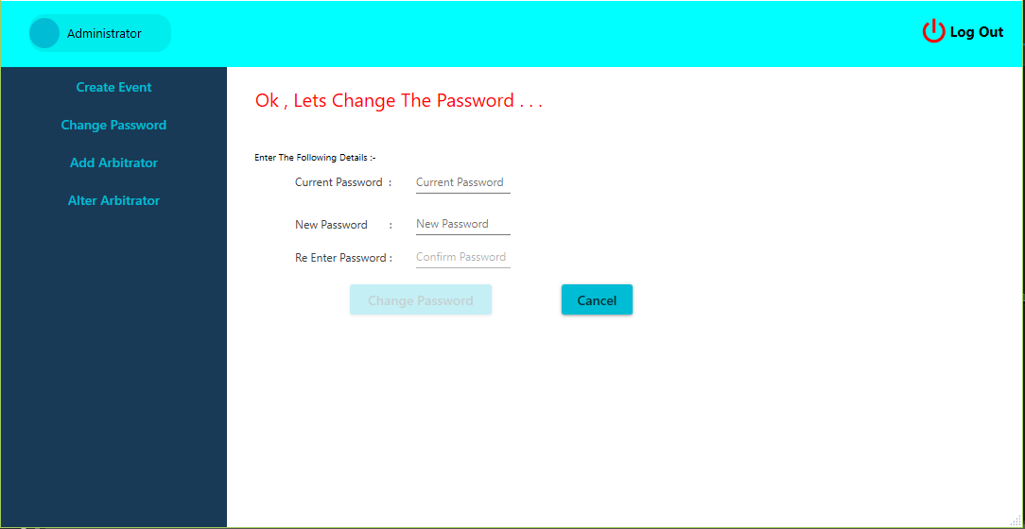

Slide 33
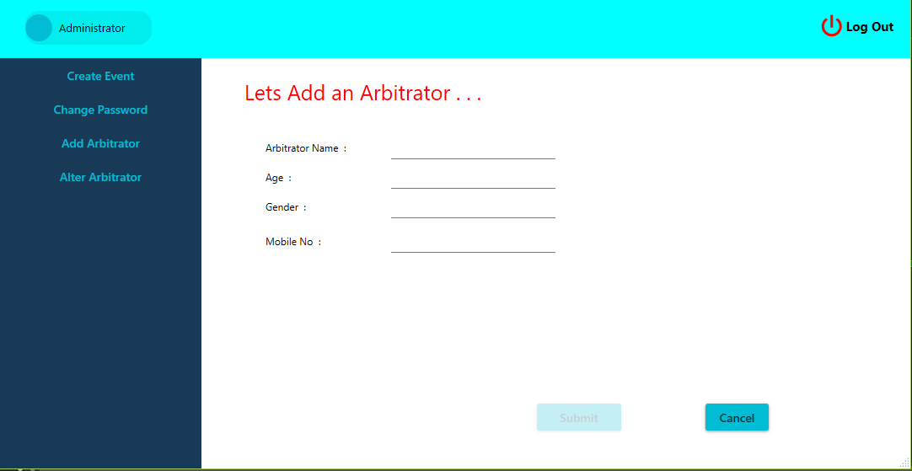

Slide 34
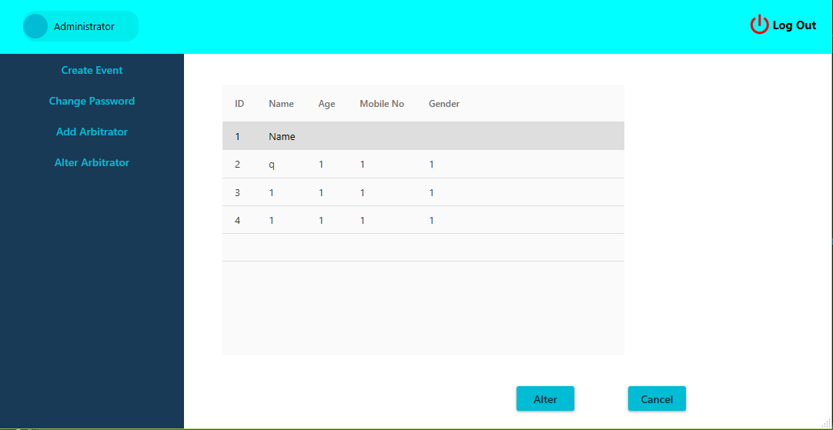

Slide 35


Slide 36
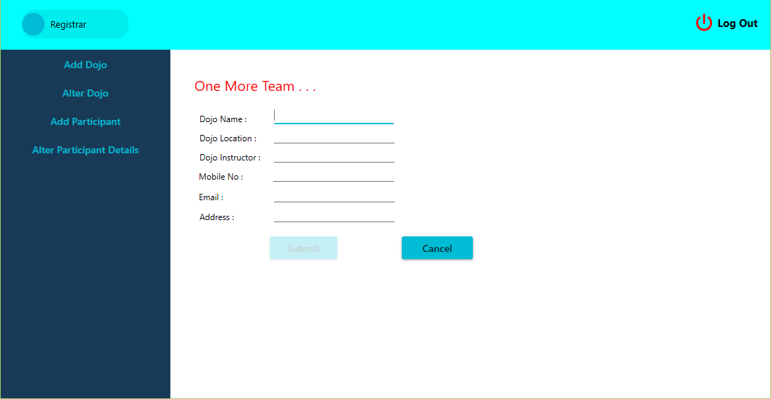
Current Status & Future Scope
To be added

Slide 37
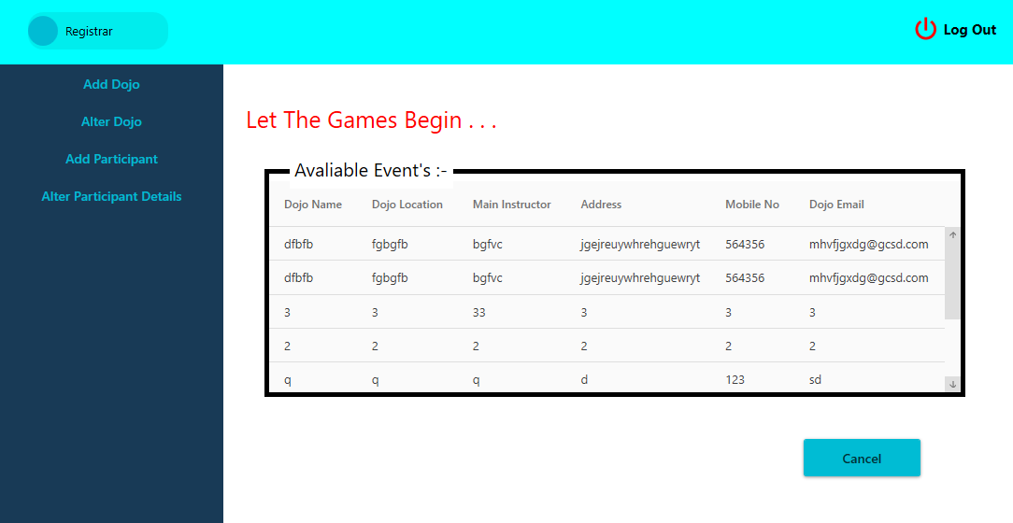

Slide 38
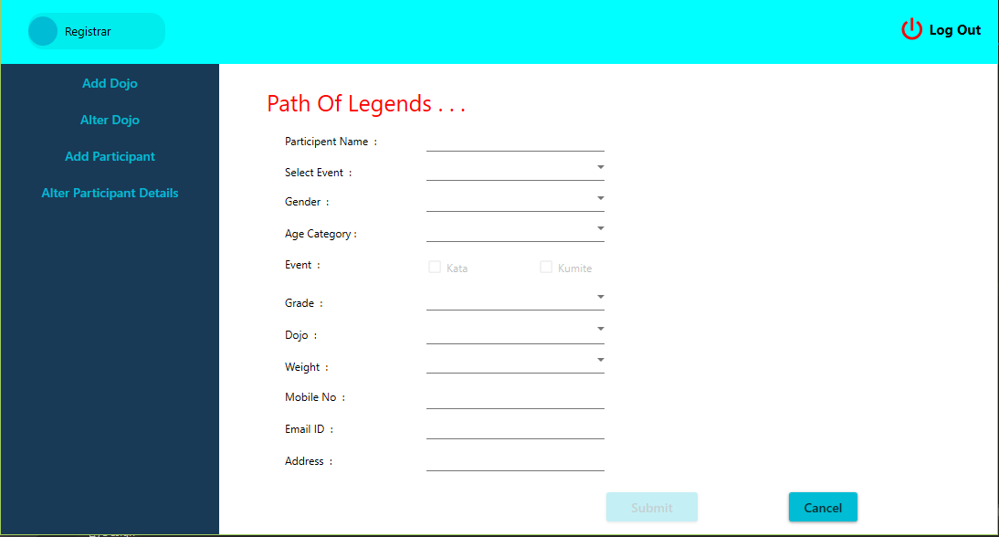

Slide 39


Slide 40
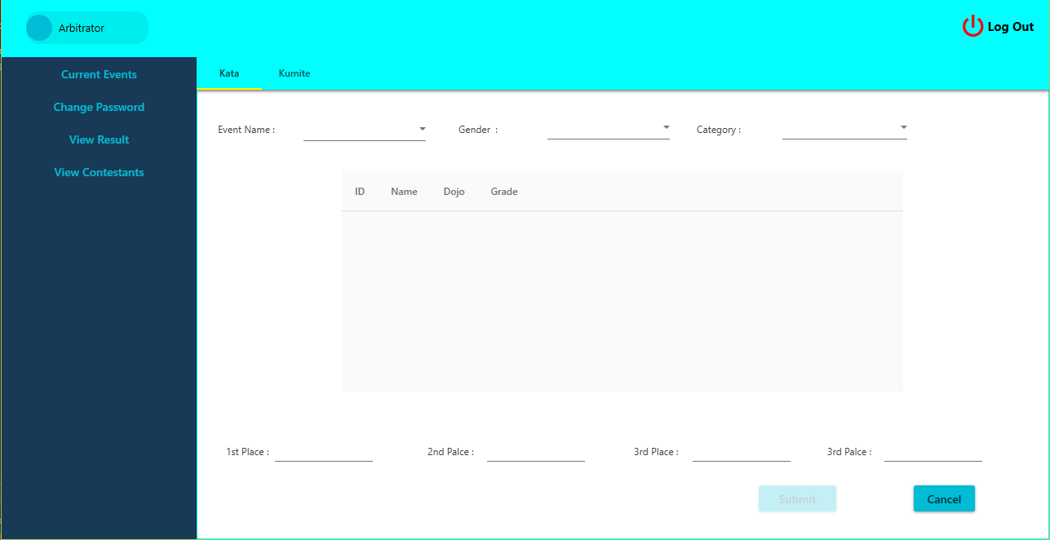

Slide 41
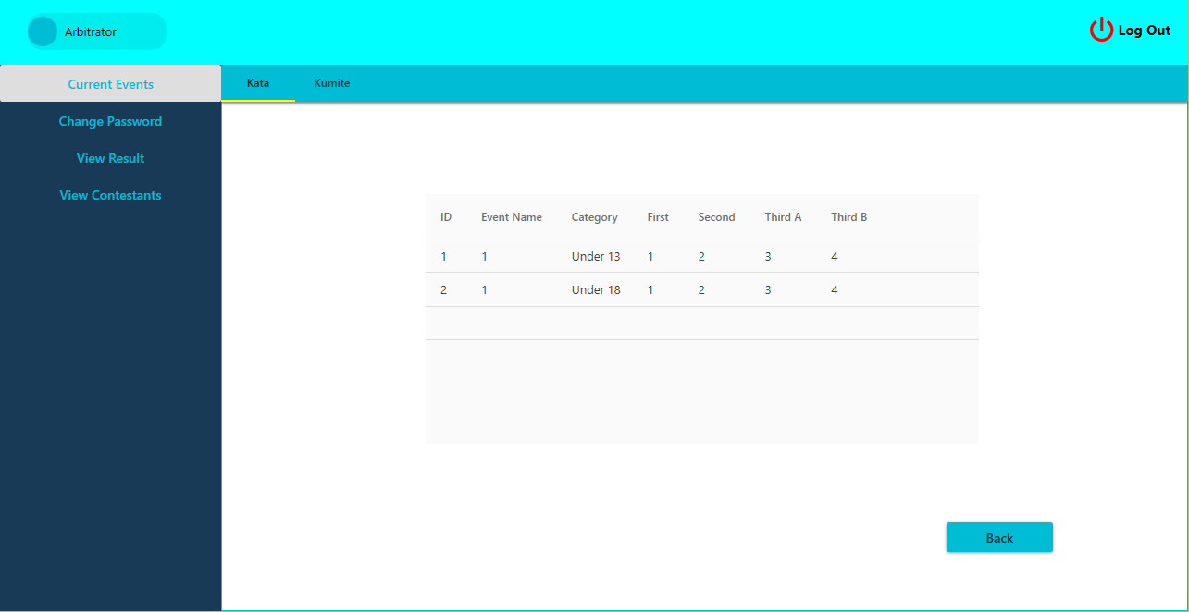

Slide 42
Limitations & Future Scope
Limitations
Have to use another software for scoreboard display
Conducting of an event is done manually
Certificates for the winners has to be manually written
Future Scope
Implemented over internet where participants can register from home
Scoreboard Integration
Automatic certificate generation using data from result table

Slide 43
Conclusion
Only the authorized users who will have a valid password can run the system thus the system is secure and the administrator controls the entire system.
The newly developing system can carry out tasks in short time.
It is secured, accurate to an extent & ease in operation.
This software solves many drawback in the existing system and is more accurate, fast, less time consuming and provide more data security.
This package is developed in windows platform. The programming language used is Visual Basic with Visual Studio 2015 IDE. MS Access is used as backend database for the details to be stored.

Slide 44
Thank You ☺

