Slide 1

In the Field & In the Classroom;
How Communication is the ultimate Bottleneck.
31st October 2026
By Joshua McManus
[Pg. №]

Slide 2
Introduction
Hello, My name is Joshua McManus. But who am I?
- I am from Newcastle, lived here almost all my life.
- I am currently a Master’s student @ Newcastle University.
- I have a Bachelor’s Degree in Security and Intelligence Studies.
Most Importantly:
I am here to learn more, and hopefully start my pathway to give back the same opportunities I was given when I was a cadet (From both the ATC and ACF)
[Pg. №]

Slide 3
Communication.
[Pg. №]

Slide 4
The Single Point of Failure
The Environment:
The Environment in which lessons are taken dictates the methods in which one can teach.
Friction, fatigue, and environmental noise all obscure the intent behind the instructions you give.
Teams rarely fail due to a lack of resources, fitness, or intent.
Operations break down when the signal between planning and execution is corrupted.
The Instructions:
This is why you must make everything you say Clear, Precise, and to the Point.
Or as I was once told “The less you ramble on, the higher the chance anyone would ever pay attention”.
[Pg. №]

Slide 5
The SMEAC Formula.
The Context
Mission:
Situation:
The Objective
This is the section in which you outline the Who, the What, and the Where.
This can be the Environment, the Conditions, and the current standpoint on intelligence.
This is one of the most important sections. This details what actions are taking place, and the expectations of the individuals you are briefing.
This should be concise, and as accurate as you can get.
Execution:
Additional:
The Method
The Extra
The tactical plan. This details exactly how the mission will be accomplished, including individual responsibilities, phases of the plan, and contingencies.
Different people use this section in different ways.
From Logistics, Admin, Signals, and Equipment, this is your time to give the information that does not fit elsewhere.
[Pg. №]

Slide 6
CHECK UNDERSTANDING!
[Pg. №]

Slide 7
What differences does this pose on the field?
Structured Orders:
Feedback:
The Cost of Noise:
Frameworks, like SMEAC, are extremely important. They eliminate:
- Stress,
- Assumptions,
- Lack of Understanding,
- Lack of Knowledge.
Ensuring that your instructions are repeated, under the ‘C’ in ‘SMEAC’ is the final safety check, especially in the field which, by default, has more Health and Safety nuances and complications, be it practising patrolling on a drill square or down the range.
Vague directives trigger immediate operational collapse on the ground.
The best way to check understanding is to quiz those you are briefing. The last thing you need is someone to not ask out of fear. Encourage cadets to speak up the moment clarity is lost.
[Pg. №]

Slide 8
Even though rifles are no longer in the equation, communication skills are still the most important part of teaching.
As a student and an Ex-Cadet, the most boring lectures are those from professors who can't teach, no matter how much they know (or say they know).
You could have 10 doctorates, but if you do not know how to be captive and ensure that the students understand and absorb what you teach, you have lost them before they even know your name.
Cut the fluff. Deliver clear, active instructions tailored to young learners.
Another thing to remember is that just because they are in uniform, it does not mean they are not fundamentally school children. They are here because they want to be, but as future instructors, it’s our jobs to ensure that they keep wanting to learn.
How does this translate in the Classroom?
[Pg. №]

Slide 9
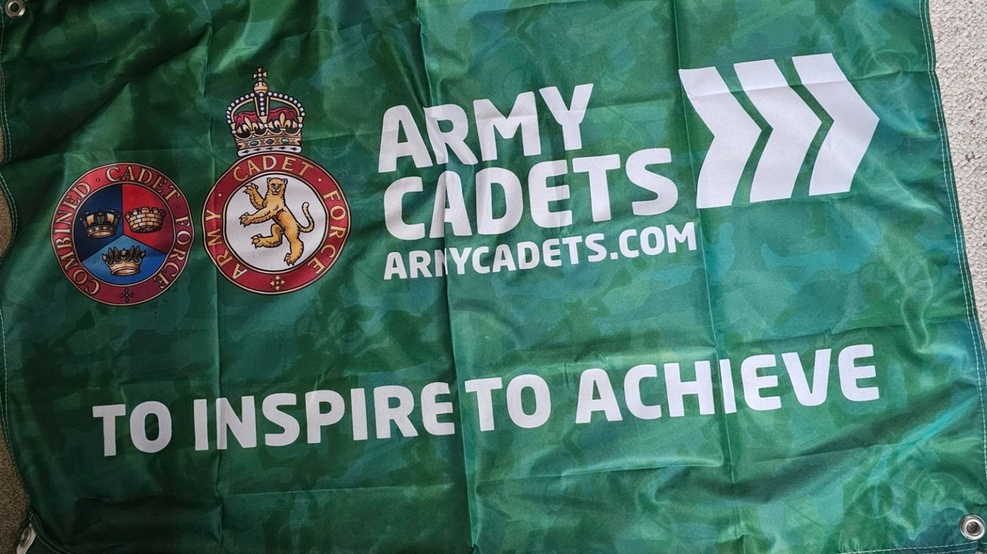
Remember:
[Pg. №]

Slide 10
THANK YOU FOR LISTENING
Any Questions?
[Pg. №]

Slide 11
[Pg. №]

