Slide 1

BioMade: Eco-Friendly Solutions for a Sustainable Future
BioMade is a company dedicated to providing sustainable and eco-friendly alternatives to plastic products. We are committed to reducing plastic waste and promoting a circular economy.
Notes:
1

Slide 2
The Problem: Plastic Pollution
Global Challenge
Bangladesh's Situation
Over 300 million tons of plastic are produced annually, with much of it ending up as waste. Plastic waste takes centuries to decompose, harming wildlife and ecosystems.
Plastic pollution is a growing environmental challenge in Bangladesh, impacting its natural beauty and the livelihoods of its people.
Notes:
2

Slide 3

BioMade's Solution: Biodegradable Alternatives
Sustainable Products
Product Range
Key Benefits
BioMade offers biodegradable, eco-friendly alternatives to plastic products.
Plates, cups, spoons made from bagasse, rice husks, and bamboo fibers. Edible straws made from rice, wheat, and seaweed.
100% compostable, affordable, and sustainable.
Notes:
3

Slide 4
Market Opportunity: Growing Demand for Biodegradable Products
$10B
100%
Market Size
Consumer Awareness
The global biodegradable products market is projected to reach $10 billion by 2025.
Rising consumer awareness and government regulations drive demand.
Notes:
4

Slide 5


Target Audience: Restaurants, Catering Services, and Eco-Conscious Consumers
Restaurants
Eco-Conscious Consumers
BioMade provides sustainable alternatives for restaurants and catering services.
BioMade caters to consumers who are looking for eco-friendly and sustainable products.
Notes:
5

Slide 6

BioMade's Business Model:
Revenue Streams
Pricing Strategy
Distribution Channels
B2B (bulk orders from businesses) and B2C (direct sales).
Competitive pricing for mass adoption.
Online platforms, retail partnerships, and direct sales.

Slide 7
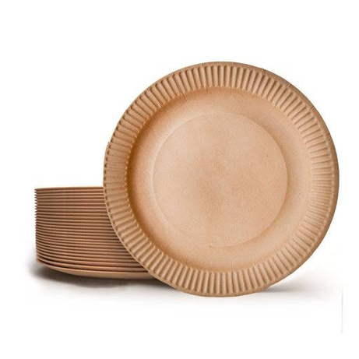
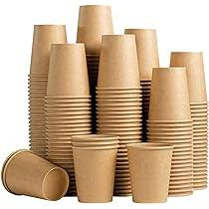

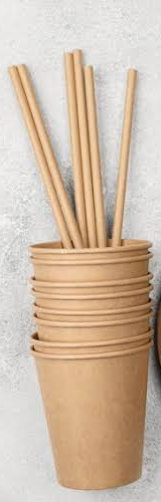
Product Showcase: A Glimpse into BioMade
Biodegradable Plates
Biodegradable Cups
Biodegradable Spoons
Edible Straws
Made from bagasse or rice husks, our plates are durable, microwave-safe, and perfect for both hot and cold foods.
Our cups are designed to hold both hot and cold beverages. Made from sustainable materials, they are a great alternative to disposable plastic cups.
Our plant-based spoons are strong, durable, and perfect for everyday use. They are a great alternative to plastic cutlery
Our straws are made from rice, wheat, or seaweed and come in a variety of flavors. They are a fun and eco-friendly alternative to plastic straws.

Slide 8
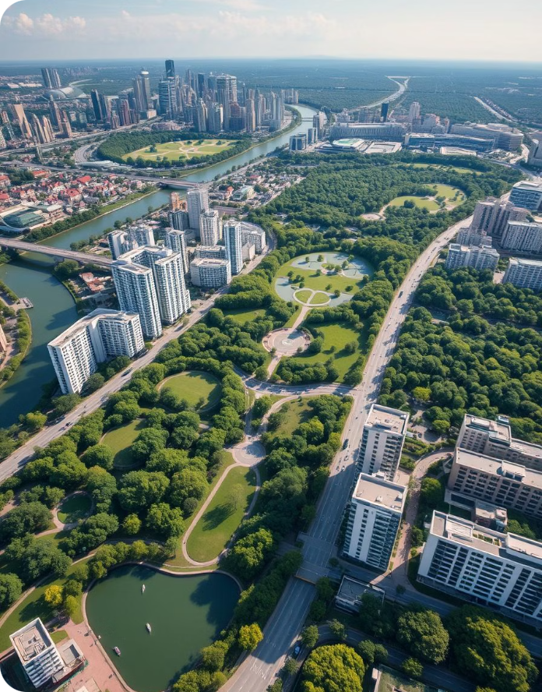



Sustainability Impact:
Waste Reduction
Circular Economy
Reduces plastic waste in landfills and oceans.
Promotes circular economy using agricultural by-products.
Global Sustainability
Contributes to global sustainability goals (e.g., SDGs).

Slide 9
Biodegradable Tableware Production
This presentation outlines the machinery required for a medium-scale biodegradable tableware production facility, utilizing agricultural waste as the primary raw material.The production process involves several stages, each requiring specialized equipment to ensure efficient and high-quality output.

Slide 10
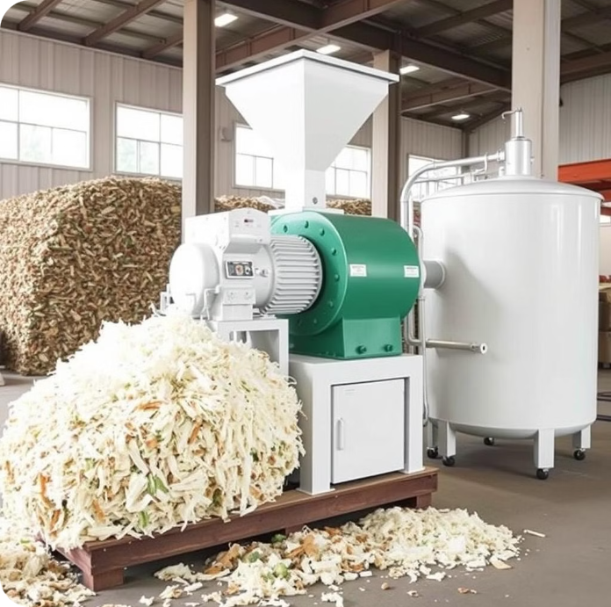
Pulping System
Function
Machines
Converts agricultural waste into pulp.
Hydraulic Pulper
High-Speed Mixer
Pulp Storage Tank

Slide 11
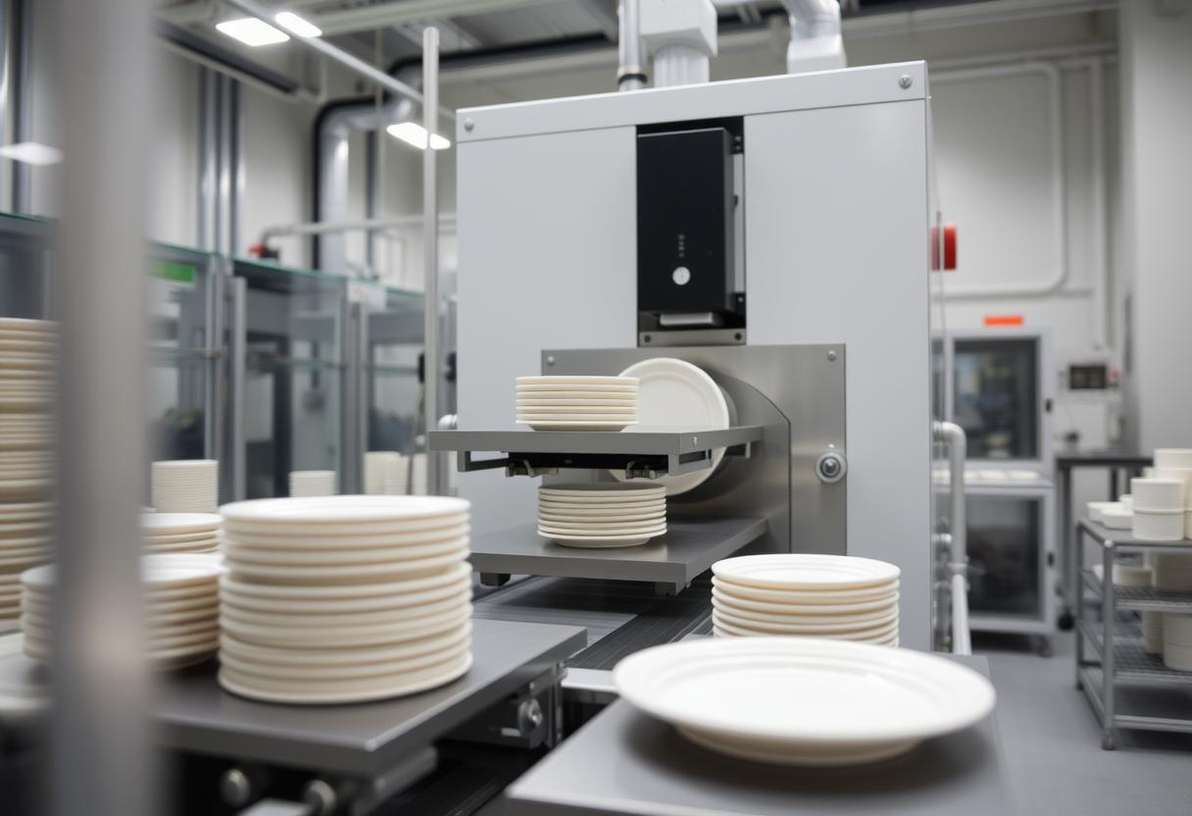
Automatic Forming Machines
Function
Machines
1
2
Shapes pulp into tableware products.
Fully Automatic Forming Machine
Thermoforming Machine
Capacity
3
10,000–50,000 pieces/day.

Slide 12

Drying System
Function
Removes moisture from formed products.
Machines
Tunnel Dryer
Hot Air Drying Oven

Slide 13
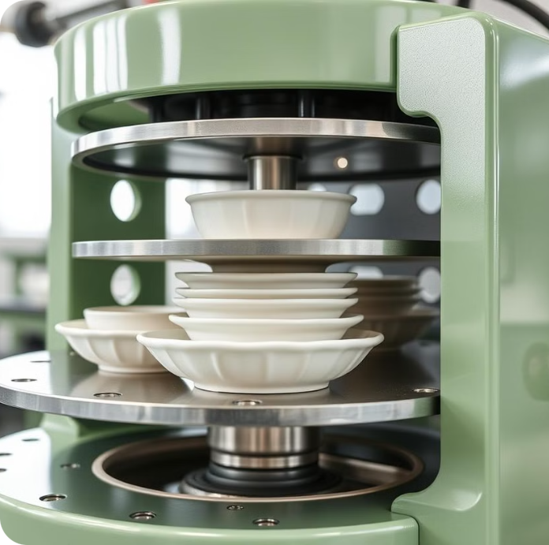


Hot Press Machines
Function
Machine
Improves product surface quality, durability, and strength.
Multi-Cavity Hot Press Machine

Slide 14
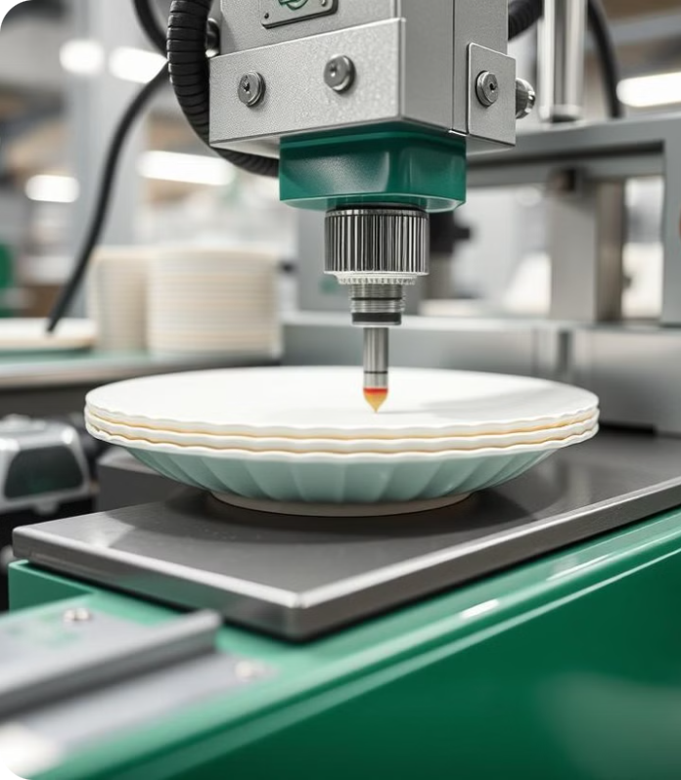
Trimming and Edge-Cutting Machines
Function
1
Trims excess material to achieve the final shape.
Machines
2
Automatic Edge Trimming Machine
Laser Cutter (optional)

Slide 15
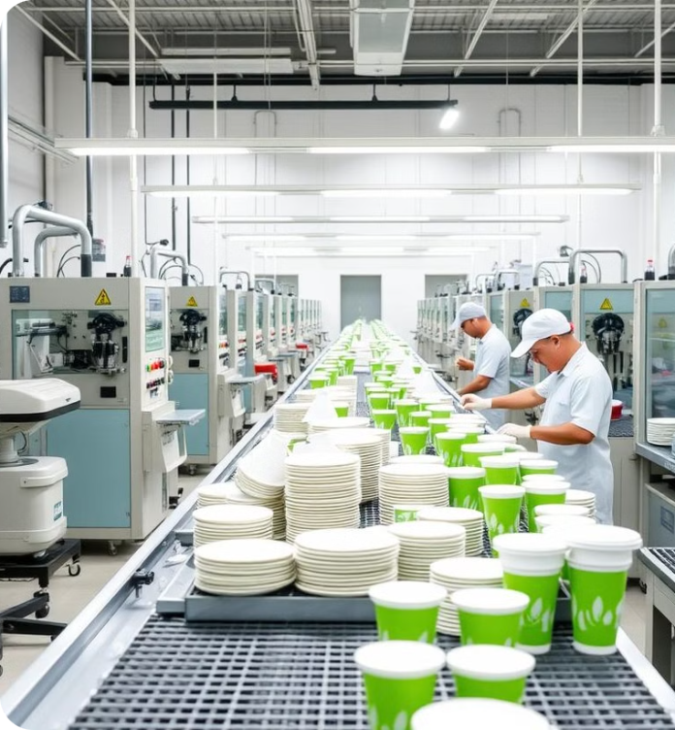


Packaging Machines
Function
Packages finished products for storage or shipment.
Machines
Automatic Sealing and Wrapping Machine
Box Filling Machine (optional)

Slide 16
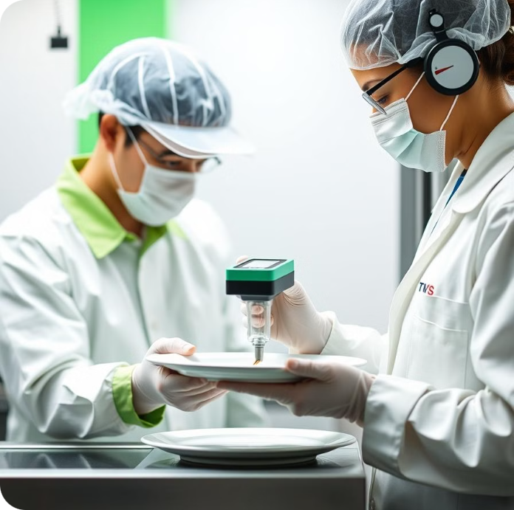
Quality Control Equipment
1
2
Function
Machines
Ensures product quality meets industry standards.
Product Strength Tester
Moisture Content Analyzer

Slide 17
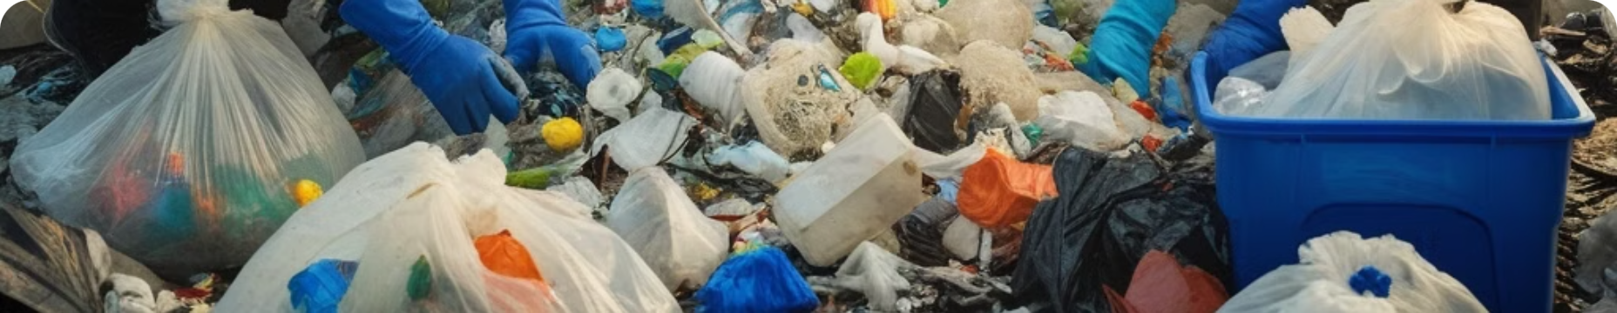
Join the BioMade Movement: Together, Let's Build a Sustainable Future
BioMade invites you to join our movement for a sustainable future. By choosing BioMade's eco-friendly products, you can make a difference in reducing plastic waste and promoting a circular economy.
Notes:
10

Slide 18
Contact Us: Get in Touch with BioMade
BioMade
Contact Information
Address: Dhaka, Bangladesh
Email: jakirhossainjoy77@gmail.com
WhatsApp: +8801707370333
Phone: +8801707370333
Notes:
9

