Slide 1
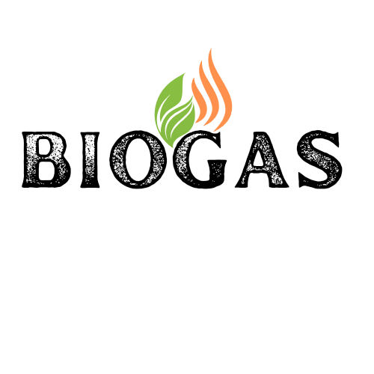


Turning Food Waste into Clean Energy for Bangladesh
Household food waste → Biogas plant → Cylinder gas → Homes & Businesses
📍 Bangladesh | Waste-to-Energy Solution | Circular Economy | SDG 7 & SDG 11
Notes:
1

Slide 2




THE PROBLEM
Bangladesh's Waste & Energy Crisis
15,000+
60-70%
80%
~60M
Tonnes of solid waste
generated daily in BD
Waste is organic /
food-based material
Urban households use
cylinder LPG for cooking
People lack access to
clean cooking fuel
⚡ Dhaka alone generates ~4,500 tonnes/day of waste — yet millions cannot afford clean cooking gas. This gap is our opportunity.
Notes:
2

Slide 3





OUR SOLUTION
01
02
03
04
05
Collect
Process
Purify
Fill
Deliver
Household food waste collection via dedicated bins & daily pickup routes
Anaerobic digestion in biogas plant converts organic matter to methane gas
Gas purification system removes CO₂, H₂S and moisture to cooking-grade purity
Compressed into standard LPG-compatible cylinders (12kg & 35kg)
Distribute to homes, restaurants & industries via dealer network
Notes:
3

Slide 4
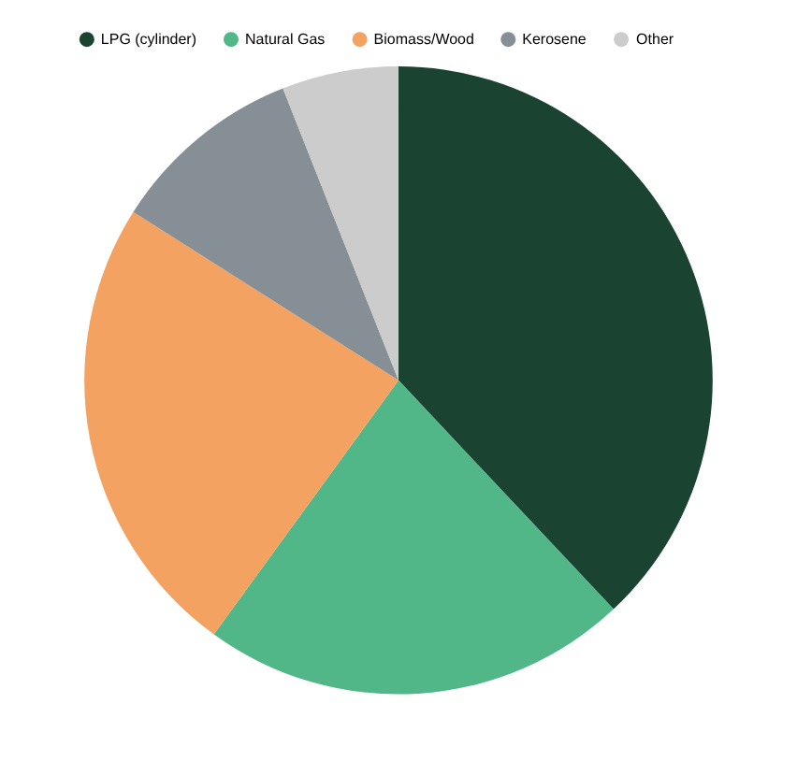
MARKET OPPORTUNITY
Bangladesh LPG Market
Growing at 15% annually; ~4 million cylinder users in Dhaka alone
Government Policy
GoB's National 3R Strategy & Waste Management Policy strongly supports biogas
Urban Population
Dhaka's 22M+ residents generate massive organic waste streams daily
Import Dependency
Bangladesh imports 97% of LPG — domestic biogas reduces import costs
💡 Bangladesh's LPG market is worth USD 800M+ — domestic biogas can capture 5–10% within 5 years
Target Customers
Urban households, restaurants, garment factories, hospitals, schools
Notes:
4

Slide 5




BUSINESS MODEL
Cylinder Gas Sales
Bio-fertilizer Sales
12 kg & 35 kg cylinders sold to households, restaurants & industries via dealer network at BDT 900–1,200/cylinder
Digested slurry (digestate) sold as organic fertilizer to farmers at BDT 8–15/kg — high-value by-product
Waste Collection Fee
Carbon Credits
Municipal partnership fee per tonne of organic waste collected from city wards — BDT 400–700/tonne
Register with Gold Standard / VERRA for carbon credits. Estimated 8,000 tCO₂e/year per 50T plant
Notes:
5

Slide 6
PLANT OPERATIONS & TECHNOLOGY
Phase 1 Plant Specifications
Key Equipment & Process
Feedstock Capacity
50 tonnes/day of organic waste
Waste Reception
Weighbridge, tipping floor, shredder & mixer
Biogas Output
~10,000 m³/day raw biogas
Digester
CSTR anaerobic digester, insulated & heated
Methane Content
55–65% CH₄ after digestion
Gas Cleaning
H₂S scrubber → CO₂ removal (PSA/membrane)
Purified Gas Output
~5,500 m³/day (after cleaning)
Compression
Multi-stage compressor up to 200 bar
Cylinders/Day
~450 units (12 kg equivalent)
Cylinder Filling
Auto-filling manifold with safety cut-offs
Retention Time
25–30 days (HRT)
Quality Testing
GC analysis lab for gas purity certification
Digester Type
Continuous Stirred Tank Reactor
Digestate Handling
Screw press separator + drying for fertilizer
Location
Narayanganj / Gazipur, near Dhaka
Safety Systems
Flame arrestors, gas detectors, emergency vent
Notes:
6

Slide 7
PROJECT PLAN & TIMELINE
Phase 1
Phase 2
Phase 3
Phase 4
Month 1–6
Month 7–12
Month 13–18
Month 19–36
Feasibility & Setup
Construction
Pilot Operations
Full Scale & Expansion
Waste audit & site selection
Plant civil works & installation
Trial runs at 30% capacity
Ramp to 100% capacity
Legal registration & permits
Equipment procurement
Quality testing & QC setup
Second plant planning
Municipal MOU signing
Staff recruitment & training
Dealer network onboarding
Export to rural dealerships
Detailed engineering design
Safety certification & testing
Carbon credit registration
Fertilizer market development
Notes:
7

Slide 8
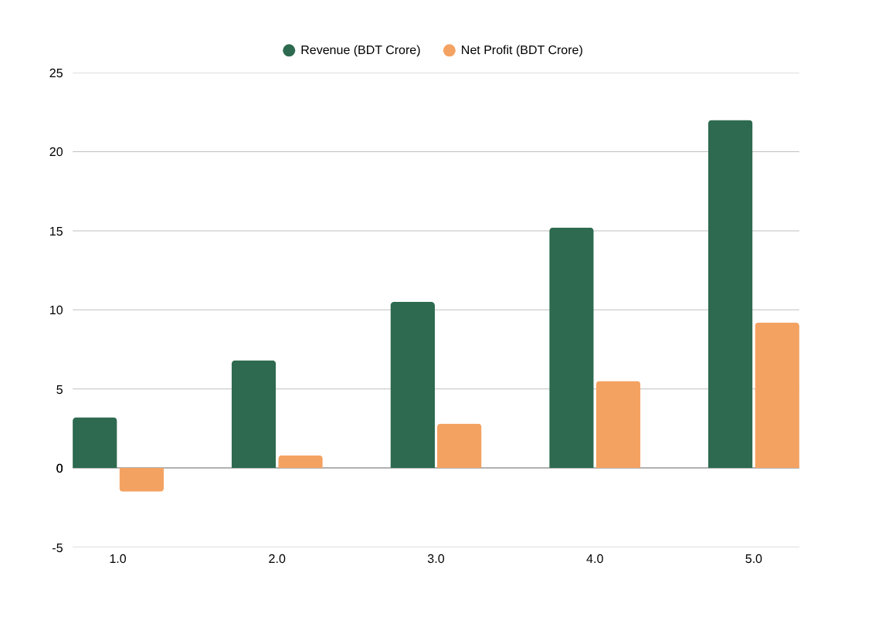
FINANCIAL PROJECTIONS
Initial Investment (Phase 1 Plant)
Land & Civil Works
BDT 2.5 Crore
Biogas Digester
BDT 3.0 Crore
Gas Purification Unit
BDT 1.8 Crore
Compression & Filling
BDT 1.5 Crore
Cylinder Fleet (500)
BDT 0.75 Crore
Vehicles & Equipment
BDT 0.9 Crore
Working Capital
BDT 1.05 Crore
3.5 Yrs
28%
Month 22
BDT 22Cr
TOTAL CAPEX
BDT 11.5 Crore
Payback Period
IRR
Break-even
Y5 Revenue
Notes:
8

Slide 9






GO-TO-MARKET STRATEGY
Waste Collection Network
Dealer Distribution Channel
Restaurant & Hotel B2B
Partner with Dhaka North/South City Corporation & Narayanganj City Corporation for designated waste collection zones. Target residential areas generating 2+ tonnes/day organic waste.
Recruit 50+ authorized dealers in Year 1 across Dhaka, Chittagong & Narayanganj. Provide dealer financing, cylinder stock & marketing support.
Direct supply agreements with 200+ restaurants, hotels & food courts who are heavy gas consumers. Offer 10% discount vs market LPG price.
Brand & Awareness Campaign
Government & Institutional Sales
Digital Platform
Position as Bangladesh's first household-waste biogas brand. Social media, TV ads emphasizing green credentials. Partner with NGOs for community buy-in.
Supply government offices, hospitals, schools & army cantonments via tender/procurement. Leverage GoB waste-to-energy policy support.
Mobile app for cylinder ordering, delivery tracking & waste pickup scheduling. Enable cashless payments & subscription model for regular customers.
Notes:
9

Slide 10


ENVIRONMENTAL & SOCIAL IMPACT
18,250 tonnes
12,000 tCO₂e
1,650 Families
Organic waste diverted from landfill per year (50T/day × 365)
Greenhouse gases avoided annually vs landfill methane emissions
Urban households supplied with clean cooking gas daily (Year 1)
150+ Jobs
BDT 18Cr
SDG 7, 11, 13
Direct & indirect employment created in collection, operations & distribution
Annual LPG import substitution savings for Bangladesh in Year 3
Contributes to Clean Energy, Sustainable Cities & Climate Action goals
Notes:
10

Slide 11
RISK ASSESSMENT & MITIGATION
Risk
Level
Mitigation Strategy
Feedstock Supply Variability
Multi-ward collection agreements + market food waste backup contracts with wet markets & restaurants
Medium
Regulatory & Permit Delays
Early engagement with DoE, BIDA & City Corporations; hire experienced compliance consultant
Medium
Competition from LPG Importers
Price 10–15% below market LPG; market green credentials; focus B2B contracts
Medium
Technology & Operational Risk
Commission proven Indian/Chinese CSTR technology; hire 2 experienced biogas engineers
Low
Gas Quality Below Standard
Install inline gas analyser; stringent QC before any cylinder is filled
Low
Fire / Safety Incident
Full NFPA & Bangladesh BGFCL safety standards; regular drills; comprehensive insurance
Low
Notes:
11

Slide 12
JOIN THE GREEN REVOLUTION
Invest in Bangladesh's
Cleanest Energy Future
We are seeking BDT 11.5 Crore in seed investment to build Bangladesh's
first commercial household food-waste biogas cylinder plant.
Equity Investment
Debt Financing
Grant / GoB Support
BDT 6 Crore
(52% stake)
BDT 4 Crore
(Green Bond / Bank)
BDT 1.5 Crore
(IDCOL / SREDA)
📧 jakirhossainjoy77@gmail.com | 📞 /Whatsapp: +8801707370333 | 📍 Dhaka, Bangladesh
Notes:
12

