Slide 1
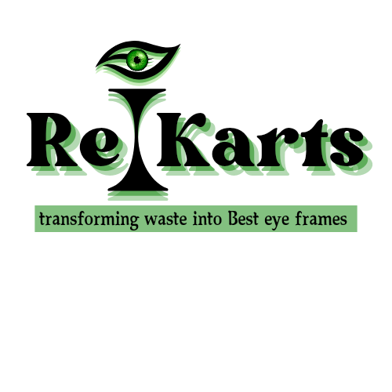

Transforming Waste Into Best Eye Frames
Sustainable Eyewear Innovation | Dhaka, Bangladesh
Founder: Jakir Hossain Joy
Notes:
1

Slide 2



THE PROBLEM
Global Plastic Crisis
Non-Recyclable Plastics
Wood Waste Ignored
Millions of tonnes of plastic waste accumulate in landfills and oceans each year, with no scalable solution in sight.
All types of plastic waste — bottles, containers, packaging — remain largely unrecycled due to lack of efficient technology.
Wood offcuts and sawdust from furniture & construction industries go to waste, representing an untapped raw material opportunity.
Notes:
2

Slide 3




OUR SOLUTION
Re|Karts converts ALL plastic & wood waste into premium eyewear
All Plastic Types
Wood Waste
PET, HDPE, PVC, LDPE, PP, PS — we process all plastic waste streams, not just chip packets.
Sawdust & offcuts from furniture factories, construction sites, and timber mills become premium wood-frame sunglasses.
Eco-Friendly Process
Premium Products
Energy-efficient processing with near-zero emissions. A circular economy model from collection to product.
Durable, stylish, customizable sunglasses frames — both recycled plastic and reclaimed wood variants.
Notes:
3

Slide 4
RAW MATERIALS
♻ PLASTIC WASTE TYPES
🪵 WOOD WASTE TYPES
PET (Bottles, packaging)
HDPE (Containers, pipes)
PVC (Pipes, window frames)
LDPE (Bags, film packaging)
PP (Caps, straws, chip packets)
PS (Foam cups, disposables)
Mixed / Multilayer packaging
Sawdust (furniture factories)
Wood offcuts & trimmings
Construction timber scrap
Plywood & MDF offcuts
Bamboo waste
Cork & natural wood chips
Notes:
4

Slide 5
PRODUCTION PROCESS
Two parallel recycling pipelines — Plastic & Wood
01
02
03
04
05
Collection
Sorting & Cleaning
Processing
Molding & Shaping
QA & Finishing
Plastic waste & wood offcuts gathered from households, factories, restaurants, and construction sites.
Materials sorted by type, thoroughly cleaned and contaminant-free before processing.
Plastic: Shredded → Pelletized. Wood: Ground into composite powder or laminated sheets.
Injection molding for plastic frames. CNC cutting + hand finishing for wood frames.
Surface treatment, polishing, hinge fitting, quality control checks and branding.
★ Proprietary techniques ensure durable, premium quality in both plastic and wood frame variants
Notes:
5

Slide 6
OUR PRODUCTS
Recycled Plastic Frames
Reclaimed Wood Frames
Stationery & Accessories
Made from all plastic types (PET, HDPE, PP, etc.)
Lightweight & durable
100+ customizable colors & finishes
UV-resistant coating
Hypoallergenic surface treatment
Crafted from sawdust composite & offcuts
Natural grain aesthetics
Unique one-of-a-kind patterns
Lightweight bamboo variants available
Hand-finished & polished
Pens, rulers & clips from plastic waste
Notebook covers from wood composite
Corporate branded merchandise
Educational institution supply
Fully customizable bulk orders
Notes:
6

Slide 7
MARKET OPPORTUNITY
$197B
73%
$38B
Global Eyewear Market 2024
Consumers prefer eco brands
Sustainable fashion market
Growing at 8.5% CAGR
Nielsen Global Survey
Asia Pacific segment growing
TARGET CUSTOMER SEGMENTS
Eco-conscious individual buyers
Sustainable fashion brands seeking eco-sourced frames
Optical retailers & eyewear chains
Corporate CSR gifting programs
NGOs & government sustainability initiatives
Educational institutions (stationery)
Notes:
7

Slide 8
BUSINESS MODEL
💰 REVENUE STREAMS
📊 COST STRUCTURE
Direct B2C Sales
Raw Materials
Online & retail sales of plastic and wood sunglasses frames directly to consumers.
Plastic & wood waste (low-cost/free from partners)
Machinery & Equipment
B2B Bulk Supply
Shredders, pelletizers, injection molds, CNC machines
Supply frames to eyewear brands, optical chains, and fashion retailers.
Facility & Operations
Technology Licensing
Processing facility, utilities, maintenance
License recycling process & IP to manufacturers globally.
Labor
Skilled technicians, quality control, admin
Waste Collection Fees
Partner with municipalities and factories to collect waste — generating revenue at source.
Sales & Marketing
Brand building, digital marketing, B2B outreach
Notes:
8

Slide 9
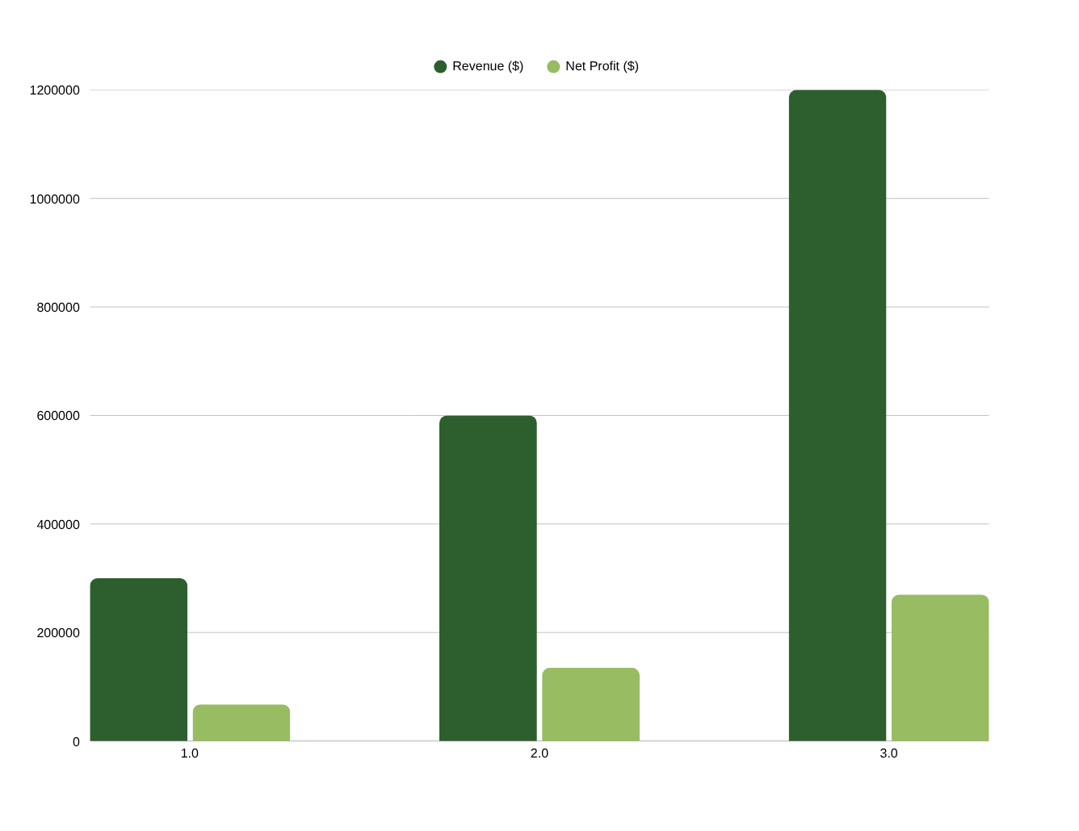
FINANCIAL PROJECTIONS
$300K
$600K
Year 1 Revenue
Year 2 Revenue
$1.2M
40-50%
Year 3 Revenue
Gross Margin
20-25%
Month 14
Net Margin
Break-even
Notes:
9

Slide 10



SOCIAL & ENVIRONMENTAL IMPACT
100+ tons/yr
60% lower
Waste Diverted
Carbon Reduction
Diverts plastic and wood waste from landfills and oceans annually at full capacity.
Compared to virgin plastic manufacturing. Circular production dramatically cuts carbon footprint.
50+ jobs
5 Goals
Jobs Created
SDG Alignment
Direct employment in collection, processing, and manufacturing — boosting local communities.
Supports UN SDGs: No Poverty, Good Health, Decent Work, Industry & Innovation, Climate Action.
Notes:
10

Slide 11

OUR TEAM
Recycling Engineer
Product Designer
Expert in plastic & wood processing technology, machinery operation, and process optimization.
Specializes in eyewear aesthetics, ergonomics, and sustainable material design.
Marketing Lead
Supply Chain Manager
Jakir Hossain Joy
Builds brand presence across eco-conscious markets and manages brand partnerships.
Manages waste collection networks, supplier relationships, and logistics.
Founder & CEO
Experienced in sustainable product development
Passionate about eco-friendly innovations
Leading ReiKarts from concept to market
Notes:
11

Slide 12
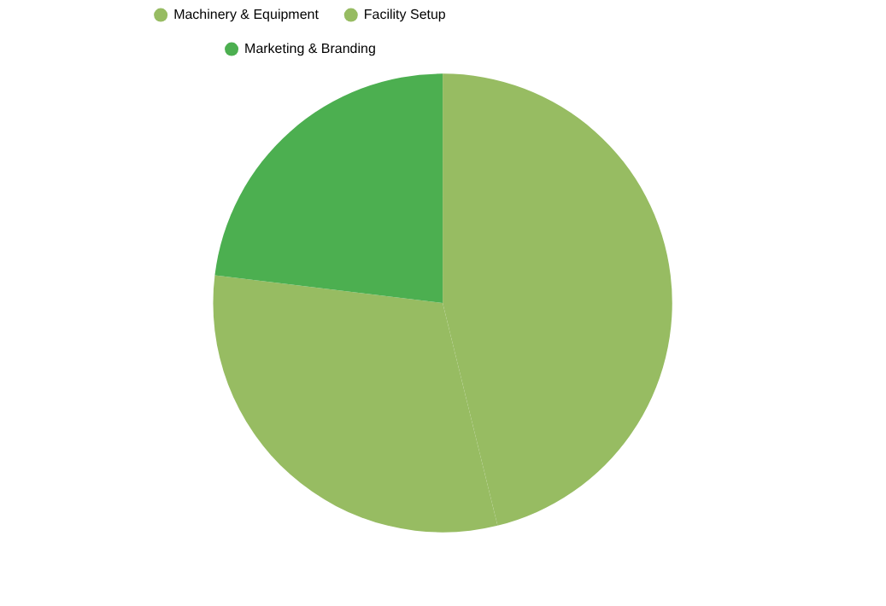
FUNDING ASK
$260,000
SEED FUNDING REQUIRED
Machinery & Equipment 46%
$120,000 — Shredders, pelletizers, injection molds, CNC machines, QA tools
Facility Setup 31%
$80,000 — Factory lease, utilities, storage, safety systems
Marketing & Branding 23%
$60,000 — Brand identity, digital marketing, trade shows, partnerships
Notes:
12

Slide 13





JOIN THE MOVEMENT
Partner with Reikarts to transform waste into premium eyewear
and build a sustainable future for fashion
Email
Phone / WhatsApp
Location
jakirhossainjoy77@gmail.com
+880 1707 370 333
Dhaka, Bangladesh
Re|Karts — Transforming Waste Into Best Eye Frames
Notes:
13

