Slide 1
Java多线程----锁

Slide 2
两种锁
1.Synchronized
2.Lock

Slide 3
Synchronized
synchronized是Java中的关键字，是一种同步锁。它修饰的对象有以下两种：
修饰一个代码块，被修饰的代码块称为同步语句块
修饰一个方法，被修饰的方法称为同步方法

Slide 4
Synchronized
1.同步代码块格式：
synchronized(同步对象){
需要同步的代码;
}
2.同步方法定义格式：
synchronized 方法返回值 方法名(参数列表) {}

Slide 5

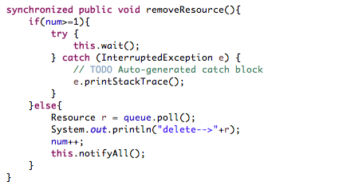
Synchronized
1.同步代码块
2.同步方法

Slide 6
Synchronized
Synchronized与wait(),notifiy(),notifyAll()方法配合使用实现线程间的相互唤醒

Slide 7
Synchronized
Java.lang.Object.wait()
Causes the current thread to wait until another thread invokes the java.lang.Object.notify() method or the java.lang.Object.notifyAll() method for this object.
The current thread must own this object's monitor. The thread releases ownership of this monitor and waits until another thread notifies threads waiting on this object's monitor to wake up either through a call to the notify method or the notifyAll method. The thread then waits until it can re-obtain ownership of the monitor and resumes execution.

Slide 8
Synchronized
Java.lang.Object.notify()
Wakes up a single thread that is waiting on this object's monitor. If any threads are waiting on this object, one of them is chosen to be awakened. The choice is arbitrary and occurs at the discretion of the implementation. A thread waits on an object's monitor by calling one of the wait methods.

Slide 9
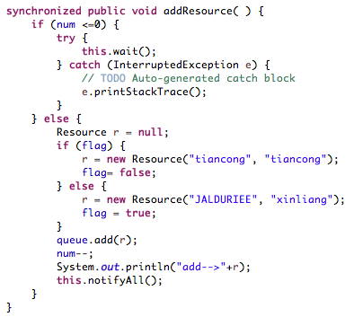
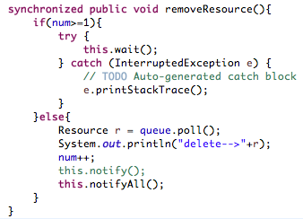
Synchronized

Slide 10
Lock

