Slide 1
UCI Online Retail
Business Data Analysis — Executive Insights
Prepared by: Abdeljalil El Khyati
Lead Data Analyst | September 2026
UCI Online Retail Dataset — ID 352

Slide 2
Executive Summary
Four signals define the business story
£10.64M
£10.11M
4,338
£1.50M
Valid transaction revenue
Clean physical-product revenue
Known customers
November 2011 peak
KEY FINDINGS
Seasonality: November 2011 was the highest observed month at £1.50M.
Customer concentration: the top 26% of known customers generated 80% of known-customer revenue; Gini = 0.716.
Geographic concentration: the United Kingdom represented 84.59% of revenue and 90.0% of Champions.
Retention signal: 1,188 customers were classified as Potential Loyalists / At Risk; their historical revenue baseline was approximately £689K.
Core message: revenue is substantial, but concentration and customer recency deserve management attention.
UCI Online Retail Analysis | Abdeljalil El Khyati | September 2026

Slide 3
Data Integrity & Critical Decisions
The final dataset is traceable from raw transactions to physical-product analysis
541,909
524,878
522,728
£0.00
Raw transactions
Valid sales rows
Physical-product rows
Revenue reconciliation difference
KEY QUALITY DECISIONS
Missing CustomerID: 24.93% of raw records are treated as Unknown for customer-level analysis.
Exact duplicates: 5,268 rows removed before analytical calculations.
Extreme outlier isolated: PAPER CRAFT , LITTLE BIRDIE — 80,995 units and £168,469.60.
Operational items separated from merchandise analysis: £362,103.47.
Final physical-product dataset: 522,728 rows and £10,111,537.73.
December 2011 is incomplete: the dataset ends on 9 December, so it is not treated as a full-month observation.
Validation result: row difference = 0 and revenue difference = £0.00.
UCI Online Retail Analysis | Abdeljalil El Khyati | September 2026

Slide 4
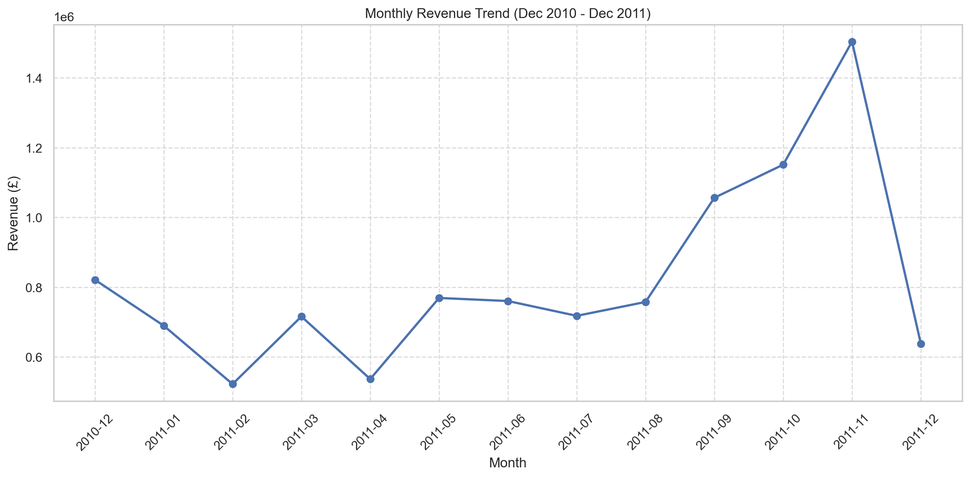
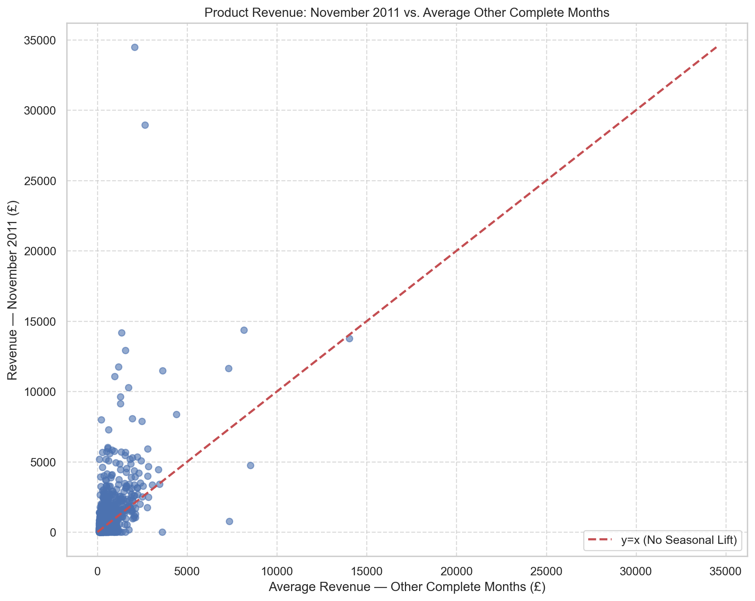
Key Finding 1 — November Revenue Peak
The November spike is accompanied by a clear change in product mix
November 2011: £1,503,866.78
RABBIT NIGHT LIGHT generated £34,478.40 with a seasonal lift of £32,409.02.
UCI Online Retail Analysis | Abdeljalil El Khyati | September 2026

Slide 5
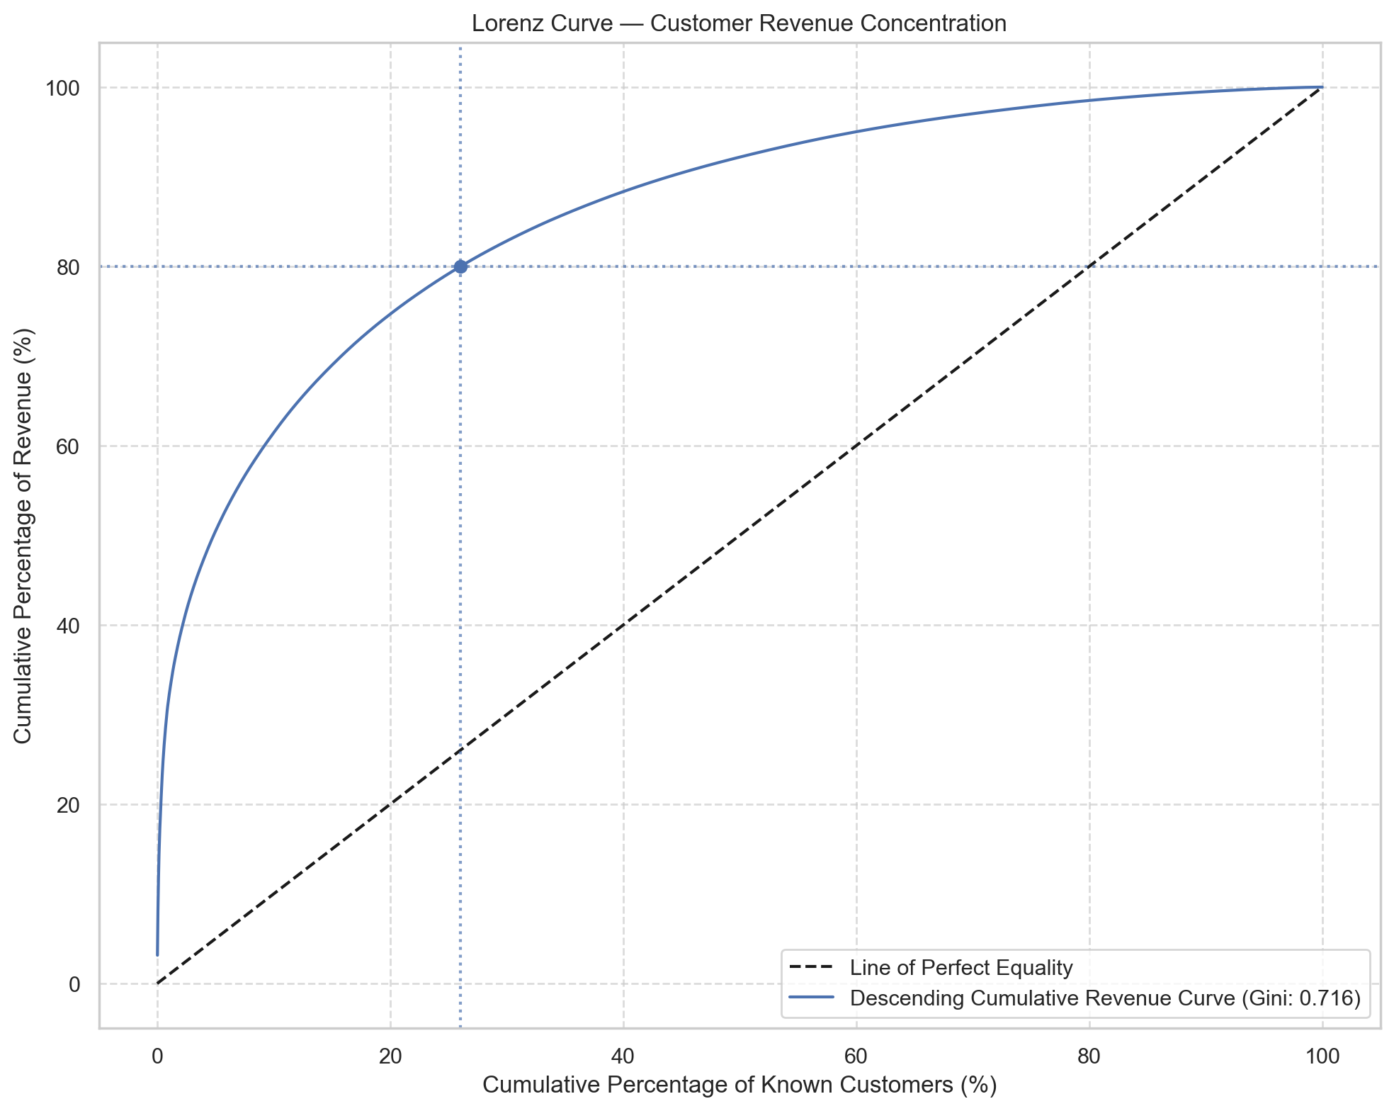
Key Finding 2 — Customer Concentration & RFM
Revenue is concentrated, while customer behaviour reveals four distinct groups
26%
80%
Top customer share
Known-customer revenue generated
0.716
2,073
Gini coefficient
At Risk + Lost customers
Champions
Loyal Customers
Potential Loyalists / At Risk
Lost / Hibernating
1,243 customers
1,022 customers
1,188 customers
885 customers
Recency: 18 days
Frequency: 10.0
Monetary: £5,465
Recency: 55 days
Frequency: 3.2
Monetary: £1,176
Recency: 102 days
Frequency: 1.6
Monetary: £580
Recency: 223 days
Frequency: 1.1
Monetary: £228
UCI Online Retail Analysis | Abdeljalil El Khyati | September 2026

Slide 6
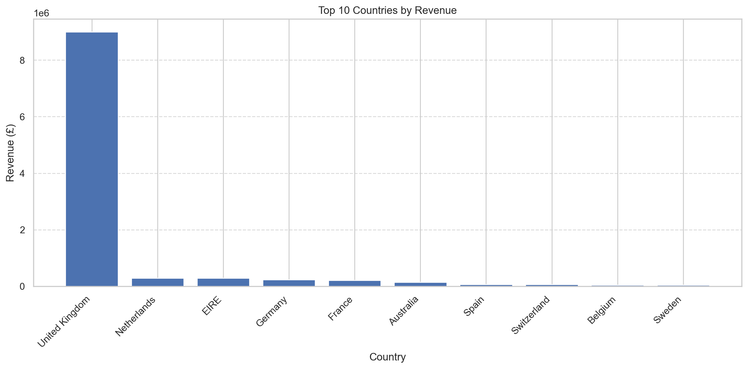
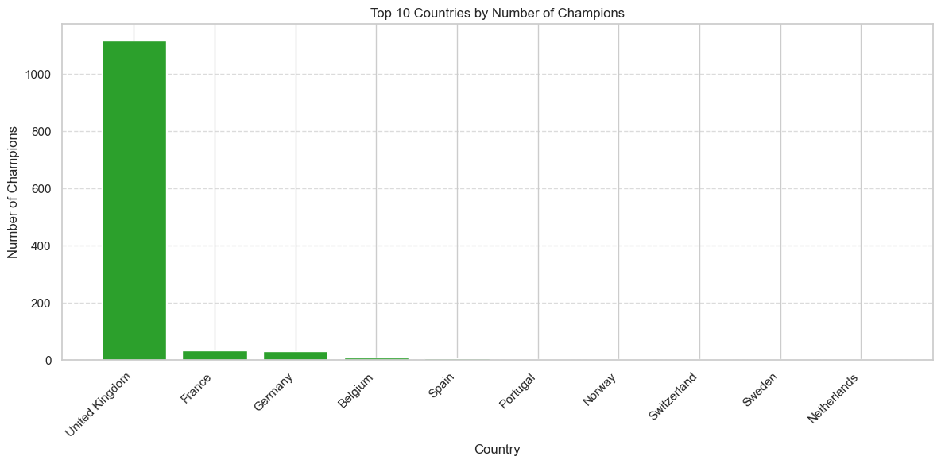
Key Finding 3 — Geographic Concentration
The United Kingdom dominates both revenue and the Champion customer base
84.59%
1,119
35
33
United Kingdom revenue share
UK Champions
France Champions
Germany Champions
UCI Online Retail Analysis | Abdeljalil El Khyati | September 2026

Slide 7
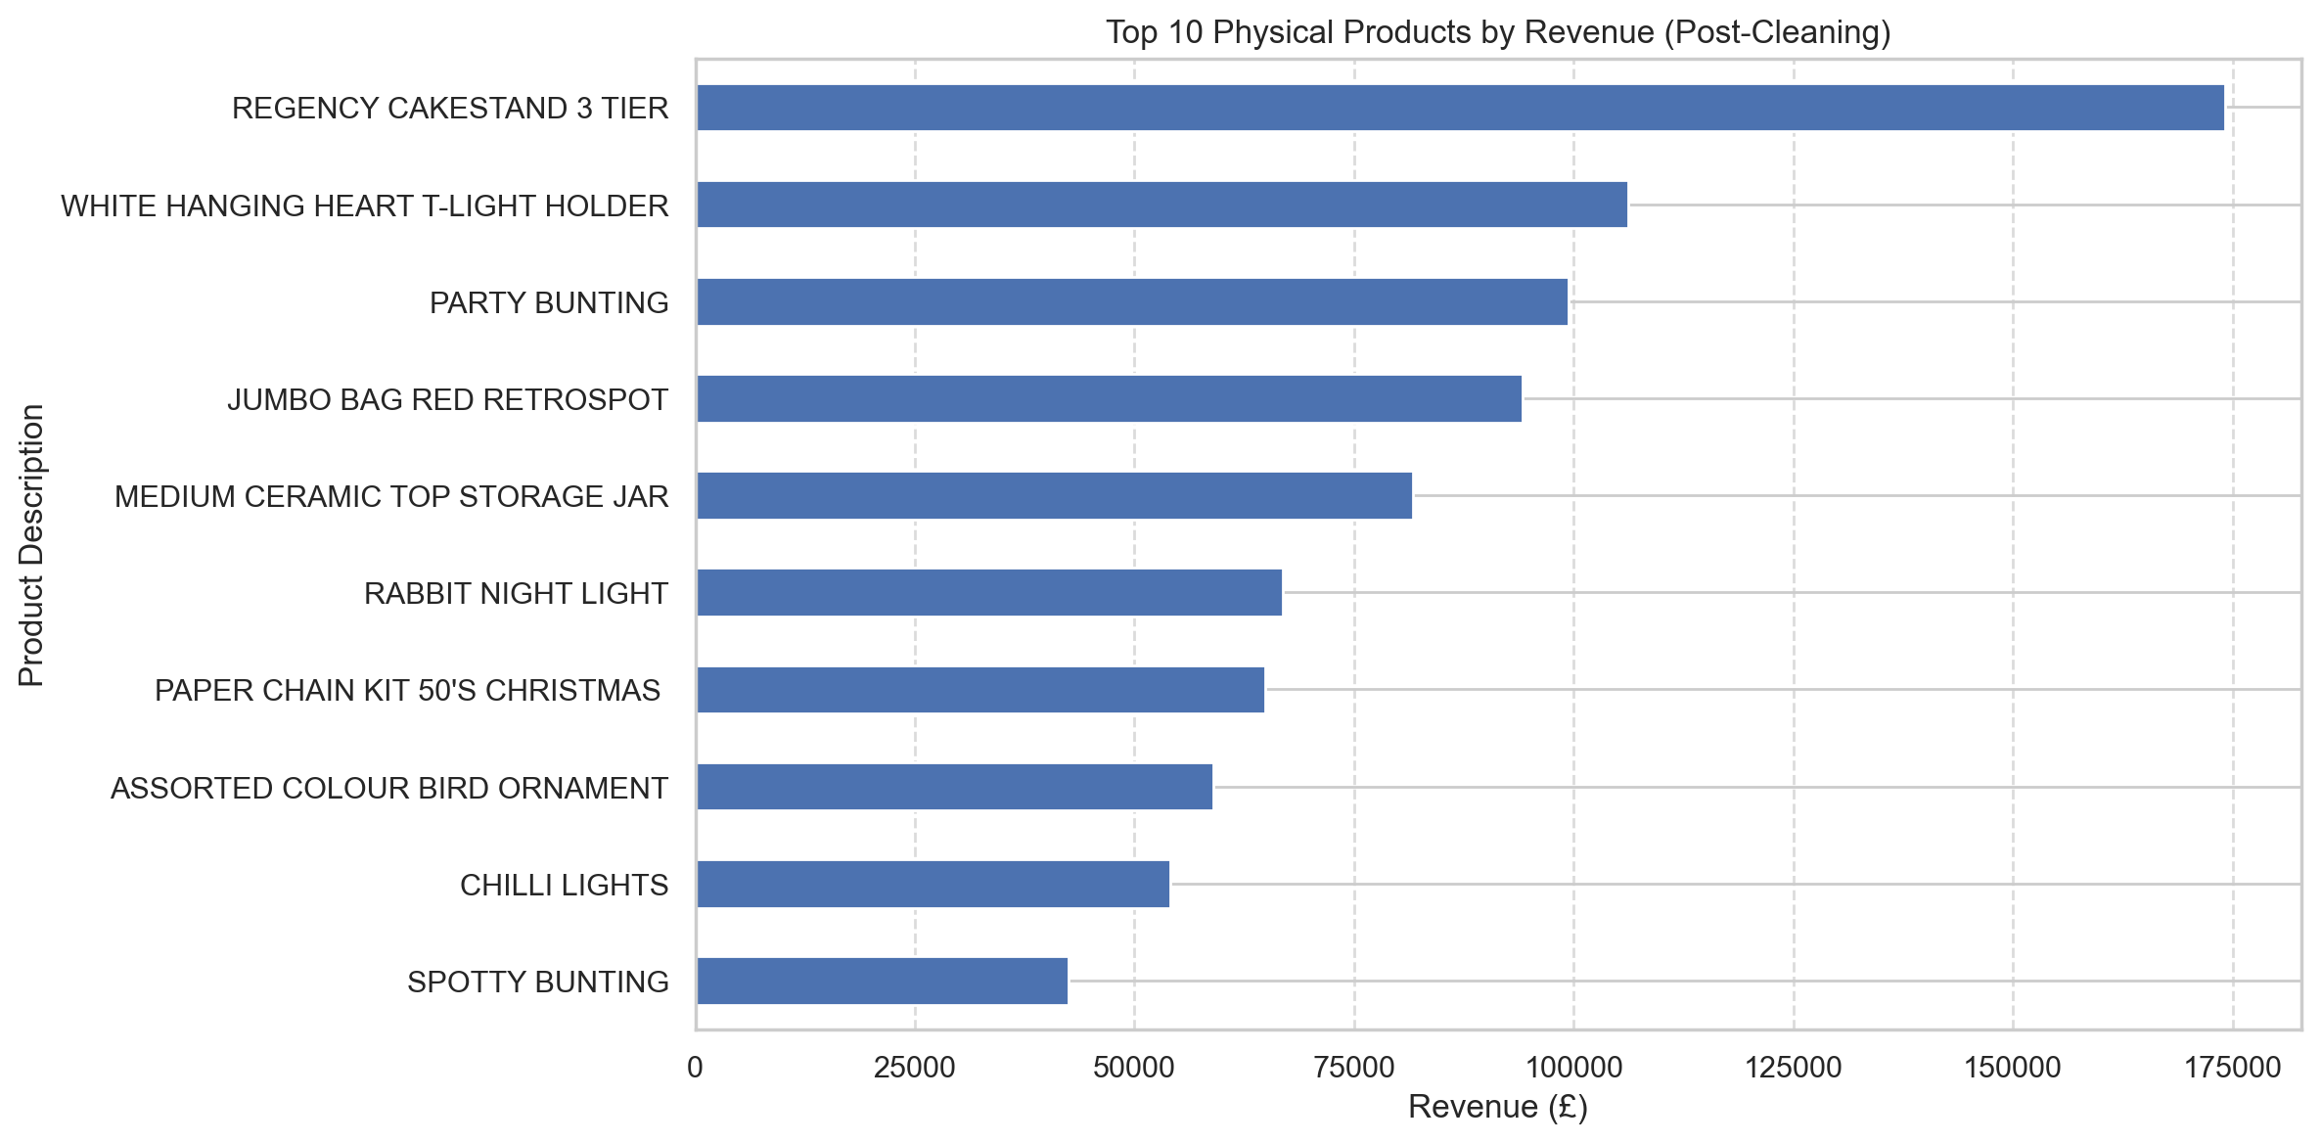
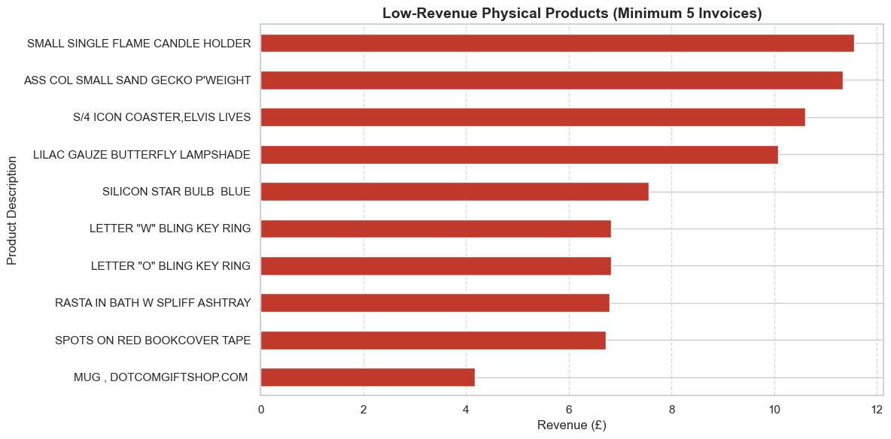
Product Portfolio — Winners & Low-Revenue Tail
Strong sellers coexist with a small group of very low-revenue products
Top product: REGENCY CAKESTAND 3 TIER
£174,156.54 across 1,988 invoices.
Top 3 physical products account for approximately 3.8% of clean physical-product revenue.
Low-revenue tail: candidates for product/catalog review.
The dataset does not contain inventory cost or storage-cost data.
UCI Online Retail Analysis | Abdeljalil El Khyati | September 2026

Slide 8
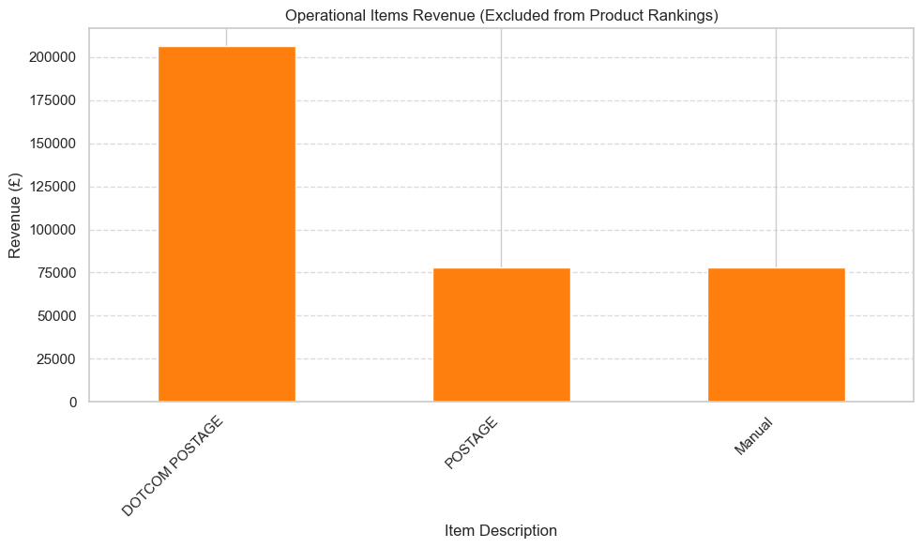
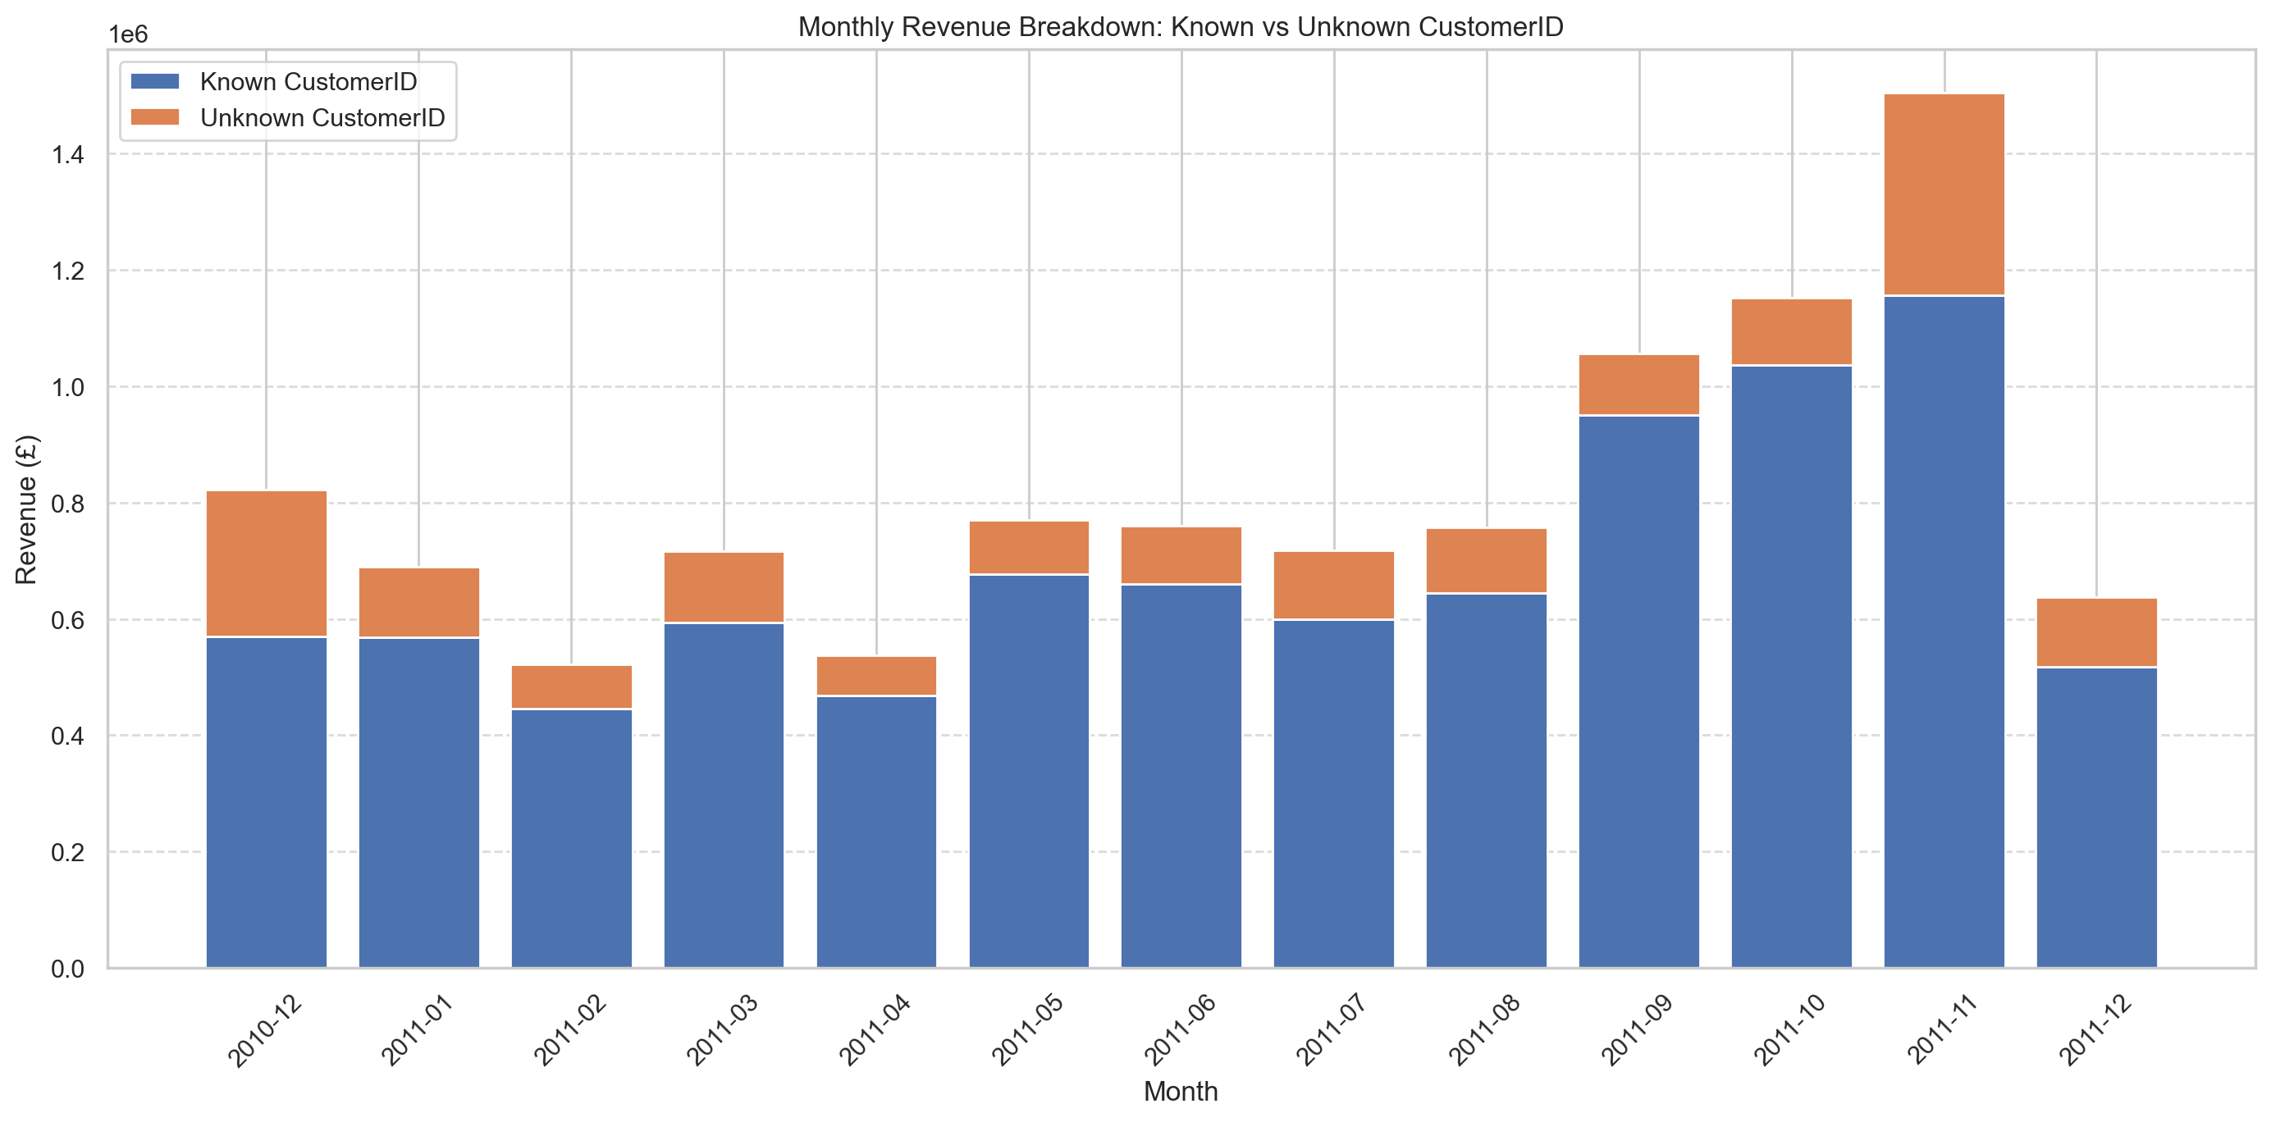
Operational Revenue & Unknown Customer Activity
Separating merchandise performance from non-product revenue and unidentified customer activity
£362K
16.5%
£1.75M
Operational revenue
Revenue linked to Unknown CustomerID
Revenue from unidentified customer transactions
UCI Online Retail Analysis | Abdeljalil El Khyati | September 2026

Slide 9
Recommended Action Areas
Actions are framed as testable business responses to observed evidence
1. CUSTOMER RETENTION
2. SEASONAL PLANNING
3. CONCENTRATION & PORTFOLIO REVIEW
Segment the 1,188 Potential Loyalists / At Risk customers for targeted retention tests.
Use the historical £689K revenue baseline as context, not as a guaranteed recovery forecast.
Compare campaign performance against a control group before scaling.
Use the November product-mix shift to support seasonal planning.
Monitor RABBIT NIGHT LIGHT and the top seasonal-lift products before the next peak period.
Separate recurring high-volume demand from products whose performance is concentrated in November.
Monitor UK concentration: 84.6% of revenue and 1,119 Champions.
Evaluate international markets using both revenue and customer counts, especially where sample sizes are small.
Review the low-revenue product tail before making catalog or inventory decisions.
UCI Online Retail Analysis | Abdeljalil El Khyati | September 2026

Slide 10
Next Steps for Management
The current analysis identifies where deeper analysis should begin
01
Retention testing
02
Customer lifetime value
Measure campaign lift among Potential Loyalists / At Risk customers.
Estimate the long-term value of Champions and Loyal Customers.
03
Cohort retention
04
Market basket analysis
Measure customer retention by acquisition period and identify changing patterns.
Identify products frequently purchased together for cross-selling analysis.
05
Unknown customer analysis
Investigate the origin and conversion potential of transactions without CustomerID.
UCI Online Retail Analysis | Abdeljalil El Khyati | September 2026

Slide 11
Thank You
Questions & Discussion
Abdeljalil El Khyati
Lead Data Analyst
UCI Online Retail Dataset — ID 352
Analysis conducted using Python, Pandas, Matplotlib and Seaborn.
Implementation assistance: Qwen,ai / ChatGPT .

