Slide 1
Pluto Frame Capture
Coherency vs Frame Length
January 26, 2020

Slide 2
Test Frame-to-Frame Coherency
It was observed that multiple frame captures are not always contiguous
A simple experiment was devised by transmitting a 10 kHz carrier offset then at the receiver creating a 10 kHz complex sinusoid at -10 kHz
The idea being to convert the received signal to a complex constant, assuming the transmit clock and receive clocks are synchronous
The examples that follow look at the real part following the complex product of the received signal and the local reference
This testing was done in a simple for-loop; would aync and await resolve this?

Slide 3
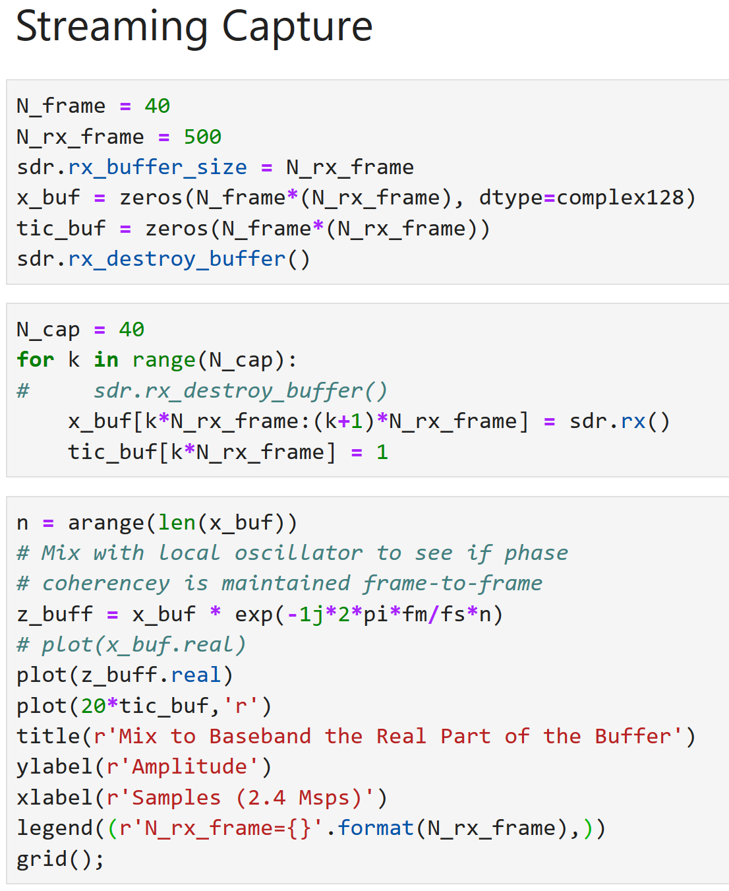
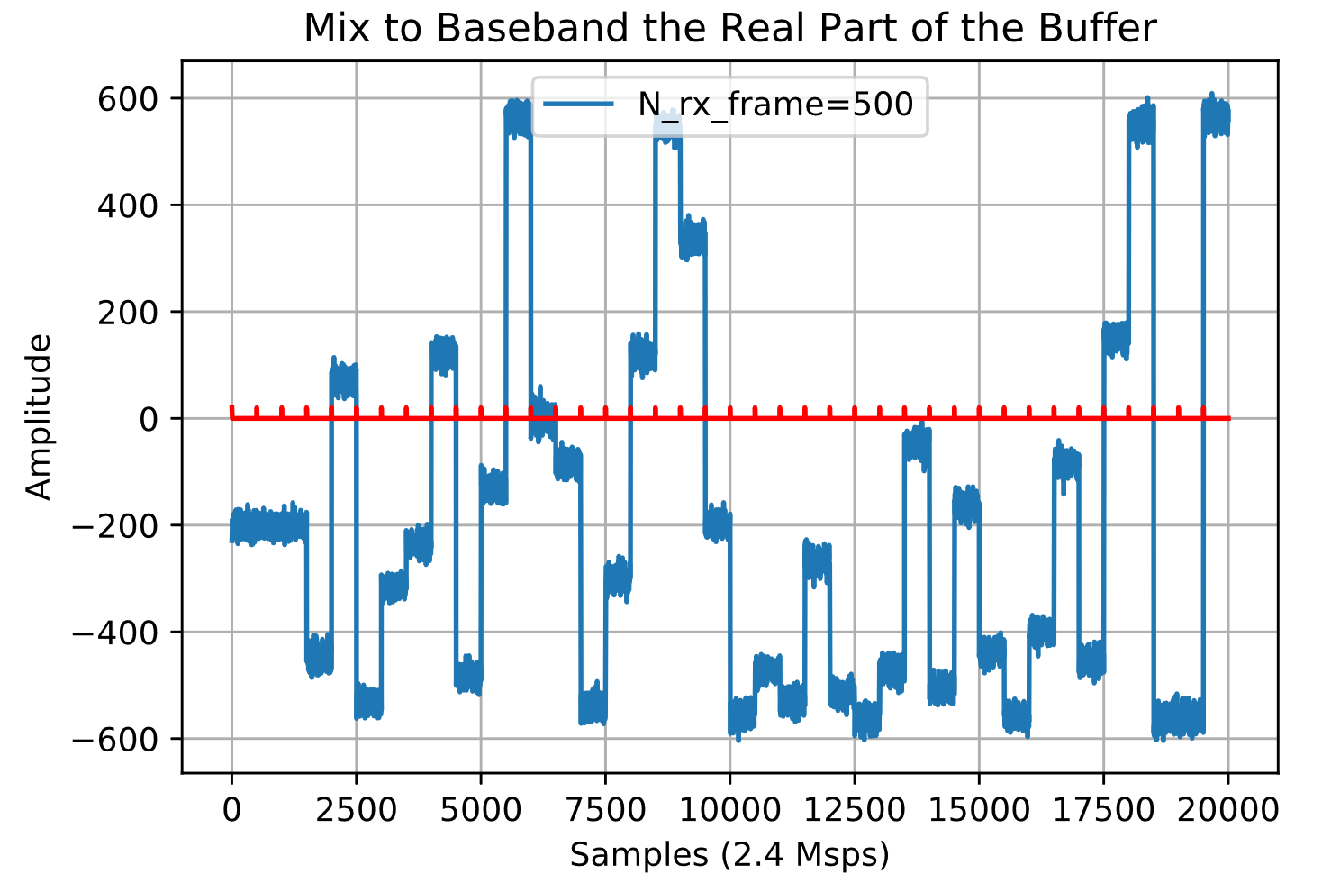
N_rx_frame = 500
The red trace with ticks shows the frame boundaries
Almost every frame starts with a discontinuity

Slide 4
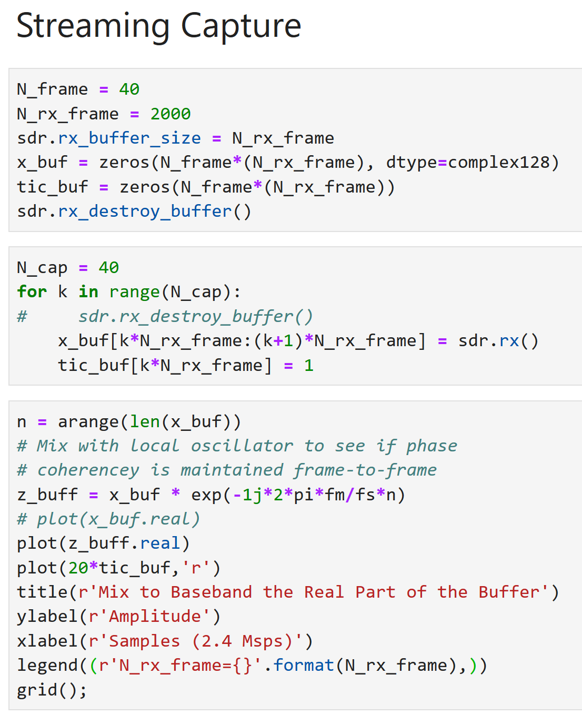
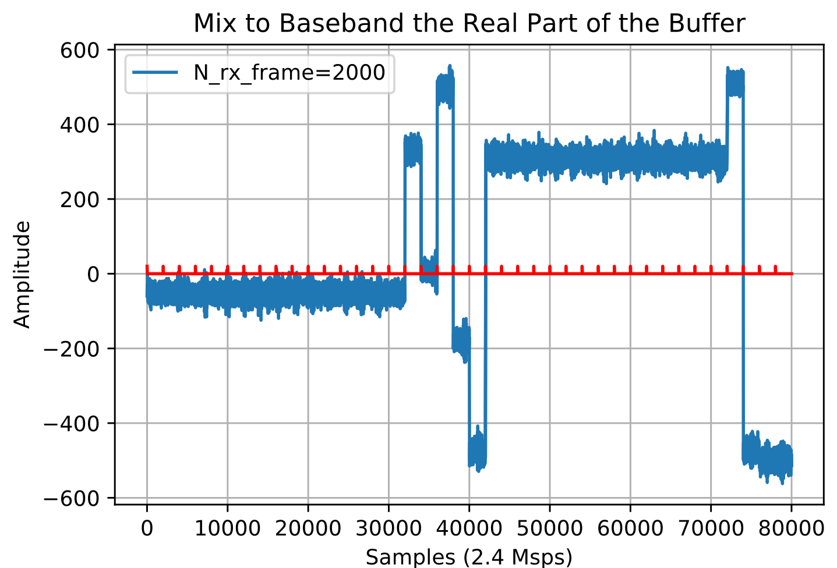
N_rx_frame = 2000
Increasing the frame length from 500 to 2000 helps, but still issues

Slide 5
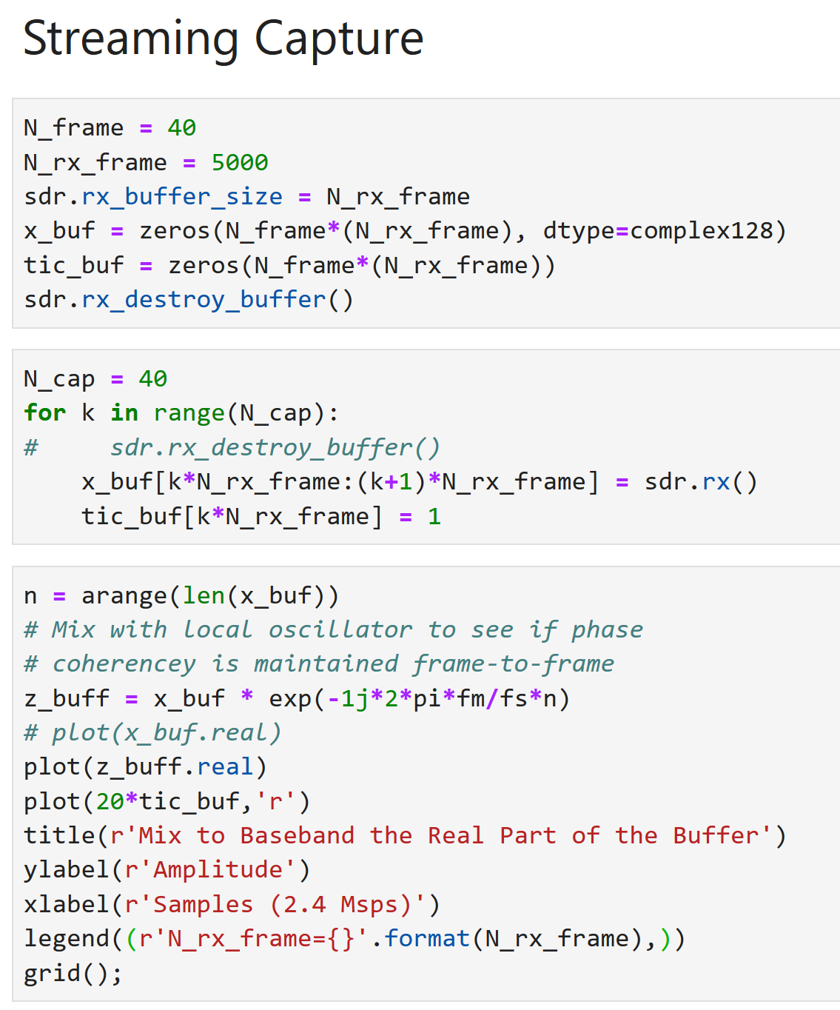
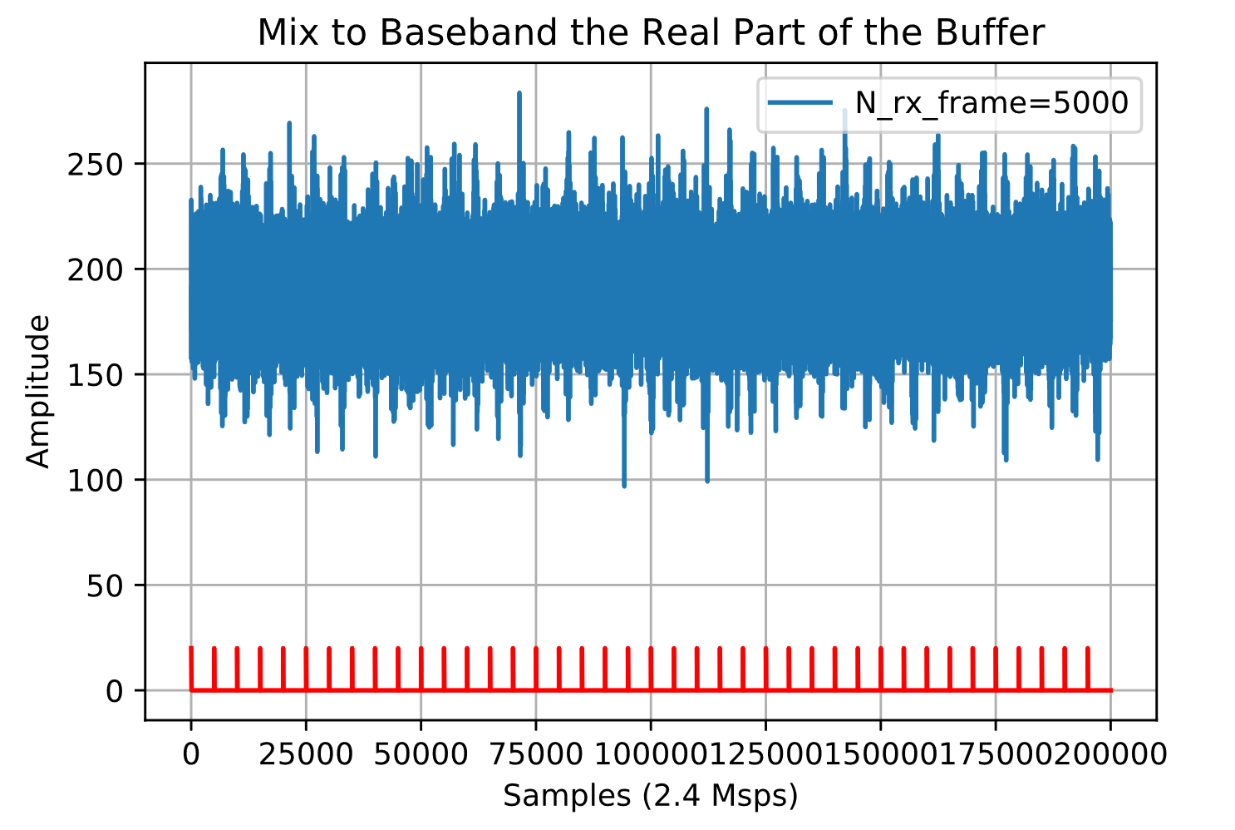
N_rx_frame = 5000
No problems here

Slide 6
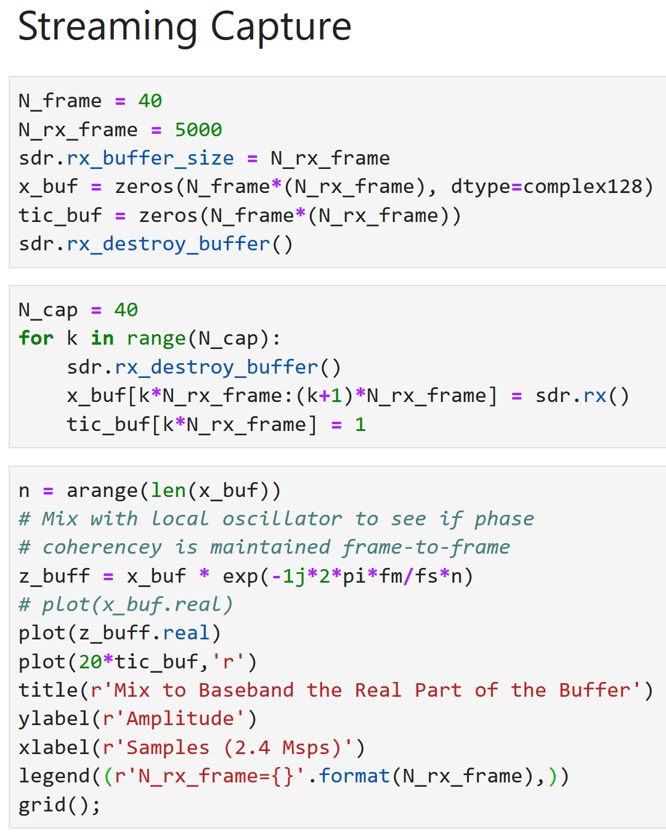
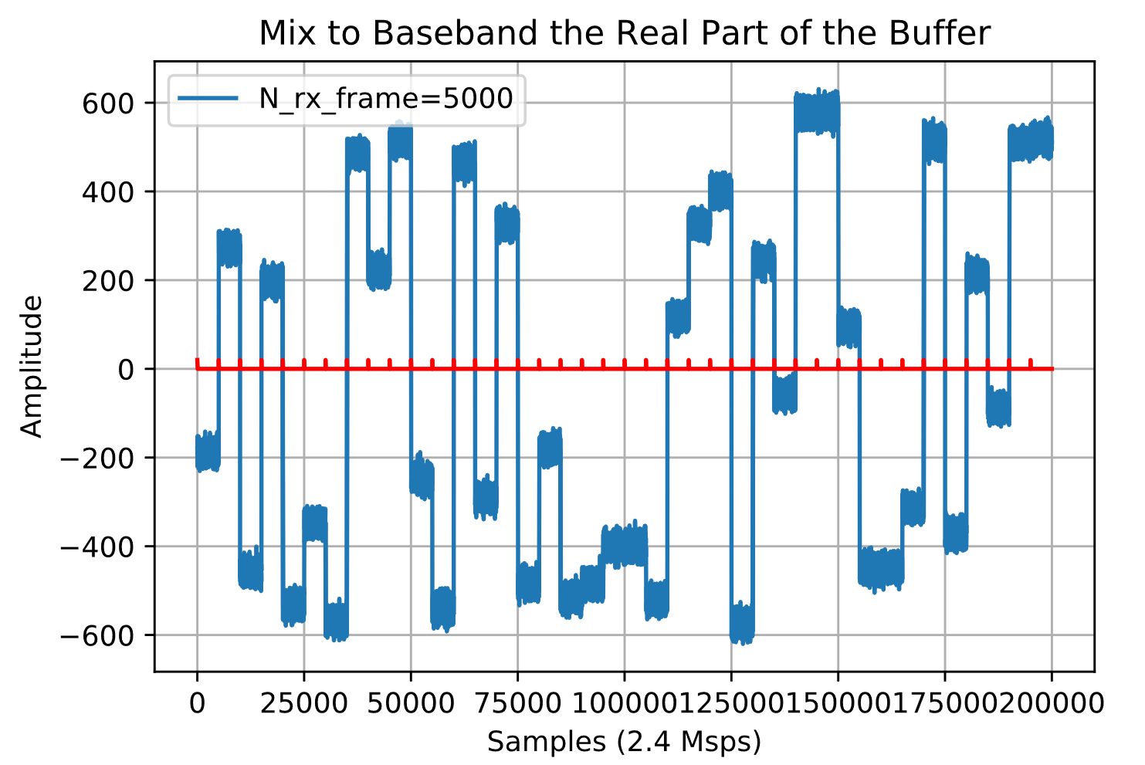
N_rx_frame = 5000 & sdr.rx_destroy_buffer()
Here I wanted to see the impact of rx_destroy_buffer()
Clearing the buffer clearly takes time and results in loss of coherency

Slide 7
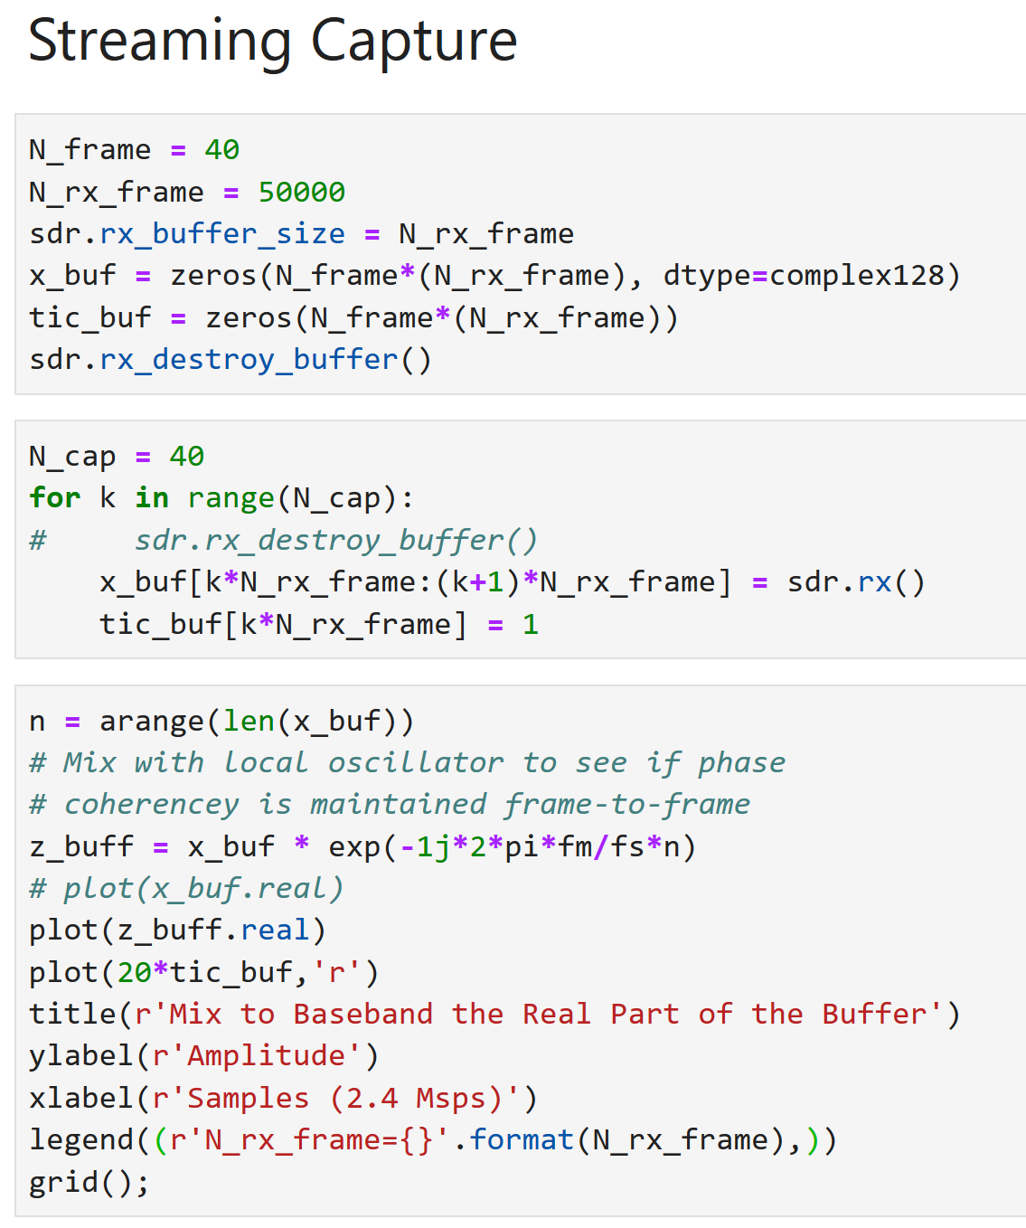
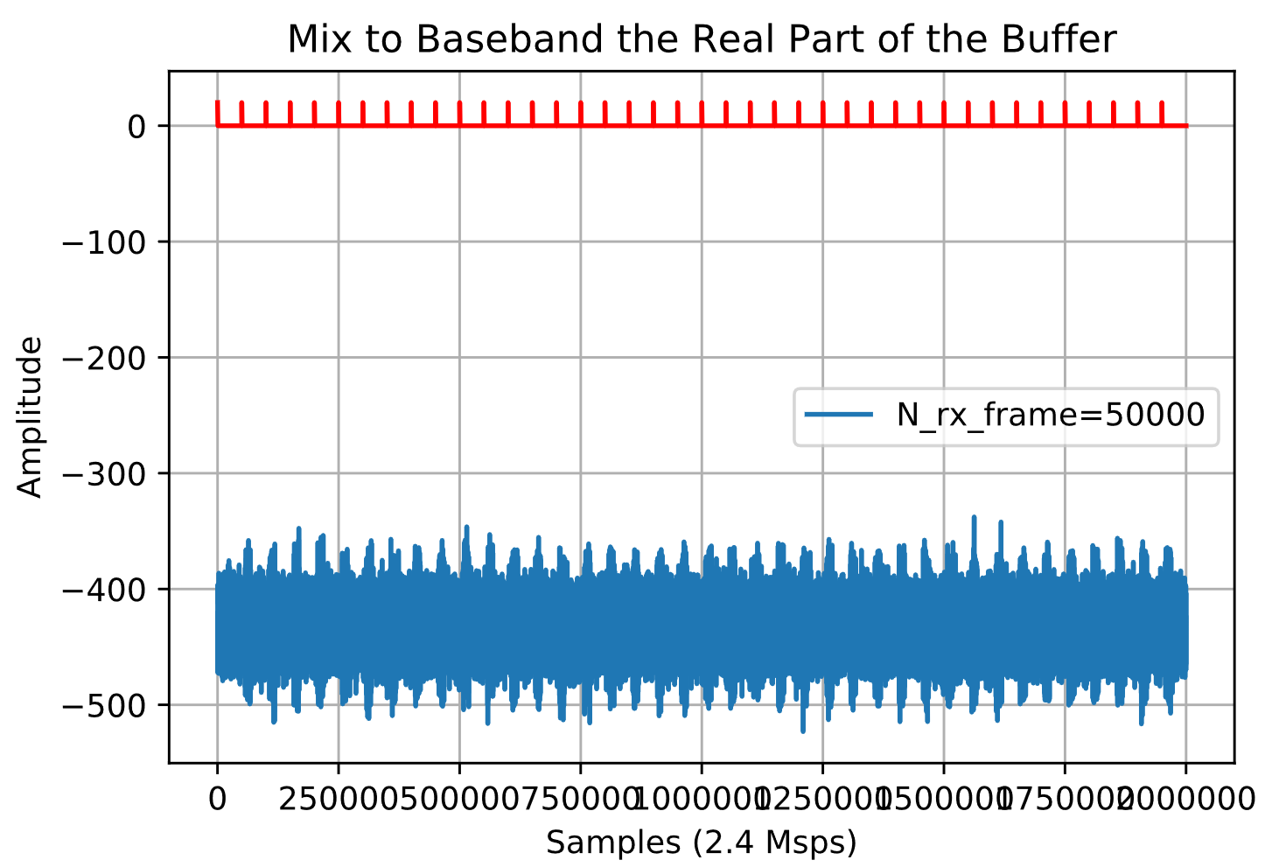
N_rx_frame = 50000

