Slide 1
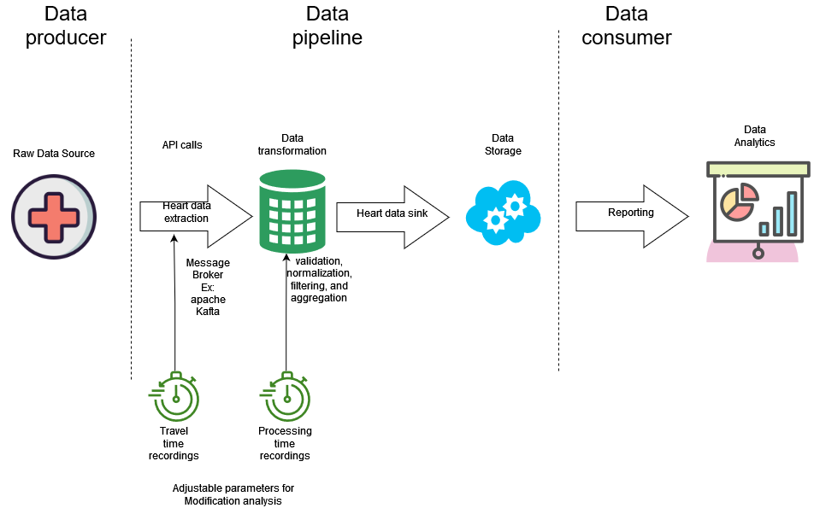
What are the performance characteristics, efficiency, and impact of modifications within a data processing framework?
Notes:
What are the performance characteristics, efficiency, and impact of modifications within a data processing framework as we can see from the figure of my prototype, we have an initial raw data source that will access our data pipeline through api calls, transforms the data into a readable standardised format and stores it ready for analysis.
During this process we will record the travel time and processing time of each of the requests and we will use these as the prior for our analysis.

Slide 2
Literature review
Current cloud computing challenges
State of the art
Most adequate tool analysis
Cloud computing modelling
General M/m/m queue analysis
Modification analysis and modelling of data queues
Zhang, Q., Cheng, L., & Boutaba, R. (2010). Cloud computing: State-of-the-art and research challenges. Journal of Internet Services and Applications, 1(1), 7–18. https://doi.org/10.1007/s13174-010-0007-6
A Survey of Big Data Pipeline Orchestration Tools from the Perspective of the DataCloud Project. (n.d.). https://www.researchgate.net/publication/357340660_A_Survey_of_Big_Data_Pipeline_Orchestration_Tools_from_the_Perspective_of_the_DataCloud_Project
Kafka: A distributed messaging system for log processing. (n.d.-b). https://course.ece.cmu.edu/~ece845/sp19/docs/kafka.pdf
Danilo Ardagna, Giuliano Casale, Michele Ciavotta, Juan F Pérez, &amp; Weikun Wang. (n.d.). Quality-of-service in cloud computing: modeling techniques and their applications. https://www.researchgate.net/publication/286266847_Quality-of-service_in_cloud_computing_modeling_techniques_and_their_applications
Khazaei, H., Misic, J., &amp; Misic, V. B. (2012). Performance analysis of cloud computing centers using M/g/m/m+r queuing systems. IEEE Transactions on Parallel and Distributed Systems, 23(5), 936–943. https://doi.org/10.1109/tpds.2011.199
Harchol-Balter, M. (2014). Performance modeling and design of computer systems: Queueing theory in action. Cambridge University Press.
Notes:
For the literature review I have first started by having a look at the current challenges in the field as well as the current state of the art.
After revising the state of the art I have designated apache Kafka as the most adequate tool to build my demo and start simulating the travel and processing time data
Furthermore, I have investigated general modelling for a M/M/1 queue using the basis of M/m/m
Lastly, I have read about how to do modification analysis to further analyse the impact of each of the previously recorded parameters

Slide 3
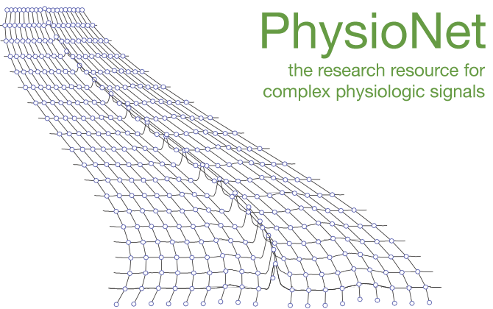
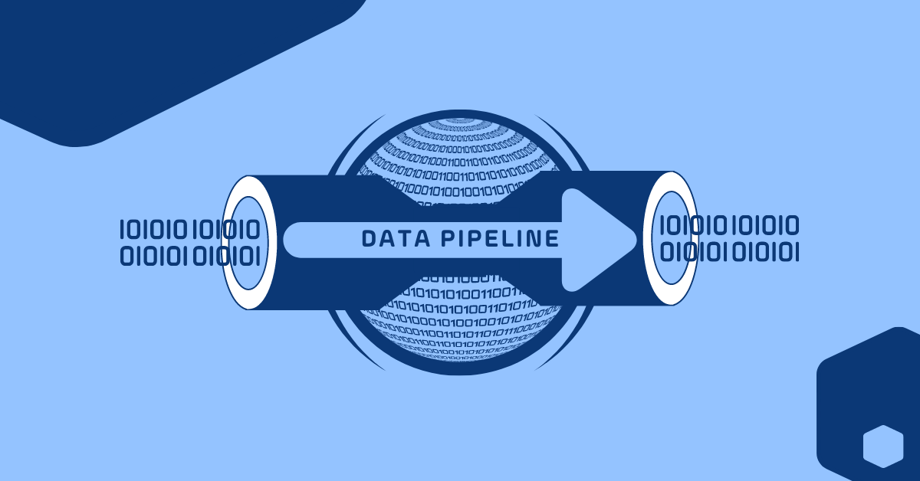

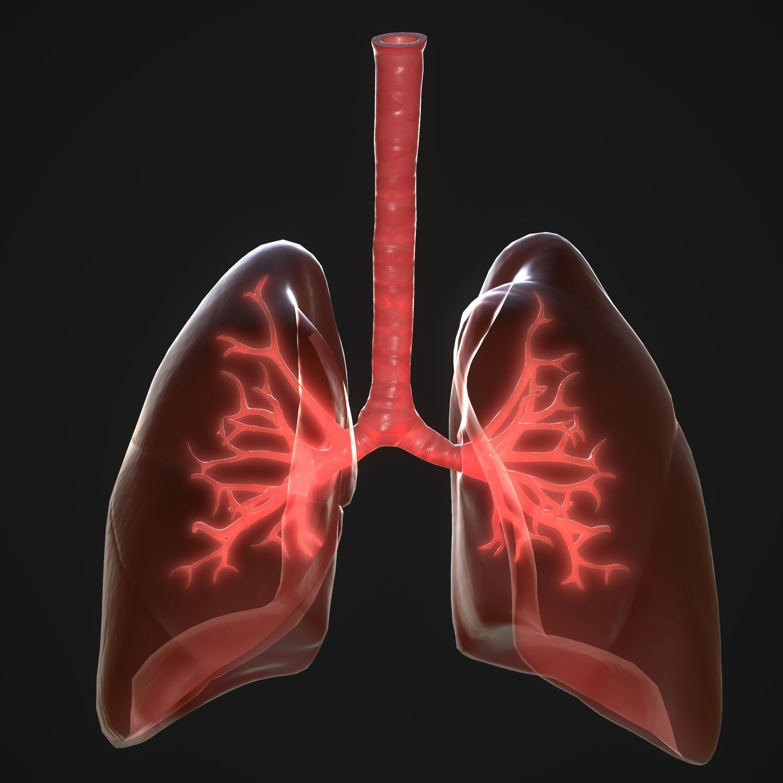

Data source and data queue assumptions
M/d/1 data queue
Heart rate
Respiratory force
Blood oxygen concentration
Markovian
Deterministic
1 server
Notes:
For the initial data source I have used a dataset of a timeseries recording of heart rate, respiratory force and bloody oxygen concentration that is freely available on physionet.
For my data pipeline I have narrowed it down to an M/d/1 which has the following assumptions, Markovian assumption of independence, memoryless and stationary of the arrival of new messages , determinist payloads, which means all the messages arriving in the queue are determined to follow a specific standardised format and such should not vary in processing time between each of the messages and the 1 server which can only process one single message at the time.

