Slide 1
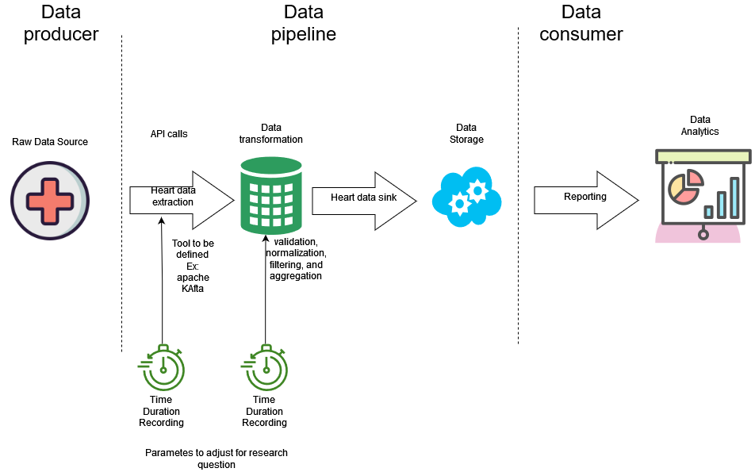
What are the performance characteristics, efficiency, and impact of modifications on the data queue within a data processing framework?

Slide 2
Literature review
Current cloud computing challenges
State of the art
Most adequate tool analysis
Cloud computing modelling
General M/g/m queue analysis
Modification analysis of data queues
Zhang, Q., Cheng, L., & Boutaba, R. (2010). Cloud computing: State-of-the-art and research challenges. Journal of Internet Services and Applications, 1(1), 7–18. https://doi.org/10.1007/s13174-010-0007-6
A Survey of Big Data Pipeline Orchestration Tools from the Perspective of the DataCloud Project. (n.d.). https://www.researchgate.net/publication/357340660_A_Survey_of_Big_Data_Pipeline_Orchestration_Tools_from_the_Perspective_of_the_DataCloud_Project
Kafka: A distributed messaging system for log processing. (n.d.-b). https://course.ece.cmu.edu/~ece845/sp19/docs/kafka.pdf
Danilo Ardagna, Giuliano Casale, Michele Ciavotta, Juan F Pérez, &amp; Weikun Wang. (n.d.). Quality-of-service in cloud computing: modeling techniques and their applications. https://www.researchgate.net/publication/286266847_Quality-of-service_in_cloud_computing_modeling_techniques_and_their_applications
Khazaei, H., Misic, J., &amp; Misic, V. B. (2012). Performance analysis of cloud computing centers using M/g/m/m+r queuing systems. IEEE Transactions on Parallel and Distributed Systems, 23(5), 936–943. https://doi.org/10.1109/tpds.2011.199
Harchol-Balter, M. (2014). Performance modeling and design of computer systems: Queueing theory in action. Cambridge University Press.

Slide 3
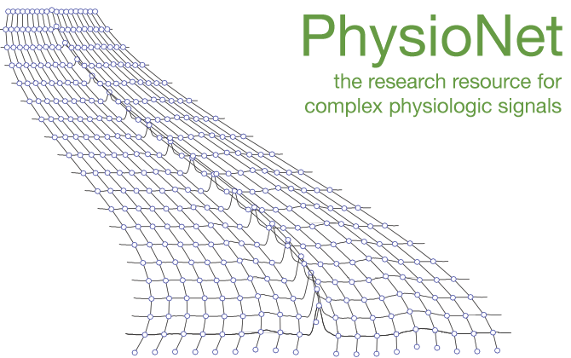
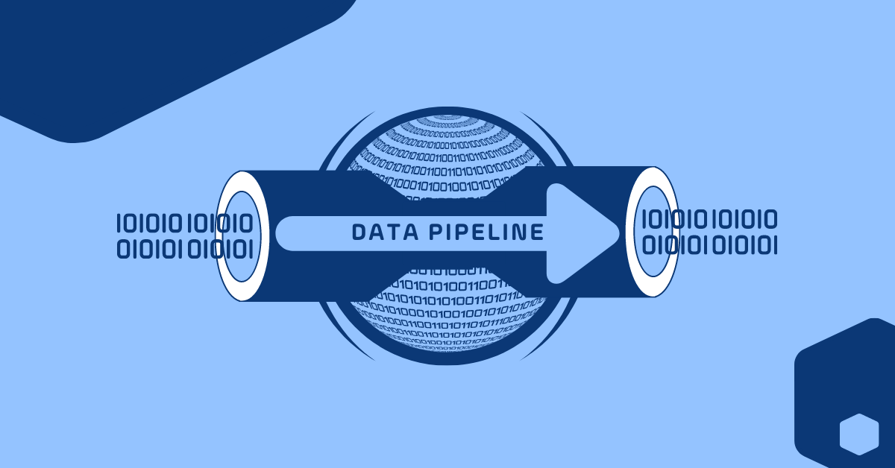

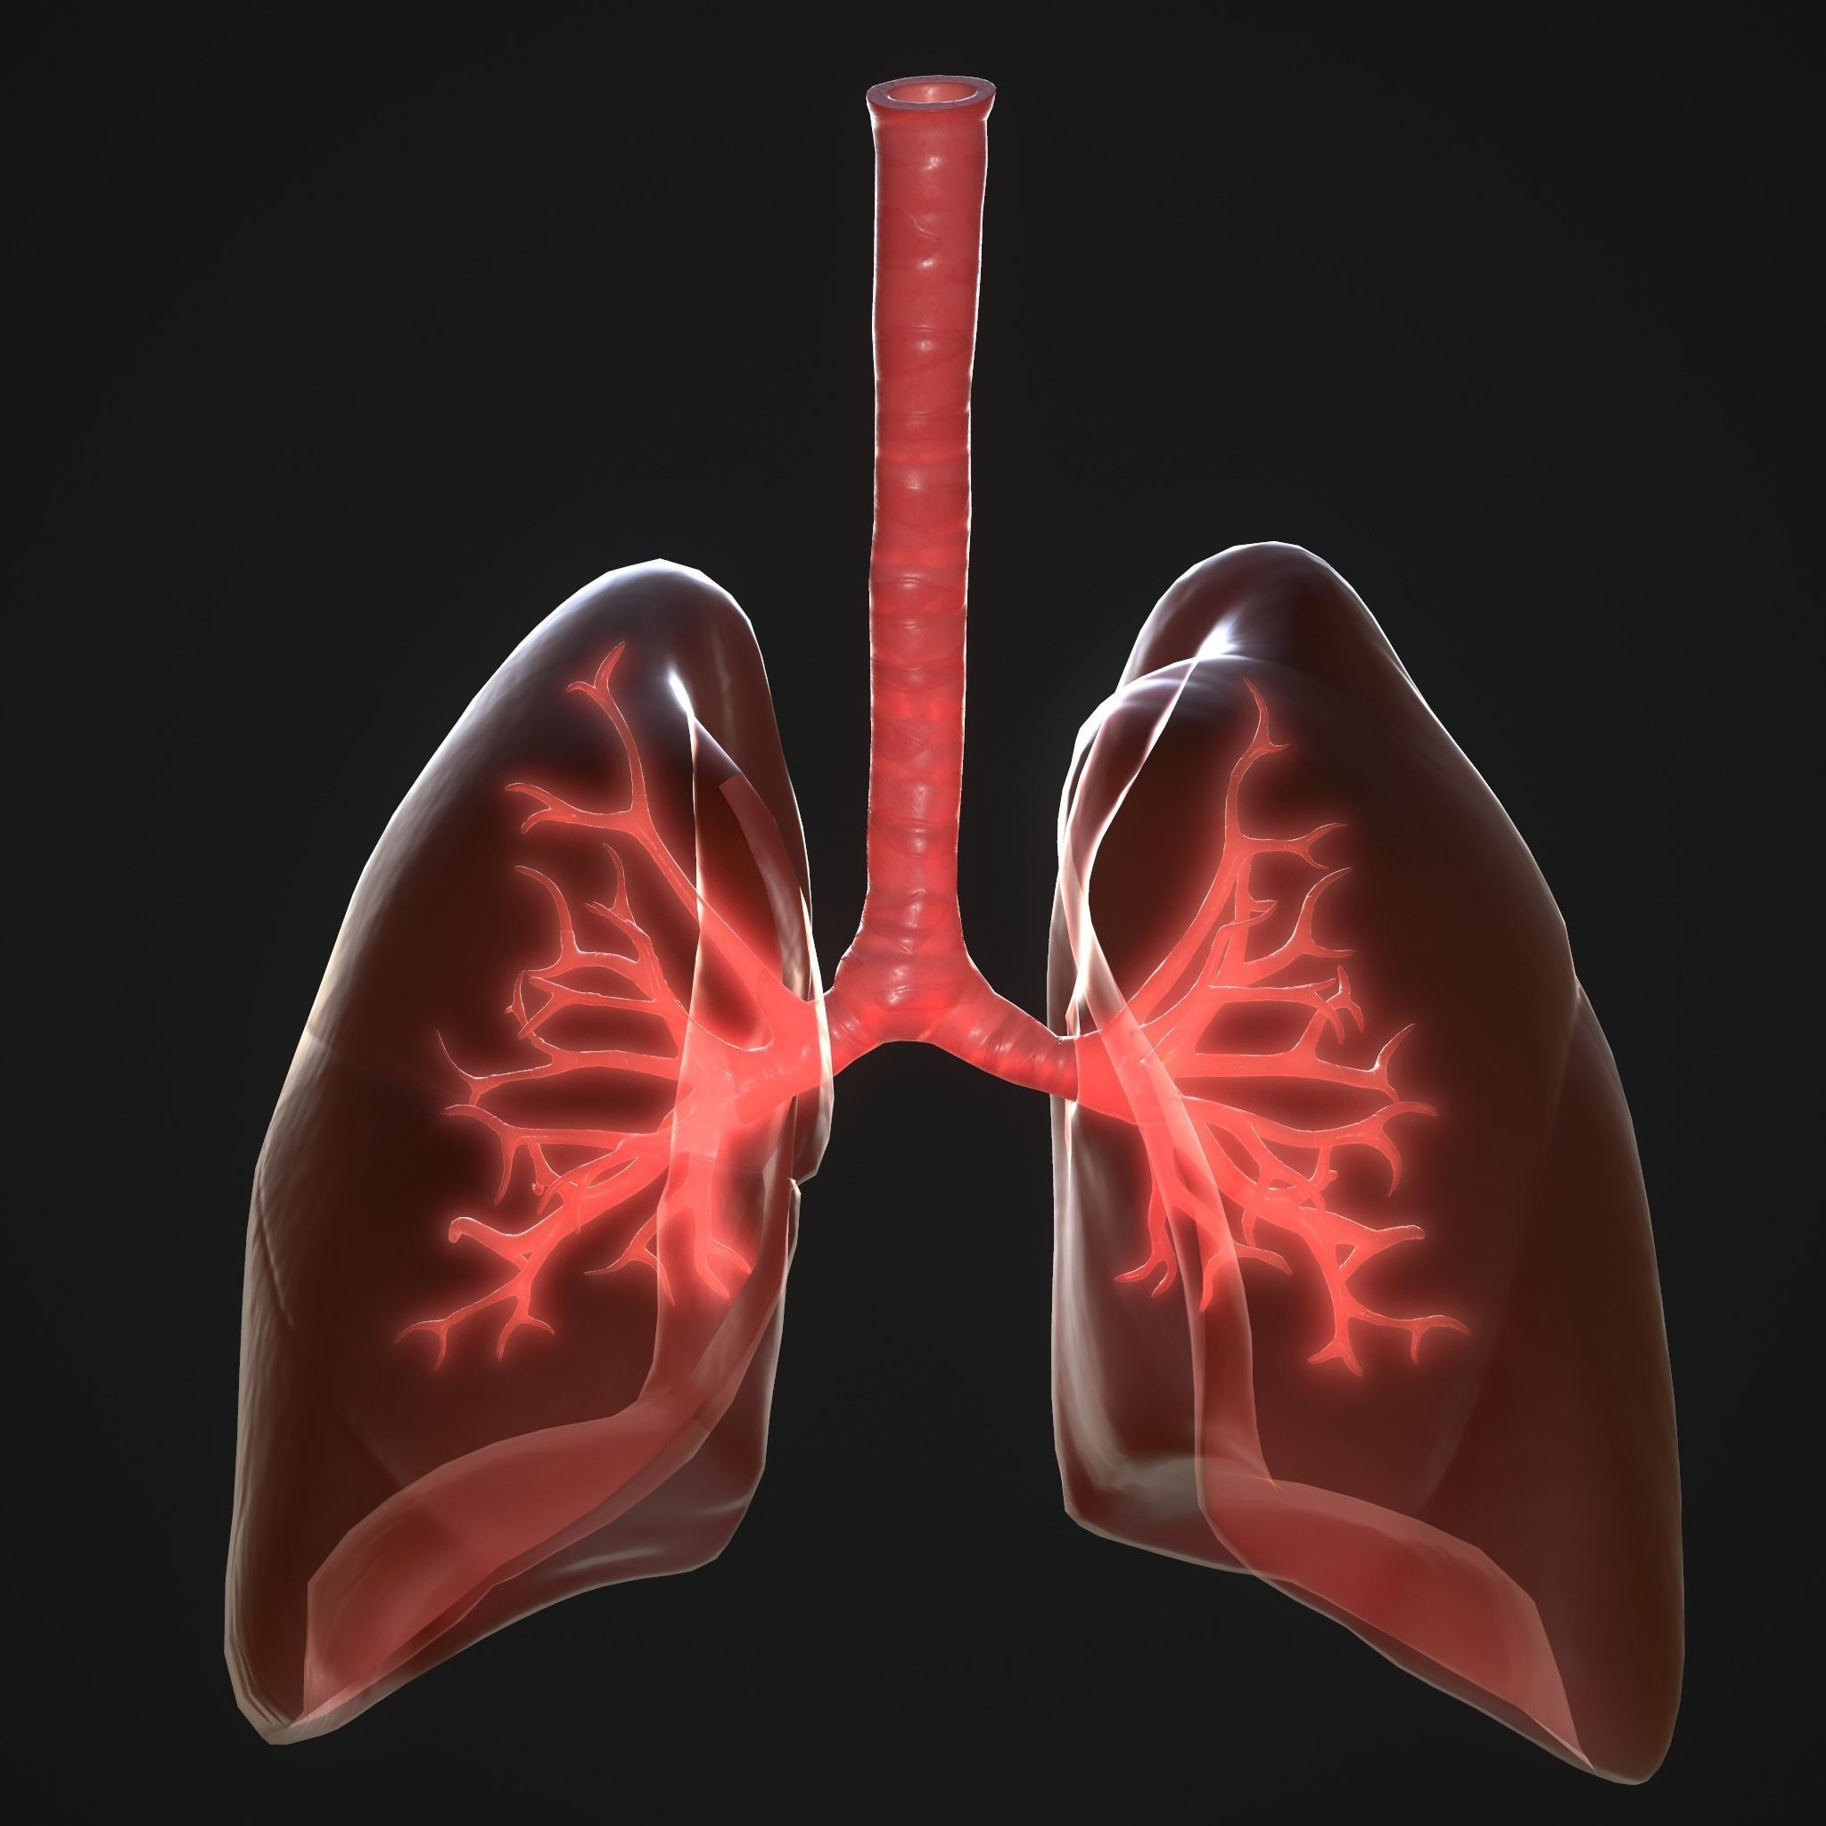

Data source and data queue assumptions
m/d/1 data queue
Heart rate
Respiratory force
Blood oxygen concentration

