Slide 1
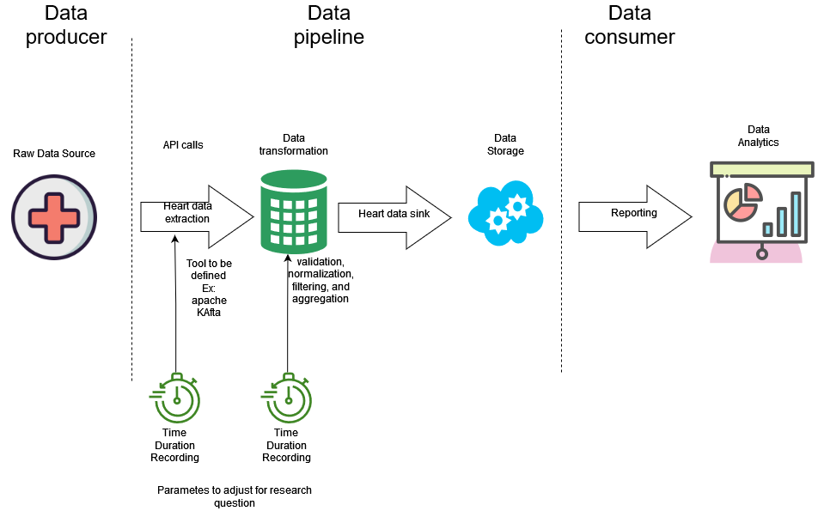

Slide 2
- Given the original system, how high can I make N while keeping E [R] below some threshold? - Assume a fixed multiprogramming level, N. Given that we can make changes to the central subsystem, which changes will improve E [R] the most? - Batch systems are a type of closed system where typically one is running many jobs overnight and as soon as one job completes, another one is started. - Asymptotic bounds can be used to estimate the performance of closed systems as a function of the multiprogramming level N.

Slide 3
