Slide 1
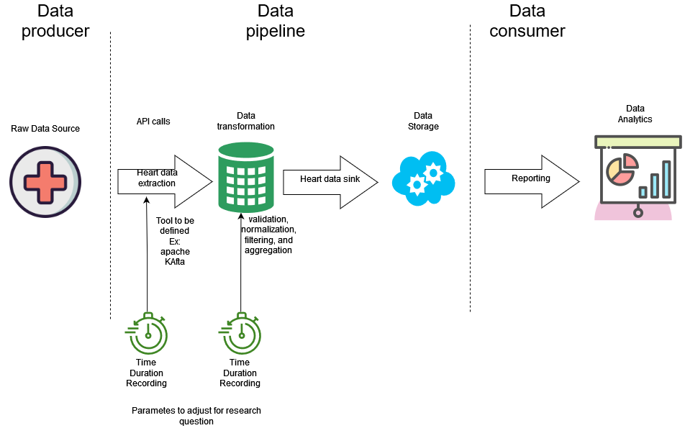
What are the performance characteristics, efficiency, and impact of modifications on the data queue within a data processing framework?

Slide 3
- Given the original system, how high can I make N while keeping E [R] below some threshold? - Assume a fixed multiprogramming level, N. Given that we can make changes to the central subsystem, which changes will improve E [R] the most? - Batch systems are a type of closed system where typically one is running many jobs overnight and as soon as one job completes, another one is started. - Asymptotic bounds can be used to estimate the performance of closed systems as a function of the multiprogramming level N.
Operational laws
Little law for closed systems
Modification Analysis

Slide 4
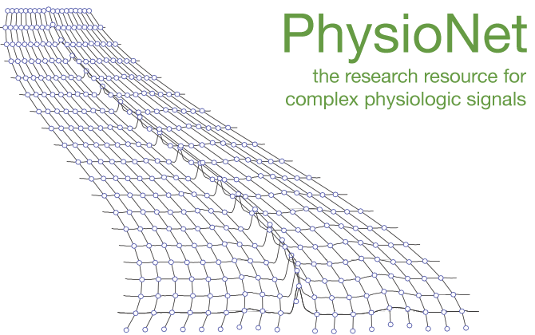
How we go to m/d/1

