Slide 1

AGB1211 – DESIGN THINKING
Department of Artificial Intelligence and Data Science
Academic Year: 2024 – 2025 (Odd Semester)
Year :II
Semester :III
Section :A
Date :05.12.2024
PRESENTED BY
1. JANANKA V
2. IRIN MINERWA S
3. JANAKIRANI V
4. JANANI P
AGB1211 – DESIGN THINKING

Slide 2
Title of the Project
AI IN TRAFFIC MONITORING
AGB1211 – DESIGN THINKING

Slide 3
Problem Identification
Current traffic monitoring systems are outdated and have many limitations.
They struggle to handle large amounts of data, cannot detect all types of traffic (like pedestrians and cyclists), and lack the ability to predict traffic problems before they happen.
This results in traffic jams, delays, and safety issues.
There is a need for a more advanced system that can monitor traffic in real-time, detect congestion, predict future problems, and provide solutions to make traffic management more efficient
AGB1211 – DESIGN THINKING

Slide 4
Objective
The goal of this research is to develop a traffic monitoring system that uses AI to improve traffic management.
The main objectives include:
Real-time Traffic Monitoring: Using AI to track traffic conditions and vehicle counts in real-time.
Detecting and Predicting Congestion: Using AI to identify traffic jams and predict where and when they
might happen.
Accident Detection: Creating a system to automatically detect accidents and send alerts for faster response.
Improving Traffic Flow: Using AI to optimize traffic signals and reduce congestion .
AGB1211 – DESIGN THINKING

Slide 5
Brain Storming
2.Find my route
1.Live Traffic
Search location
Location
Distance
Destination
Real time update
Predictive Routing
Traffic flow
Fast Predictions
User application
AI IN TRAFFIC MONITORING
My account
3.Petrol Bank
4.
Google maps
Location
Heat maps
Feedback
Share
Ratings
Profile managing
AGB1211 – DESIGN THINKING

Slide 6
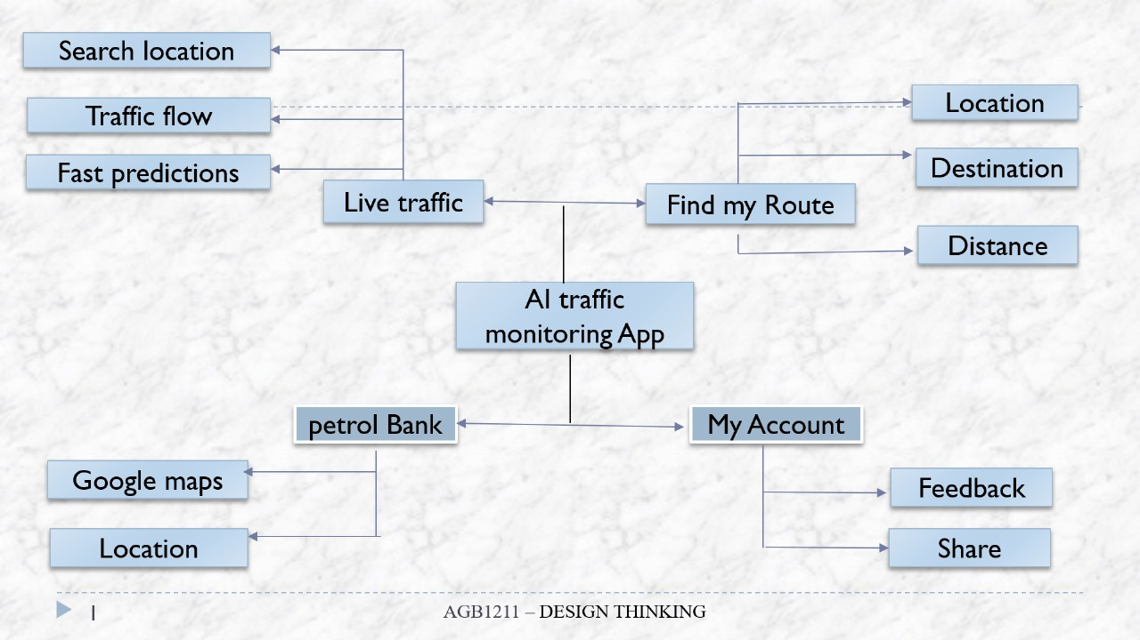
Mind Map
AGB1211 – DESIGN THINKING

Slide 7
Primary Research
1.Traffic Data Collection
Surveys and Interviews with Stakeholders: Conducting interviews with traffic authorities, city planners, or drivers.
Sensor Deployment: Installing traffic sensors, cameras, and GPS devices to collect real-time traffic data (e.g., traffic volume, vehicle
speeds, congestion patterns).
2.Behavioral Research
User Behavior Studies: Understanding how drivers make route decisions, their preferences for traffic updates, and how they interact
with traffic apps can help shape the user interface (UI) and experience (UX).
AGB1211 – DESIGN THINKING

Slide 8
Secondary Research
1. Traffic Flow and Congestion Research
Traffic Flow Models: Review academic and industry research on traffic flow theory and mathematical models used to predict and manage congestion.
2.Technological Trends and Innovation
Advances in AI and Machine Learning: Keep up to date with research papers
The technical articles on the latest advancements in AI and learning models that can be applied to traffic
monitoring, such as deep learning for vehicle detection and reinforcement
learning for route optimization.
AGB1211 – DESIGN THINKING

Slide 9
Proposed Work
1. Live Traffic Updates :
It Provide users with real-time information on traffic conditions to help them plan their routes effectively.
2. Find My Route :
It Help users navigate the quickest or most efficient routes based on current conditions.
3. My Account :
Users can create profiles to save favorite routes (home, work, etc.) and other personalized preferences.
AGB1211 – DESIGN THINKING

Slide 10
List of Modules
1. TRAFFIC JAM MODULE
2. GPS TRACKING MODULE
3. PETROL BANK MODULE
4. FIND MY ROUTE MODULE
5. MY ACCOUNT MODULE
AGB1211 – DESIGN THINKING

Slide 11
Module 1 Description
1. TRAFFIC JAM MODULE
This module helps detect and predict traffic jams in real time by analysing traffic data from sensors and GPS. It can show areas with heavy traffic and suggest alternate routes to avoid congestion.
Key Features:
Detects traffic slowdowns
Predicts where jams might happen
Sends alerts to avoid congested areas.
AGB1211 – DESIGN THINKING

Slide 12
Module 2 Description
2.GPS TRACKING MODULE
This module tracks vehicles in real time using GPS. It shows their current location and speed, and keeps a a
history of where they've been. It’s useful for managing fleets or monitoring vehicles on the road.
Key Features:
Tracks vehicle location
Monitors speed and movement
Sends alerts if vehicles leave certain areas
AGB1211 – DESIGN THINKING

Slide 13
Module 3 Description
3. PETROL BANK MODULE
This module tracks how much fuel vehicles use and suggests ways to save fuel. It helps drivers find the best
routes for better fuel efficiency and gives tips on how to drive more efficiently.
Key Features:
Tracks fuel usage
Suggests fuel-efficient routes
Gives tips to save fuel
AGB1211 – DESIGN THINKING

Slide 14
Module 4 Description
4. FIND MY ROUTE MODULE
This module helps drivers find the fastest route by checking traffic conditions and road closures. It updates routes in real time to help avoid delays.
Key Features:
Finds the best routes
Updates routes based on traffic
Shows alternate routes if there are delays
AGB1211 – DESIGN THINKING

Slide 15
Module 5 Description
5.MY ACCOUNT MODULE
The "My Account" module allows users to manage their profile, vehicle details, and driving history. It keeps track of your preferences and gives personalized suggestions based on your driving patterns.
Key Features:
Stores personal and vehicle information
Shows traffic and route history
Provides custom driving tips
AGB1211 – DESIGN THINKING

Slide 16
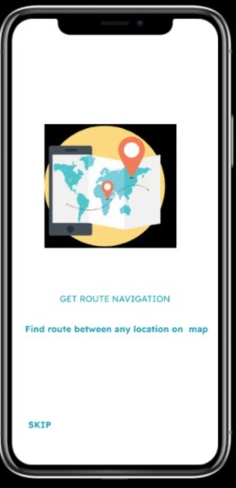
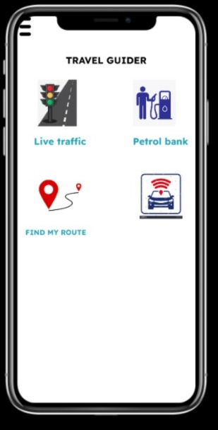
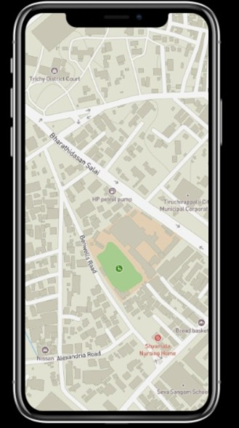
Results
AGB1211 – DESIGN THINKING

Slide 17
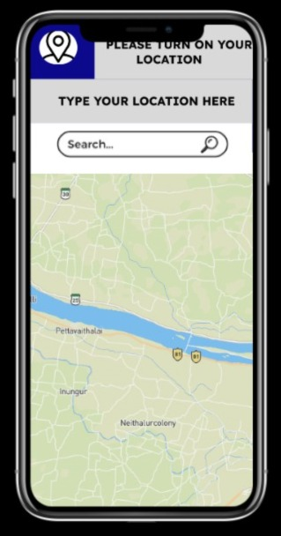
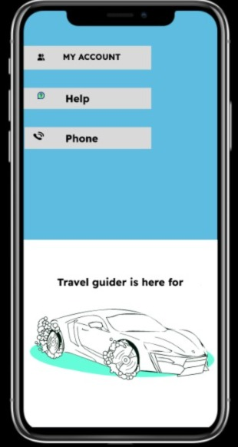
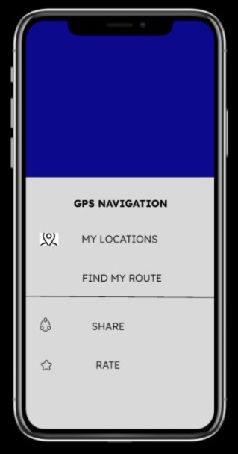
Results
EGB1201 – JAVA PROGRAMMING –PROJECT REVIEW 2

Slide 18
Conclusion
AI traffic monitoring systems can greatly improve how we manage traffic in cities. By using technologies like machine learning and computer vision, AI can predict traffic jams, detect accidents quickly, and help manage traffic lights to keep everything running smoothly. This makes driving safer and reduces delays.
With AI, traffic managers can make smarter decisions based on real-time data, and commuters benefit from less congestion and safer roads. As more cities use smart technologies, AI will become a key part of how we manage traffic.
However, for AI to work well, it needs accurate data and good algorithms. Future improvements should focus on making these systems more accurate, easier to use, and able to work in different cities.
AGB1211 – DESIGN THINKING

Slide 19
Thank You
ANY QUERIES???
AGB1211 – DESIGN THINKING

