Slide 1
BIGDATA
Presented By
R.K.B.JANANE

Slide 2
BIGDATA
Big data is a term for data sets that are so large or complex that traditional data processing application software is inadequate to deal with them.
Big data challenges include capturing data, data storage, data analysis, search, sharing, transfer, visualization, querying, updating.

Slide 3
CHARACTERISTICS
Volume
Variety
Velocity
Variability
Veracity
3 CATEGORIES
1)structured
2)semi-structured
3)unstructured

Slide 4
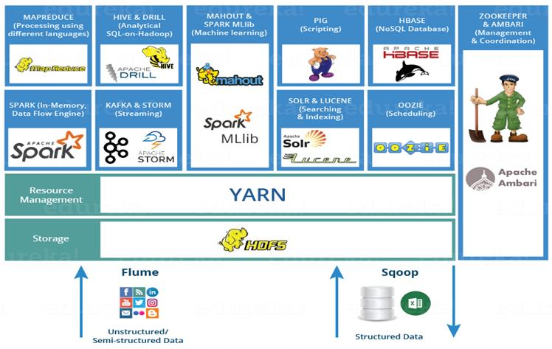
HADOOP ECOSYSTEM

Slide 5
Hadoop Ecosystem is neither a programming language nor a service, it is a platform or framework which solves big data problems.
HDFS -> Hadoop Distributed File System
YARN -> Yet Another Resource Negotiator
MapReduce -> Data processing using programming
Spark -> In-memory Data Processing
PIG, HIVE-> Data Processing Services using Query (SQL-like)
HBase -> NoSQL Database
Mahout, Spark MLlib -> Machine Learning
Apache Drill -> SQL on Hadoop
Zookeeper -> Managing Cluster
Oozie -> Job Scheduling
Flume, Sqoop -> Data Ingesting Services

Slide 6
HADOOP
Open source Java framework.
Designed for storage and processing of large scale data on cluster of commodity hardware.
Created by Doug cutting and Mike in 2005.
Hadoop is being used by Facebook ,Google , Twitter.
It works on Master-Slave architecture.
2 components
HDFS
MAPREDUCE

Slide 7
HDFS
Hadoop Distributed File System.
Open source parallel storage component.
Responsible for storing data on the cluster.
High fault tolerant.
Data files are split into blocks and distributed across the nodes in the cluster
The default block size 128MB
Each block can replicated multiple times (REPLICATION FACTOR is 3)

Slide 8
COMPONENTS
NAME NODE- MASTER NODE
It is use to store meta data.
The NameNode executes file system namespace operations like opening, closing, and renaming files and directories.
It also determines the mapping of blocks to DataNodes.
DATA NODE-SLAVE NODE
The DataNodes also perform block creation, deletion, and replication upon instruction from the NameNode.
The DataNodes are responsible for serving read and write requests from the file system’s clients.
SECONDARY NAME NODE-
It is backup for name node.

Slide 9
MAPREDUCE
Processing technique and program model.
MAPPER stage
SORT AND SHUFFLE stage
REDUCE stage
2 Components
1)Job tracker – master node
2)Task tracker – slave node

Slide 10
Methods & Classes
METHODS
1)setup
2)map
3)run
4)clean up
CLASSES
1)Driver
2)Mapper
3)Partitioner
4)Combiner
5)Reducer

Slide 11
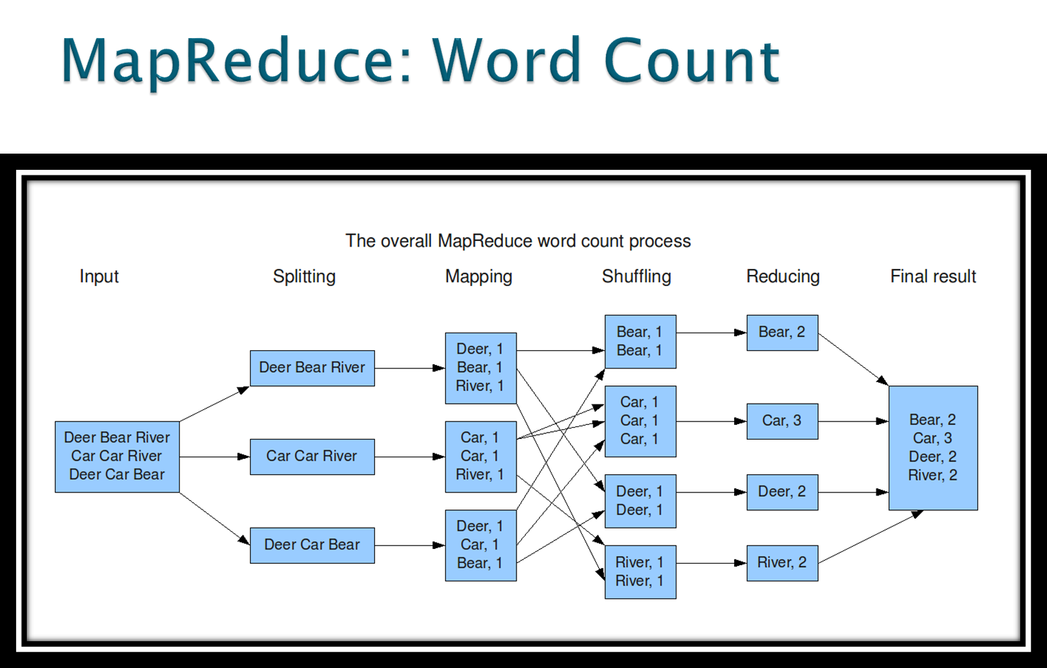
Word Count

Slide 12
Hadoop 1.x Limitations
It is only suitable huge amount of data.
It is not suitable for Real-time Data Processing.
It is not suitable for Data Streaming.
It supports upto 4000 Nodes per Cluster.
JobTracker is the single point of failure.
It does not support Multi-tenancy Support.
It supports only one Name Node and One Namespace per Cluster.

Slide 13
YARN
Yet Another Resource Negotiator.
It is new Component in Hadoop 2.x Architecture. It is also know as “MR V2”.
3 Components
1)Resource Manager
i)Scheduler
ii)Application Master
2)Data Node
3)Container

Slide 14
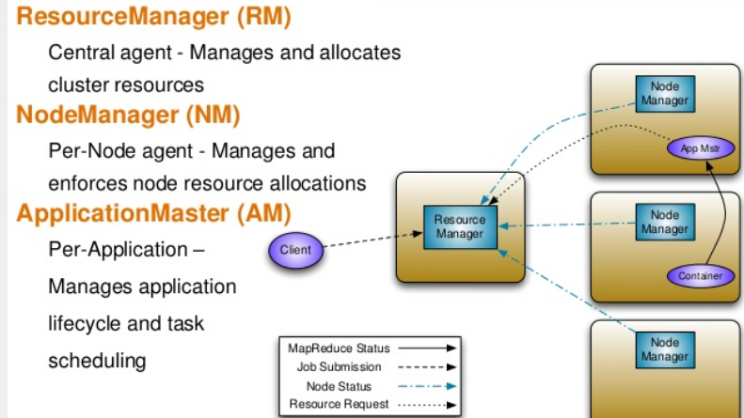

Slide 15
BENIFITS
New Application & Services
Improved cluster utilization
Scale
Experimental agility
Shared services

Slide 16
Difference B/w 1.x and 2.x
HADOOP 1.X
Single point Failure
No Multi-tenancy support
4000 Nodes
Fixed-sized Containers
HADOOP 2.X
Multiple namespaces
Multi-tenancy Support
10,000 Nodes
Variable-sized Containers

Slide 17
HIVE
Hive is an ETL and Data warehousing tool.
Process structured data in Hadoop.
It provides SQL type language for querying called HiveQL or HQL.
It is familiar, fast, scalable, and extensible.
Hive is "Schema on READ only".
Functions like the update, modifications, etc. don't work with this.
Because the Hive query in a typical cluster runs on multiple Data Nodes.
Notes:
Hive is "Schema on READ only". So, functions like the update, modifications, etc. don't work with this. Because the Hive query in a typical cluster runs on multiple Data Nodes.
Hive is not
A relational database
A design for OnLine Transaction Processing (OLTP)
A language for real-time queries and row-level updates

Slide 18
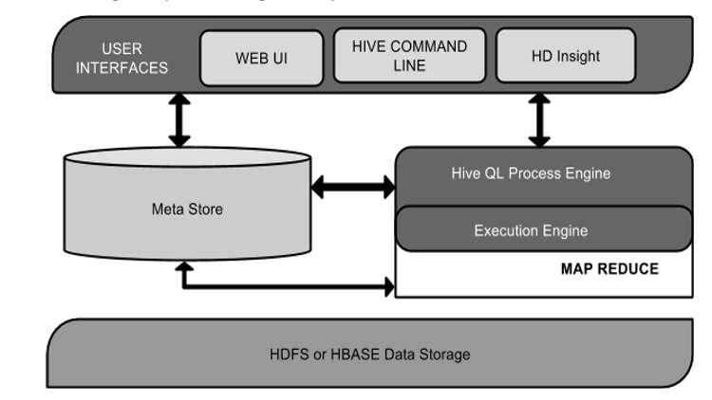
ARCHITECTURE

Slide 19
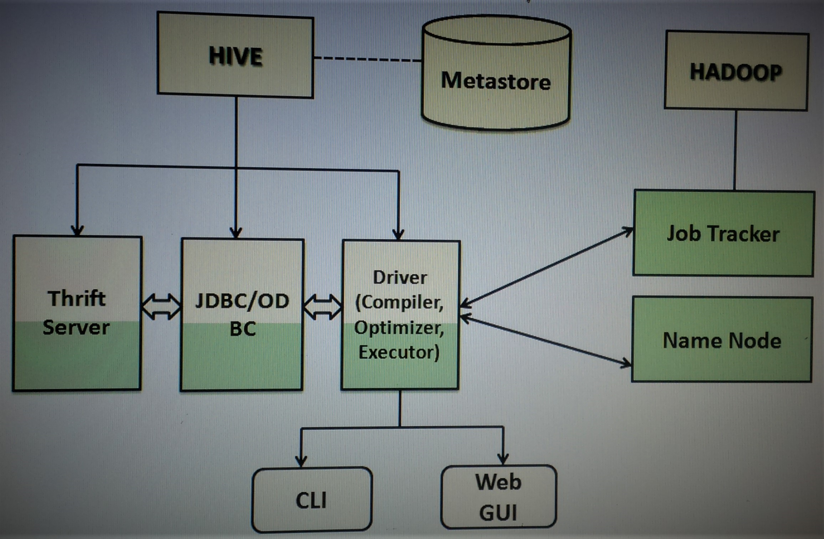
ARCHITECTURE

Slide 20
PIG
It is a scripting language.
Apache Pig is a high level extensible language.
Used to process semi-structured.
Every pig program consists of three parts. Loading, Transforming, Dumping of the data.
It allows users to write the custom functions using Java, Python,Jython, Ruby, Groovy and Javascript.

Slide 21
SQOOP
Apache Sqoop is a tool designed for efficiently transferring bulk data between Apache Hadoop and external datastores such as relational databases, enterprise data warehouses.
Parallel import/export
Compression
Connectors for all major RDBMS Databases
Load data directly into Hive/Hbase

Slide 22
THANK YOU

