Slide 1



Early Detection Of Parkinson’s Disease Using Machine Learning
PROJECT GUIDE
Mrs.A.S.RENUGADEVI
Assistant Professor
Artificial Intelligence
PROJECT MEMBERS
23ADR069-JANANI K
23ADR084-KAVISHNAA SRI G.S
23ADR114-NAGUMEENA UDAYAPPAN

Slide 2
INTRODUCTION
Parkinson's disease is often diagnosed after significant neural damage. Early prediction is vital for timely intervention.
Machine learning algorithms can help by analyzing clinical, genetic, and non-motor data to detect Parkinson's earlier. The challenge is creating a reliable model that minimizes false positives and improves early detection for better outcomes.

Slide 3
LITERATURE REVIEW
Authors | Title of the Paper | Publication Year | Algorithms used
Aditi Govindu, Sushila Palwe | Early Detection Of Parkinson's Disease Using Machine Learning | 2023 | Random Forest classifier,Logistic Regression,Support Vector Machine,KNN
Jiayu zhang,Wenchao Zhou | Prediction of Parkinson’s Disease Using ML Methods | 2023 | Logistic regression and XGBoost
W Yuvan, N Palmer | Accelerating diagnosis of Parkinson's disease through risk prediction | 2022 | XGBoost,Random forest
MA Sayed,DM Cao | Prediction of Parkinson's disease | 2023 | Support vector Machine,LightGBM

Slide 4
OBJECTIVE
Develop a machine learning model for the early detection of Parkinson's disease by analyzing clinical, genetic, and lifestyle data.

Slide 5
PROPOSED WORK (WORK FLOW)
DataSet
Data Preprocessing
(SMOTE)
Training Data
Test Data
Support Vector Machine
Random Forest Classifier
Decision Tree
K-Nearest-Neighbor
Model
Model Evaluation
Model Deployment

Slide 6
DATASET USED
DataSet Name:Parkinson's Disease Dataset from Kaggle
Number of Recods:195 patient record
Number of Features:24
Key Attribute:Name,Fundamental frequency,Noise to harmonic tone(NHR),Harmonic tone to noise(HNR),Status,Pitch period entropy(PPE).
Categorical Attribute:1
Numerical Attribute:23
Link:https://www.kaggle.com/datasets/gargmanas/parkinsonsdataset

Slide 7
MODULES OF THE PROJECT
Data Preprocessing
Training
Machine Learning Algorithms
Model Building
Model Evaluation
Testing

Slide 8
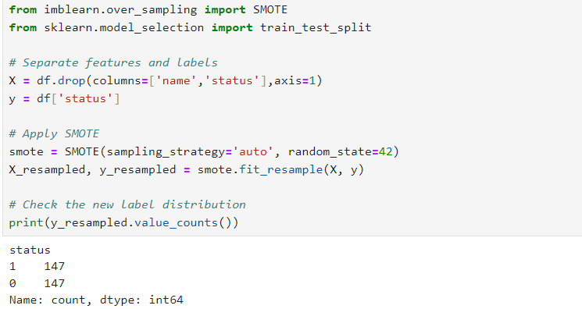
Data Preprocessing
Handling Imbalanced Data:
SMOTE (Synthetic Minority Oversampling Technique) is used for generating synthetic data samples to address class imbalance in datasets.

Slide 9
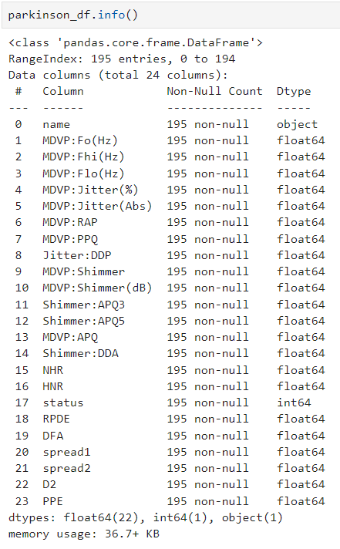
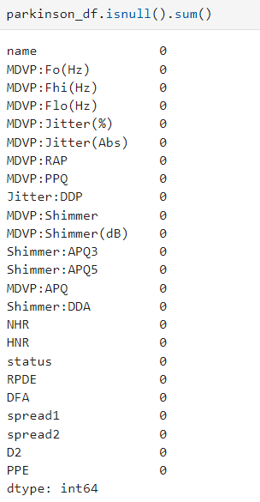
Data preprocessing
Handling Missing values:

Slide 10
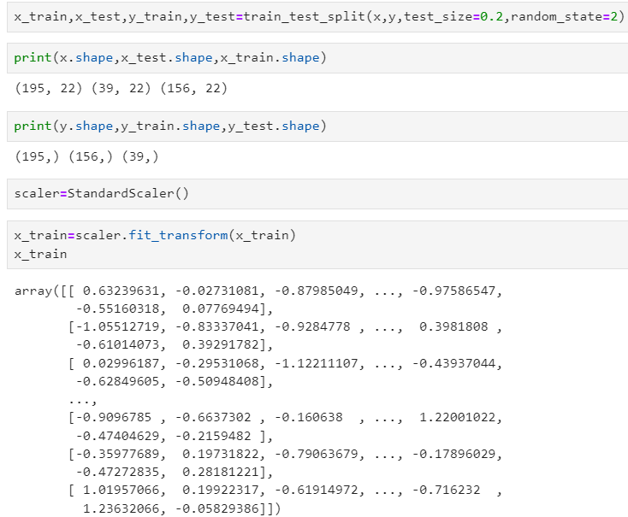
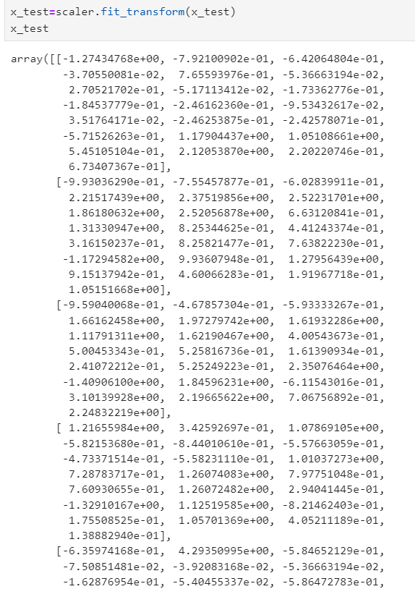
Train-Test Split

Slide 11
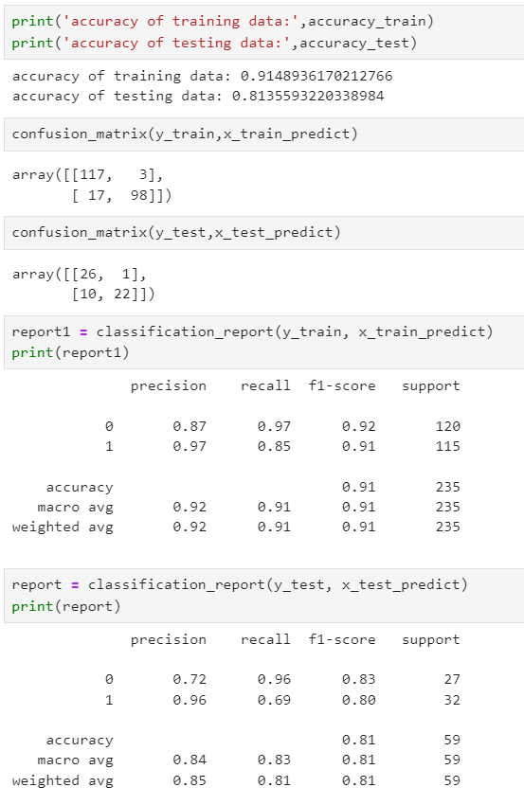
1.Support Vector Machine
MACHINE LEARNING ALGORITHMS
Support Vector Machine (SVM) is a supervised learning algorithm that finds the optimal hyperplane to separate classes in a dataset.

Slide 12
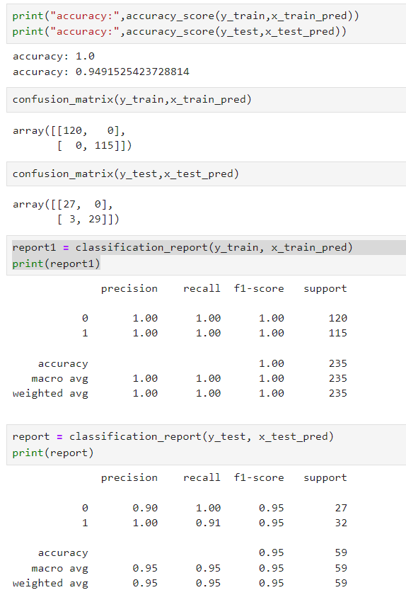
2. Decision Tree
A Decision Tree is a supervised algorithm used for classification and regression, splitting data based on features to create decision rules.

Slide 13
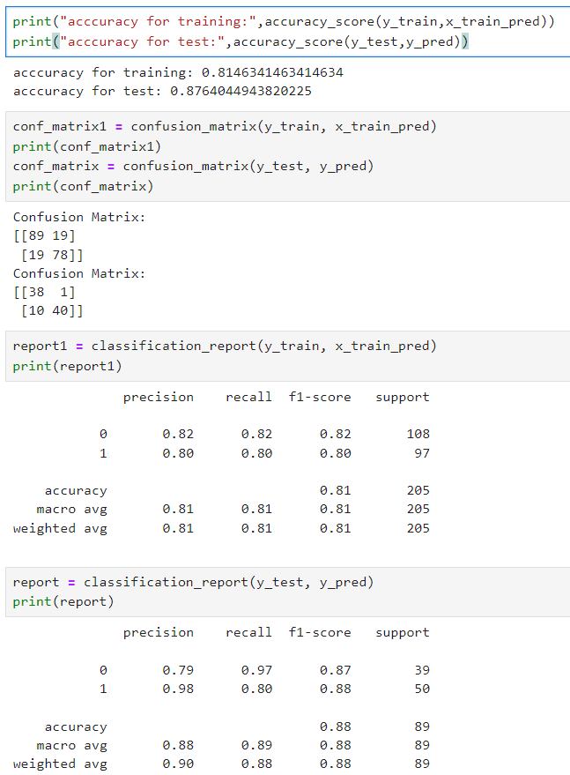
3. Logistic Regression
Logistic Regression is a supervised learning algorithm used for binary and multiclass classification.

Slide 14
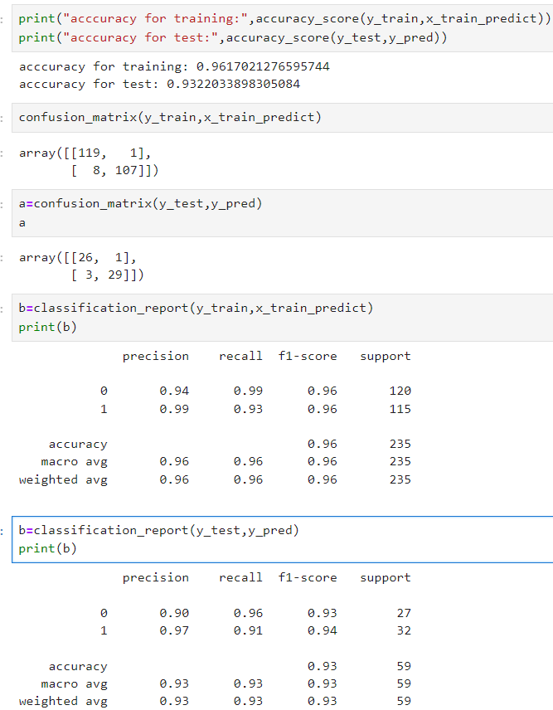
4. K-Nearest Neighbor
K-Nearest Neighbors (KNN) is a simple, non-parametric supervised algorithm used for classification and regression.

Slide 15
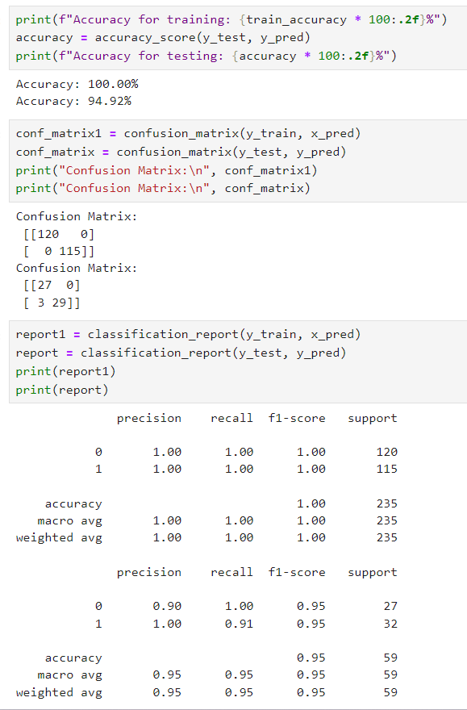
5. Gradient Boosting
Gradient Boosting is an ensemble learning technique that builds strong predictive models by combining multiple weak learners.

Slide 16
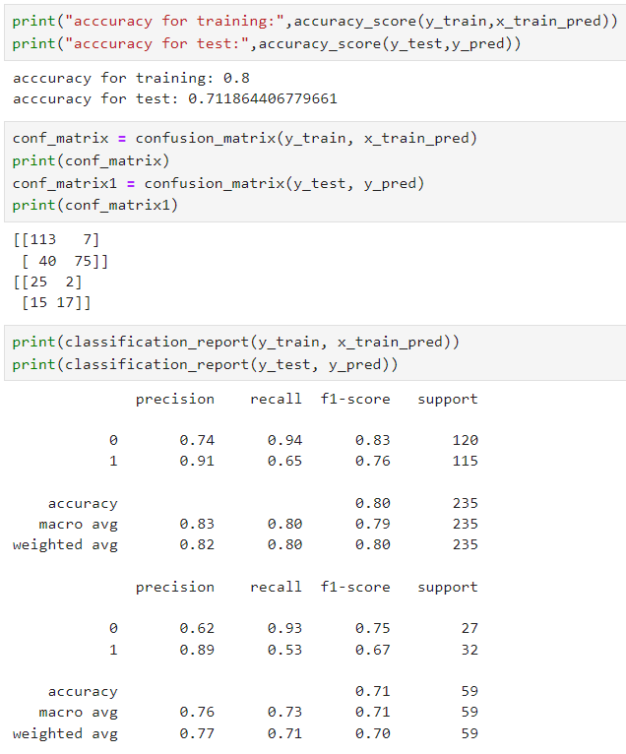
6.Naive Bayes
Naïve Bayes is a simple yet powerful probabilistic classifier based on Bayes' Theorem, assuming independence between features.

Slide 17
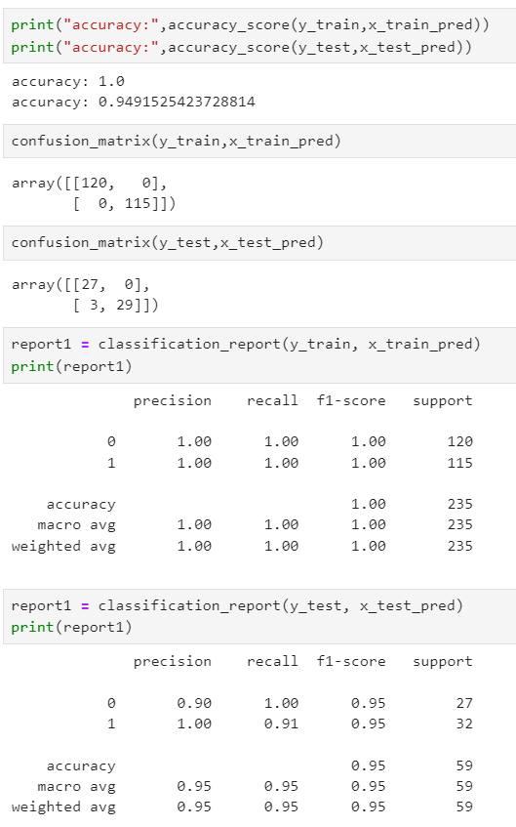
7. RandomForestClassifier
RandomForestClassifier is an ensemble learning algorithm that combines multiple decision trees to improve accuracy and reduce overfitting.

Slide 18
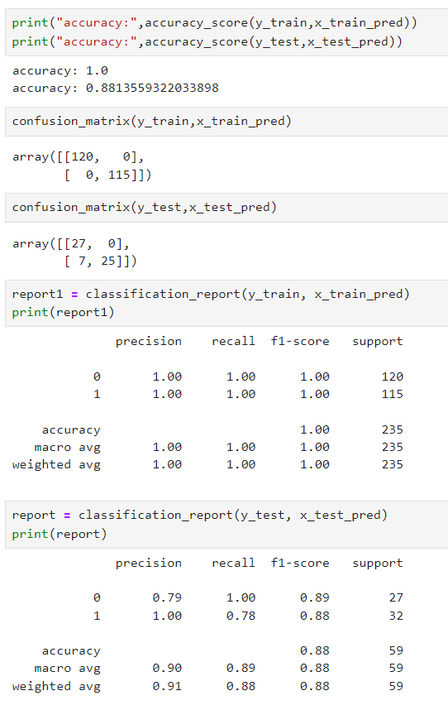
8.AdaBoostClasssifier
AdaBoostClassifier is an ensemble method that combines weak learners, like decision stumps, to create a strong classifier by focusing on misclassified samples.

Slide 19
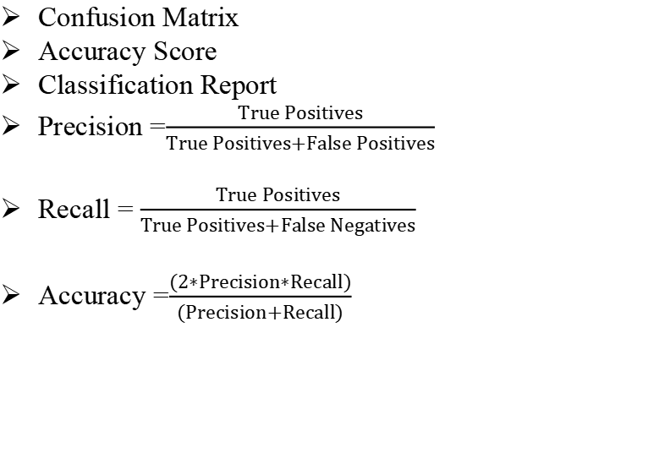
PERFORMANCE METRICS
Confusion Matrix
Accuracy Score
Classification Report
Precision =$\frac{True Positives}{True Positives+False Positives}$
Recall = $\frac{True Positives}{True Positives+False Negatives}$
Accuracy =$\frac{(2∗Precision∗Recall)}{(Precision+Recall)}$

Slide 20
EVALUATION
Support Vector Machine(SVM): Accuracy = 81.35%
Decision Tree: Accuracy = 94.91%
Logistic Regression: Accuracy = 87.64%
K-Nearest Neighbors(KNN): Accuracy = 93.22%
Gradient Boosting : Accuracy = 94.92%
Naive Bayes: Accuracy = 71.18%
Random Forest Classifier: Accuracy = 94.91%
Adaboost Classifier: Accuracy = 88.13%

Slide 21
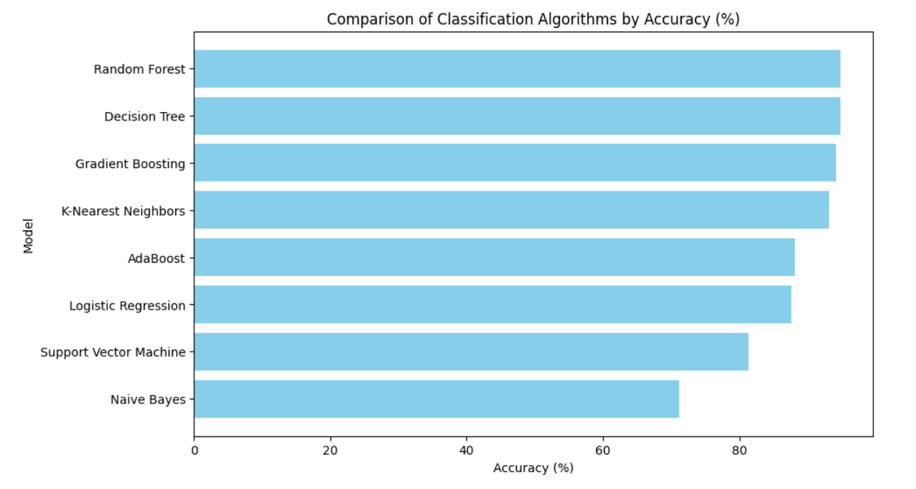
RESULTS

Slide 22
CONCLUSION
In this Parkinson’s disease prediction project, Random Forest Classifier emerged as the most accurate model, achieving 94.91% accuracy, followed closely by Decision Tree and Gradient Boosting.
These results suggest that advanced ensemble methods are effective for predicting Parkinson’s disease.
This model could aid in early intervention, potentially helping healthcare providers to identify and support high-risk patients proactively.

Slide 23
REFERENCE
1.Sandhiya s,G Vishnu Vardhan rao(2022),Parkinson's Disease Prediction Using Machine Learning Algorithm.Methods used are Random forest classifier,KNN.
2.Jiayu zhang,Wenchao Zhou(2023),Prediction of Parkinson’s Disease Using ML Methods.Methods used are Logistic regression and XGBoost.
3.W Yuvan,N Palmer(2022),Accelerating diagnosis of Parkinson's disease through risk prediction.Methods used are XGBoost,Random
forest.
4.MA Sayed,DM Cao(2023),Prediction of Parkinson's disease.Methods used are Support vector Machine,LightGBM.
5.X.Yang,Q. Ye,G.Cai,Y.Wang and G.Cai,(2022),Classification of Parkinson’s diseasefrom Ga it,Methods used are KNN,Random forest.

Slide 24
THANK YOU

