Slide 1
Healthcare Data Analysis Summary
Part - 1

Slide 2
Objective
To analyze the healthcare dataset and identify key insights such as department distribution, treatment costs, and patient outcomes.

Slide 3
Dataset Overview
Total Records: 99
Columns: Patient ID, Department, Age, Gender, Diagnosis with result, Admission Date, Discharge Date, Treatment Cost, Outcome

Slide 4
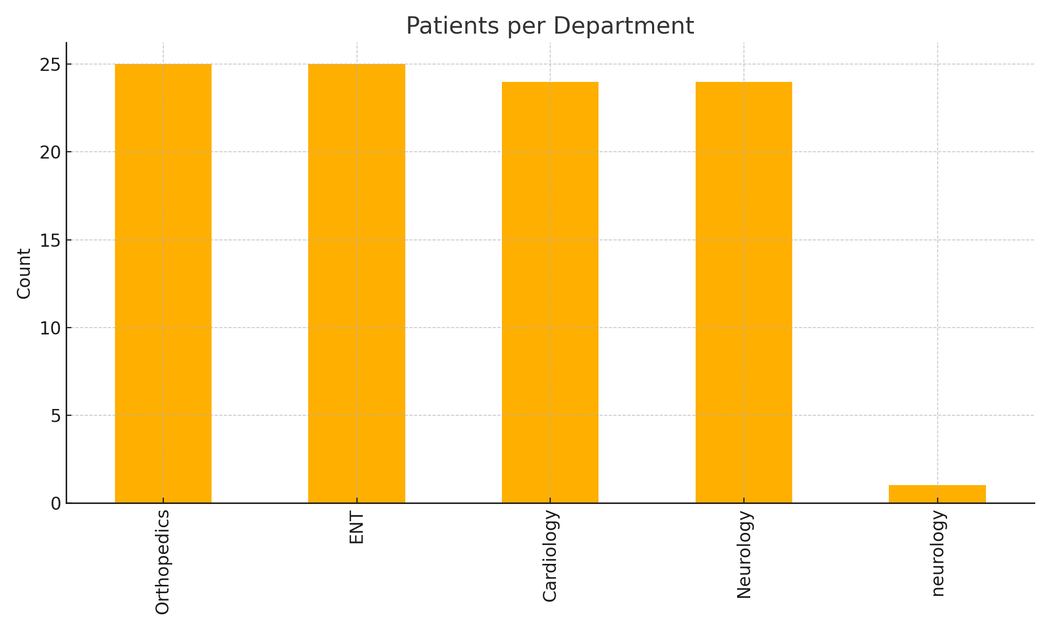
Patients per Department

Slide 5
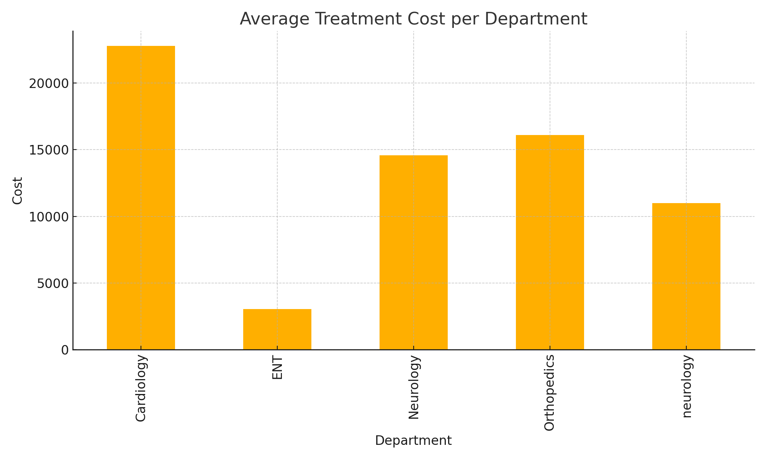
Average Treatment Cost per Department

Slide 6
Insights & Recommendations
- Departments with higher patient load may need additional resources.
- Cost variations suggest opportunities for optimization.
- Patient outcomes show strong recovery trends.

Slide 7
Summary
This analysis provided an overview of patient distribution, treatment costs, and outcomes to support healthcare decision-making.

