Slide 1

Basic Details of the Team and Problem Statement
Problem Statement Title: IOT based Sewer And septic tank sentinal
(Protecting workers from toxic gas exposure)
Team Name: Eclliptic Nexus
Team Leader Name: Jannathul Firthouse A
Theme Name: Smart Automation

Slide 2

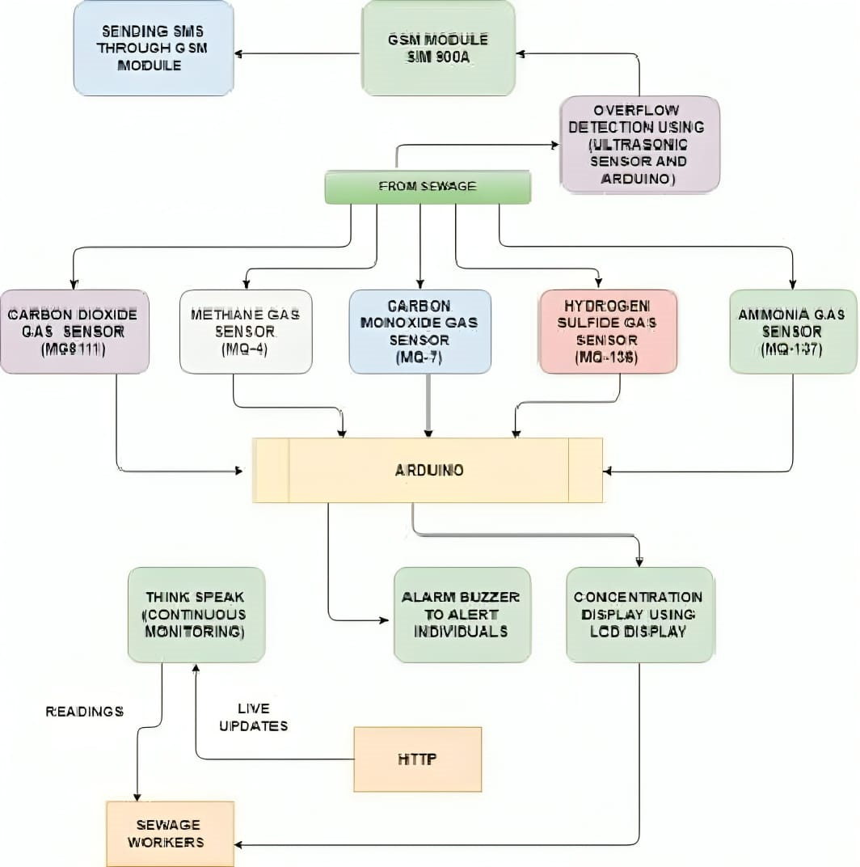

IOT sewer and septic tank sentinals
Motive:
“IOT sewer and septic tank sentinal“ is used to enhance the safety of workers involved in sewer and septic tank cleaning by monitoring and mitigating toxic and non-toxic gases through IOT based system.
Objectives:
1. Devolop a IOT - based gas monitoring system for sewer and septic tank to detect toxic and non-toxic gases in real time.
2. Implement a user friendly interface for remote monitoring and alerting to ensure the safety of workers.
3. Investigate and Incoprate saftey measures and protocols to respond effectively to detect gas level.
4. Implementing an oxygen sensor in this IoT-based project to monitor dissolved oxygen levels by providing insight into environmental condition of sewer and septic tank.
5. Raise awarness and educate workers about the dangerous of manual cleaning and the benifits of the IOT based system

Slide 3

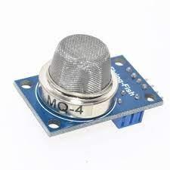
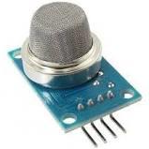
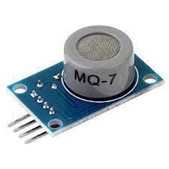
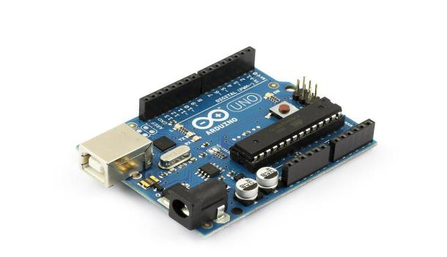
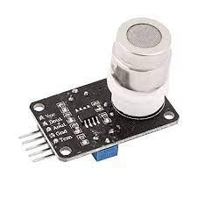
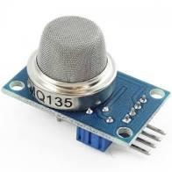
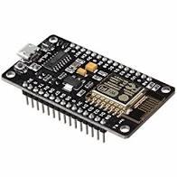
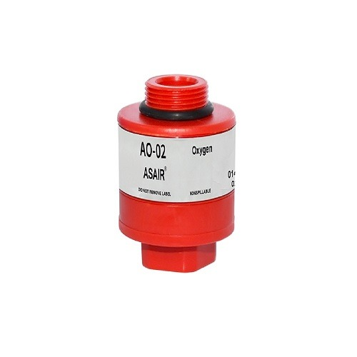
Methodology:
MQ-4
1. CONCENTRATION DETERMINATION OF HAZARDOUS GASES:
In the proposed system we use various gas sensors inclusive of MQ4 (Methane sensor) MQ7(Carbon Monoxide sensor), MQ135(Ammonia Sensor), MQ136(H2S Sensor) & MQ811(Co2 Sensor) for detecting the presence of hazardous gases in sewage.
2. DETECTING THE OXYGEN LEVEL :
Utilize oxygen sensors placed strategically within the septic tank to continuously monitor oxygen levels.
Transmit sensor data wirelessly to a central monitoring system for real-time assessment of oxygen concentration.
3. DATABASE UPLOAD & DEVELOPMENT OF USER-FRIENDLY MOBILE-APP :
Creating a user-friendly mobile app enabling login, displaying gas ppm levels, and plotting gas variations via ThingSpeak IoTPlatform.
Gas sensor data is uploaded to Firebase and ThingSpeak through Nodemcu's serial communication, utilizing Wi-Fi, with GSM Module backup for areas without Wi-Fi.
MQ-138
MQ-7
MQ-811
MQ-135
ARDUINO
O2 SENSOR
NODEMCU

Slide 4
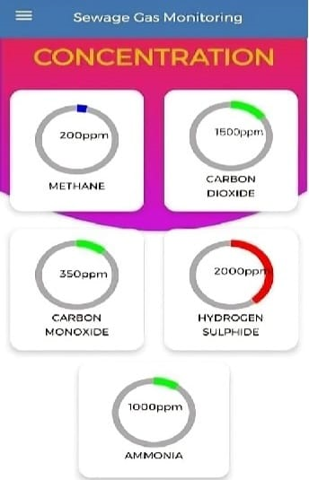
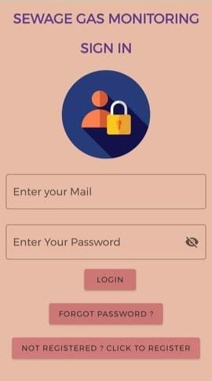
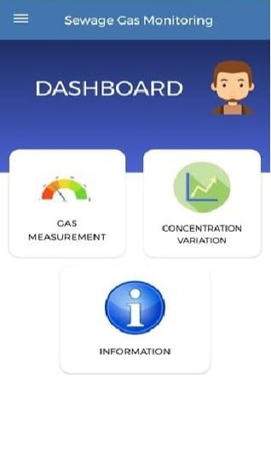
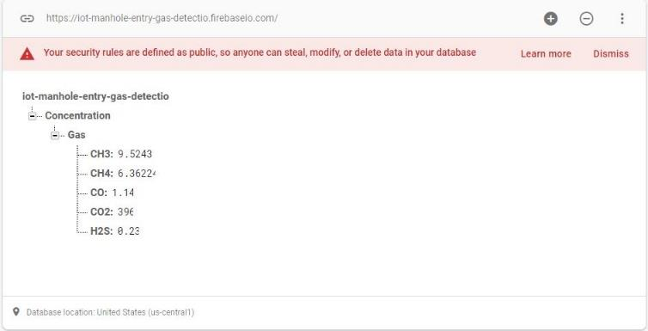
APP INTERFACE
Firebase for data upload:

Slide 5
Team Member Details
Team Leader Name: JANNATHUL FIRTHOUSE A
Branch (Btech/Mtech/PhD etc):BE Stream (ECE, CSE etc): CSE Year (I,II,III,IV): III
Team Member 1 Name: SANJANA S
Branch (Btech/Mtech/PhD etc):BE Stream (ECE, CSE etc): CSE Year (I,II,III,IV): III
Team Member 2 Name:ANUGRAHA S
Branch (Btech/Mtech/PhD etc):BE Stream (ECE, CSE etc): CSE Year (I,II,III,IV):III
Team Member 3 Name: ABITHRA
Branch (Btech/Mtech/PhD etc):BTECH Stream (ECE, CSE etc): AGRI Year (I,II,III,IV): I
Team Member 4 Name: MEERA SHAHANA
Branch (Btech/Mtech/PhD etc):BTECH Stream (ECE, CSE etc): AGRI Year (I,II,III,IV): I
Team Mentor 1 Name: Type Your Name Here(Not Mandatory)
Category (Academic/Industry): Expertise (AI/ML/Blockchain etc): Domain Experience (in years):

