Slide 1


MACHINE LEARNING
III-I CIC
BY
Dr K Venkata Nagendra,
M.Tech, Ph.D, PDF.
Associate Professor, Dept.of CSE.

Slide 2
UNIT-IV
Linear Discriminants for Machine Learning:
Introduction to Linear Discriminants, Linear Discriminants for Classification, Perceptron Classifier, Perceptron Learning Algorithm, Support Vector Machines, Logistic Regression, Linear Regression, Multi-Layer Perceptrons (MLPs), Backpropagation for Training an MLP.

Slide 3

Introduction to Linear Discriminants
In ML, Linear Discriminants are used to solve classification problems by finding a linear decision boundary that separates different classes.A linear discriminant is a function that attempts to classify data by creating a decision rule based on a linear combination of the features.
In other words, it finds a hyperplane (a linear boundary) that can divide the data into different classes. The general form of a linear discriminant function for classification is:
Where
y(x) is The Discriminant Score. x-The Input Vector,
W^{T} -The Weight Vector / Coefficients, W₀- The Bias or Threshold

Slide 4
Introduction to Linear Discriminants
The main goal of LDA is to:
Maximize the separability between different classes.
Minimize the variance within each class.

Slide 5
4.2. LINEAR DISCRIMINANTS FOR CLASSIFICATION
Linear Discriminant Analysis (LDA) is a supervised learning technique used for classification tasks. It helps distinguish between different classes by projecting data points onto a lower-dimensional space, maximizing the separation between those classes.
Key Assumptions of LDA:
For LDA to perform effectively, certain assumptions are made:
Gaussian distribution: The data in each class should follow a normal bell-shaped distribution.
Equal Covariance Matrices: All classes should have the same covariance structure.
Linear Separability: The data should be separable using a straight line or plane.

Slide 6
LDA performs two key roles:
Classification: It finds a linear combination of features that best separates multiple classes.
Dimensionality Reduction: It reduces the number of input features while preserving the information necessary for classification.
Working Mechanism:
Step 1: Compute the mean vectors for each class.
Step 2: Calculate the within-class and between-class scatter matrices.
Step 3: Solve for the linear discriminants that maximize the ratio of between-class variance to within-class variance.
Step 4: Project the data onto the new lower-dimensional space.

Slide 7
Advantages of LDA:
Efficient
Good for smaller datasets
Interpretability

Slide 8
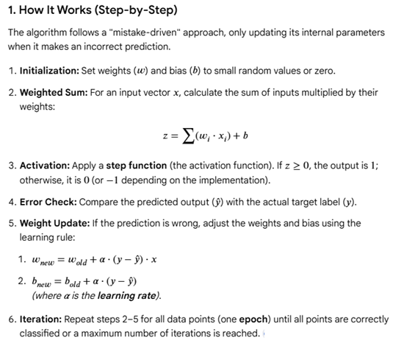
Perceptron Learning Algorithm

Slide 9
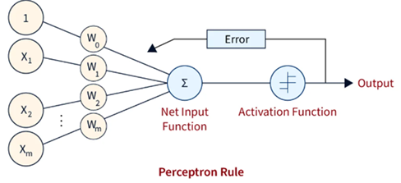
THE PERCEPTRON
A perceptron is the simplest building block of an artificial neural network, designed to perform binary classification by imitating the function of a biological neuron. Developed in 1957 by Frank Rosenblatt, it is a supervised learning algorithm that processes input data, applies weights to determine the relative importance of each input, and produces a binary output (typically 0 or 1).

Slide 10
This step function or Activation function is vital in ensuring that output is mapped between (0,1) or (-1,1). Take note that the weight of input indicates a node’s strength. Similarly, an input value gives the ability the shift the activation function curve up or down.
Step 1: Multiply all input values with corresponding weight values and then add to calculate the weighted sum. The following is the mathematical expression of it:
∑w_{i}*x_{i} = x₁*w₁ + x₂*w₂ + x₃*w₃+……..x_{n}*w_{n}
Add a term called bias ‘b’ to this weighted sum to improve the model’s performance.
Step 2: An activation function is applied with the above-mentioned weighted sum giving us an output either in binary form or a continuous value as follows:
Y=f(∑w_{i}*x_{i} + b)

Slide 11
Types of perceptron
Perceptrons are categorized by their architecture, which determines the complexity of problems they can solve.
Single-layer perceptron (SLP): The most basic form, it consists of a single layer of output nodes connected directly to the inputs. SLPs can only solve problems that are linearly separable, meaning the data can be divided into two classes by a single straight line or hyperplane.
Multi-layer perceptron (MLP): This advanced architecture includes one or more "hidden" layers between the input and output layers. The hidden layers enable MLPs to model more complex, non-linear patterns, allowing them to solve problems that are not linearly separable, such as the famous XOR problem.

Slide 12
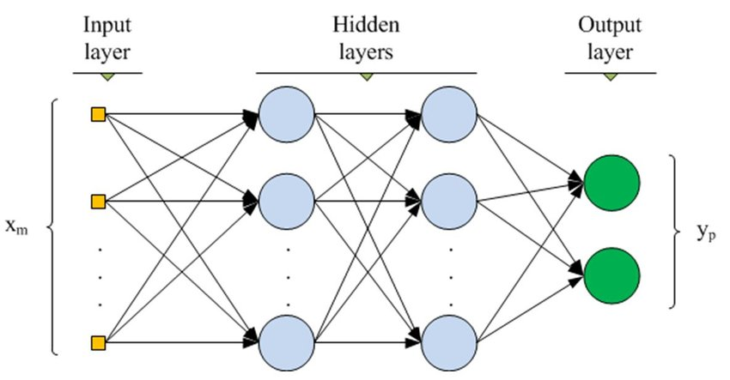
MULTILAYER PERCEPTRON
A multilayer perceptron is a type of feedforward neural network consisting of fully connected neurons with a nonlinear kind of activation function. It is widely used to distinguish data that is not linearly separable.
Components of an MLP:
MLPs have been widely used in various fields, including image recognition, natural language processing, and speech recognition, among others.
Input layer:
Hidden layer:
Output layer:
Weights:
Bias neurons:

Slide 13
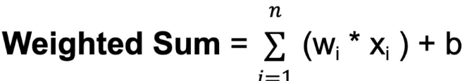
For each neuron in a hidden layer or the output layer, the weighted sum of its inputs is computed. This involves multiplying each input by its corresponding weight, summing up these products, and adding the bias:
Where
n is the total number of input connections,
wi is the weight for the i-th input, and
xi is the i-th input value.

Slide 14
MLP GOING FORWARD, GOING BACKWARD
Forward propagation (going forward): Forward propagation is the process of feeding input data through the network to produce an output. This process consists of the following steps, for a single training example:
Input layer: The features of the input data are fed into the input layer of the MLP.
Weighted sum: Each neuron in the first hidden layer calculates a weighted sum of all the inputs from the input layer. This involves multiplying each input by its corresponding connection weight and summing the results.
Bias addition: A bias term is added to the weighted sum to account for constant offsets.
Activation: A non-linear activation function (like ReLU, sigmoid, or tanh) is applied to the result of the weighted sum and bias, which produces the neuron's output. This output then serves as the input for the next layer.
Iteration: This process is repeated for each subsequent hidden layer until the final output layer is reached, producing the network's prediction.

Slide 15
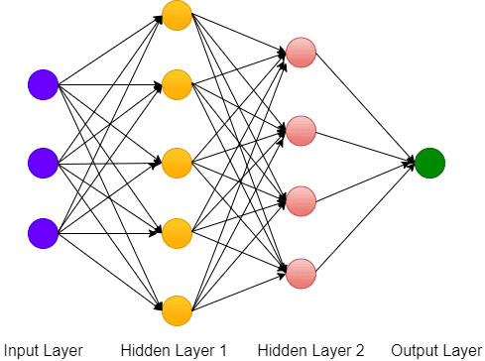

Slide 16
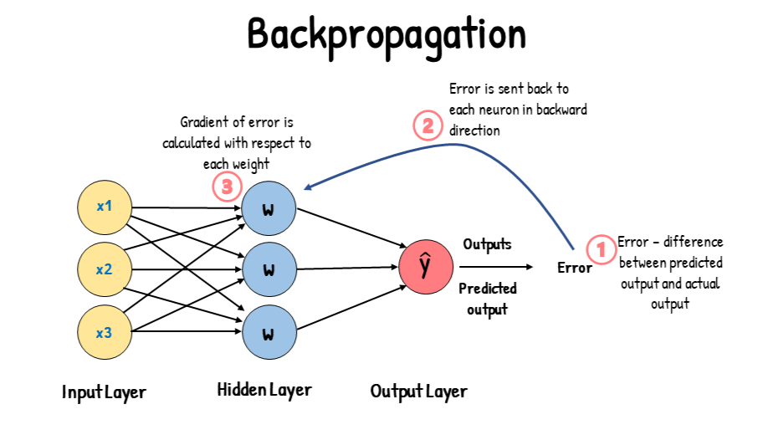
Backpropagation (going backward)
After the forward pass is complete, the network's prediction is compared to the actual target output. The error, or "loss," is then used in a reverse process called backpropagation to update the network's weights and reduce the error in future predictions.

Slide 17
This process involves:
Error calculation: A loss function measures the difference between the network's predicted output and the actual target value.
Gradient computation: Using the chain rule of calculus, the algorithm computes the gradient of the loss function with respect to each weight and bias in the network.
Backward pass: The calculated error is propagated backward from the output layer through the hidden layers. It determines how much each connection weight contributed to the overall error.
Parameter update: An optimization algorithm, most commonly a form of gradient descent, uses the calculated gradients to adjust the network's weights and biases. The update moves the parameters in the direction that decreases the loss.
Iteration: The entire forward and backward process is repeated over many training examples (epochs) until the network's error is minimized and its predictions are accurate.

Slide 18
SUPPORT VECTOR MACHINES
Support Vector Machines is a model, which can do linear classification as well as regression.
SVM is based on the concept of a surface, called a hyper-plane,
Support Vectors: SVM chooses extreme points [vectors] that helps to create the hyper-plane, these extreme cases are called Support Vectors.
How SVM works:
Step 1: Classification can be done using hyper plane.
Step 2: Identifying the correct hyper plane in SVM.
Step 3: Find maximum marginal hyper plane based on Support Vectors.
Step 4: Kernal trick.

Slide 19
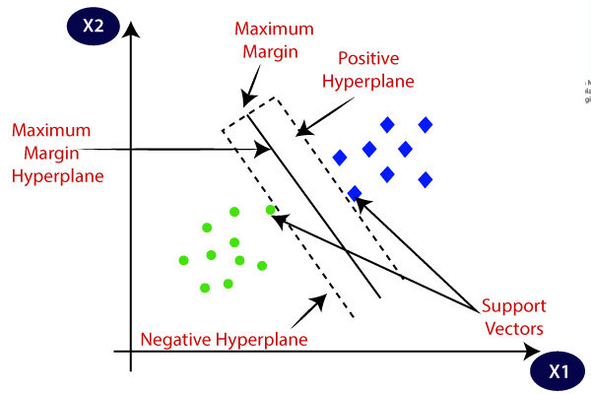

Slide 20
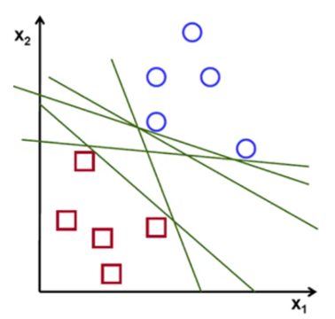

Slide 21
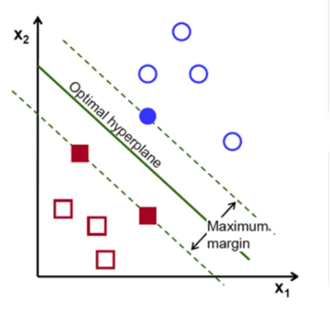

Slide 22
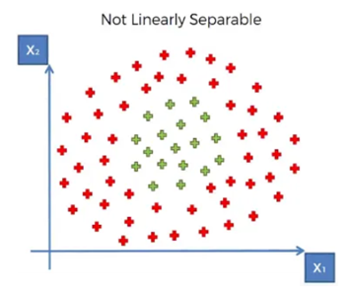

Slide 23
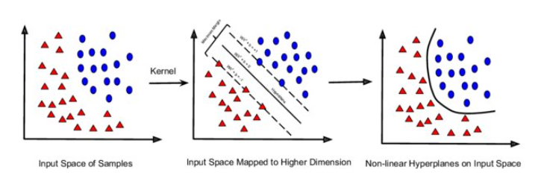

Slide 24
Types of SVM:
Liner SVM: It uses single straight line.
Non-Linear SVM: It does not use any straight line.
Strengths of SVM
SVM can be used for both classification and regression.
It is robust, i.e. not much impacted by data with noise or outliers. The prediction results using this model are very promising.

Slide 25
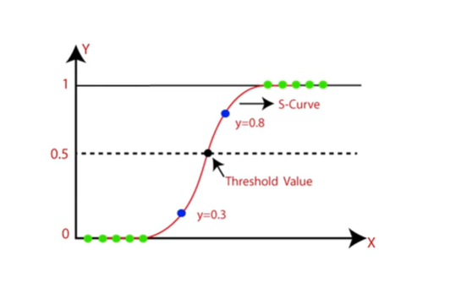
LOGISTIC REGRESSION
The name “logistic regression” is derived from the concept of the logistic function that it uses. The logistic function is also known as the sigmoid function. The value of this logistic function lies between zero and one.

Slide 26
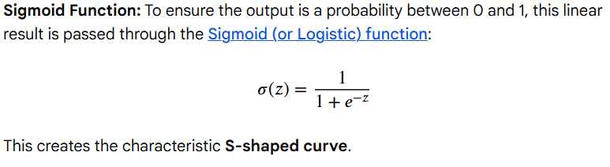
LOGISTIC REGRESSION

Slide 27
LOGISTIC REGRESSION
Common Applications
Healthcare: Predicting the likelihood of a patient having a specific disease.
Finance: Detecting fraudulent credit card transactions.
Marketing: Calculating a customer's response to an ad or offer.
Email: Filtering messages into "Spam" or "Inbox".

Slide 28
LOGISTIC REGRESSION
Advantages of the Logistic Regression Algorithm
Logistic regression performs better when the data is linearly separable
It does not require too many computational resources as it’s highly interpretable
It is easy to implement and train a model using logistic regression

Slide 29
LINEAR REGRESSION
Linear regression is a fundamental supervised machine learning algorithm used to predict a continuous numeric value based on the relationship between variables.
While logistic regression deals with classification (Yes/No), linear regression answers "How much?" or "How many?" by fitting a straight line (the "best-fit line") through data points.

Slide 30
LINEAR REGRESSION

Slide 31
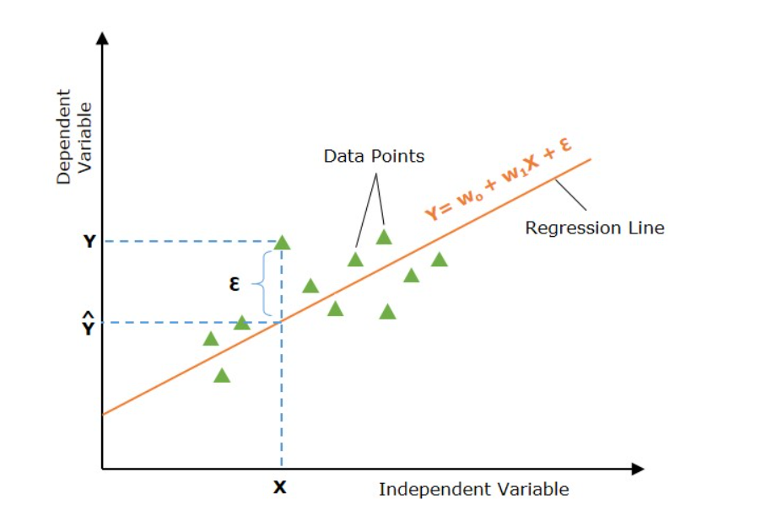
A regression line is said to be the best fit if the error between actual and predicted values is minimal.

Slide 32
Common Use Cases
Real Estate: Estimating property values based on square footage and amenities.
Business: Forecasting future sales revenue based on advertising spend or seasonal trends.
Economics: Analyzing how changes in pricing impact consumer demand (price elasticity).
Healthcare: Predicting patient recovery times based on age and pre-existing conditions

Slide 33
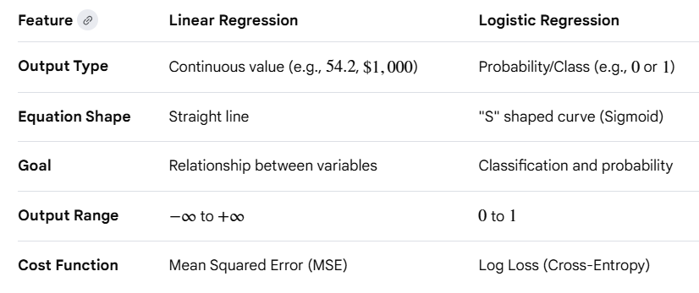
Linear Regression Vs Logistic Regression

Slide 34


