Slide 1

Platoon.Me
Team Janus

Slide 2
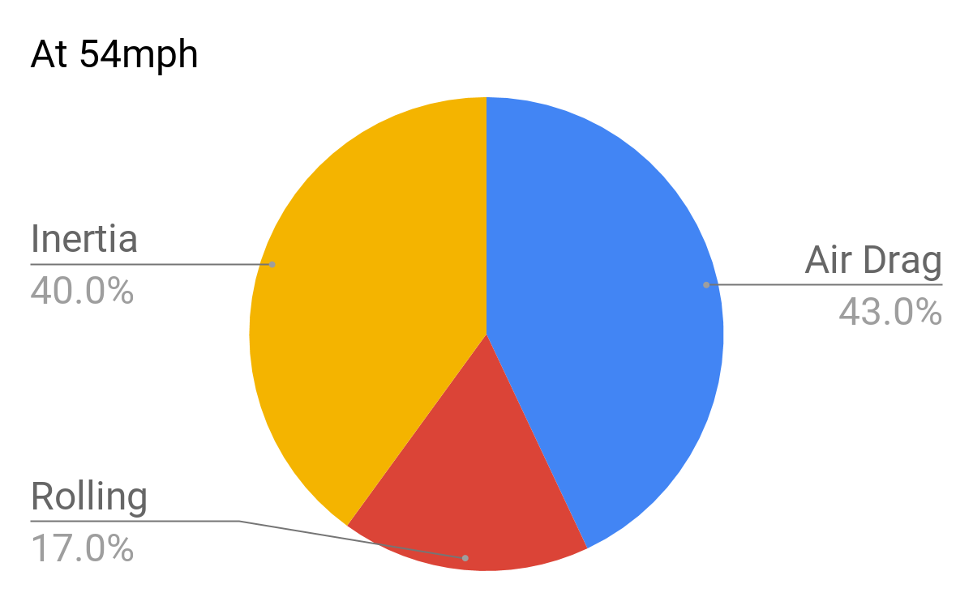
Energy Consumption In Trucks
Source: Auto Research Center,ARC

Slide 3
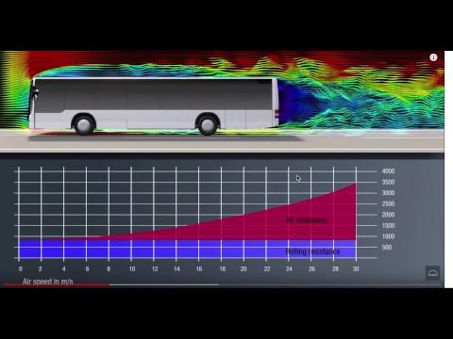
Aerodynamics Analysis In Trucks
Source: MAN

Slide 4

Platooning
Fuel Reduction by up to 16% for Rear Vehicle up to 8% for Front Vehicle*
Accident Rates are Reported to Decrease by 80%**
* ITS4CV study by Ertico **Survey by Polteon

Slide 5
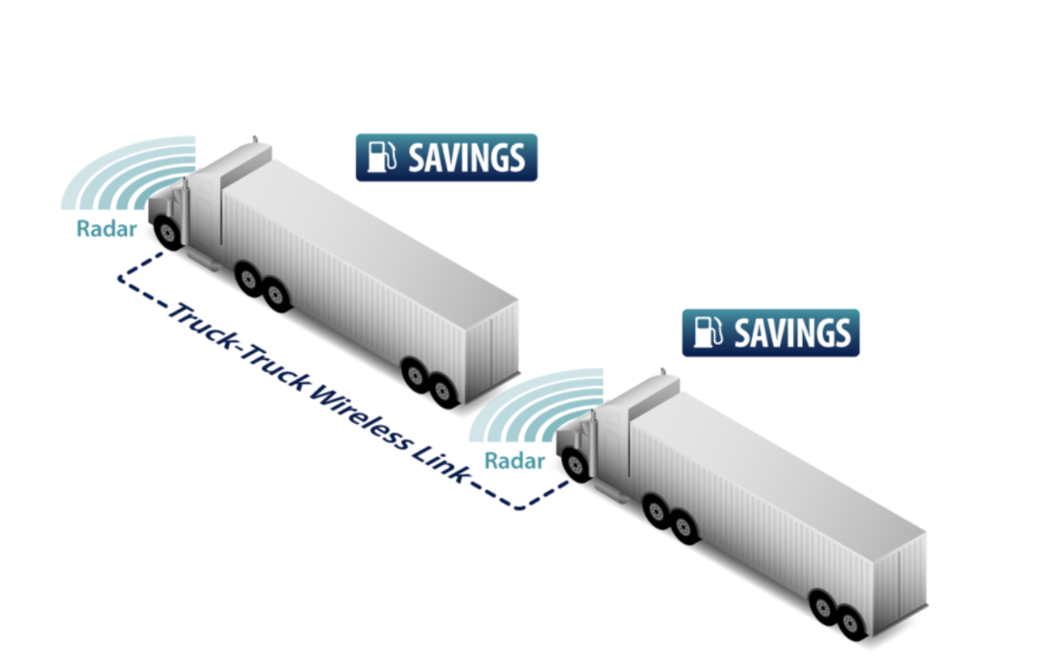
State of the Art in Platooning
Most Truck Manufacturers Already Started Testing Platooning Technology
IEEE 802.11p WiFi protocol for V2X communication
Radar and Camera Integration
Further increase in efficiency with full autonomy
Platooning is expected to be fully adapted at the end of 2020
Source: ECEA Image: Volvo Trucks

Slide 6

The Problem
Big Energy Consumption
Ever Increasing Need in Transportation
High Carbon Dioxide Emissions
Lack of Communication Between
Truck Drivers
Fleet Operator
Logistics Companies
Image: Hurriyet Newspaper

Slide 7

Solution: Platoon.Me
get platooned, get efficient
Enter Your Destination
Choose the Best-Fit Platoon
Join the Platoon
Decrease Fuel Efficiency
Start in-Platoon Conversations

Slide 8
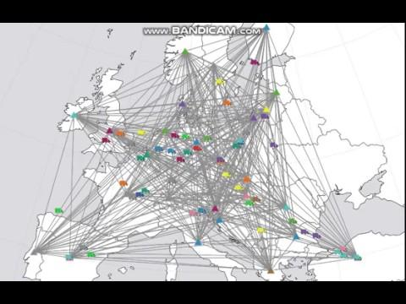
Business Model
B2B
Providing Service to Businesses
Customers
Vehicle Manufactures
Fleet Operators
Logistics Firms
Value Proposition
Inter-Brand Communication
Up to 10% Fuel Savings

Slide 9
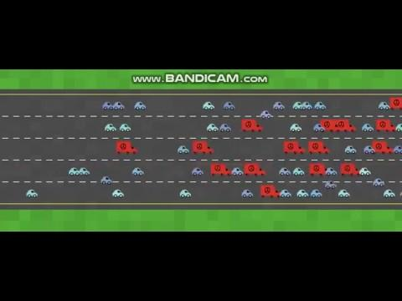

The Future
Usage of Platoon.Me by 10% of Trucks in Europe
2.5 Billion EUR in fuel savings
4 Million Tonnes Less CO2 Emission
Major Reduction in Accident Rates
a better world...

