Slide 1
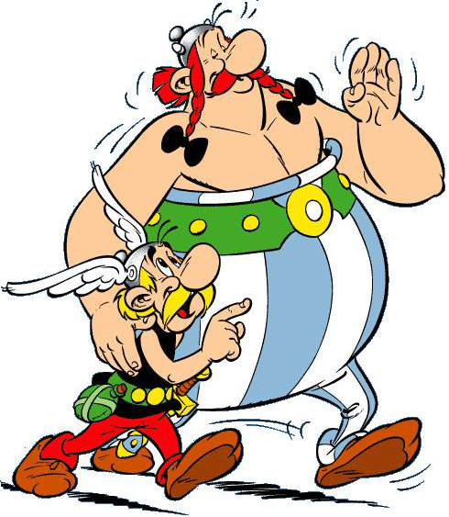
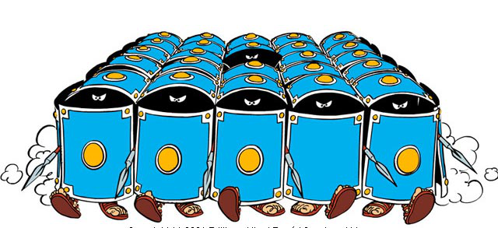
Asterix and Obelix RPG
Console based role-playing game by JAPHETTE-ORCHID

Slide 2
Game description
Heroes – Asterix and Obelix
Stats – Level, Experience, Attack, Defense, Health, Gold
Enemies – Cadet, Manipilarius, Tribune, Centurion, Ordinatus
The boss – Caesar
Drop – Random item, Gold
Items – Sword, Helmet, Chest, Pants, Belt, Boots, Potion
Items rarity – Common, Uncommon, Rare, Magic, Legendary
Market – All items

Slide 3
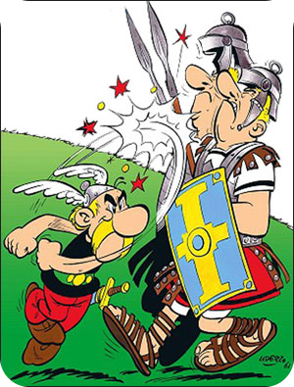
Possible commands
add hero asterix / obelix
info
battle
attack cadet / manipularius / tribune /
centurion / ordinatus / caesar
market
- First step choice rarity
- Second step choice item

Slide 4
Team JAPHETTE-ORCHID
Nikolay Bankin - mentor
Valentin Tronkov
Dimitar Hadzhiev
Ivan Hristov
Ilian Kostov

Slide 5
Contributions of Valentin Tronkov
Please fill your work as list

Slide 6
Contributions of Dimitar Hadzhiev
Please fill your work as list

Slide 7
Contributions of Ivan Hristov
Please fill your work as list

Slide 8
Contributions of Ilian Kostov
Modeling hierarchy of the classes
Create enemies with drop random item functionality
Create enemy generator and attack enemy functionality
Create functionality for replacing weak items
Create leveling depends from experience
Create custom exceptions and validations

Slide 9
Asterix and Obelix console based RPG
https://softuni.bg/courses/oop/

