Slide 1




Miroslav Holec / MSP, MCP, MCSD, MTA
Developer Evangelist
miroslavholec.cz @miroslavholec
Hoď to do cloudu
Azure Workshop
Software Engineer
HAVIT, s.r.o.

Slide 2

Azure Overview
Azure Web Apps
Azure Application Insights
Azure Storage
Azure SQL
AGENDA

Slide 3

Notes:
In the early days, the "cloud" was primarily a place to host VMs and park data. Today, it is so much more. Azure offers more than 100 different services enabling you to do anything from storing data in blobs to building rich and sophisticated machine-learning models. The REAL story about what's happening in the cloud these days is Software as a Service (SaaS), in which higher and higher level services are being made available with a few button clicks. Just one example: researchers who use Apache Spark are probably well aware of the time, expense, and aggravation involved in setting up and maintain a single Spark server, much less a cluster of Spark servers. With Azure HDInsight, you can spin up a Spark cluster in minutes with all the relevant software preinstalled and ready to go to work. Or how about the recently announced Linux Data Science Virtual Machine (https://azure.microsoft.com/en-us/marketplace/partners/microsoft-ads/linux-data-science-vm/)? From the documentation:
This Linux based virtual machine contains popular tools for data science modeling and development activities. The main tools include Microsoft R Open, Anaconda Python distribution, Jupyter notebooks for Python and R, Postgres database, Azure command line tools, libraries to access various Azure services like AzureML, databases, Azure storage and big data services. It also has machine learning tools and algorithms like CNTK (a deep learning toolkit from Microsoft Research), Vowpal Wabbit and xgboost.
THIS IS THE FUTURE…one in which the cloud provides for you, with low cost, high reliability and availability, and no hassle, the tools you need to do your job, whether you're a genomics researcher needing tools and CPU power to analyze massive amounts of data, or a developer looking to build apps that scale to meet demand and utilize rich APIs (such as the Microsoft Cognitive Services APIs) that are only available in the cloud.

Slide 4



Azure Data Centers
North America
Europe
Asia Pacific
Central Canada
N. Europe
N. Central US
East Canada
Central US
W. Europe
Japan West
West US
East US
China North
Japan East
East US 2
Central India
China South
S Central US
E. Asia
S.E. Asia
West India
Brazil South
South India
Australia East
Australia Southeast
Notes:
Azure is generally available in 24 regions around the world, and has announced plans for 8 additional regions. Geographic expansion is a priority for Azure because it enables customers to achieve higher performance and it supports their requirements and preferences regarding data location. Newly announced regions include US DoD East, US DoD West, Germany Central, Germany Northeast, UK South, UK West, Korea Central, and Korea South. Not shown on this map are US Gov Iowa and US Gov Virginia. The Chinese and (soon) German data centers are available only in those countries due to laws regarding the storage of data in those locations. In Germany, for example, the law forbids German companies from storing data in the cloud outside Germany.

Slide 5
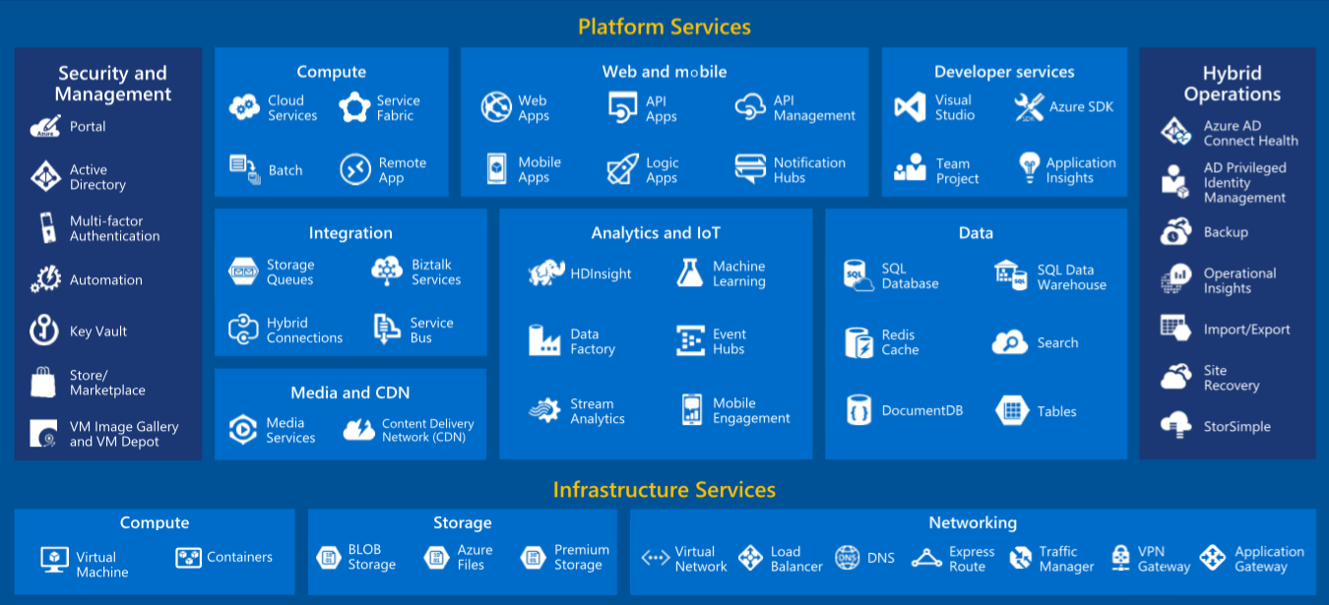
Azure Services
Notes:
Azure is a wide-ranging and comprehensive cloud-computing platform that is evolving every day with new features and services. Currently, Azure includes more than 100 different services, ranging from IaaS services such as VMs to rich SaaS services such as Azure Machine Learning, Azure Stream Analytics, and Azure HDInsight.

Slide 6
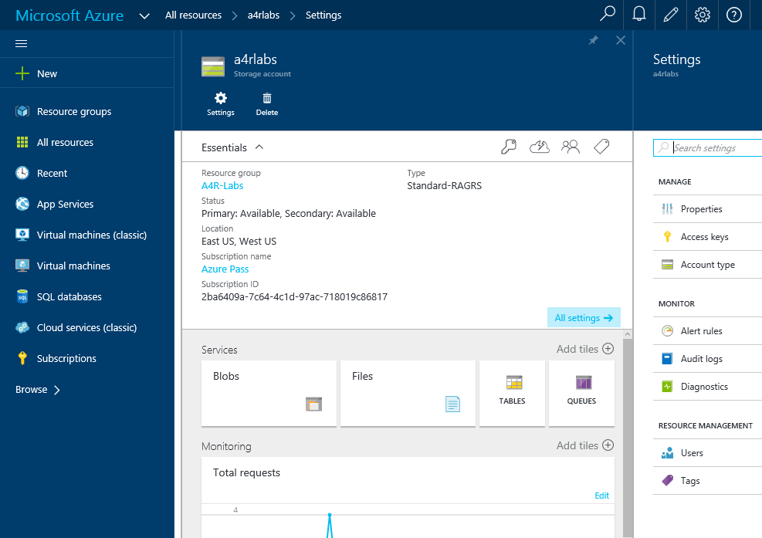
Azure Portal
https://portal.azure.com
Notes:
The Azure Portal is your gateway to all things Azure. This is where you create Azure resources and connect them together to form comprehensive solutions, manage those resources, and monitor billing.

Slide 7
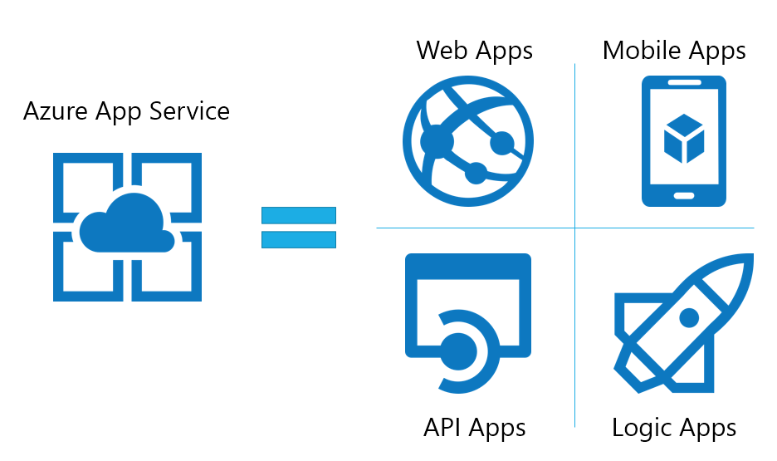

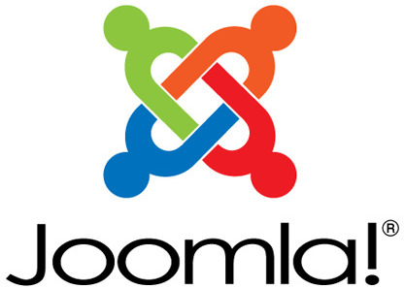



Publish a Web Site
Use prebuilt templates to build a personal Web site with technologies you know, or create a commercial Web site that scales to serve millions of customers
Notes:
Azure Web Apps, which are part of the Azure App Service family, allow you to publish Web sites/apps using a variety of popular technology stacks. To help, the Microsoft Azure Marketplace contains thousands of free templates for deploying apps, services, virtual machines, and more, preconfigured for Azure and provisioned with popular tools such as WordPress, CakePHP, Joomla, and Django.

Slide 8





Azure App Service Family
Web Apps
Web apps that scale with your business
Mobile Apps
Build mobile apps for any device
Logic Apps
Automate business processes across SaaS and on-premises
API Apps
Build and consume APIs in the cloud
Notes:
Azure App Service is a PaaS offering that comprises four separate (but related) services:
Web Apps is a fully managed compute platform optimized to host Web sites and Web applications
Mobile Apps provides infrastructure for hosting back-ends for mobile apps -- for example, it provides infrastructure for sending push notifications not only to Windows clients, but to iOS and Android clients as well
API Apps makes it easy to host APIs in the cloud, features integrated support for Swagger (http://swagger.io/), and offers a built-in authentication service for restricting access to APIs
Logic Apps allows you to automate business processes and workflow -- for example, automatically finding negative tweets about your company and sending notifications to a Slack channel
Together, these services comprise a ready-made solution to many of the challenges involved in publishing Web sites, Web apps, Web services, mobile apps, and more.

Slide 9
Scaling - Cloud Computing Patterns
Inactivity
Period
Compute
Compute
t
t
On and Off
Unpredictable Bursts
On & off workloads (e.g. batch job)
Over provisioned capacity is wasted
Time to market can be cumbersome
Unexpected/unplanned peak in demand
Sudden spike impacts performance
Can’t over provision for extreme cases
Compute
Compute
t
t
Growing Fast
Predictable Bursts
Successful services needs to grow/scale
Keeping up w/ growth is big IT challenge
Cannot provision hardware fast enough
Services with micro seasonality trends
Peaks due to periodic increased demand
IT complexity and wasted capacity
Notes:
Deploy a Web app on a single server and you'll hit a wall when the demand on that server reaches a certain level. Deploy it in Azure, however, and you can handle bursts through auto-scaling or steady growth through manual scaling.

Slide 10
Scaling Up vs. Scaling Out
Scale Up
Scale Out
Vary the VM size
Vary the VM count
1 Core w/ 1.75 GB RAM 2 Cores w/ 3.5 GB RAM 4 Cores w/ 7 GB RAM
Max 3* instances Max 10 instances Max 20/50** instances
Notes:
With a traditional server farm, there are two ways to scale to meet demand:
Scale up by beefing up the servers (more RAM, more cores, etc.)
Scale out by adding servers
The same holds true for virtual server farms. In App Services, scale up is a choice between B/S/P 1-3, where 1 = 1 Core, 1/75 GB RAM, 2 = 2 Core, 3.5 GB RAM, 3 = 4 Core, 7 GB RAM. You can also scale up/down between tiers (B/S/P), which impacts local HDD storage (10/50/250 GB) as well as the cap on number of instances (3/10/50).
* For 3 instances on Basic, only manual scaling is supported
** For Premium Tier, there is a max of 20 if not using ASEs, and 50 if using ASE’s

Slide 11
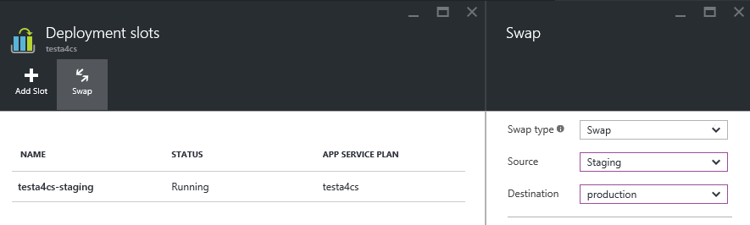
Deployment Slots
Use a Deploy-Confirm-Promote workflow
Promote via “swap” through Azure portal
http://sitename-slotname.azurewebsites.net
Notes:
When you deploy an Azure Web App, you can deploy to a separate deployment slot instead of the default production slot when running in the Standard or Premium App Service plan mode. Deployment slots are actually live web apps with their own hostnames. Web app content and configurations elements can be swapped between two deployment slots, including the production slot. Deploying your application to a deployment slot has the following benefits:
You can validate changes in a staging deployment slot before swapping it with the production slot.
Deploying a web app to a slot first and swapping it into production ensures that all instances of the slot are warmed up before being swapped into production. This eliminates downtime when you deploy your web app. The traffic redirection is seamless, and no requests are dropped as a result of swap operations. This entire workflow can be automated by configuring Auto Swap when pre-swap validation is not needed.
After a swap, the slot with the previously staged web app now has the previous production web app. If the changes swapped into the production slot are not as you expected, you can perform the same swap immediately to get your "last known good site" back
For more information, see https://azure.microsoft.com/en-us/documentation/articles/web-sites-staged-publishing/.

Slide 12



Continuous Integration + Deployment Slots
Production
5
Developer commits code
Automated process builds/compiles and deploys to staging slot
Automated and other tests validate content in staging slot
Staging content promoted to production
Users see updated site
1
4
2
3
Source Control
Staging
Test
Notes:
This process is a tried and tested one that is easily enacted using a combination of Azure features (e.g., deployment slots) and tooling support (e.g., Visual Studio).

Slide 13
DEMO />
Nástroje pro vývojáře aplikací

Slide 14
Q & A
miroslavholec.cz
mirek@miroslavholec.cz

